Slide 1
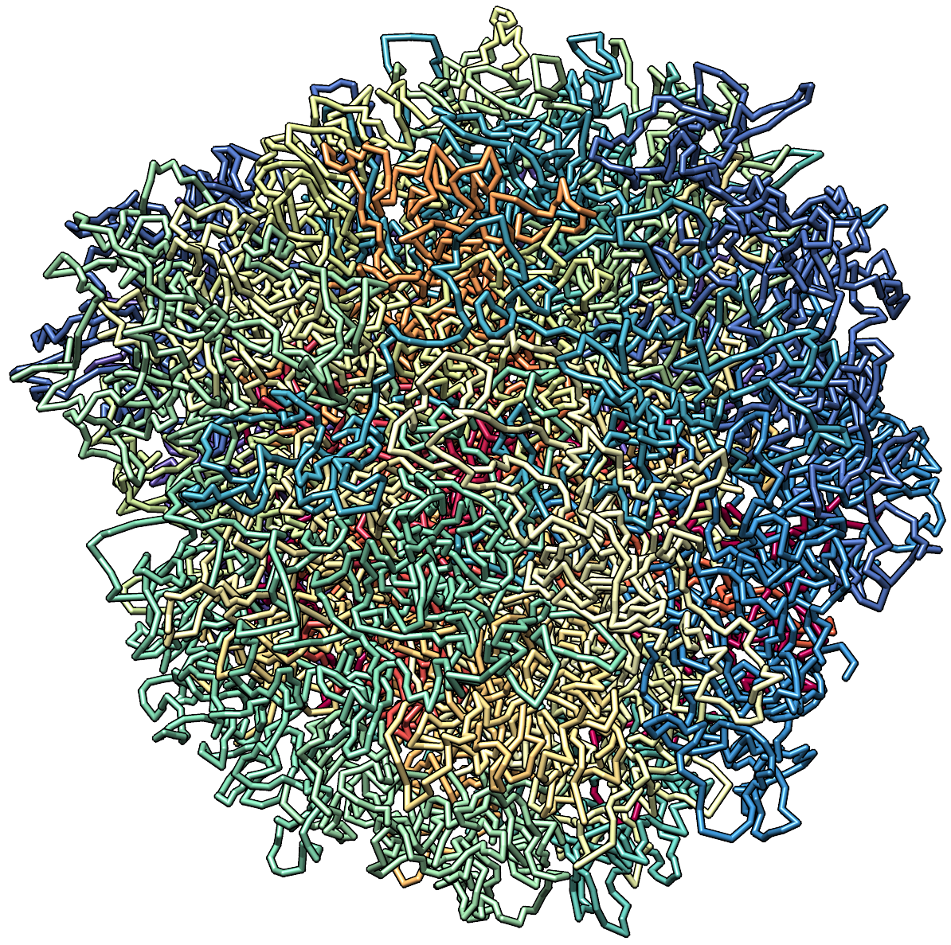

TASK:
i
j
i
j
✓
valid
shuffle
distance between i and j not greater than 2Mb
╳
genomic end
╳
i > j & present in orig set
genomic
start
orig*
new*
*
A set should contain unique contacts.

Slide 2

TASK:
genomic end
i
j
i
j
✓
valid
shuffle
distance between i and j not greater than 2Mb
╳
╳
i > j & present in orig set
genomic
start
orig*
new*
*
A set should contain unique contacts.

