Slide 1
Approach A: Optimising G4Hunter Coefficients to deal with i-motifs
Optimise G4Hunter coefficients for i-motifs
C – positive base, T – negative (penalised) base
 |  | RUN LENGTH
Replica | Pearson’s, r | 1 | 2 | 3 | 4 | 5 | 6
1 | 0.9633802 | 17.0 | 15.5 | 8.5 | 27.6 | 40.8 | 50.0
2 | 0.9633801 | 6.6 | 5.5 | 0.4 | 14.3 | 23.9 | 30.6
3 | 0.9633801 | 6.4 | 5.3 | 0.2 | 14.1 | 23.7 | 30.4
optimised
coefficients
Best model: Replica 1

Slide 2
Approach B: Feature Importance with Gradient Boosting Machines
Chosen features of i-motif sequences
The following features were used for the other modelling methods
C – length of C runs; [3,6]; per sequence the length of the 4 C runs are equal
T1 – length of 1st T loop; [1,6]
T2 – length of 2nd T loop; [1,6]
T3 – length of 3rd T loop; [1,6]
length – total sequence length; [15,36]
Dependent variable: T_{m} [48,81.9]

Slide 3
Approach B: Feature Quality Control and Preprocessing
Features not extremely correlated.
No zero- (predictor have one unique value) and near zero-variance predictors.
Features centred and scaled.

Slide 4
Approach B: XGBoost Hyperparameter/Architecture Optimisation
All 196 sequences were used for this step.
Features: C, T1, T2, T3, length
Hyperparameter of optimal model architecture
Hyperparameter | value
eta | 0.01
max_depth | 4
Gamma* | 0
colsample_bytree** | 1
min_child_weight | 5
subsample | 0.6
nrounds | 1000
*No regularisation (gamma=0, default)
**All features used by every tree (colsample_bytree=1, default)
Notes:
80% training, 20% test, used optimal hyperparameter

Slide 5
Approach B: XGBoost (Re)training, Performance and Feature Importance
Using the identified optimal hyperparameters, the model was tuned using 80% of data for training. The modified model was then tested on remaining 20%.
Metric | 100% training | 80%training
RMSE | 1.318517 | 1.4011
Rsquared | 0.9780108 | 0.9758311
MAE | 1.055605 | 1.135564
RMSESD | 0.1180056 | 0.1692699
RsquaredSD | 0.004539234 | 0.005186407
MAESD | 0.1071623 | 0.1139668
Feature | 100% training
C | 100
length | 4.644648
T3 | 3.799481
T1 | 3.299907
T2 | 3.035882
Calculated on test data
Notes:
table for variable importance, scale importance to max=1
take then use the same architecture()
xgboost package to get trees - generate model
Different r^2?
-> make model without length

Slide 6
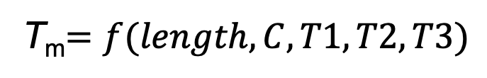
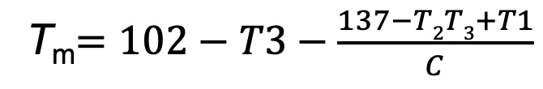
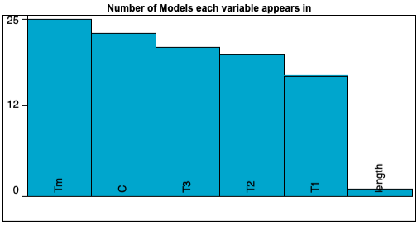
Approach C: Developing Non-Linear Analytical Equation that Explains T_{m}
Allowed forms: Basic (constant, input variable, ±, x, ÷) and Exponential (power, sqrt)
Error metric is absolute error (default)
Target expression:
Same training and test data as xgbTree’s
SAMPLE MODEL:
C-run length (C) appears in almost all models obtained.
25 models generated
Calculated on test data
With features unscaled as in this case, length only appeared in the 2nd least accurate model (T_{m}=42.3 + length). After centering and scaling, it did appear but only in more complex models, complexity>27 (for reference, sample model has complexity=14).

Slide 7
Conclusions
With a restricted sub-universe of the C/T-based i-motifs, all three approaches still resulted to a reasonable quality of T_{m} prediction. Out of the three, the gradient boosting machines performed the best (r² = 0.98, RMSE = 1.4).
Feature importance analysis from the GBM machine learning approach shows that the most important feature in defining the stability of the i-motifs is the length of the C tracts (C), followed by the overall i-motif length and the loop lengths. Also, out of the three loops, the length of the 3rd loop (T3) is more important than that of the other two.
The sample model from Eureqa shows that with only a slight compromise in prediction quality, we can have a simple, transparent analytical equation that expresses T_{m} as a function of the chosen features. The equation captures the interplay between the C-tract length and the loop lengths 1-3 in modulating the stability (T_{m}) of i-motifs in the given sub-universe.

