Slide 1
3 approaches and rationale
Optimus
Modify the G4Hunter algorithm to make it applicable for i-motifs.
In G4Hunter, one G has a score of 1; in a GG tract, each G is scored 2 and so on. C’s get the same score but negated. To make G4Hunter applicable for the CT-based i-motifs, Optimus will be used to find the optimum scoring for each C (positive base, counterpart of G in the case of G-quadruplexes) in a given C-tract length (e.g. the score of each C in a CC tract in an i-motif). Similarly, T will get the same score but negated.
Gradient boosting machines
Build a machine learning model predicting the T_{m}/pH_{t} of a limited sub-universe of CT-based i-motifs.
Get an idea of the importance of chosen features in terms of prediction.
Eureqa
Obtain a simple analytical equation expressing T_{m}/pH_{t} as a function of the chosen features.
Reveal relationship of features.
Dependent variables
Melting temperature (T_{m})
pH at mid-transition (pH_{t})

Slide 2
T_{m}
Approach A: Optimising G4Hunter Coefficients to deal with i-motifs
Optimise G4Hunter coefficients for i-motifs
C – positive base, rest of bases are given a score of 0.
3 independent rounds (replicas) of optimisation were done for each method.
Interpreting the table: each C in CC-tract of i-motif (run length=4) is scored 24.1.
Note that in the given sub-universe of the C/T-based i-motifs, C-tract length range from 3 to 6 bases. Therefore the scores in the table for C-tract lengths less than 3 do not matter in this case.
 |  |  | SCORE OF POSITIVE BASE PER TRACT LENGTH
Method | Replica | Pearson’s, r | 1 | 2 | 3 | 4 | 5 | 6
Trad. G4 | 1 | 0.8770789 | 0.3 | 1 | 13.2 | 39.5 | - | -
 | 2 | 0.8770789 | 8.8 | 13.7 | 18.4 | 55.1 | - | -
 | 3 | 0.8770789 | 0.1 | 6.2 | 12.8 | 38.3 | - | -
Ext. G4 | 1 | 0.9579802 | 0 | 0 | 0 | 24.1 | 37.0 | 45.1
 | 2 | 0.9579801 | 0 | 0 | 0 | 11.6 | 17.8 | 21.7
 | 3 | 0.9579802 | 0 | 0 | 0 | 24.1 | 37.0 | 45.1

Slide 3
T_{m}
Approach A: Optimising G4Hunter Coefficients to deal with i-motifs

Slide 4
T_{m}
Approach B: Feature Importance with Gradient Boosting Machines
Chosen features of i-motif sequences
The following features were used for the other modelling methods
C – length of C tract; [3,6]; per sequence the length of the 4 C tracts are equal
T1 – length of 1st T loop; [1,6]
T2 – length of 2nd T loop; [1,6]
T3 – length of 3rd T loop; [1,6]
length – total sequence length; [15,36]
Dependent variable: T_{m} [48,81.9]

Slide 5
Approach B: Feature Quality Control and Preprocessing
Features not extremely correlated.
No zero- (predictor have one unique value) and near zero-variance predictors.
Features centred and scaled.

Slide 6
T_{m}
Approach B: XGBoost Hyperparameter/Architecture Optimisation
All 196 sequences were used for this step.
Features: C, T1, T2, T3
Hyperparameter of optimal model architecture
Hyperparameter | Value
eta | 0.01
max_depth | 4
Gamma* | 0
colsample_bytree** | 1
min_child_weight | 5
subsample | 0.6
nrounds | 1000
*No regularisation (gamma=0, default)
**All features used by every tree (colsample_bytree=1, default)
Notes:
80% training, 20% test, used optimal hyperparameter

Slide 7
T_{m}
Approach B: XGBoost (Re)training, Performance and Feature Importance
Using the identified optimal hyperparameters, the model was tuned using 80% of data for training (randomly chosen). The retrained model was then tested on remaining 20%.
Values based on training with 80% of data:
Metric | No length
RMSE | 1.376196
r² | 0.9767373
MAE | 1.120195
RMSESD | 0.1639031
r²SD | 0.005370633
MAESD | 0.1081146
Feature | No length
C | 100
T3 | 5.147290
T1 | 4.375894
T2 | 4.289519
Calculated on test data
Model without length

Slide 8
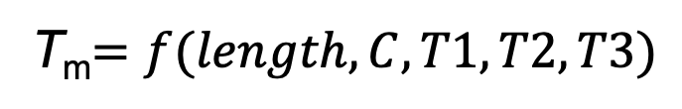
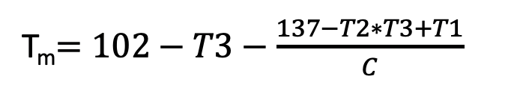
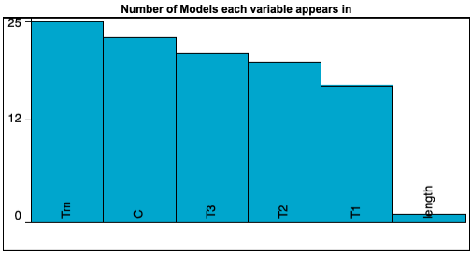

Approach C: Developing Non-Linear Analytical Equation that Explains T_{m}
Allowed forms: Basic (constant, input variable, ±, x, ÷) and Exponential (power, sqrt)
Error metric is absolute error (default)
Target expression:
Same training and test data as xgbTree’s
SAMPLE MODEL:
T_{m}$=102−T3−\frac{137−T2∗T3+T1}{C}$
C-run length (C) appears in almost all models obtained.
25 models generated
Calculated on test data
With features unscaled as in this case, length only appeared in the 2nd least accurate model (T_{m}=42.3 + length). After centering and scaling, it did appear but only in more complex models, complexity>27 (for reference, sample model has complexity=14).

Slide 9
3 approaches and rationale
Optimus
Modify the G4Hunter algorithm to make it applicable for i-motifs.
In G4Hunter, one G has a score of 1; in a GG tract, each G is scored 2 and so on. C’s get the same score but negated. To make G4Hunter applicable for the CT-based i-motifs, Optimus will be used to find the optimum scoring for each C (positive base, counterpart of G in the case of G-quadruplexes) in a given C-tract length (e.g. the score of each C in a CC tract in an i-motif). Similarly, T will get the same score but negated.
Gradient boosting machines
Build a machine learning model predicting the T_{m}/pH_{t} of a limited sub-universe of CT-based i-motifs.
Get an idea of the importance of chosen features in terms of prediction.
Eureqa
Obtain a simple analytical equation expressing T_{m}/pH_{t} as a function of the chosen features.
Reveal relationship of features.
Dependent variables
Melting temperature (T_{m})
pH at mid-transition (pH_{t})

Slide 10
pH_{t}
Approach B: Feature Importance with Gradient Boosting Machines
Chosen features of i-motif sequences
The following features were used for the other modelling methods
C – length of C tract; [3,6]; per sequence the length of the 4 C tracts are equal
T1 – length of 1st T loop; [1,6]
T2 – length of 2nd T loop; [1,6]
T3 – length of 3rd T loop; [1,6]
length – total sequence length; [15,36]
Dependent variable: pHt [5.96, 6.9]

Slide 11
pH_{t}
Approach A: Optimising G4Hunter Coefficients to deal with i-motifs
Optimise G4Hunter coefficients for i-motifs
C – positive base, rest of bases are given a score of 0.
3 independent rounds (replicas) of optimisation were done for each method.
Interpreting the table: each C in CC-tract of i-motif (run length=4) is scored 24.1.
Note that in the given sub-universe of the C/T-based i-motifs, C-tract length range from 3 to 6 bases. Therefore the scores in the table for C-tract lengths less than 3 do not matter in this case.
 |  |  | SCORE OF POSITIVE BASE PER TRACT LENGTH
Method | Replica | Pearson’s, r | 1 | 2 | 3 | 4 | 5 | 6
Trad. G4 | 1
 | 2
 | 3
Ext. G4 | 1 | 0.9150095 | 0 | 0 | 0 | 20.2 | 31.4 | 38.3
 | 2 | 0.9150094 | 0 | 0 | 0 | 11.7 | 18.2 | 22.2
 | 3 | 0.9150095 | 0 | 0 | 0 | 19.3 | 30.0 | 36.6

Slide 12
pH_{t}
Approach A: Optimising G4Hunter Coefficients to deal with i-motifs

Slide 13
pH_{t}
Approach B: XGBoost Hyperparameter/Architecture Optimisation
All 196 sequences were used for this step.
Features: C, T1, T2, T3
Hyperparameter of optimal model architecture
Hyperparameter | Value
eta | 0.01
max_depth | 6
Gamma* | 0
colsample_bytree** | 1
min_child_weight | 10
subsample | 0.6
nrounds | 1500
*No regularisation (gamma=0, default)
**All features used by every tree (colsample_bytree=1, default)
Notes:
80% training, 20% test, used optimal hyperparameter

Slide 14
pH_{t}
Approach B: XGBoost (Re)training, Performance and Feature Importance
Using the identified optimal hyperparameters, the model was tuned using 80% of data for training (randomly chosen). The retrained model was then tested on remaining 20%.
Values based on training with 80% of data:
Metric | No length
RMSE | 0.05399737
r² | 0.9464987
MAE | 0.04250962
RMSESD | 0.007408617
r²SD | 0.01318266
MAESD | 0.005437334
Feature | No length
C | 100
T2 | 12.234725
T1 | 11.778001
T3 | 9.140414
Calculated on test data
Model without length

Slide 15
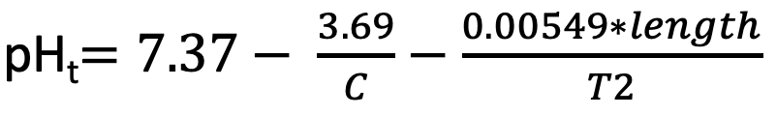
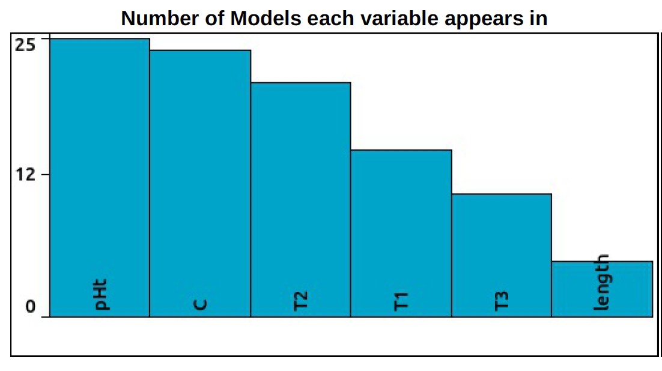

Approach C: Developing Non-Linear Analytical Equation that Explains pH_{t}
Allowed forms: Basic (constant, input variable, ±, x, ÷)
Error metric is absolute error (default)
Target expression:
Same training and test data as xgbTree’s
SAMPLE MODEL:
length = 4*C + T1 + T2 + T3
pH_{t}$=7.37− \frac{3.69}{C}−\frac{0.00549∗length}{T2}$
C-run length (C) appears in almost all models obtained.
25 models generated
Calculated on test data
Features are unscaled in this case, sample model complexity=13. More complex equations were also obtained using C-tract and all 3 loop lengths.

Slide 16

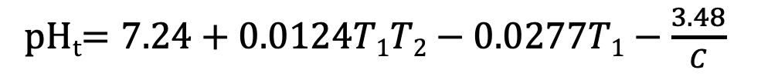
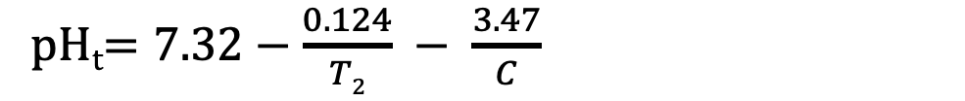
Approach C: Developing Non-Linear Analytical Equation that Explains pH_{t}
Allowed forms: Basic (constant, input variable, ±, x, ÷)
Error metric is absolute error (default)
Target expression:
SAMPLE MODEL:
pH_{t}$=7.32−\frac{0.124}{T2} − \frac{3.47}{C}$
Complexity = 11
pH_{t}$=7.37− \frac{3.69}{C}−\frac{0.00549∗length}{T2}$
Complexity = 13
pH_{t}$=7.24+0.0124T1T2−0.0277T1−\frac{3.48}{C}$
Complexity = 16
pH_{t}$=7.25+0.00469T1T2T3−0.0272T3−\frac{3.2+0.124T1}{C}$
Complexity = 22
All equations came from the same pool. For these 4, r² increases with increasing complexity based on the Eureqa calculations (be wary of overfitting).

Slide 17
Conclusions
With a restricted sub-universe of the C/T-based i-motifs, all three approaches still resulted to a reasonable quality of T_{m} and pH_{t} prediction. For both parameters, the gradient boosting machines performed the best out of the three approaches (T_{m}: r² = 0.98, RMSE = 1.4 & pH_{t}: r² =0.95, RMSE = 0.054).
Feature importance analysis from the GBM machine learning approach shows that the most important feature in defining the stability of the i-motifs (in the given sub-universe) both in terms of T_{m} and pH_{t} is the length of the C tracts (C). For T_{m} prediction, the length of the 3rd loop (T3) is slightly more important than that of the other two. For pH_{t} prediction, this is unclear because the importance ranking of the 3 loops differs whether total sequence length is included or not as a feature.
GBM models were built with and without total sequence length because this length can be derived using or is dependent on the other features. This is also why it is not surprising that not specifying length as a feature can result in a model performing comparably (even better in the case of pH_{t} prediction) than a model with it included.
The sample model from Eureqa shows that with only a slight compromise in prediction quality, we can have a simple, transparent analytical equation that expresses T_{m} and pH_{t} as a function of the chosen features. The T_{m} equation captures the interplay between the C-tract length and the loop lengths 1-3 in modulating the T_{m} of i-motifs in the given sub-universe. For pH_{t}, the equation makes use of C, T2 and length (in turn dictated by the C-tract and loop lengths) to define its value.
With nearly all Eureqa equations using C-tract lengths, Eureqa results agree with GBM’s that this feature is very important in predicting the stability in terms of T_{m} and pH_{t} of this sub-universe of i-motifs.

