Slide 1
3 approaches and rationale
Optimus
Modify the G4Hunter algorithm to make it applicable for i-motifs.
In G4Hunter, one G has a score of 1; in a GG tract, each G is scored 2 and so on. C’s get the same score but negated. To make G4Hunter applicable for the CT-based i-motifs, Optimus will be used to find the optimum scoring for each C (positive base, counterpart of G in the case of G-quadruplexes) in a given C-tract length (e.g. the score of each C in a CC tract in an i-motif). Two ways will be tried to score T; (1) T treated as negative base such that it’s given the same score as C but negated (2) T treated as the other bases (A, G) such that it’s scored 0.
Gradient boosting machines
Build a machine learning model predicting the T_{m}/pH_{t} of a limited sub-universe of CT-based i-motifs.
Get an idea of the importance of chosen features in terms of prediction.
Eureqa
Obtain a simple analytical equation expressing T_{m}/pH_{t} as a function of the chosen features.
Reveal relationship of features.
Dependent variables
Melting temperature (T_{m})
pH at mid-transition (pH_{t})

Slide 2
T_{m}
Approach A: Optimising G4Hunter Coefficients to deal with i-motifs
Optimise G4Hunter coefficients for i-motifs
C – positive base, T – negative (penalised) base
3 independent rounds (replicas) of optimisation were done and all arrived at the same set of coefficients/scoring scheme
Interpreting the table: each C in CC-tract of i-motif (run length=2) is scored 19.6
Note! May be an artefact of not having (reasonably so) C-tracts shorter than 3, hence for the minimum case only loop lengths were enough.
 |  | TRACT/RUN LENGTH
Replica | Pearson’s, r | 1 | 2 | 3 | 4 | 5 | 6
1 | 0.9593461 | 45.1 | 19.6 | 0.0 | 15.0 | 23.6 | 28.8
2 | 0.9593461 | 45.1 | 19.6 | 0.0 | 15.0 | 23.6 | 28.8
3 | 0.9593461 | 45.1 | 19.6 | 0.0 | 15.0 | 23.6 | 28.8
Model: Replica 1

Slide 3
T_{m}
Approach A: Optimising G4Hunter Coefficients to deal with i-motifs
Optimise G4Hunter coefficients for i-motifs
C – positive base, rest of bases are given a score of 0.
3 independent rounds (replicas) of optimisation were done for each method.
Interpreting the table: each C in CC-tract of i-motif (run length=4) is scored 24.1.
Note that in the given sub-universe of the C/T-based i-motifs, C-tract length range from 3 to 6 bases. Therefore the scores in the table for C-tract lengths less than 3 do not matter in this case.
 |  |  | SCORE OF POSITIVE BASE PER TRACT LENGTH
Method | Replica | Pearson’s, r | 1 | 2 | 3 | 4 | 5 | 6
Trad. G4 | 1 | 0.8770789 | 0.3 | 1 | 13.2 | 39.5 | - | -
 | 2 | 0.8770789 | 8.8 | 13.7 | 18.4 | 55.1 | - | -
 | 3 | 0.8770789 | 0.1 | 6.2 | 12.8 | 38.3 | - | -
Ext. G4 | 1 | 0.9579802 | 0 | 0 | 0 | 24.1 | 37.0 | 45.1
 | 2 | 0.9579801 | 0 | 0 | 0 | 11.6 | 17.8 | 21.7
 | 3 | 0.9579802 | 0 | 0 | 0 | 24.1 | 37.0 | 45.1

Slide 4
T_{m}
Approach A: Optimising G4Hunter Coefficients to deal with i-motifs

Slide 5
T_{m}
Approach B: Feature Importance with Gradient Boosting Machines
Chosen features of i-motif sequences
The following features were used for the other modelling methods
C – length of C tract; [3,6]; per sequence the length of the 4 C tracts are equal
T1 – length of 1st T loop; [1,6]
T2 – length of 2nd T loop; [1,6]
T3 – length of 3rd T loop; [1,6]
length – total sequence length; [15,36]
Dependent variable: T_{m} [48,81.9]

Slide 6
Approach B: Feature Quality Control and Preprocessing
Features not extremely correlated.
No zero- (predictor have one unique value) and near zero-variance predictors.
Features centred and scaled.

Slide 7
T_{m}
Approach B: XGBoost Hyperparameter/Architecture Optimisation
All 196 sequences were used for this step.
Features: C, T1, T2, T3, length
Hyperparameter of optimal model architecture
Hyperparameter | value
eta | 0.01
max_depth | 4
Gamma* | 0
colsample_bytree** | 1
min_child_weight | 5
subsample | 0.6
nrounds | 1000
*No regularisation (gamma=0, default)
**All features used by every tree (colsample_bytree=1, default)
Same optimal hyperparameters obtained with and without including total length as feature.
Notes:
80% training, 20% test, used optimal hyperparameter

Slide 8
T_{m}
Approach B: XGBoost (Re)training, Performance and Feature Importance
Using the identified optimal hyperparameters, the model was tuned using 80% of data for training (randomly chosen). The retrained model was then tested on remaining 20%.
Values based on training with 80% of data:
Metric | All features | No length
RMSE | 1.4011 | 1.376196
r² | 0.9758311 | 0.9767373
MAE | 1.135564 | 1.120195
RMSESD | 0.1692699 | 0.1639031
r²SD | 0.005186407 | 0.005370633
MAESD | 0.1139668 | 0.1081146
Feature | All features
C | 100
T3 | 5.123308
length | 4.841326
T1 | 4.253030
T2 | 3.797984
Feature | No length
C | 100
T3 | 5.147290
--- | ---
T1 | 4.375894
T2 | 4.289519
Calculated on test data
Calculated on test data
Model with all features > Model without length

Slide 9
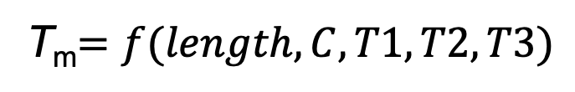
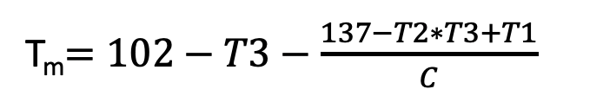
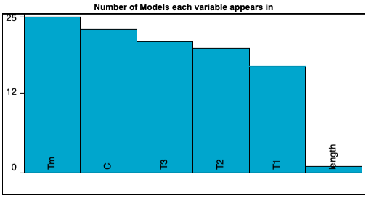

Approach C: Developing Non-Linear Analytical Equation that Explains T_{m}
Allowed forms: Basic (constant, input variable, ±, x, ÷) and Exponential (power, sqrt)
Error metric is absolute error (default)
Target expression:
Same training and test data as xgbTree’s
SAMPLE MODEL:
T_{m}$=102−T3−\frac{137−T2∗T3+T1}{C}$
C-run length (C) appears in almost all models obtained.
25 models generated
Calculated on test data
With features unscaled as in this case, length only appeared in the 2nd least accurate model (T_{m}=42.3 + length). After centering and scaling, it did appear but only in more complex models, complexity>27 (for reference, sample model has complexity=14).

Slide 10
3 approaches and rationale
Optimus
Modify the G4Hunter algorithm to make it applicable for i-motifs.
In G4Hunter, one G has a score of 1; in a GG tract, each G is scored 2 and so on. C’s get the same score but negated. To make G4Hunter applicable for the CT-based i-motifs, Optimus will be used to find the optimum scoring for each C (positive base, counterpart of G in the case of G-quadruplexes) in a given C-tract length (e.g. the score of each C in a CC tract in an i-motif). Two ways will be tried to score T; (1) T treated as negative base such that it’s given the same score as C but negated (2) T treated as the other bases (A, G) such that it’s scored 0.
Gradient boosting machines
Build a machine learning model predicting the T_{m}/pH_{t} of a limited sub-universe of CT-based i-motifs.
Get an idea of the importance of chosen features in terms of prediction.
Eureqa
Obtain a simple analytical equation expressing T_{m}/pH_{t} as a function of the chosen features.
Reveal relationship of features.
Dependent variables
Melting temperature (T_{m})
pH at mid-transition (pH_{t})

Slide 11
pH_{t}
Approach A: Optimising G4Hunter Coefficients to deal with i-motifs
Optimise G4Hunter coefficients for i-motifs
C – positive base, T – negative (penalised) base
3 independent rounds (replicas) of optimisation were also done. Replicas 1-2 arrived at the same, slightly better set of coefficients/scoring scheme
Same as in T_{m}’s
 |  | TRACT/RUN LENGTH
Replica | Pearson’s, r | 1 | 2 | 3 | 4 | 5 | 6
1 | 0.9264508 | 52.8 | 27.0 | 0.0 | 11.4 | 18.5 | 22.3
2 | 0.9264508 | 52.8 | 27.0 | 0.0 | 11.4 | 18.5 | 22.3
3 | 0.9264507 | 41.7 | 21.3 | 0.0 | 9.0 | 14.6 | 17.6
Model: Replica 1

Slide 12
pH_{t}
Approach A: Optimising G4Hunter Coefficients to deal with i-motifs
Optimise G4Hunter coefficients for i-motifs
C – positive base, rest of bases are given a score of 0.
3 independent rounds (replicas) of optimisation were done for each method.
Interpreting the table: each C in CC-tract of i-motif (run length=4) is scored 24.1.
Note that in the given sub-universe of the C/T-based i-motifs, C-tract length range from 3 to 6 bases. Therefore the scores in the table for C-tract lengths less than 3 do not matter in this case.
 |  |  | SCORE OF POSITIVE BASE PER TRACT LENGTH
Method | Replica | Pearson’s, r | 1 | 2 | 3 | 4 | 5 | 6
Trad. G4 | 1 | 0.8317956 | 0 | 0 | 0 | 7
 | 2 | 0.8317956 | 0 | 0 | 0 | 7
 | 3 | 0.8317956 | 0 | 0 | 0 | 7
Ext. G4 | 1 | 0.9150095 | 0 | 0 | 0 | 20.2 | 31.4 | 38.3
 | 2 | 0.9150094 | 0 | 0 | 0 | 11.7 | 18.2 | 22.2
 | 3 | 0.9150095 | 0 | 0 | 0 | 19.3 | 30.0 | 36.6

Slide 13
pH_{t}
Approach A: Optimising G4Hunter Coefficients to deal with i-motifs

Slide 14
pH_{t}
Approach B: Feature Importance with Gradient Boosting Machines
Chosen features of i-motif sequences
The following features were used for the other modelling methods
C – length of C tract; [3,6]; per sequence the length of the 4 C tracts are equal
T1 – length of 1st T loop; [1,6]
T2 – length of 2nd T loop; [1,6]
T3 – length of 3rd T loop; [1,6]
length – total sequence length; [15,36]
Dependent variable: pHt [5.96, 6.9]

Slide 15
pH_{t}
Approach B: XGBoost Hyperparameter/Architecture Optimisation
All 196 sequences were used for this step.
Features: C, T1, T2, T3, length
Hyperparameter of optimal model architecture
Hyperparameter | All features | No length
eta | 0.01 | 0.01
max_depth | 8 | 6
Gamma* | 0 | 0
colsample_bytree** | 1 | 1
min_child_weight | 3 | 10
subsample | 0.6 | 0.6
nrounds | 750 | 1500
*No regularisation (gamma=0, default)
**All features used by every tree (colsample_bytree=1, default)
Notes:
80% training, 20% test, used optimal hyperparameter

Slide 16
pH_{t}
Approach B: XGBoost (Re)training, Performance and Feature Importance
Using the identified optimal hyperparameters, the model was tuned using 80% of data for training (randomly chosen). The retrained model was then tested on remaining 20%.
Values based on training with 80% of data:
Metric | All features | No length
RMSE | 0.05632807 | 0.05399737
r² | 0.9424578 | 0.9464987
MAE | 0.04353706 | 0.04250962
RMSESD | 0.008222115 | 0.007408617
r²SD | 0.0180082 | 0.01318266
MAESD | 0.007648299 | 0.005437334
Feature | All features
C | 100
length | 53.124830
T1 | 11.133761
T3 | 10.844397
T2 | 8.921195
Feature | No length
C | 100
--- | ---
T2 | 12.234725
T1 | 11.778001
T3 | 9.140414
Calculated on test data
Calculated on test data
Model with all features < Model without length

Slide 17

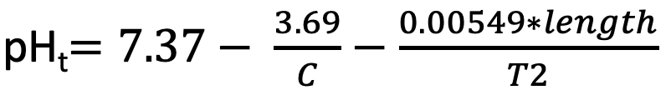
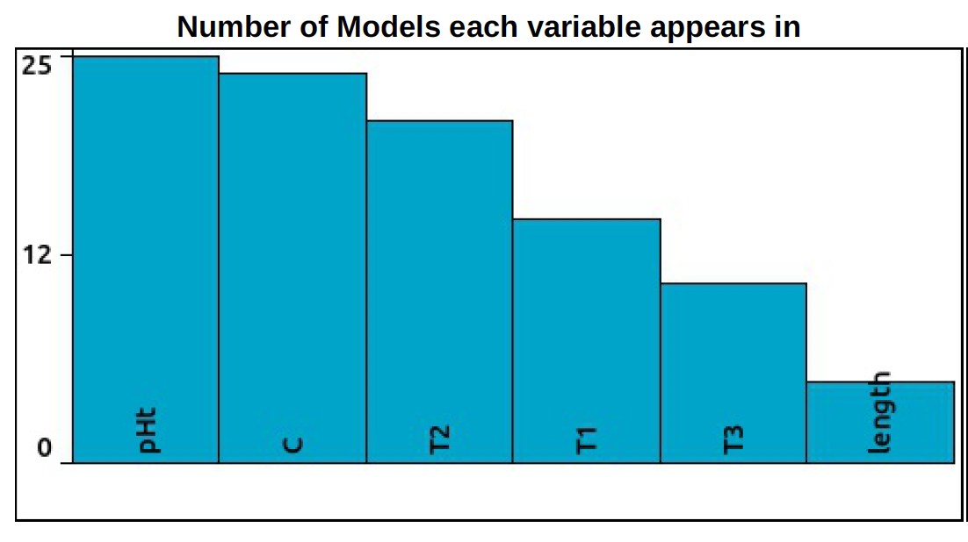


Approach C: Developing Non-Linear Analytical Equation that Explains pH_{t}
Allowed forms: Basic (constant, input variable, ±, x, ÷)
Error metric is absolute error (default)
Target expression:
pH_{t}$=f(length, C, T1, T2, T3)$
Same training and test data as xgbTree’s
SAMPLE MODEL:
length = 4*C + T1 + T2 + T3
pH_{t}$=7.37− \frac{3.69}{C}−\frac{0.00549∗length}{T2}$
C-run length (C) appears in almost all models obtained.
25 models generated
Calculated on test data
Features are unscaled in this case, sample model complexity=13. More complex equations were also obtained using C-tract and all 3 loop lengths.

Slide 18

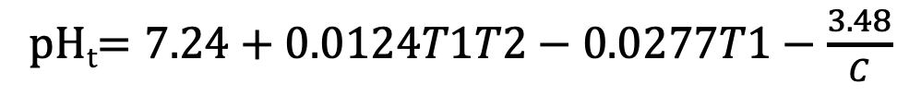
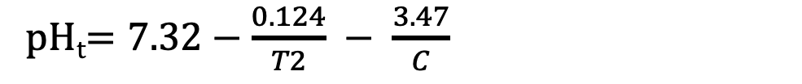
Approach C: Developing Non-Linear Analytical Equation that Explains pH_{t}
Allowed forms: Basic (constant, input variable, ±, x, ÷)
Error metric is absolute error (default)
Target expression:
Same training and test data as xgbTree’s
SAMPLE MODEL:
pH_{t}$=7.32−\frac{0.124}{T2} − \frac{3.47}{C}$
Complexity = 11
pH_{t}$=7.37− \frac{3.69}{C}−\frac{0.00549∗length}{T2}$
Calculated on test data
Complexity = 13
pH_{t}$=7.24+0.0124T1T2−0.0277T1−\frac{3.48}{C}$
Complexity = 16
pH_{t}$=7.25+0.00469T1T2T3−0.0272T3−\frac{3.2+0.124T1}{C}$
Used C and all 3 loop lengths
Complexity = 22
All equations came from the same pool. For these 4, r² increases with increasing complexity based on the Eureqa calculations (be wary of overfitting).

Slide 19
Conclusions
With a restricted sub-universe of the C/T-based i-motifs, all three approaches still resulted to a reasonable quality of T_{m} and pH_{t} prediction. For both parameters, the gradient boosting machines performed the best out of the three approaches (T_{m}: r² = 0.98, RMSE = 1.4 & pH_{t}: r² =0.95, RMSE = 0.054).
Out of the 4 suggested methods, in which T is scored 0, to apply the G4Hunter algorithm in predicting i-motif stability, the optimised, extended version performed the best (T_{m}:r²=0.918, pH_{t}:r²=0.837). However, the previous optimised version, in which T is negated, is still slightly better (T_{m}:r²=0.920, pH_{t}:r²=0.858).
Feature importance analysis from the GBM machine learning approach shows that the most important feature in defining the stability of the i-motifs (in the given sub-universe) both in terms of T_{m} and pH_{t} is the length of the C tracts (C). For T_{m} prediction, the length of the 3rd loop (T3) is slightly more important than that of the other two. For pH_{t} prediction, this is unclear because the importance ranking of the 3 loops differs whether total sequence length is included or not as a feature.
GBM models were built with and without total sequence length because this length can be derived using or is dependent on the other features. This is also why it is not surprising that not specifying length as a feature can result in a model performing comparably (even better in the case of pH_{t} prediction) than a model with it included.
The sample model from Eureqa shows that with only a slight compromise in prediction quality, we can have a simple, transparent analytical equation that expresses T_{m} and pH_{t} as a function of the chosen features. The T_{m} equation captures the interplay between the C-tract length and the loop lengths 1-3 in modulating the T_{m} of i-motifs in the given sub-universe. For pH_{t}, the chosen equation makes use of C, T2 and length (in turn dictated by the C-tract and loop lengths) to define its value. There is another, better-performing, equation using C and all 3 loop lengths but is more complex.
With nearly all Eureqa equations using C-tract lengths, Eureqa results agree with GBM’s that this feature is very important in predicting the stability in terms of T_{m} and pH_{t} of this sub-universe of i-motifs.

