Slide 1
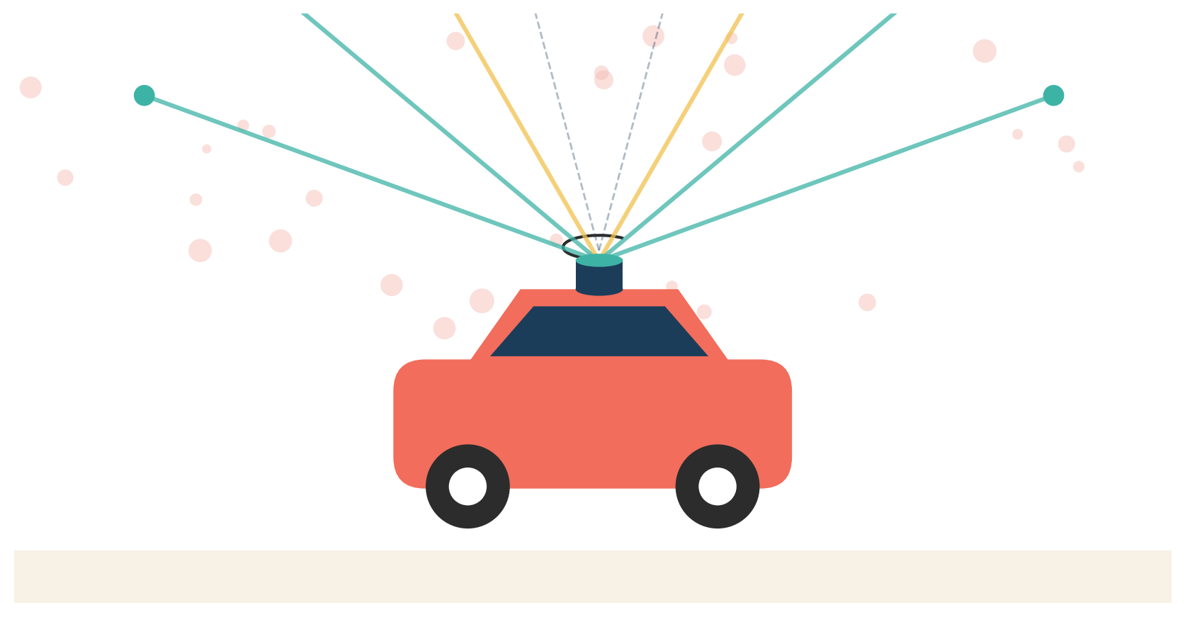
EVALUATION 2 - HONORS PROJECT
Event-Guided Motion
Compensation for LiDAR
Temporal Distortion
A lightweight, image-space pipeline for autonomous driving
Sahal Ansar Theparambil
Department of Engineering - IIIT Sri City
TITLE
1 / 15

Slide 2
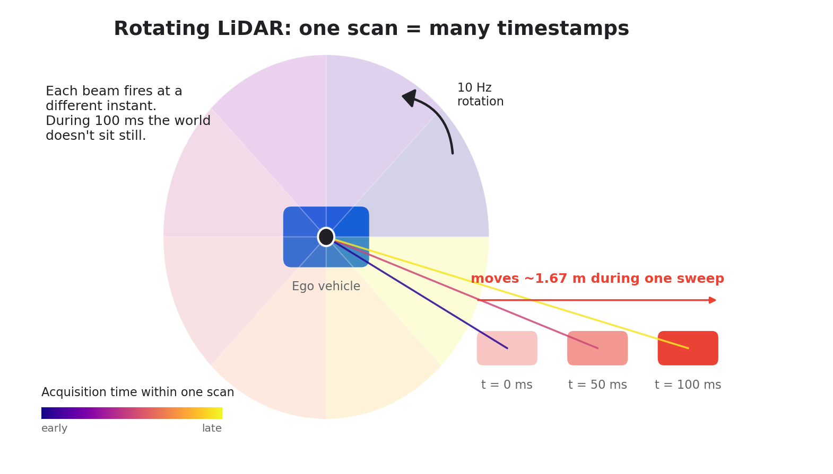
THE PROBLEM
A spinning LiDAR doesn't take a snapshot.
ONE SCAN, 100 ms
64 beams.
One rotation.
Each beam fires at a
different moment.
At 60 km/h the ego car
travels 1.67 m between
the first and last beam.
Result: projected points
no longer line up with
the image.
INTRODUCTION
2 / 15

Slide 3
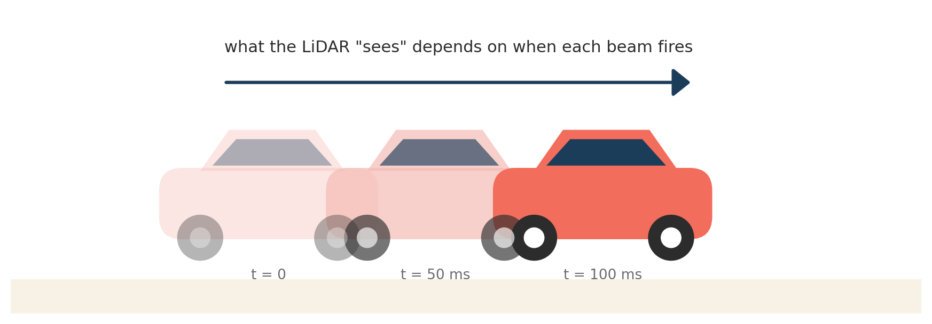
WHY THIS MATTERS
Misalignment compounds at every fusion step.
100 ms
scan duration on a 10 Hz Velodyne
1.67 m
ego displacement at highway speed
+
moving cars and people inside the scene
INTRODUCTION
3 / 15

Slide 4
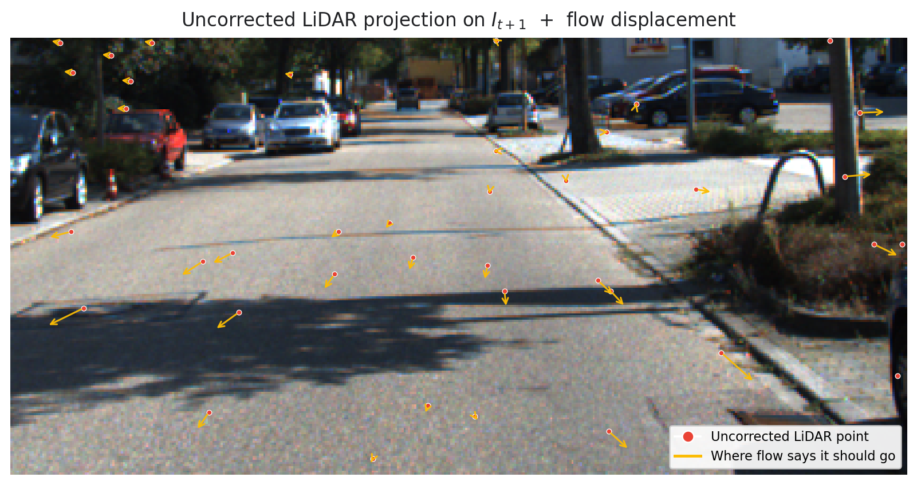
VISUAL PROOF
You can see the mismatch in a single KITTI frame.
WHAT YOU'RE LOOKING AT
Red dots: LiDAR points
projected with static
calibration.
Yellow arrows: where
dense optical flow says
those points should sit
in the next frame.
Static calibration cannot
close this gap on its own.
INTRODUCTION
4 / 15

Slide 5

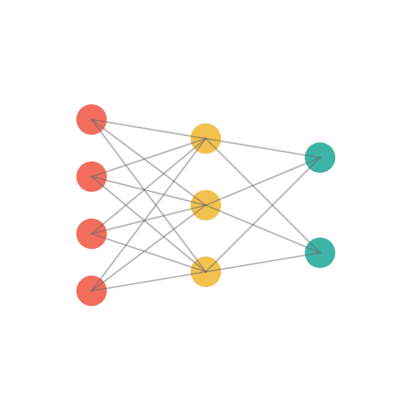

RELATED WORK
Existing fixes need hardware or GPUs.
IMU de-skew
Deep fusion
Ours (classical)
Integrates ego-motion
between per-point
timestamps.
Needs raw timestamps and tight inertial coupling - unavailable in
KITTI-sync.
Transformer / CNN models for cross-modal alignment.
Strong benchmarks but
require GPU inference
and training data.
Image-space optical flow,
event-gated, no DL,
no IMU, no hardware.
Runs on a laptop CPU and
covers both ego- and
scene-motion.
RELATED WORK
5 / 15

Slide 6
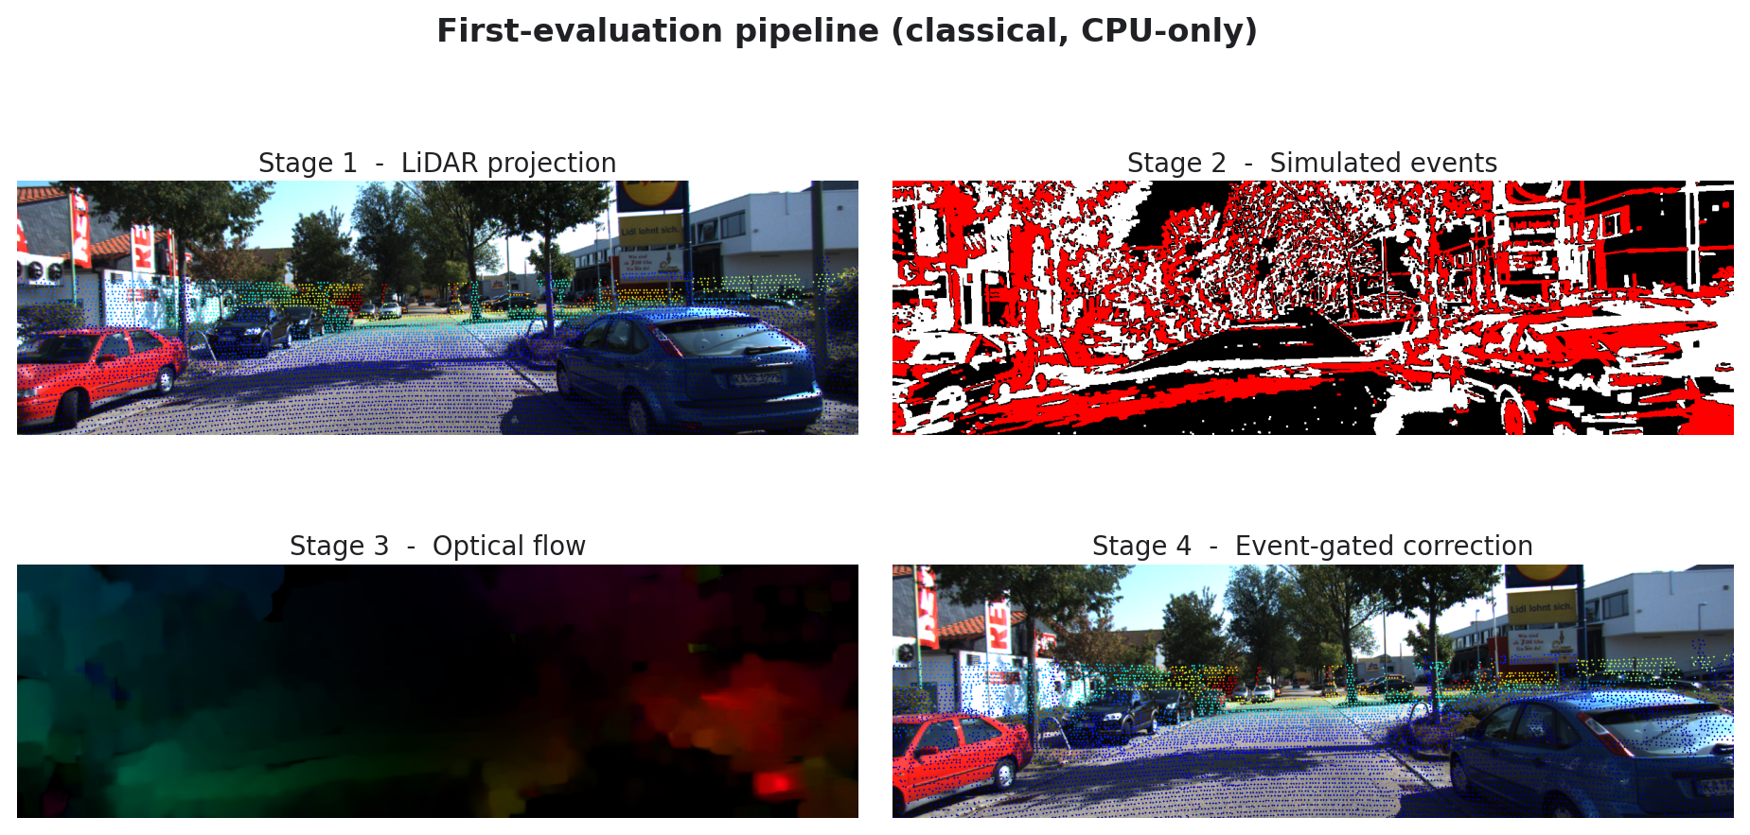
RECAP
Where the first evaluation left off.
WHAT WAS WORKING
End-to-end classical pipeline:
project -> simulate -> flow ->
event-gated fix.
Interactive demo in
main.py with side-by-side
before/after views.
Validation harness reading
4 KITTI sequences and
comparing modes.
Open questions: does it
generalize, and does it
measurably help?
RECAP
6 / 15

Slide 7
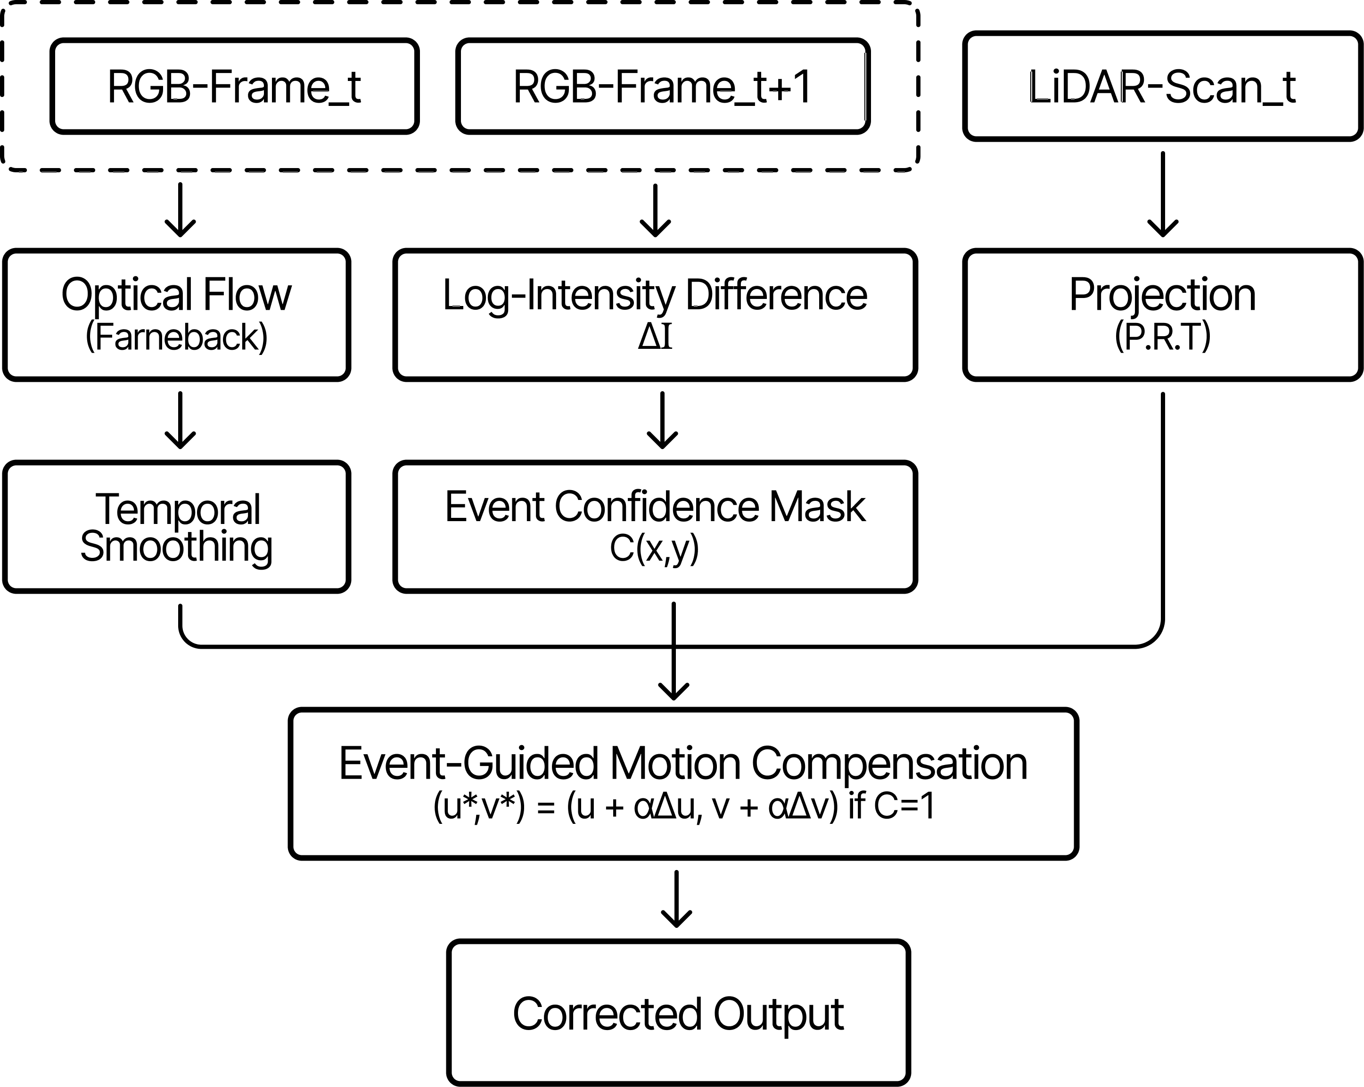
APPROACH
Four stages, all in 2D image space.
ONE-LINE SUMMARY
Take the dense flow
between two RGB frames.
Use simulated events as
a confidence gate so the
fix only fires where
something actually moved.
Smooth across time to
keep the correction stable.
Apply only to the 2D
LiDAR projection - no 3D
points touched.
METHOD
7 / 15

Slide 8
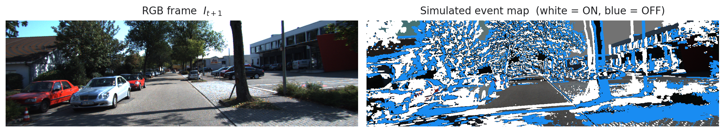
KEY IDEA
The trick: trust flow only where events fire.
WHY GATING HELPS
Optical flow estimates
something everywhere -
even over a flat road.
log(I_t+1) - log(I_t)
approximates a DVS sensor
at near-zero compute cost.
Edge-proximity filtering
localizes events to true
scene boundaries.
Net effect: correction
fires on objects,
stays quiet on flat ground.
METHOD
8 / 15

Slide 9
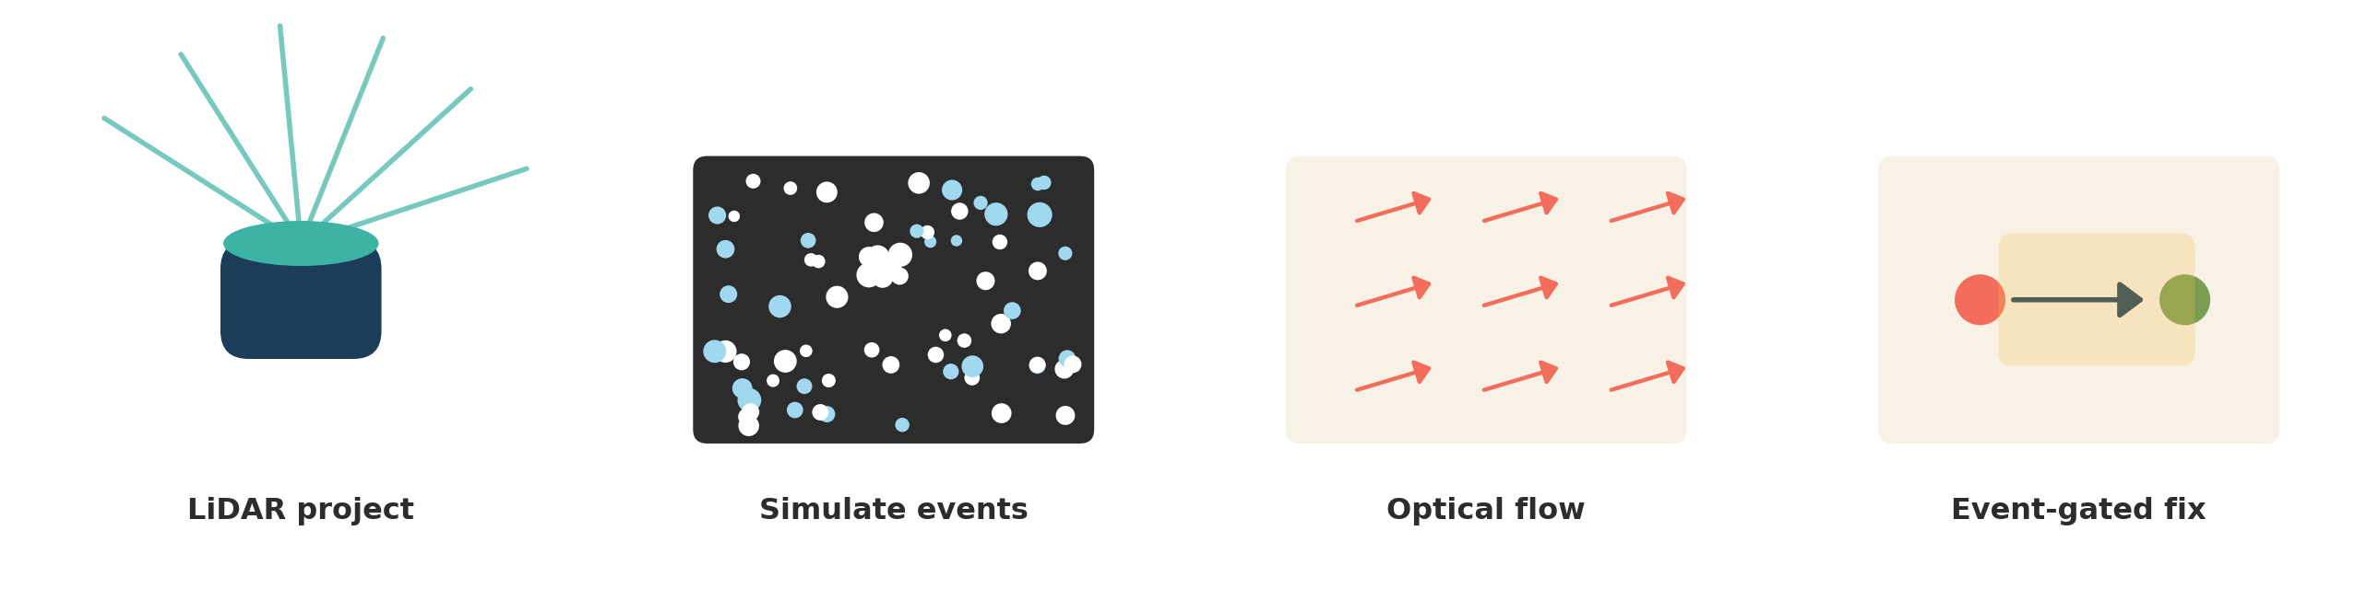
IMPLEMENTATION
Each stage is a few lines of NumPy / OpenCV.
Project
Simulate
Flow
Correct
KITTI calibration chain:
P_rect @ R_rect @ T_velo->cam
log-intensity diff,
threshold = 0.3,
edge-gated by Canny
Farneback dense flow,
EMA-smoothed with
alpha = 0.7
Shift point by 0.5 x flow
only inside the event mask
IMPLEMENTATION
9 / 15

Slide 10
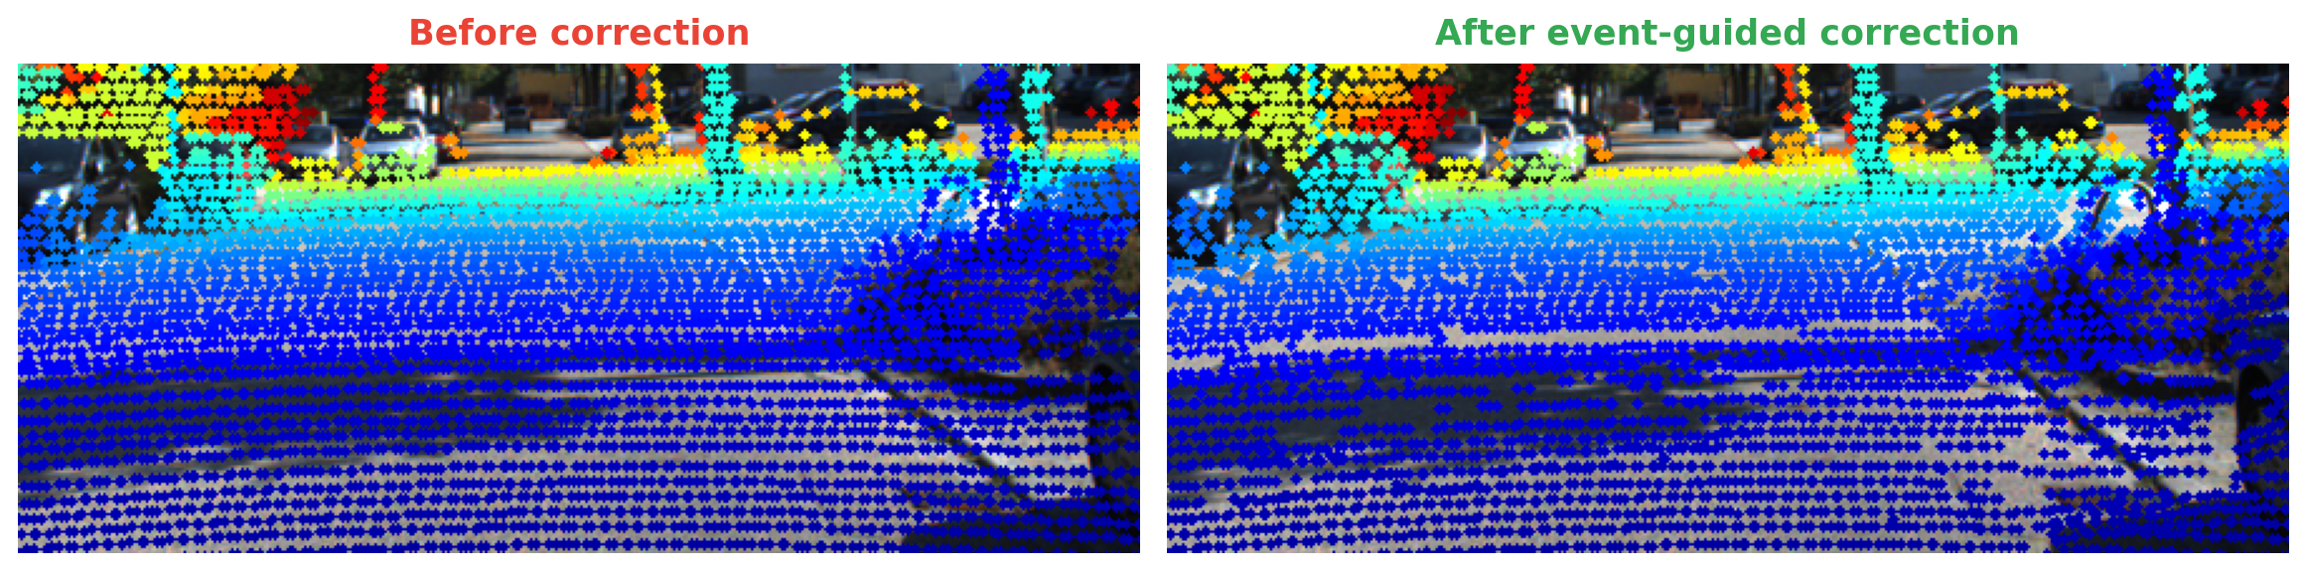
QUALITATIVE RESULT
Sharper alignment on real KITTI frames.
Zoom on drive_0009 frame 40. Same LiDAR scan, projected onto frame t+1, before and after the event-gated correction.
RESULTS
10 / 15

Slide 11
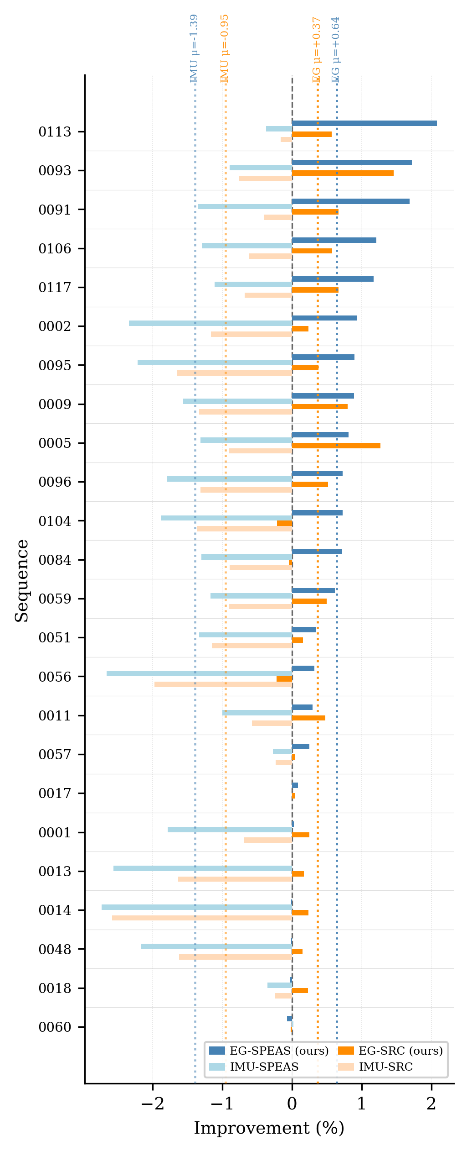
QUANTITATIVE RESULT
Statistically significant across 24 sequences.
SPEAS - edge alignment
+0.64 %
p < 0.001 - Cohen's d = 1.05
SRC - stereo reprojection
+0.37 %
p < 0.001 - d = 0.90
23 / 24 SEQUENCES
we beat the IMU-only
baseline on both metrics.
RESULTS
11 / 15

Slide 12
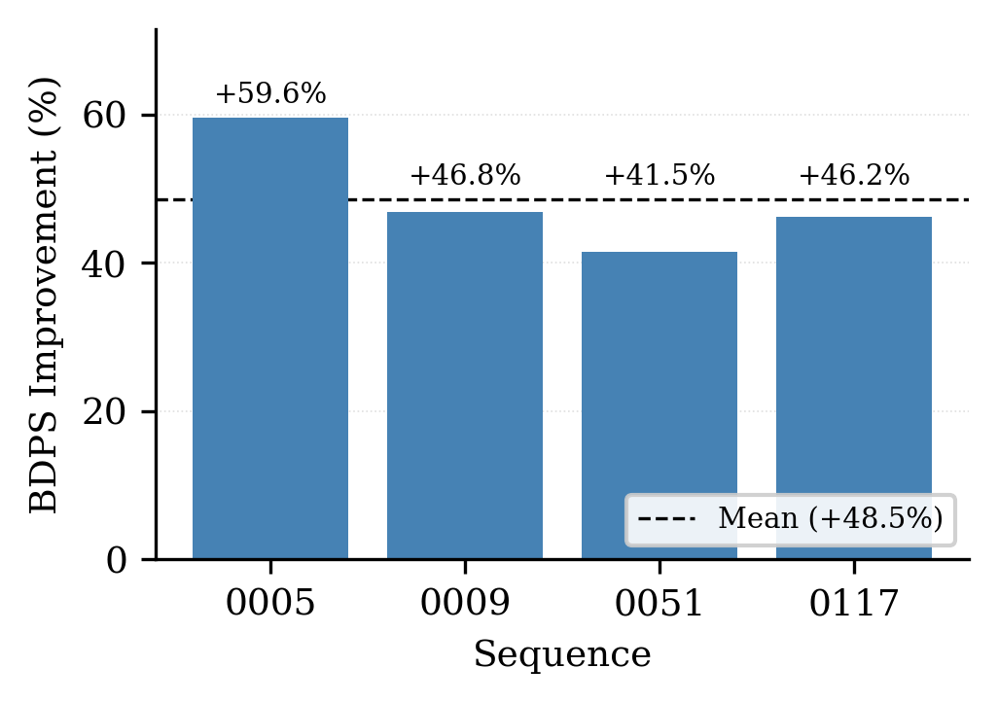
DOWNSTREAM IMPACT
Sharper depth edges at object boundaries.
BDPS IMPROVEMENT
+48.5 %
mean improvement
across 1,691 frames
99.2 % of frames improve
BDPS = Sobel-gradient sharpness of sparse depth near image edges.
RESULTS
12 / 15

Slide 13
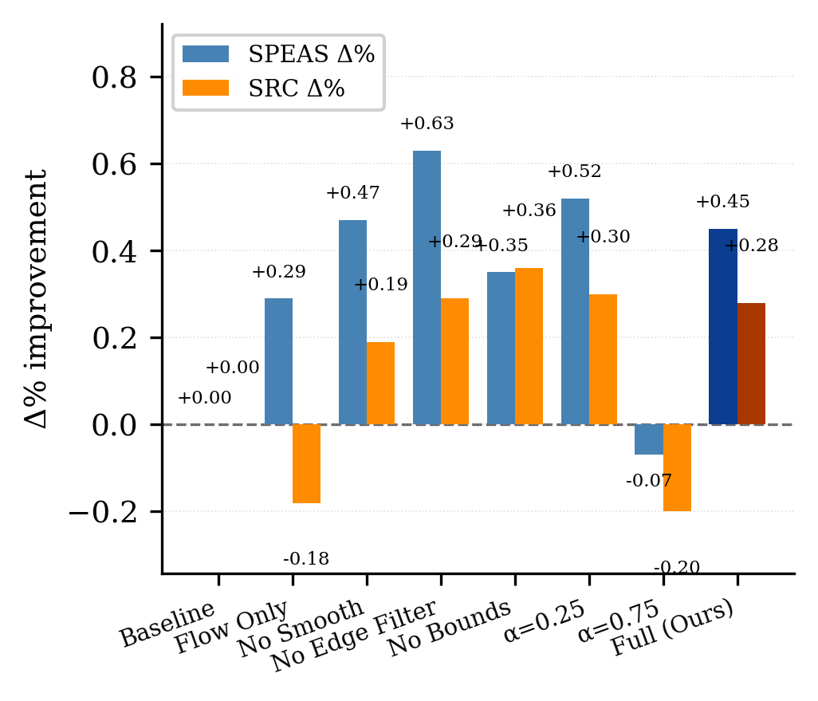
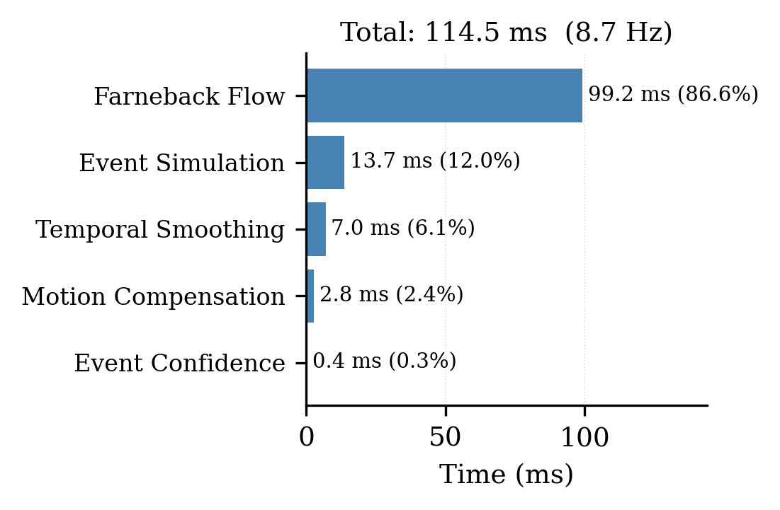
ABLATION & RUNTIME
Every component carries its weight.
Drop event gating -> SRC goes negative. alpha = 0.75 -> both worsen.
Total 114.5 ms / pair (8.7 Hz, CPU). Farneback is 87% of the bill.
RESULTS
13 / 15

Slide 14
CONCLUSION
A small classical idea, a measurable win.
TAKEAWAYS
WHAT'S NEXT
Image-space is enough.
Future directions
Correcting the projection, not the point cloud, works.
Events as a gate.
->
Per-scan-angle temporal offset estimation.
Simulated DVS-style events cheaply localize where to fire.
->
3D extension via depth-preserved unprojection.
Beats IMU baseline.
On 23/24 KITTI sequences - dynamic objects matter.
->
Validation on a real LiDAR-event dataset (DSEC).
Real-time-adjacent on CPU.
->
GPU Farneback / RAFT for full 10 Hz throughput.
8.7 Hz today; GPU flow takes us past 10 Hz.
CONCLUSION
14 / 15

Slide 15

EVALUATION 2 - HONORS PROJECT
Thank you.
Questions and comments welcome.
Sahal Ansar Theparambil
sahalansar.t23@iiits.in
KEY REFERENCES
Geiger et al., KITTI dataset, IJRR 2013.
Farneback, Two-frame motion estimation, SCIA 2003.
Lichtsteiner et al., 128x128 DVS, JSSC 2008.
Gallego et al., Event-based optical flow, TPAMI 2024.
THANKS
15 / 15

