Slide 1

Draw.io
Group 33

Slide 2

Introduction

Slide 3
Draw.io is an open source technology stack for building diagramming applications, and the world’s most widely used browser-based end-user diagramming application.
In the Software Design Stage Draw.io comes into paly
Usage to our Subject
Draw User Case Diagrams
Draw EER Diagrams
Draw ER Diagrams
Data Flow Diagrams

Slide 4
Features

Slide 5
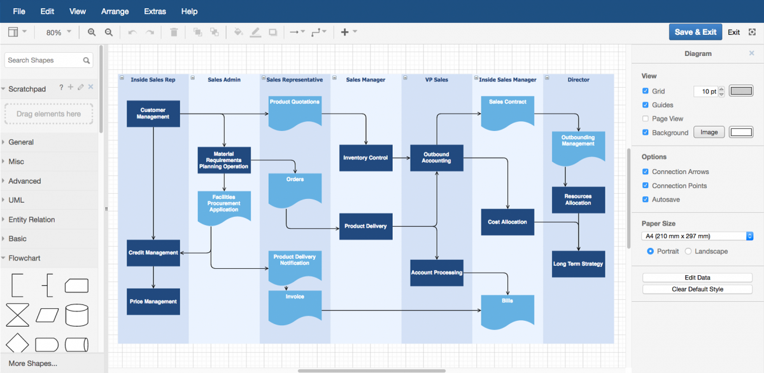
1.Easy to use
Intuitive interface
Nothing to install
Drag & drop functionality
Extensive shape library
Lots of templates
Helpful training material

Slide 6
2. Rich functionality
Track & restore changes
Import & export various formats
Automatic layout
Publish & share your work

Slide 7

3.Secure & reliable
We don´t store your data
High performance
You own the content you produce

Slide 8
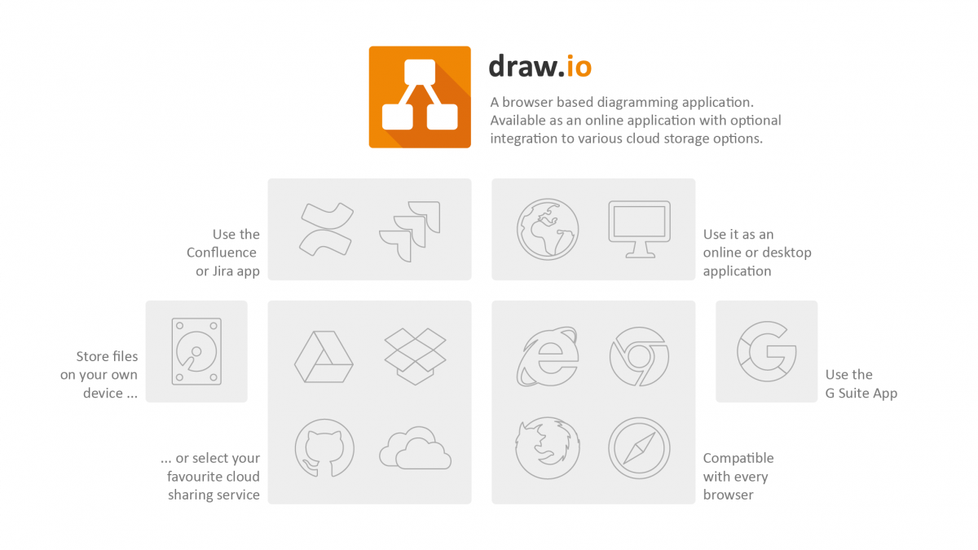
4.Works Everywhere
Works online & offline
Works on desktop & mobile devices
Compatible with every browser

Slide 9
Setup & Guide

Slide 10
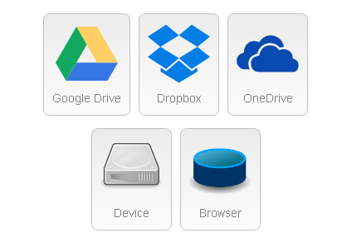
Selection Storage
Offline Mode (memory)
Dropbox Mode
Google Drive Mode

Slide 11
Offline Mode
Download Setup
Open It
Save It
Use It
-Offline Web Application
-Offline Desktop Application
-Chrome OS Application

Slide 12
Dropbox Mode
Dropbox is no longer primary storage option for draw.io for 2 main reasons:
1) They selected unpkg.com as a CDN for distribution of their JavaScript and unpkg suffered a DNS hack. Dropbox clearly did not audit unpkg (though, in fairness, neither did we), but we feel that the JavaScript client is not treatly as a "first-class component" if quality slips of this magnitude occur.
2) Files cannot be shared.

Slide 13
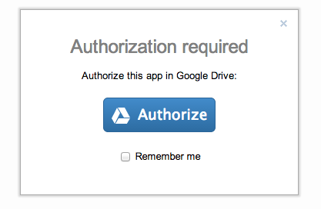
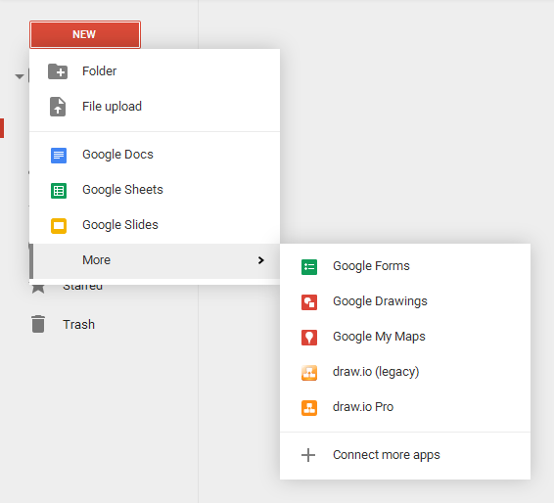
Google Drive Mode
-Authorization Guide
-Permission Handling
-Use

Slide 14
Workings

Slide 15
Advantages

Slide 16
Disadvantage

