Slide 1


Slide 2
How to a Webpage
HTML Refers to HyperText Markup Language
Based on Tags
<opening_tag></ending_tag>
Modern Web Structure
HTML/HTML5 – Structure
CSS/CSS3 – Presentation(Designing)
JavaScript/jQuery – Behavior
PHP – Backend
CMS – Content Management

Slide 3
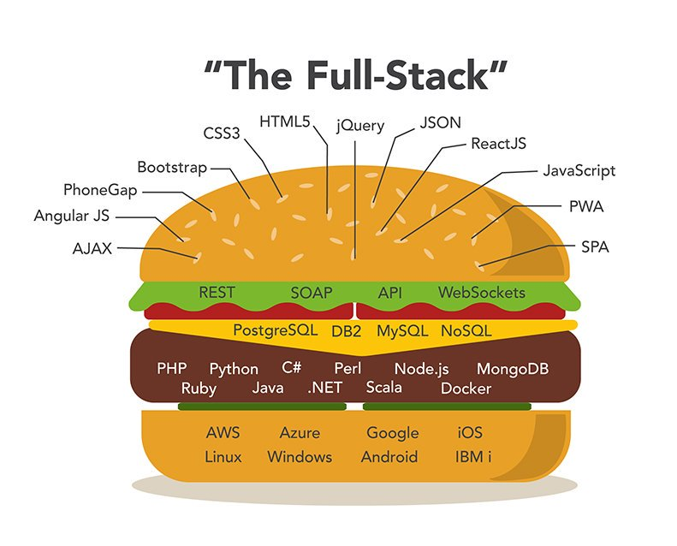
Web Burger
Web Technology in today’s context

Slide 4
Basic Documents Structure
<html>
<head></head>
<body></body>
</html>
html- everything in a HTML document is surrounded by a html tag
head- contains all of the non-visual elements that help make the page work
body- contains all visual-structural elements are contained within this tag

Slide 5
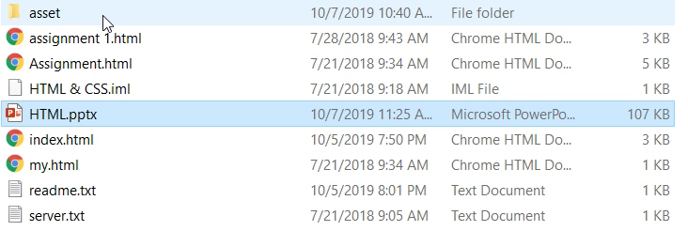
HTML File
.html or .htm extension
e.g. :- first.html
How to add a Title
<title>My First Web</title>
Inside the head tag

Slide 6
My Blog

