Slide 1

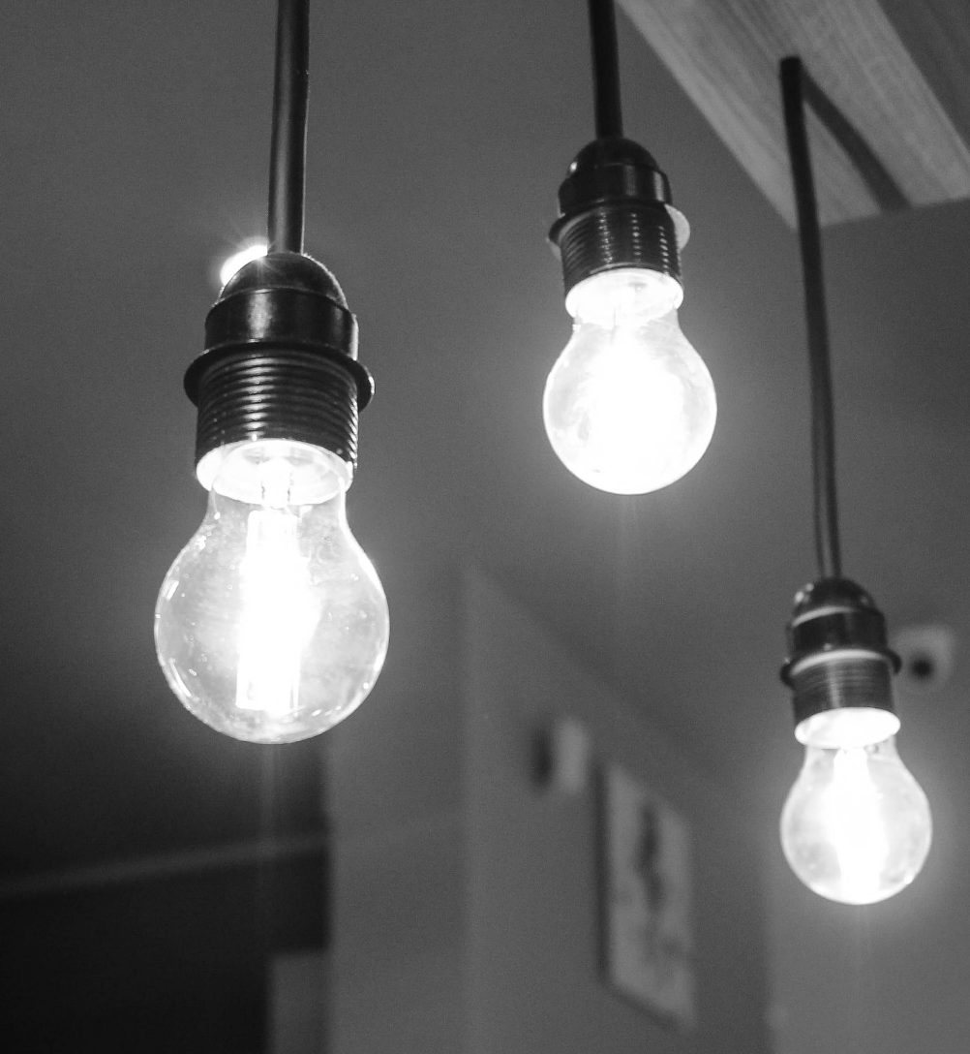
Power Saving Automatic Light Controller
Team Techno beast
210141U – Dissanayaka D.M.S.P.
210341H – Liyanaarachchi L.A.S
210303U – Kulasingham P.N
210705E – Wickramasingha M.P.D.N

Slide 2

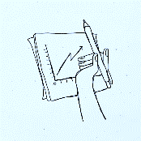




Content
Problem & Solution
Problem
Survey Results
Solution
Technical Feasibility
Resource Requirements
Performance Targets
Technical Risks
Testing and Evaluation
Product Architecture
Sensor part
Light bulb part
Sketches
Initial Sketch
Finalized Sketch
Marketing & Sales
Marketing
Sales
After-sale Service
Bill of quantities
Summery of expenditure
Quantities

Slide 3

Problem & Solution
Do you forget to switch off the bulb when they are leaving the place?
Have you any children or disable member in your family which can’t turn off lights.
The development of this project is a timely and essential project with the potential to solve not only that but also extra too many problems.

Slide 4

Survey Results
We got 198 responses from the survey.
We targeted a sample in society with all types of people covered.
We could find many valuable facts and identify what people need.

Slide 5
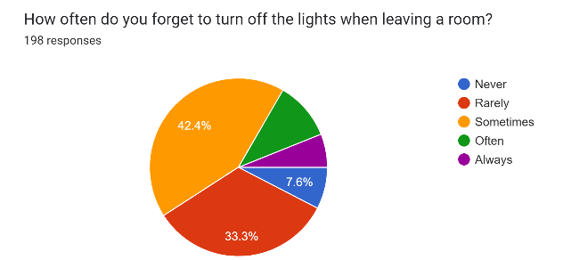
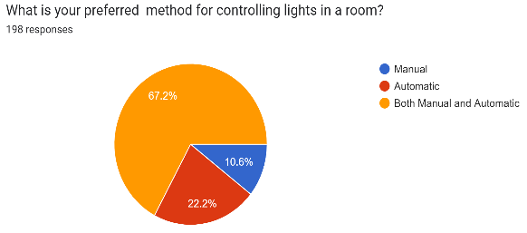
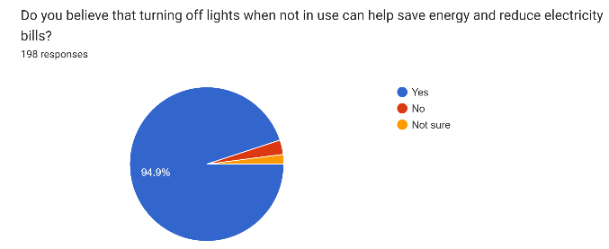
Survey Results

Slide 6
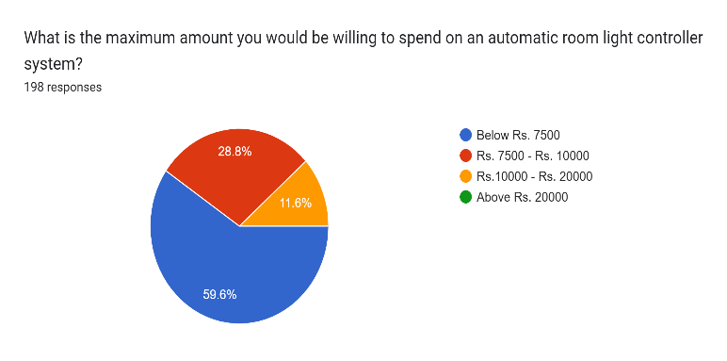
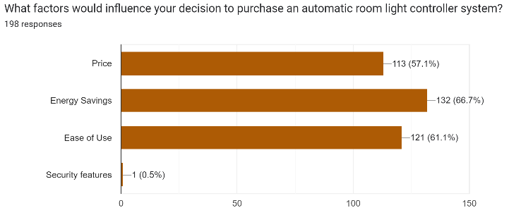
Survey Results

Slide 7
Technical Feasibility
Resource Requirements
Performance Targets
Include light bulbs, sensors, PCBs, power-supplying methods, and transmitters.
The software requirements include firmware for the microcontrollers, communication protocols.
The software that we needed is Arduino, Solid Works, Altium, etc.
Based on industry standards.
The system will be designed to turn on the lights automatically when someone enters the room and turn them off when they leave, thereby conserving energy.
The main thing is when people enter the room more than one, the light will only be off if all of them left from the room.

Slide 8
Technical Feasibility
Technical Risks
Testing and Evaluation
mainly related to hardware and software compatibility.
We have addressed these risks by carefully selecting the components and developing software components that are compatible with each other.
tested the system thoroughly in a controlled environment and have identified and resolved any issues.
Tested using a combination of manual testing and automated testing tools using simulations and hardware components.
The tests will be conducted in a controlled environment simulating different scenarios and conditions.
The evaluation criteria will be based on the system's energy efficiency, response time, reliability, and accuracy.

Slide 9

Product Architecture
Power Supply (Battery)
7805 Regulator
Microprocessor
Ultrasonic
input
input
output
Transmitter
Receiver
input
Main Power 230V
Microprocessor
Relay Module
Hi-Link Transformer
input
output
Bulb

Slide 10
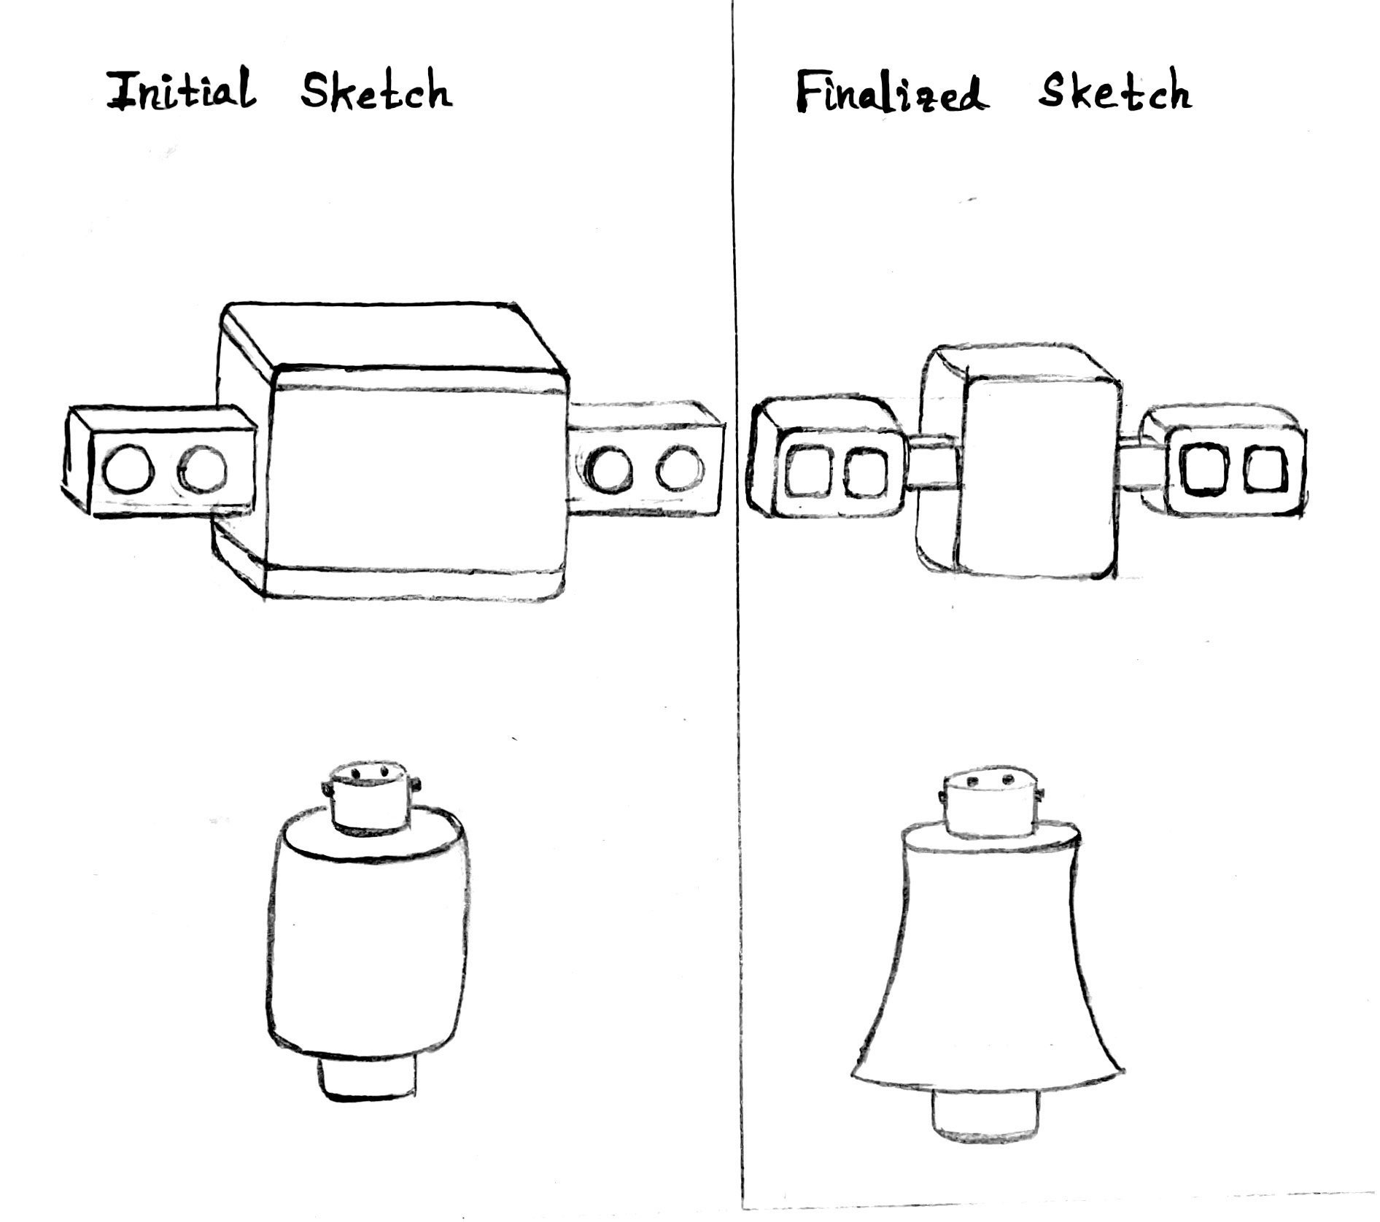
Initial and Finalized Sketches

Slide 11
Marketing, Sales, and After-Sale Service Considerations
Marketing
Sales
Mostly middle age people will be targeted because they are interested in technology and easy ways to do something.
Use social media platforms and digital marketing strategies to reach a wider audience and it’s better to advertise on TV is useful because most people can be caught.
Partner with home automation companies and energy-efficient solution providers to increase exposure and reach new customers.
Attend trade shows and exhibitions to showcase the product and generate interest.
Develop a sales strategy to ensure the automatic light bulb system is priced competitively. Create a sales team to promote and sell the product to potential customers.
Offer discounts or prizes to make the product more attractive.
Provide incentives to retailers and distributors to promote the product.
Develop a sales forecast to project revenue and sales targets. It is a back-office task but more important to succeed in the purpose.

Slide 12

After-Sale Service
Offer a warranty and maintenance plan for the automatic light bulb system. But pay attention to the period and conditions.
Provide customer support via email, phone, or online chat to answer questions and troubleshoot issues.
Develop a customer feedback mechanism to monitor satisfaction levels and improve the product. I will be really important to the market also.
Provide training and educational resources for customers to ensure they get the most out of the product.
Develop a repair and replacement plan to address any issues that may arise.

Slide 13
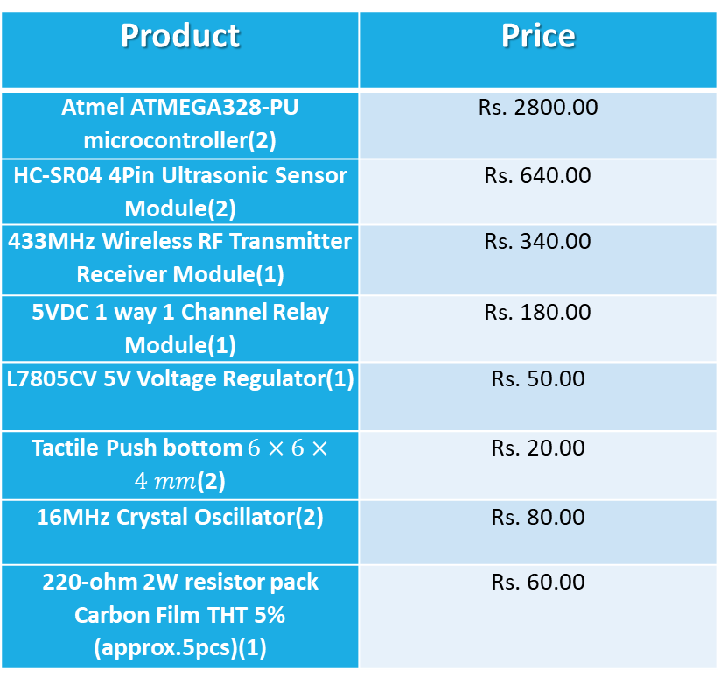
Bill of Quantities
Product | Price
Atmel ATMEGA328-PU microcontroller(2) | Rs. 2800.00
HC-SR04 4Pin Ultrasonic Sensor Module(2) | Rs. 640.00
433MHz Wireless RF Transmitter Receiver Module(1) | Rs. 340.00
5VDC 1 way 1 Channel Relay Module(1) | Rs. 180.00
L7805CV 5V Voltage Regulator(1) | Rs. 50.00
Tactile Push bottom $6×6×4 mm$(2) | Rs. 20.00
16MHz Crystal Oscillator(2) | Rs. 80.00
220-ohm 2W resistor pack Carbon Film THT 5% (approx.5pcs)(1) | Rs. 60.00
Product | Price
10k ½ W Resistor Pack Carbon Film THT 5% (Approx.20pcs) | Rs.60.00
22pF Ceramic Capacitor THT(4) | Rs. 20.00
10uF 16V Electrolytic Capacitor THT(3) | Rs. 30.00
1nF 16V Electrolytic Capacitor THT(2) | Rs. 10.00
2-way Mini JST 2.0 PH Connector Wire Micro bit(2) | Rs. 40.00
Hi-Link HLK-5M05 220VAC to 5VDC 5W Step-Down Power Supply Module(1) | Rs. 1350.00
28-pin Normal IC Base 2.5 mm (HE0021)(2) | Rs. 40.00
433MHz Helical Antenna(2) | Rs. 230.00
Total | Rs. 5945.00

Slide 14

Thank you!

