Slide 1
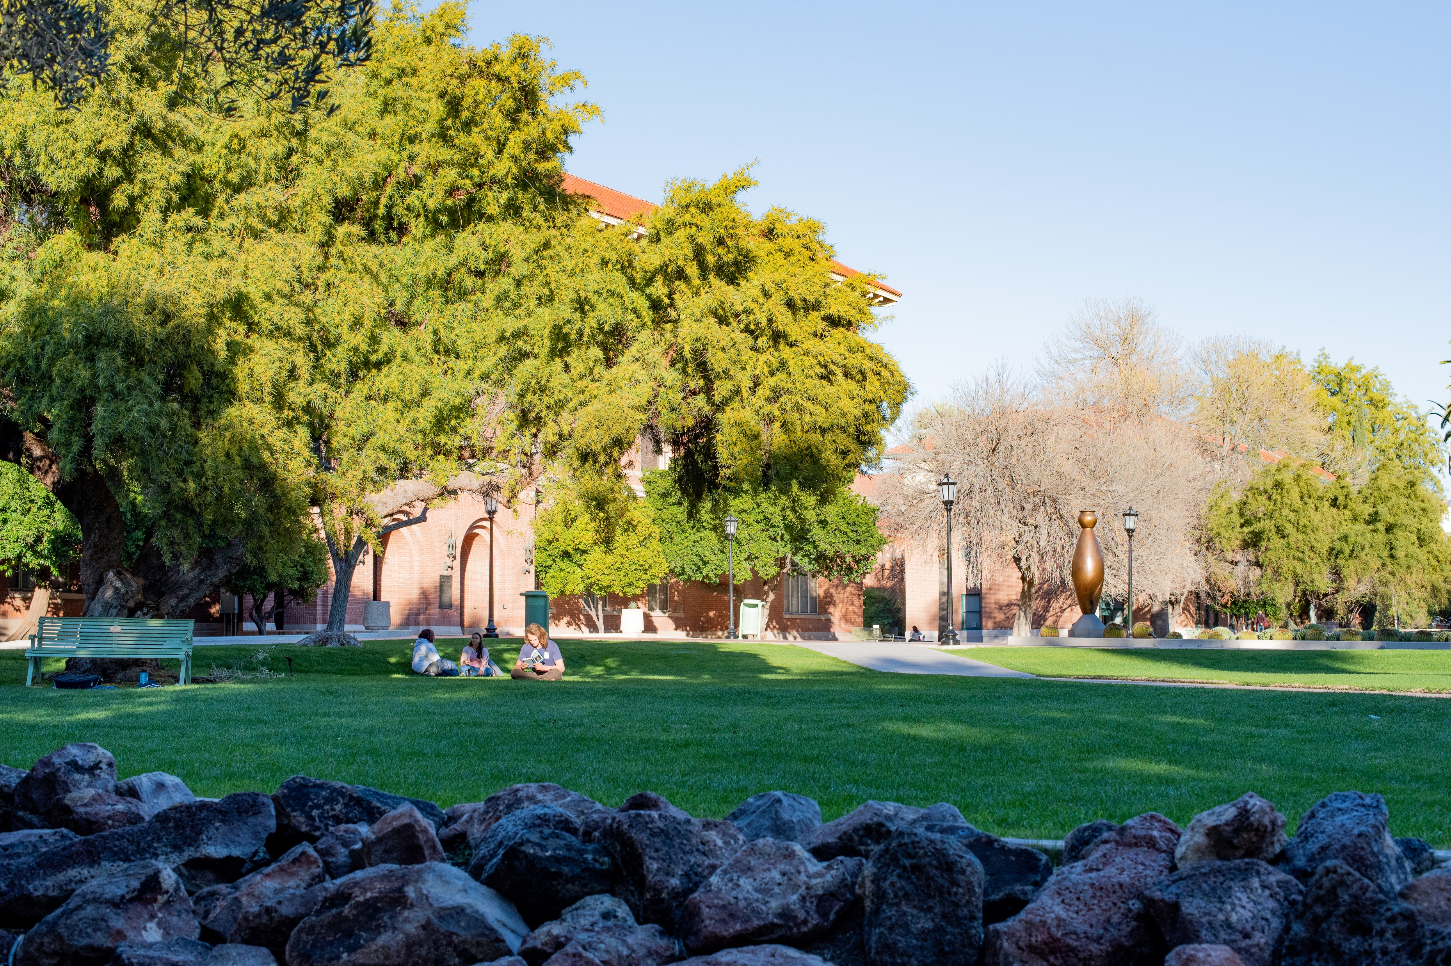

THE UNIVERSITY OF ARIZONA – College of Information
UA Nav Access: AI-Powered Accessible Campus Navigation

Slide 2
PURPOSE
Working together to enhance accessibility, foster independence, and create an inclusive environment through AI-driven campus navigation assistance.

Slide 3
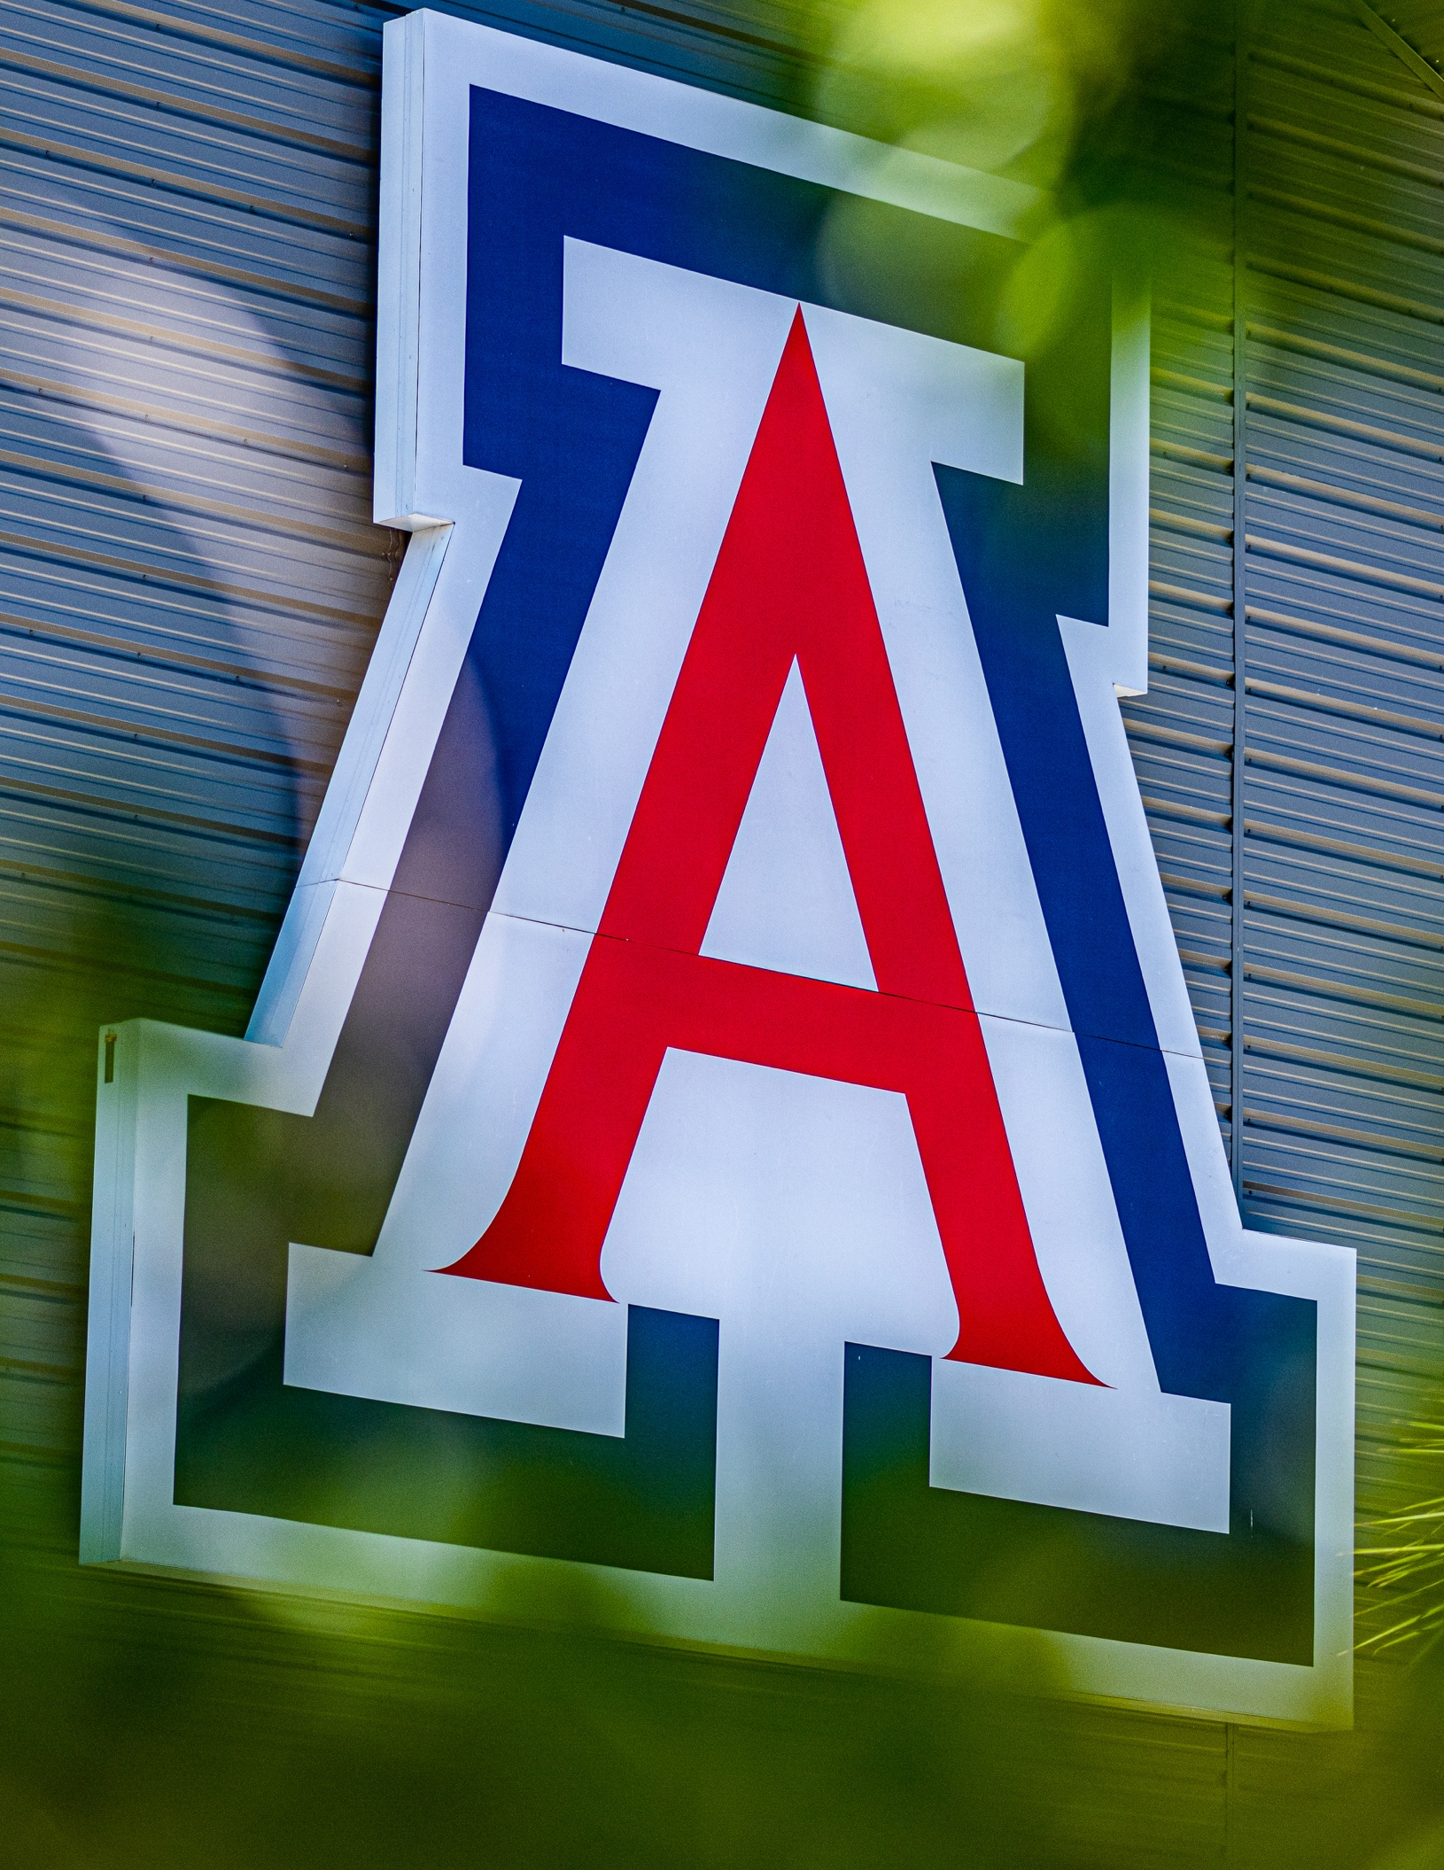
Mission
To enhance campus accessibility and safety by developing AI-powered tools that convert visual map data into accessible, non-visual navigation instructions, thereby empowering visually impaired individuals to navigate the University of Arizona campus independently.
The University of Arizona

Slide 4
Project Motivation
Traditional campus maps are visual and inaccessible to visually impaired people.
Existing tools lack context-aware, accessible navigation.
Goal: AI-powered, independent navigation with building identification, nearby places, and accessible routing.

Slide 5

📸 Upload Campus Map Screenshot
📍 Geolocation and Nearby Place Discovery
🚶‍♂️ Step-by-Step Route Directions
♿ Accessibility Feature Integration (Ramps & Elevators)
KEY FEATURES

Slide 6
Improves campus navigation accessibility.
Supports independent exploration for visually
impaired users.
Provides real-time, context-aware help using
AI and GIS technologies.
Unique fusion of OCR, LLMs, geospatial
APIs and PWA.
Easily extendable to other universities and
environments.
PROJECT IMPACT

Slide 7
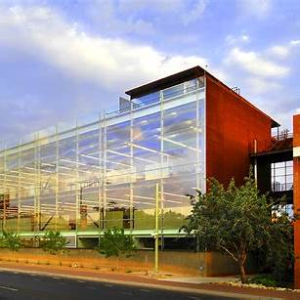
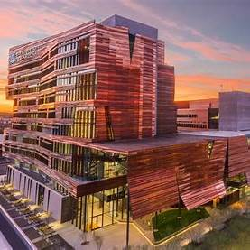
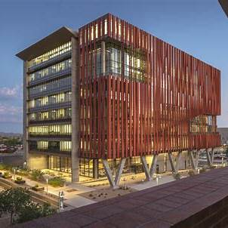
WORK FLOW
Upload Screenshot
Extract Building Information
Find Nearby Buildings
Generate Walking Directions
Include Accessibility Information

Slide 8

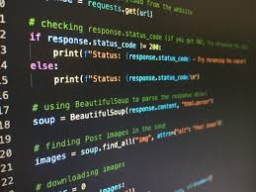
Frontend
HTML, CSS, JavaScript
Backend
FastAPI (Python)

Slide 9
AI Models
Tesseract OCR,
Llama-3 Vision-Language Model
Geospatial Tools
OpenStreetMap APIs OSRM Routing
Overpass API
Other technology

Slide 10
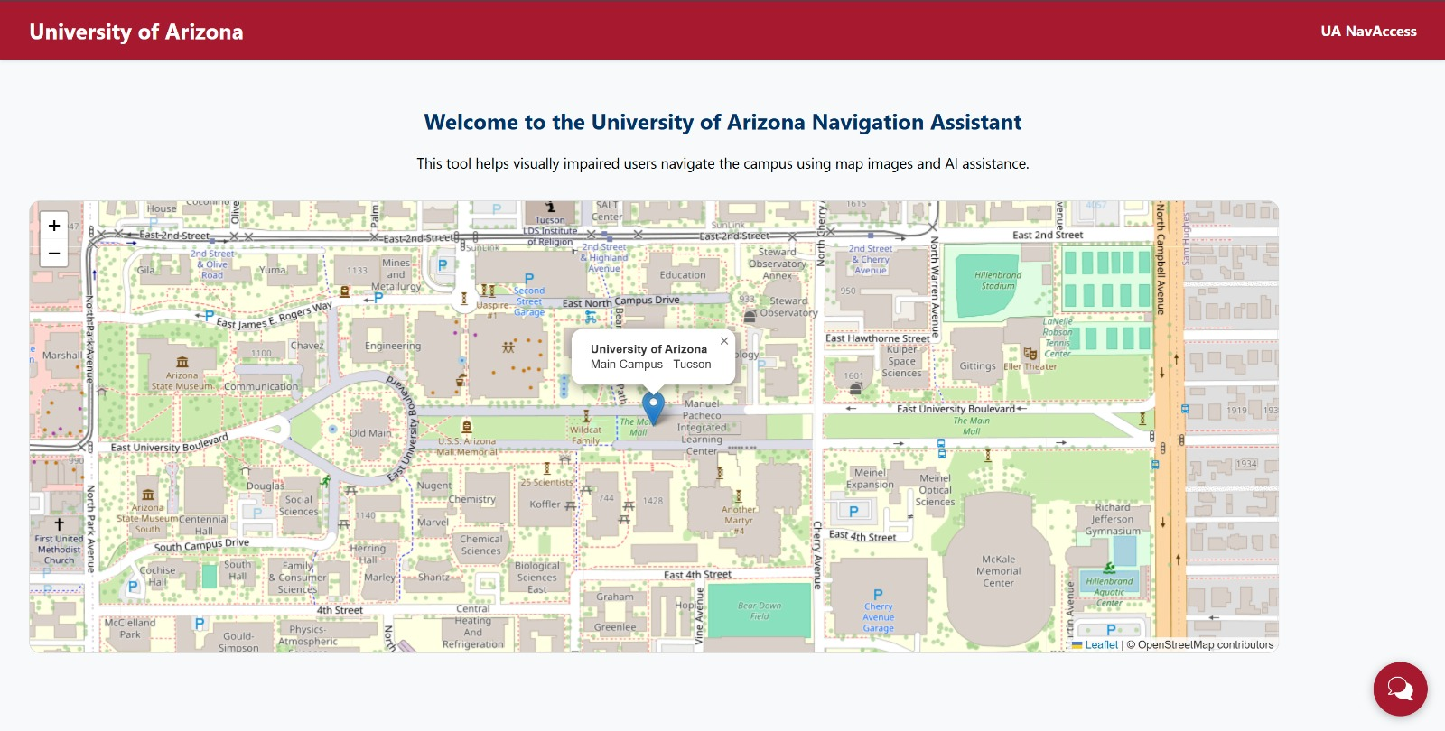
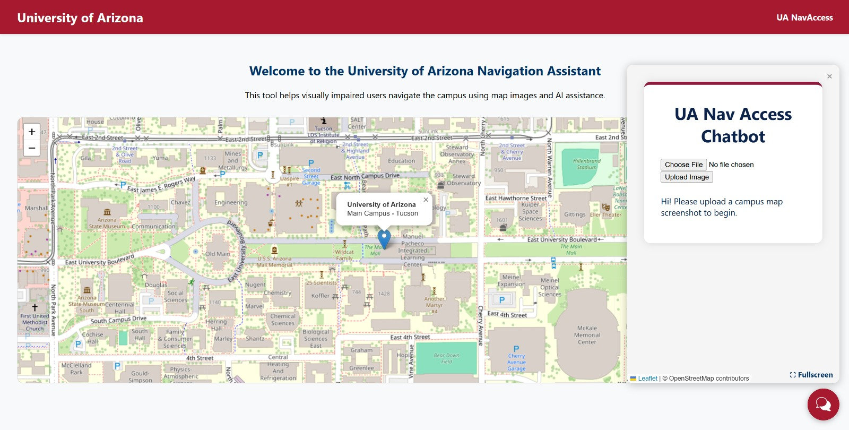
Home Page
Home Page with Chatbot

Slide 11
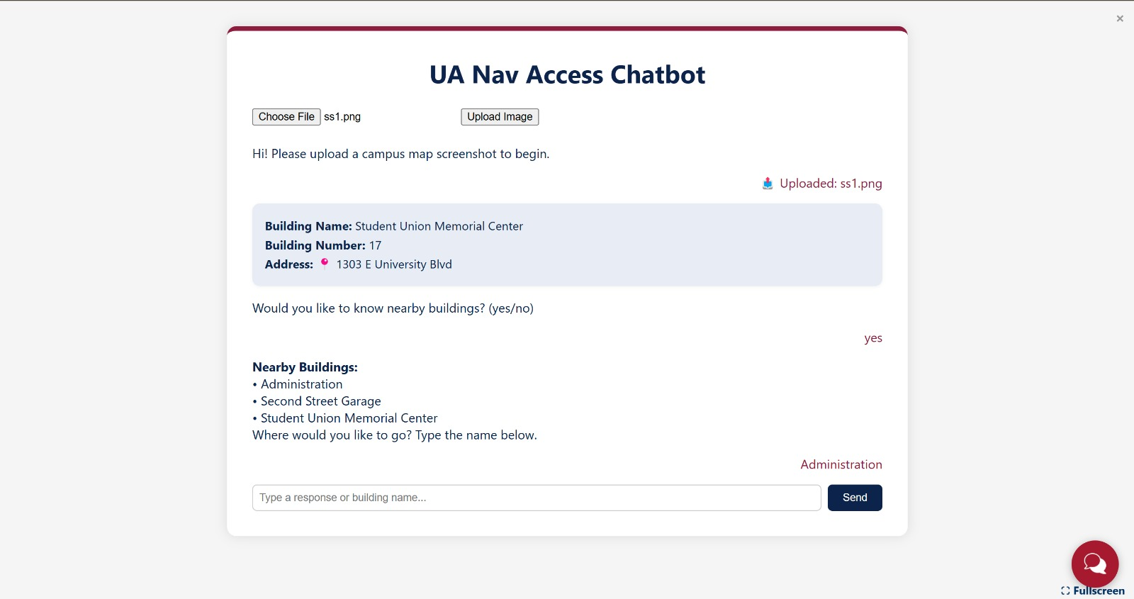
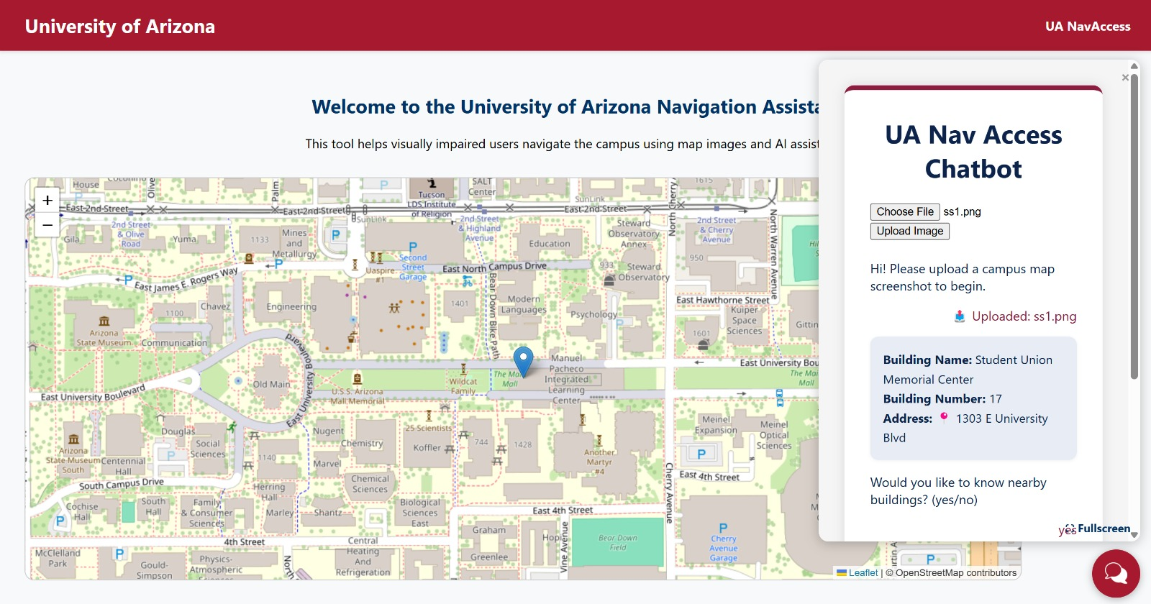
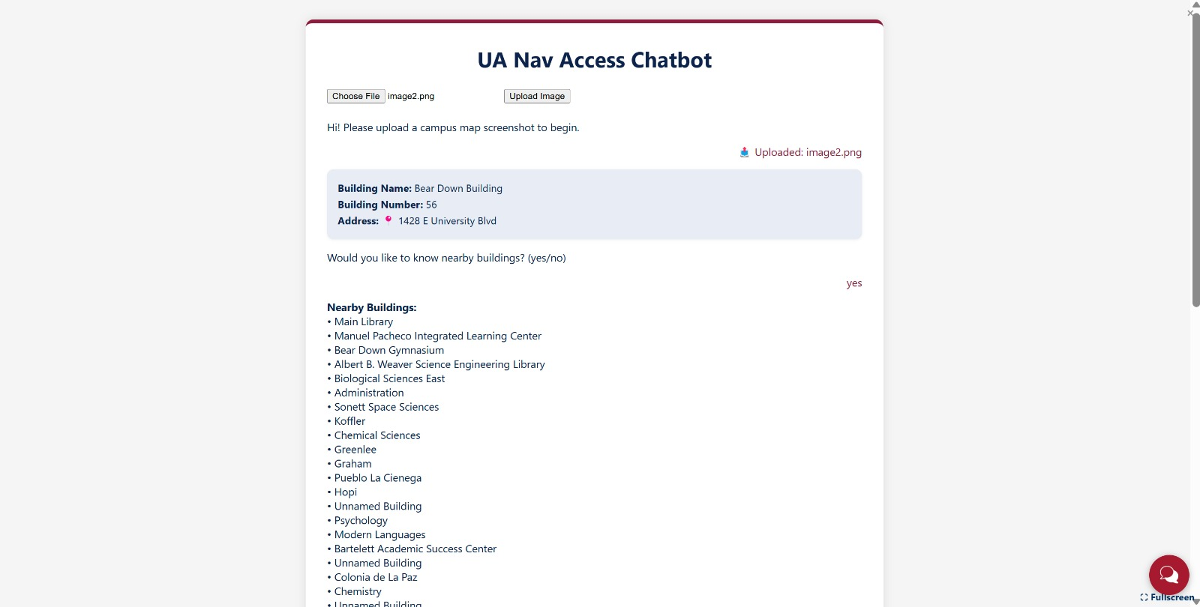
Chatbot [Full Screen mode]

Slide 12
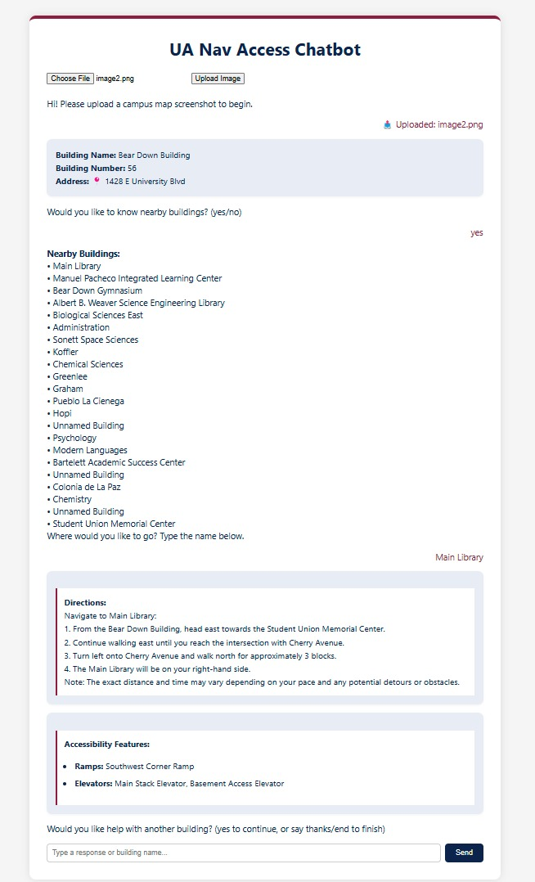
Final
Output

Slide 13
THANK YOU

