Slide 1
BASH AUTOMATION TEST SYSTEM

Slide 2
BATS
BAT is TAP-complaint testing framework for bash.
Simplest way to check if script written behaves as expected
BAT is a shell script with special syntax defining test cases.
Test case execute successfully , then it return 0 as exit status
Test case fails, then it return 1
Notes:
BAT is TAP complaint testing framework for bash
BAT is used to test the script written in shell and check if it behaves as required
BAT has special syntax which can be used for testing cases.
When a test case executes successfully, then return 0 as exit status. else, return1 if test case fails.

Slide 3
Syntax Of BATS
#!/usr/bin/env bats Specifies script needs to be executed by bats
@test “test_case_name” { test definition declared
space has to be provided
commands executed Execute LINUX commands/functions/loops
} Closing braces should be in new line
Stored in file ls_test.bat
Notes:
Here,
#!/usr/bin/env bats , this is used to specify that the script has to be executed by bat
@test is the command to specify that it is a test case
String in quotes “test_case_name” : test definition is declared.
A space between definition and curly braces is necessary
Command executed , inside the curly braces, the LINUX command is executed
The closing curly braces is always at the next line.

Slide 4
Example
#!/usr/bin/env bats Run in BAT environment
@test “test to list files” { Definition for test cases
command ls -l
}
Command is a keyword
to execute LINUX command
Notes:
In the above example mentioned:
Test case definition is “test to list file” : This test case is used to list file in a directory
Command ls –l is use to execute the command of Linux ls –l
command is the keyword used to execute the Linux command ls –l
Once the command execute successfully it return 0 , 0 is the success status.

Slide 5
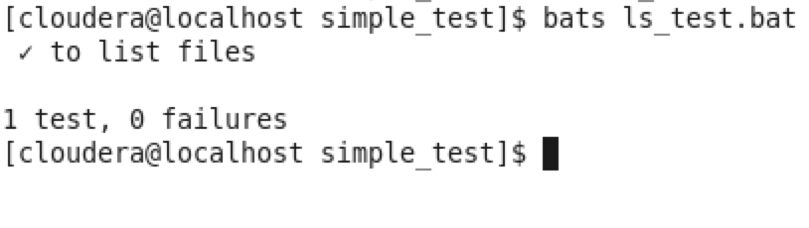
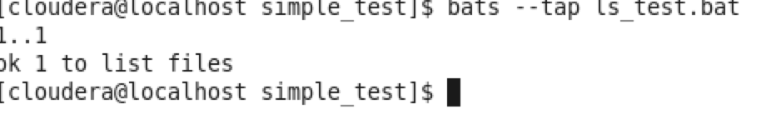
Running The Test Case
To run test case, we use bat command along with the path to test file
Example
bats ls_test.bat or bats -- tap ls_test.bat
Notes:
We execute the test case, by running with command bats along with path of the file.
The above screenshot is the output of running the ls_test.bat test case.
When the command is executed from terminal.
This first, gets the count of the number of test cases present in the bat file.
Then, each test case is executed sequentially.
Hence, twice we go through the file . Firstly to get te count of test cases present in the file. Secondly, to run the test case each sequentially
In the screen shot ,
A test case definition is mentioned once it is executed.
Preceding each definition we might find a tick or cross
Tick : test case executed successfully
Cross : test case failed
1 test , 0 failures : specifies, that there is one test case and there are no more failure.
Bats - -tap ls_test.bat : to execute the test case with bat.
1…1 => Specifies that there is only one test case.
Ok 1 to list files : OK specifies that test case executed successfully.
Not ok : specifies that test did not execute successfully

Slide 6
Test Suite
Invoke bats interpreter with multiple test arguments or with path to a directory containing multiple .bats files.
Bats will run each test file individually and aggregate the results
If test case fails, bats exits with a 1 status code.

Slide 7
run ,lines ,output and status
run is Helper that invokes its argument as a command.
Saves the exit status in status variable
Output of it is stored in output global variable.It also has the standard error message.
Using this we can continue to make assertion in your test cases.
lines is an array it is used for easily accessing indivual line of output.
Notes:
Run is used to execute the LINUX command Similar to command keyword. Run executes the argument, passed to it
The exit status of command is stored in the status variable.
The combined output of the run command and the standard error is stored in the global variable output.
lines is an array which is used to easily access the individual line of output.

Slide 8
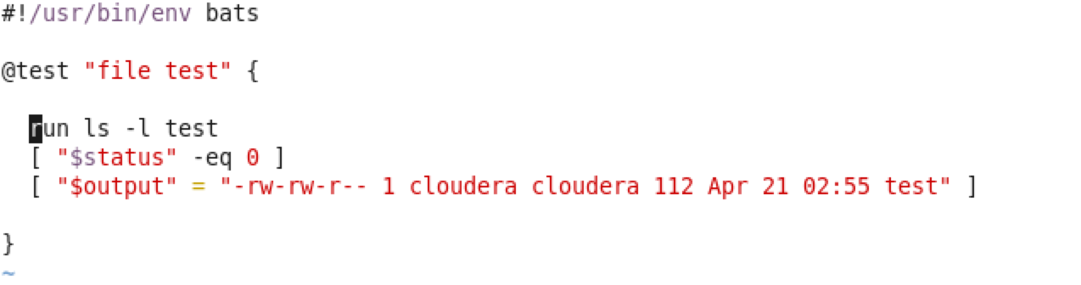
Example
List file for test file
Check is exit status of run is 0
The output of the command is checked.
The [ ] are used to test.
We can also use test command to test
Notes:
The above code snippet of the example
Run ls –l test is executed to check the listing of the test file
The status of the command is stored in status variable
Output of the command is compared
[ ] is used to verify the test case.

Slide 9
load: Share common code
Share common code across multiple test files.
Bats include convenient load command for sourcing Bash source.
Notes:
load command shares common code among multiple files
Load command sources a bash source file to the location of the current test file.
Useful for sharing function to set up environment or load fixtures.

Slide 10
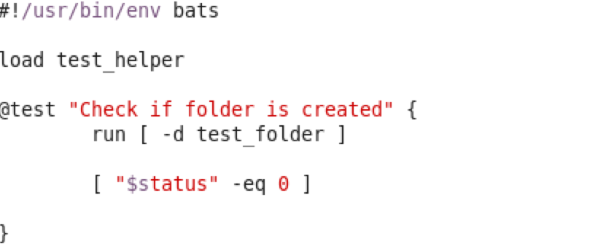
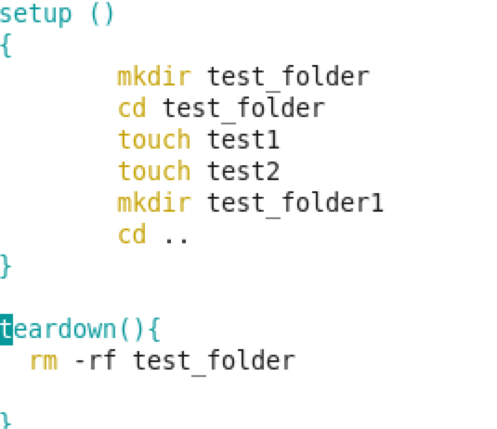
Example
Loads a file test_helper
To check if test_folder is directory
To test exit status of of previous
command.
Test_helper.bash file
Notes:
In the above example,
We have a test_helper.bash file which contains all the commonly used functions in it.
This loaded into the test class, and the function from this class can be called easily. Hence this helps in reducing duplication of code.

Slide 11
skip : Easily Skip tests
If we want to skip a test case this can be done by using the keyword skip
The key skip can be passed a reason why we need to skip the command
We can skip the test only conditionally.

Slide 12
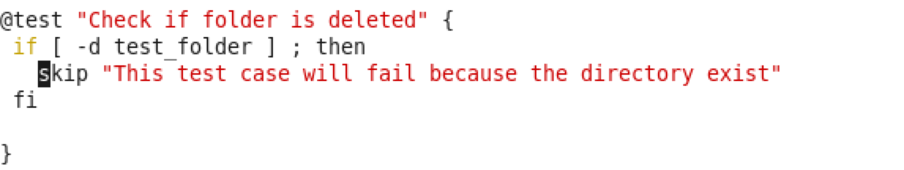
Example
Output
Notes:
In the above Example,
We skip Test case, only if the directory does not exist
In the test case , we will check if directory exist, if it is true, we will skip the test case.
In the output, we get - which specifies that test case is skipped.
In the Braces, it provides reason why the test case is skipped.

Slide 13
Setup and teardown: Pre and Post Test hooks
Special function are setup and teardown
Setup run before running any test case
Teardown run after each test case
Setup can be used to setup your environment
Teardown can be used to clean up

Slide 14
Example
test_helper.bash
Notes:
In the above example, we can observe
The test_helper.bash contains all the code that are common to test cases.
In this file we have written setup and teardown function.
As specified in the previous slide, setup is used to setup the environment to execute the command
Teardown is used to do clean up after the test case is executed.
Set up and teardown are executed before and after every test case respectively.
In this example we are testing if the directory is created , that is, check if it exist or not.
Hence, in the setup we are going to create a folder called test_folder and inside that folder we create test1,test2 files and another folder called test_folder1 is created
Once this is created, test case, Check if folder is created is executed. If this test case executes successfully. Then the tear down function in the test_helper class is executed.
In teardown function we are basically cleaning up the environment created. That is, we are going to remove the folder.

Slide 15
Key Points
To run test cases, bat package has to be installed.
All the Test cases needs to be stored in .bat file
All test cases should begin with @test
Setup and teardown is always executed at the beginning and at the end of each test cases respectively.
Setup : sets up environment
Teardown : cleans up after testing

Slide 16
The common function are stored in .bash file
Any echo, printf statements in the test cases are not printed on the Standard output unless until the test case fails. Instead we can echo values of global variable to an temporary file (Check Example)
Test case cannot be read from Standard input

Slide 17
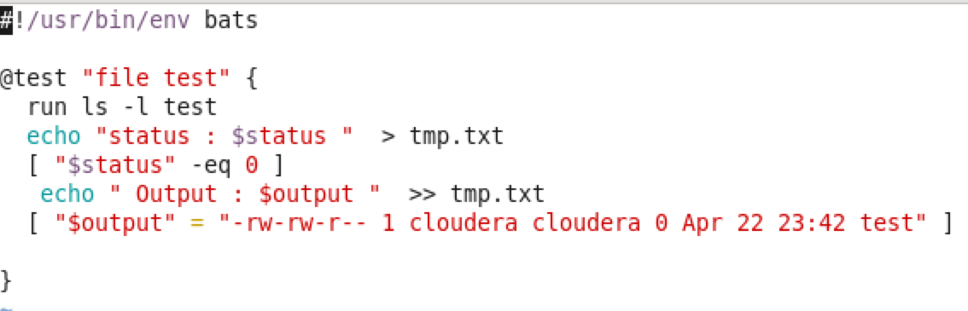
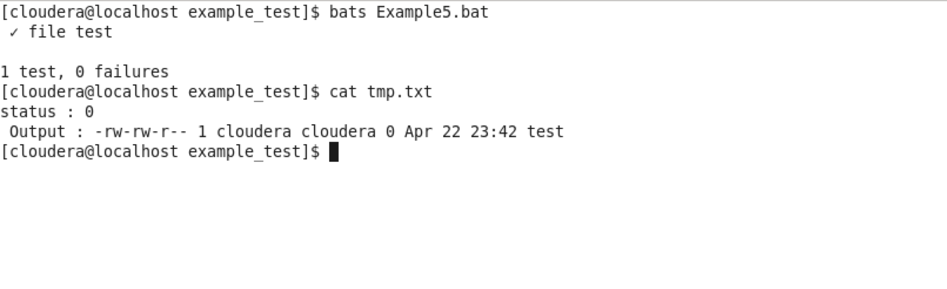
Example : echo output to file
Output

Slide 18
Links
https://github.com/sstephenson/bats
https://blog.engineyard.com/2014/bats-test-command-line-tools

