Slide 1
RUBY ASSIGNMENT
Sahana Jayaprakash
034427

Slide 2
RUBY ASSIGNMENT
Ruby CGI is used for server side scripting i.e. for the user interface through the browser.
MySQL database is used for storing the report details of the chart search.
Report is stored in MYSQL depending on the year chosen.
‘gruff’ graphical library for ruby is used to generate a graph.

Slide 3
RUBY ASSIGNMENT
Code to read a csv file and store the contents in the database
csv = File.open("report.csv","r")
if(csv) #if the file exists
csv.each_line do |line|
fields = line.split(',')
con.query("INSERT INTO REPORTS(CLIENT_NAME, RAW, RAW_INPROCESS, RAW_COMPLETED, PROCESSED, PROCESSED_UPLOADING, PROCESSED_COMPLETED) VALUES('#{fields[0]}', '#{fields[1]}', '#{fields[2]}', '#{fields[3]}', '#{fields[4]}', '#{fields[5]}', '#{fields[6]}')")
end
end
The above piece of code parses a csv file “report.csv” and stores its contents into the table called “REPORTS”.

Slide 4
RUBY ASSIGNMENT
Code to retrieve the contents from the database and draw the graph
require ‘gruff’
g = Gruff::Pie.new
g.title = "Visual Pie Graph Test"
result = con.query("SELECT * FROM REPORTS WHERE CLIENT_NAME = '#{value}'")
result.each_hash do |h|
h.each do |key, val|
if( key== “RAW”||key==“RAW_INPROCESS”||key == "RAW_COMPLETED" ||key==“PROCESSED_UPLOADING”|| key == "PROCESSED_COMPLETED")
g.data("#{key}", Integer(val))
puts key, val
end
end
g.write("graph_analysis.png")
end
The above piece of code retrieves the record of the client (selected by the user through the browser) from the database. A Bar chart is created for that client’s data.

Slide 5
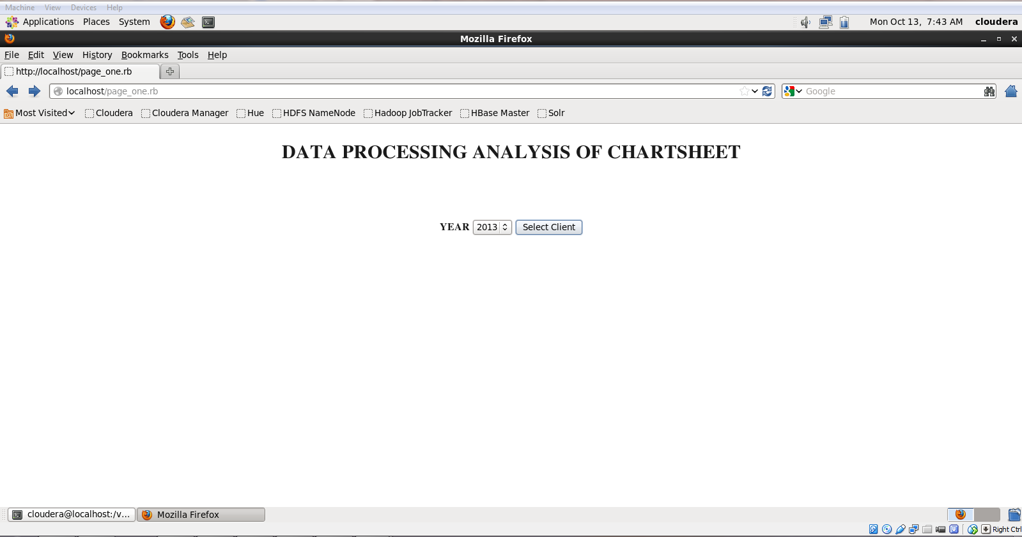
RUBY ASSIGNMENT

Slide 6
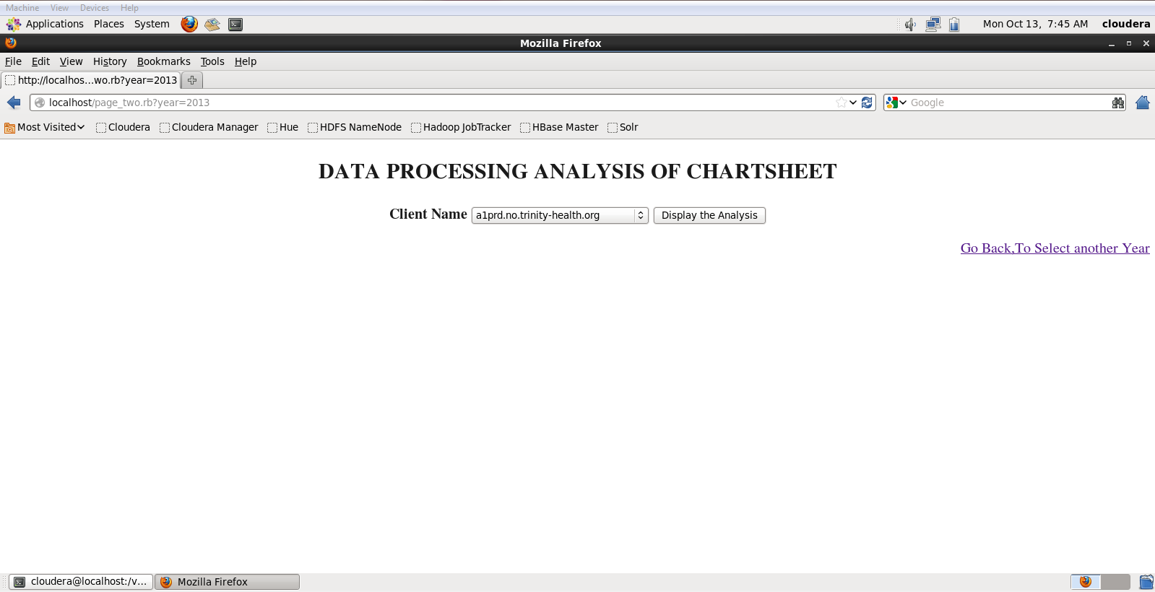
RUBY ASSIGNMENT

Slide 7
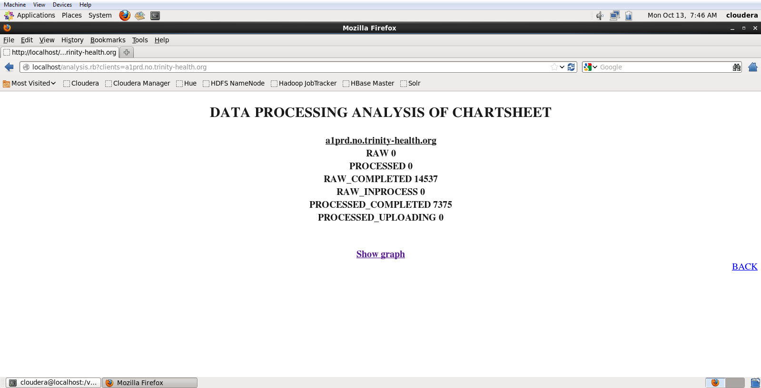
RUBY ASSIGNMENT

Slide 8
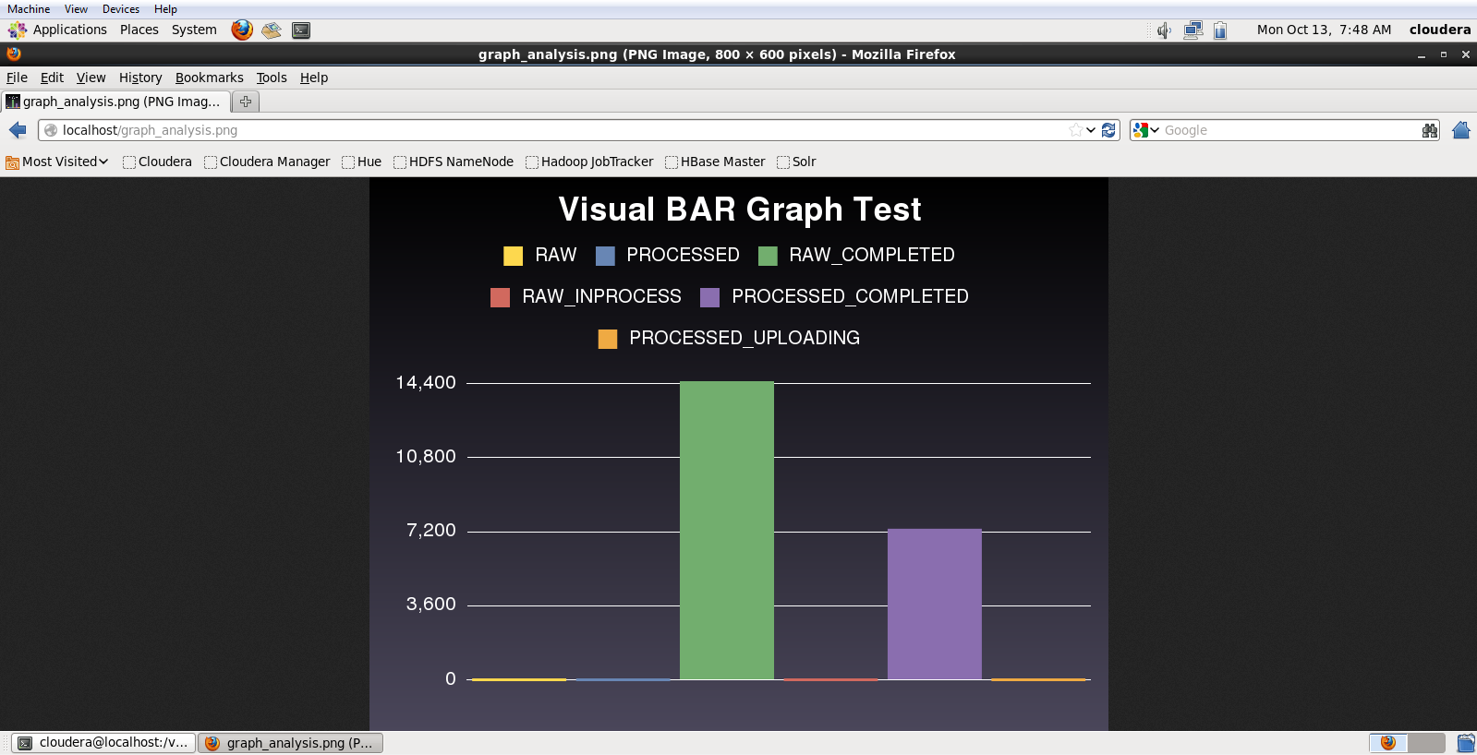
RUBY ASSIGNMENT

Slide 9

RUBY ASSIGNMENT

