Slide 1
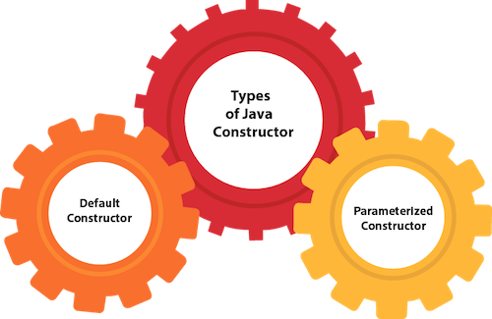
Constructor
Class
Object
constructor

Slide 2
Class & Object
Before going to learn about Constructor ,we need to discuss about
Object and class.
Object: An entity that has state and behavior is known as an object e.g., chair, bike, etc ..
State: represents the data (value) of an object.
Behavior: represents the behavior (functionality) of an object such as deposit, withdraw, etc.
Identity: An object identity is typically implemented via a unique ID. The value of the ID is not visible to the external user.
every time an object is created using the new () keyword
Syntax: Bike b1=new Bike();

Slide 3
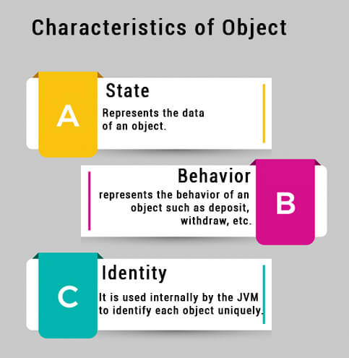
Characteristics of Object

Slide 4
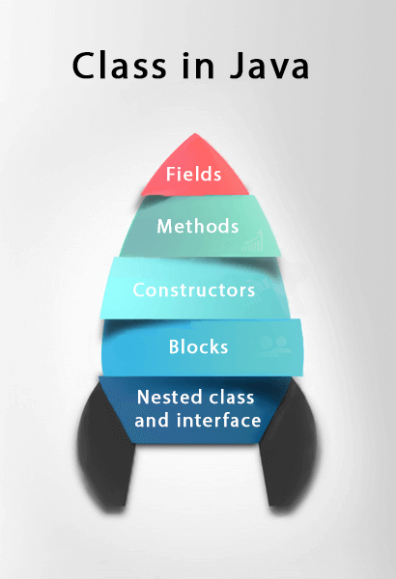
Class
Class: A class is blueprint of an object.
Java class contain fields ,methods, constructor, blocks, and interface.
A class is defined in java by creating class
as Class name.
Ex Class Student{
public int Stud_id;
public String Stud_name;
public Student(){}
Void display(){}
}

Slide 5
Constructor
Constructor is used to create object for class.
There are two rules defined for the constructor.
Constructor name must be the same as its class name
A Constructor must have no explicit return type
A Java constructor cannot be abstract, static, final, and synchronized
Constructor are similar to the methods except for two things, its name is same as class name but no return type.
Two types of constructors in java:
1.Default Constructor
2.Parameterized constructor

Slide 6
