Slide 1
Parking Lot Management System
Capgemini Cloud Programming Assignment
Sahana Hemraj
GitHub Repo Link

Slide 2
Approach & Design
Design Goals
Simple, modular, and extensible architecture
Follow separation of concerns (CLI, Core Logic, Models)
Easy to test and understand
Minimal dependencies, pure Python
High-Level Architecture
CLI Layer (parking_lot.py) - Handles user commands, input validation, and displays output.
Core Logic (parking_lot_core.py)
Slot creation using 40/40/remaining distribution
First-fit allocation algorithm
Park, Leave, Status, Find, Save, Load
Models (Slot, Vehicle)
Simple dataclasses for clear representation
Allocation Strategy
Uses First-Fit allocation
Mapping:
SMALL → Small/Large/Oversize
LARGE → Large/Oversize
OVERSIZE → Oversize only

Slide 3
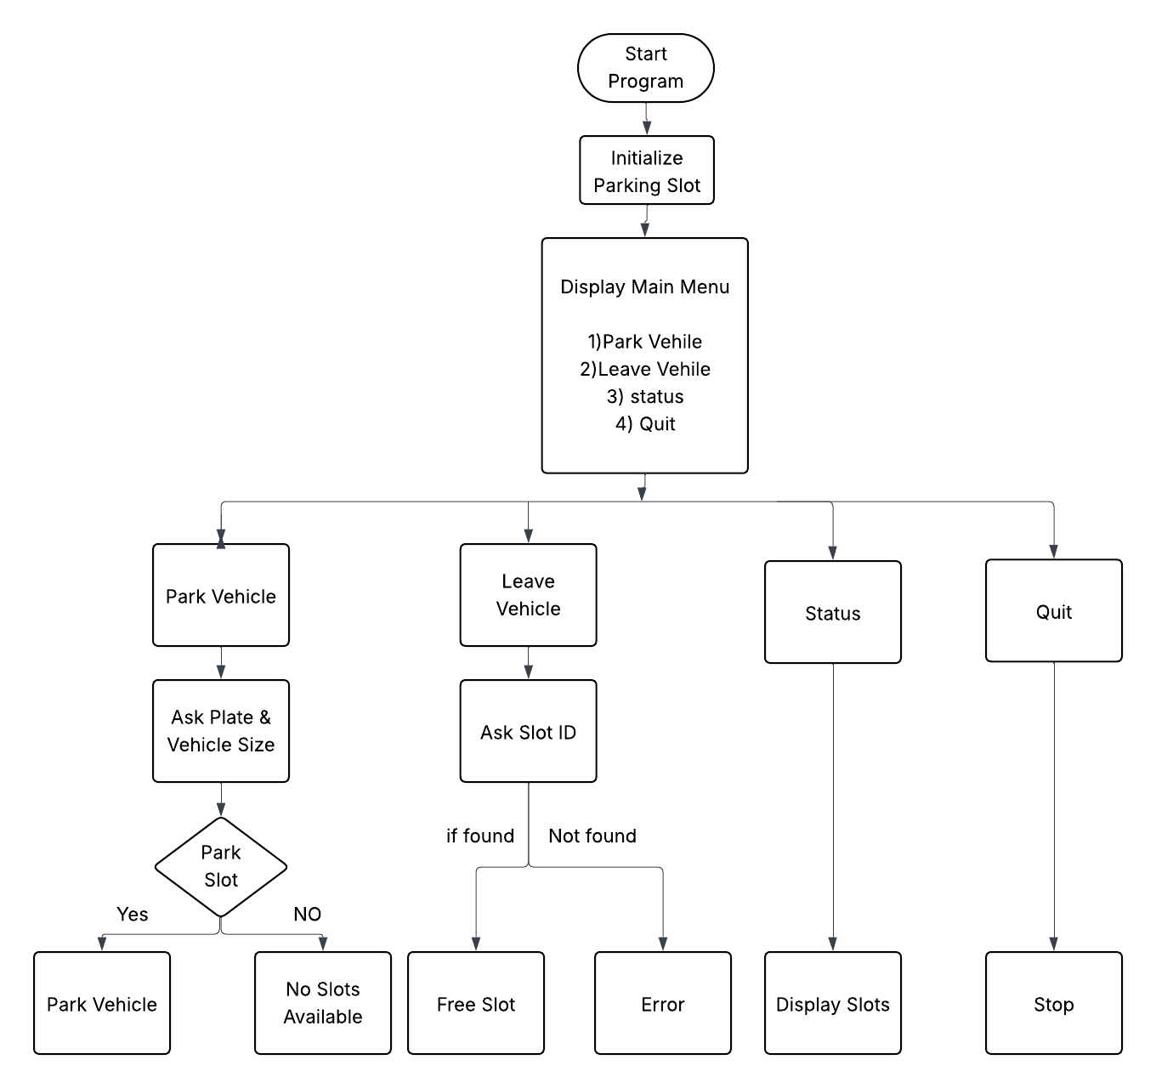
Flow Diagram

Slide 4
Key Files and Folders
parking_lot/
│
├── parking_lot.py # CLI entry point
│
├── models/
│ ├── parking_lot_core.py # Core business logic
│ ├── slot.py # Slot model
│ └── vehicle.py # Vehicle model
│
│
└── README.md # Documentation, instructions

Slide 5
Process to Run, Test, and Verify
1. Run the Application
python3 parking_lot.py
2. Available Commands
park <plate> <size>
leave <slot_id>
Status
3. Verification
Parking assigns correct first-fit slot
Leaving frees the slot
Status displays all slots + occupancy
Find returns correct slot

Slide 6
Test Data & Seed Data
Seed Data And Test Data
Example initial run:
Enter total number of parking slots: 10
SMALL: 4
LARGE: 4
OVERSIZE: 2
Test Cases Executed : Parking
park ABC123 small → slot 1
park LRG001 large → slot 5
park TRK999 oversize → slot 9
Duplicates
park ABC123 small → duplicate warning
Finding & Leaving
find ABC123 → slot 1
leave 1 → Slot 1 freed
leave 1 → already free

Slide 7
Thank You
GitHub Repo: https://github.com/SahanaHemraj/Vechile-parking-system
Email : sahanasahanah812@gmail.com

