Slide 1

Capstone Project

Slide 2



Personal BACKGROUND
(Name, Past Experience, Qualification, Career Summary)
Name :Sahana Hosamani
Past Experience :React,springboot,LLM,Mangodb,FastAPI
Qualification :B.Tech in Computer Science Engineering (CSE)
Career Summary :hands-on training in React, Spring Boot, FastAPI, LLMs, RAG, MongoDB, Selenium, JMeter, Jira, Jenkins, and Mobile Testing. Skilled in both front-end and back-end development, as well as automated and performance testing.
www.collaberadigital.com

Slide 3


Key Takeaways/Learnings from the Program (HTD)
Hands-on experience with Selenium (Java & Python), Appium, Postman, Git, Jira, and CI/CD tools like Jenkins
Build automation frameworks using Page Object Model, TestNG
Handling Alerts,iframe,cantrollers
Mobile test automation fundamentals with Appium
Performance testing using Jmeter

Slide 4

Problem Statement of the Capstone Project
The Capstone Project aimed to automate a real-world ecommerce-lambda Application focusing on functionalities like Login with invalid and valid credentials, Menupage, and Searchpage. The challenge was to build a scalable, maintainable, and fully functional test automation framework using Selenium, Java, TestNG, and Maven.API testing using Postman and Newman CLI to test GET and POST method and also performed the performance testing on same api using Jmeter

Slide 5
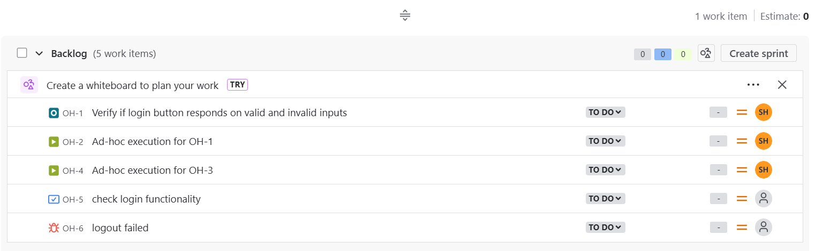
Jira
Url:https:https://learningsample.atlassian.net/
Backlog

Slide 6
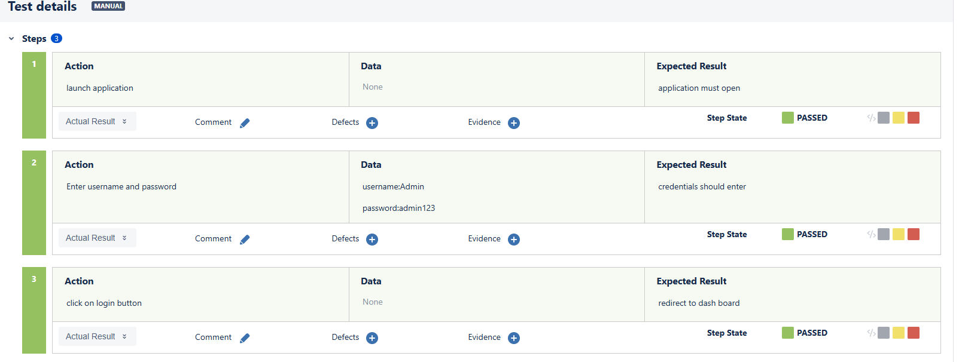
Important areas of the Project with screenshots
Test case execution using X-ray

Slide 7
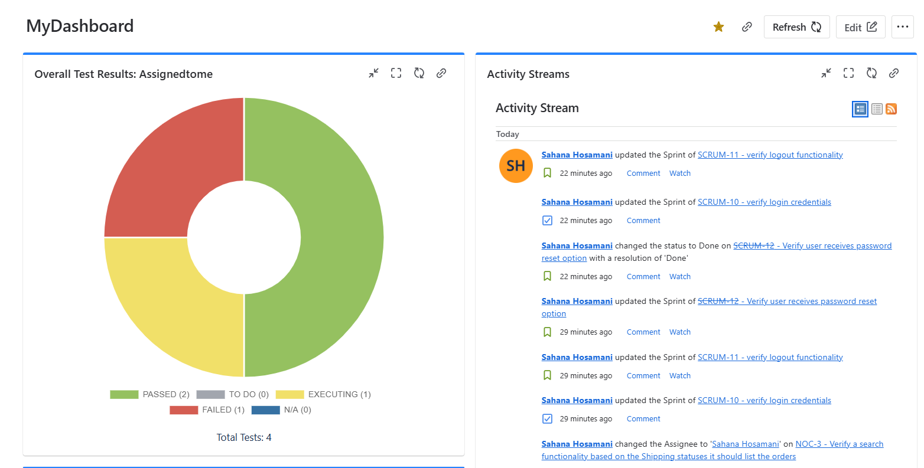
Important areas of the Project with screenshots
Dashboard

Slide 8
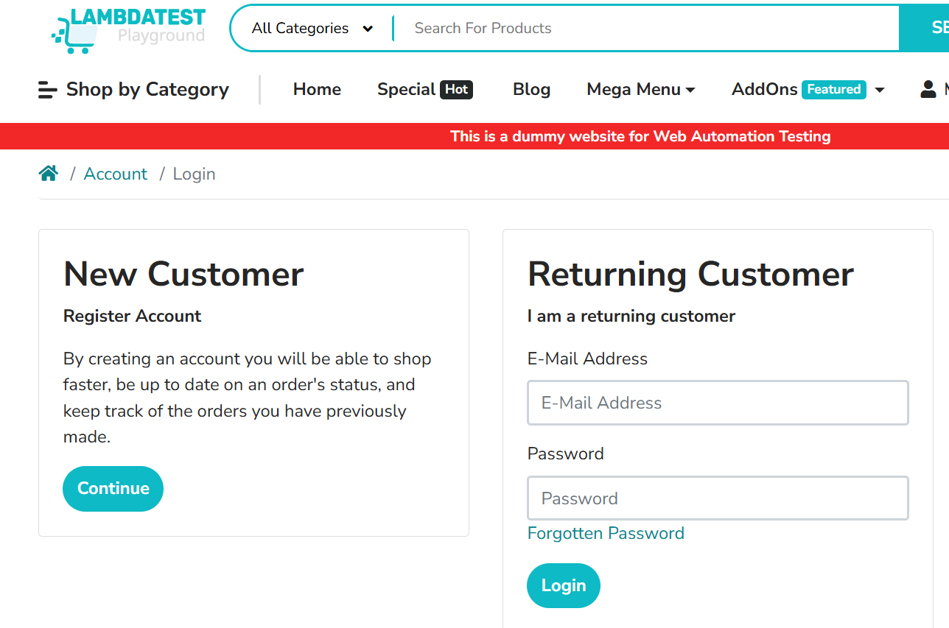
Selenium WEB UI testing
Application url:https://ecommerce-playground.lambdatest.io/index.php?route=account/login
Git url:-CAPSTONE_COGNIXIA_SELENIUM_API/com.capstone at main · SahanaHosamani16/-CAPSTONE_COGNIXIA_SELENIUM_API
TestCase1:Verify Invalid Credentials
TestCase2:Verify Valid Credentials and logout
TestCase3:Verify Menupage to select the specified product
TestCase4:Verify Search

Slide 9
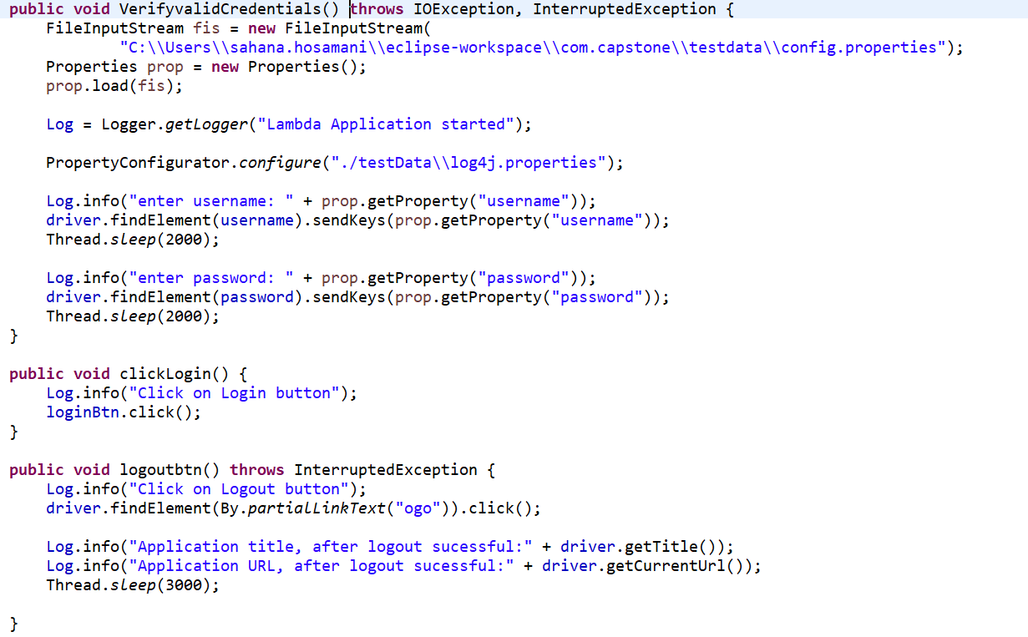
Important Areas of the Project
The VerifyvalidCredentials method reads username and password from a properties file, logs the actions, and enters the credentials into the login
The clickLogin method logs and clicks the login button to submit the form.
The logoutbtn method logs out by clicking a logout link, then logs the page title and URL after logout

Slide 10
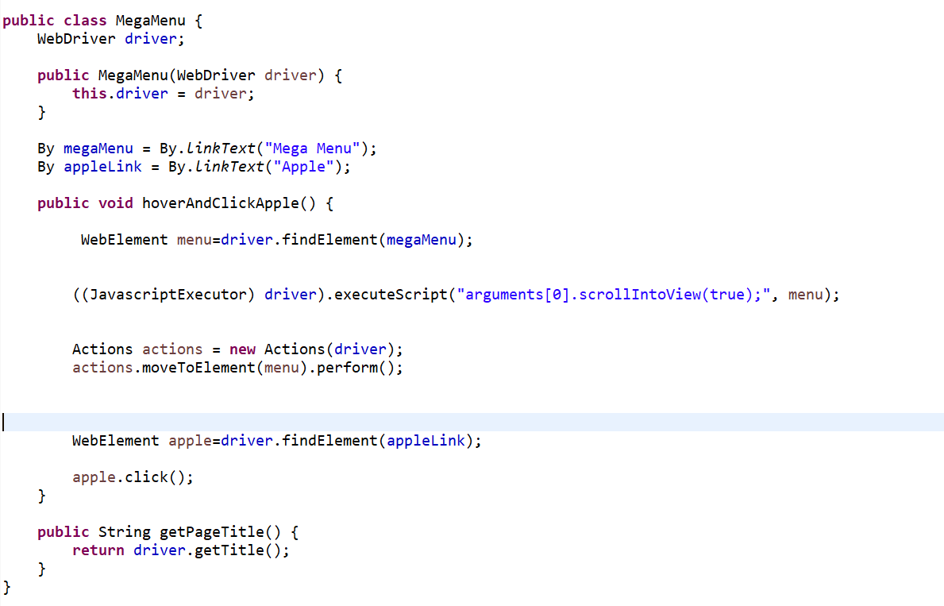
Important Areas of the Project
Scrolls the webpage to bring the mega menu element into view using JavaScript.
Uses Actions class to hover over the mega menu to reveal the submenu.
Finds and clicks the Apple link within the submenu.

Slide 11
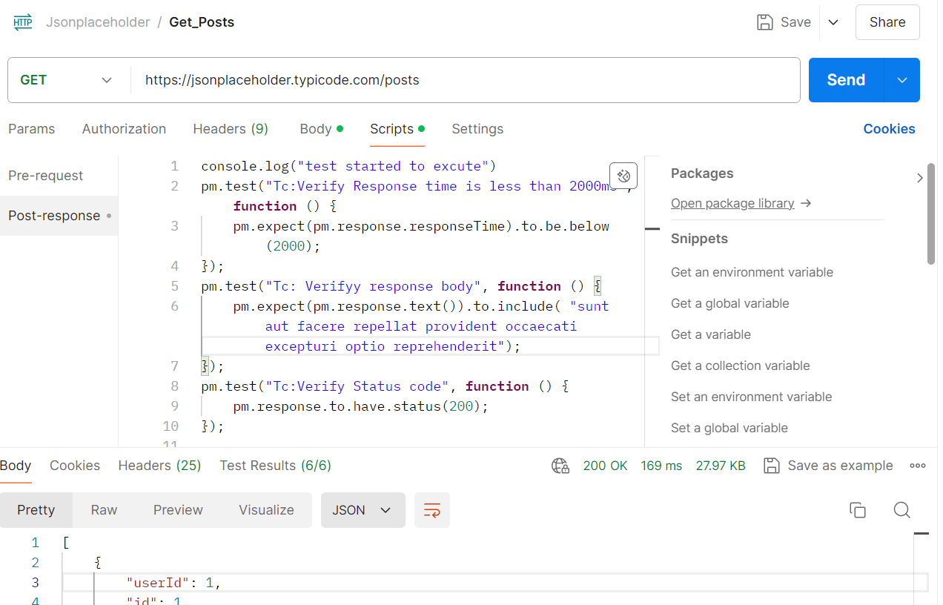
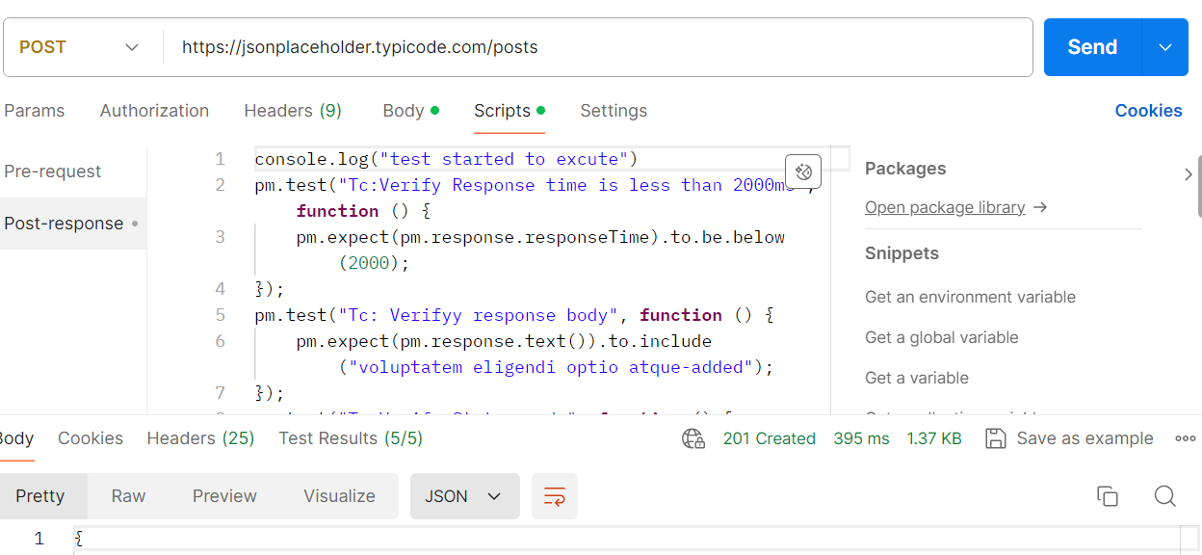
API Testing using Postman and Newman CLI
sampleApi:https://jsonplaceholder.typicode.com/

Slide 12
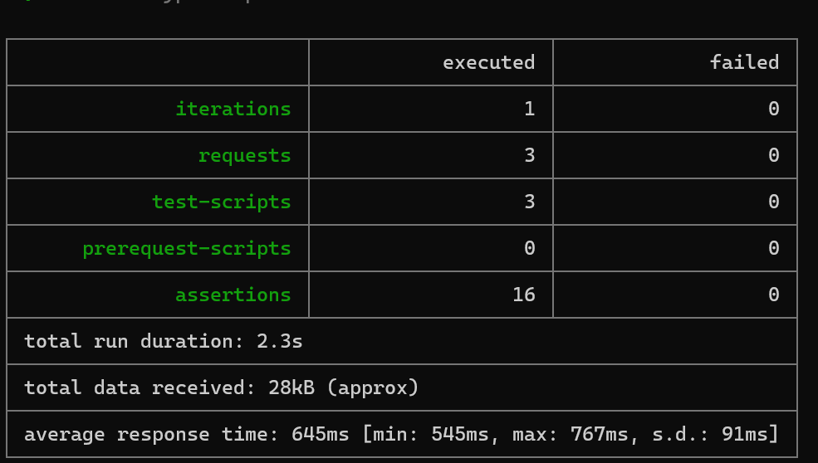
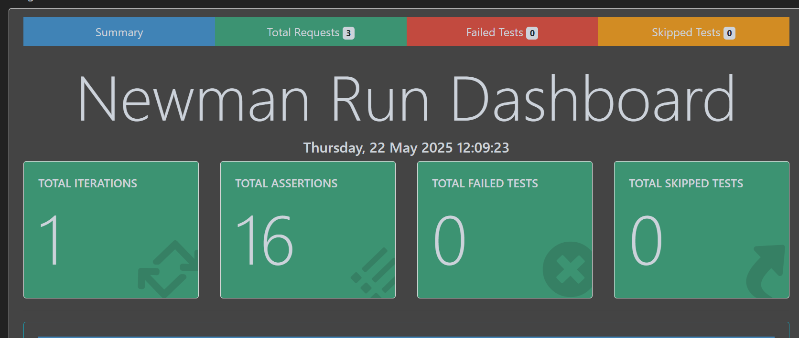
API Testing using Postman and Newman CLI
/

Slide 13
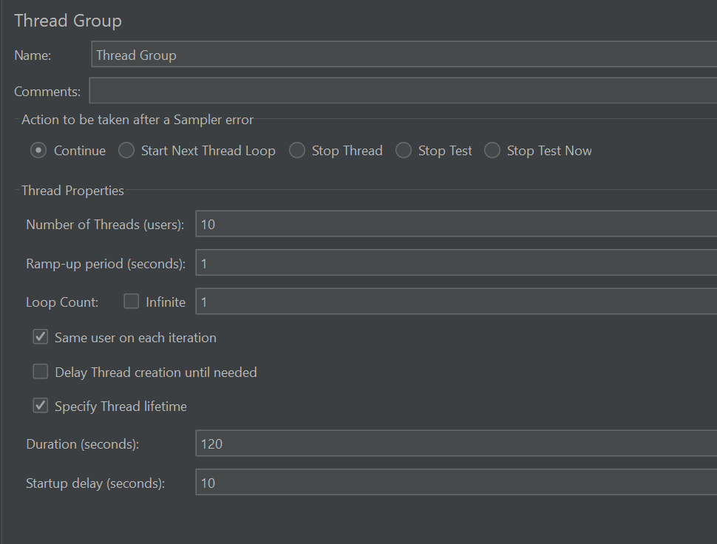
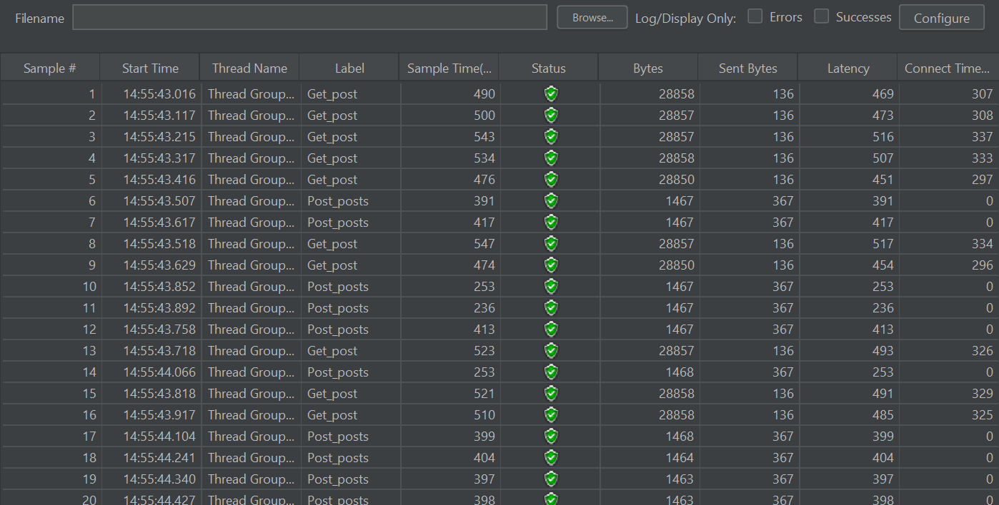
Jmeter
/

Slide 14
Conclusion
Gained strong foundations in manual, automation, mobile, API, performance, and security testing using tools like Selenium, JMeter, Postman, and Appium.
Acquired practical skills in CI/CD workflows, Jenkins, Git, and Jira
Developed and executed automation frameworks using Java, Python, and Selenium with real-time test scenarios.

Slide 15
Thank You

