Slide 1
The Climate Change Twitter Data
GROUP 5 - BUGS
Project by-
Sahana Mudduluru (sxm210164)
Rakshitha Peddi Sai (rxp210049)
Lohith Krishna Koneru (lxk210017 )
Rosheth Vijayalakshmi Manickavasalu (rxv210017)

Slide 2
CONTENTS
Introduction
Columns in the data
Visualizations without Imputation:
Box plots
Line Plots
Scatter Plots
Pie Charts
Heat Maps
Bar Charts
Histograms
Visualizations with Imputation:
Bar Charts
Histograms
Conclusion

Slide 3
Introduction
Dataset referred from Kaggle. Has 14999 rows and 10 columns.
Missing values - 18.9%
Date regarding the climate change and human opinions via Twitter.
Also provides the temperature deviation in Celsius and relative to the January 1951-December 1980 average at the time.

Slide 4
Columns in the data
Created Time: The timestamp of the tweet.
Twitter Unique_ID: The unique id of the tweet.
Longitude: The longitude the tweet was written.
Latitude: The latitude the tweet was written.
Topic: Categorization of the tweet in one of ten topics namely, seriousness of gas emissions, importance of human intervention, global stance, significance of pollution awareness events, weather extremes, impact of resource overconsumption, Donald Trump versus science, ideological positions on global warming, politics, and undefined.
Sentiment: A score on a continuous scale. This scale ranges from -1 to 1 with values closer to 1 being translated to positive sentiment, values closer to -1 representing a negative sentiment while values close to 0 depicting no sentiment or being neutral.
Stance: That is if the tweet supports the belief of man-made climate change (believer), if the tweet does not believe in man-made climate change (denier), and if the tweet neither supports nor refuses the belief of man-made climate change (neutral).
Gender: Whether the user that made the tweet is male, female, or undefined.
Temperature_Average: The temperature deviation in Celsius and relative to the January 1951-December 1980 average at the time and place the tweet was written.
Aggressiveness: That is if the tweet contains aggressive language or not.

Slide 5
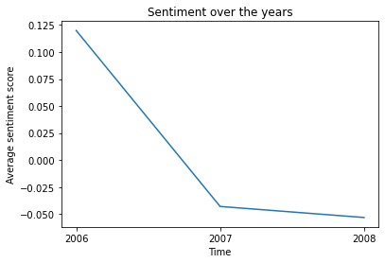
Visualizations without Imputation:
LINE PLOT
The line graph has been plotted for the dates of the tweets and the average sentiment values. Initially, in the year 2006, the average sentiment of the tweets were positive.
Later, as the time goes on, in 2007, and 2008 the tweets were tending to neutral and then drastically tended to negative.

Slide 6
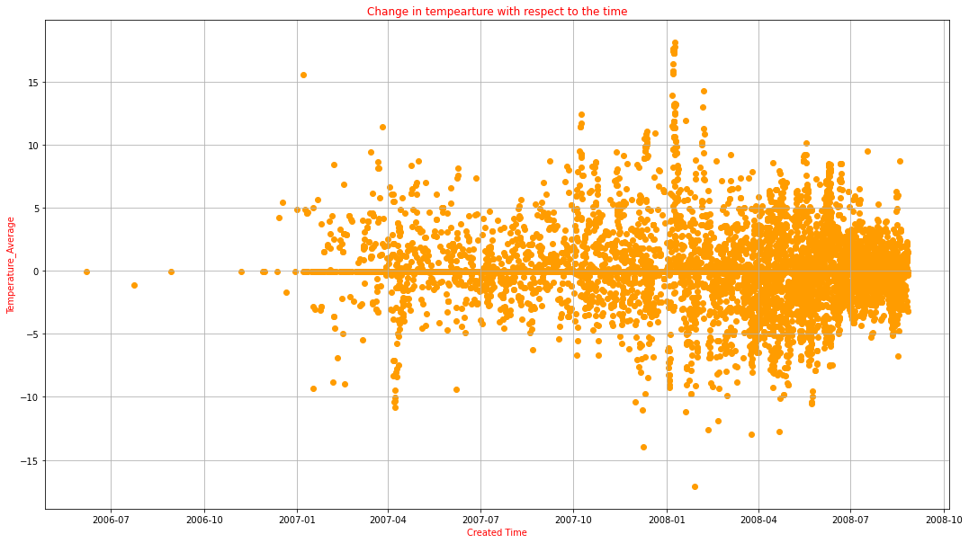
SCATTER PLOT
From the above scatter plot, we can infer that - the cluster is in between -5 to 5 which means there is an increase and decrease of temperature of -5 to 5 in years 2007-07 to 2008-10 compared to the temperature average during Jan 1951 to Dec 1980.
Also the maximum temperature difference was -17 and 17. This determines that there might be few man-made factors gives rise to the temperature during the period of 2007 to 2008.

Slide 7
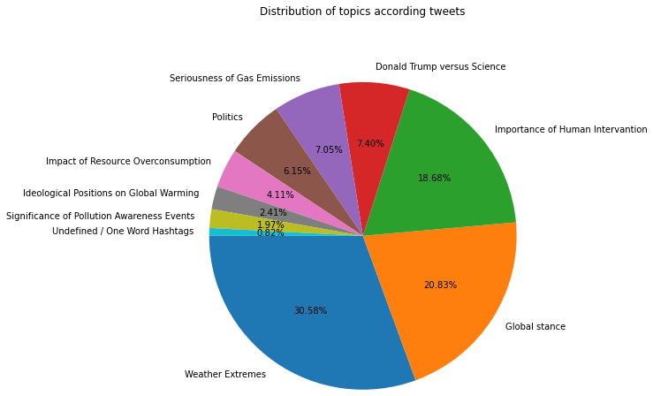
PIE CHART
The above Pie Chart depicts that total percentage of tweets in different topics related to the Climate Change. Most people (30.8%) have tweeted on the topic of weather extremes because from past decade there is difference in usual weather pattern (which might be the reason) and most people are aware of unusual weather pattern, and then followed by Global stance(20.83%) and Importance of human Intervation (10.68%) are next trending tweet topics.
The second least percentage of tweets is for the 'Significance of Pollution Awareness Events' topic with only 1.97 of the total tweets percentage which can indicate that majority of twitter population is not aware of the pollution awareness events and also their significance which play major role in climate change and global warming, and the One Word Hashtags topic is the least (0.82%)

Slide 8
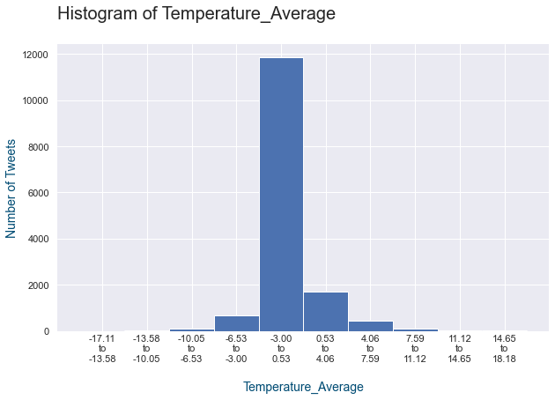
HISTOGRAM
The above histogram provides frequency of tweets for temperature average range values. There are people more than 10000 tweeted about the climate change when the temperature average is in between 0.53 to 4.06. Less than 2000 people has tweeted when there is a drastic temperature drop or raise.

Slide 9
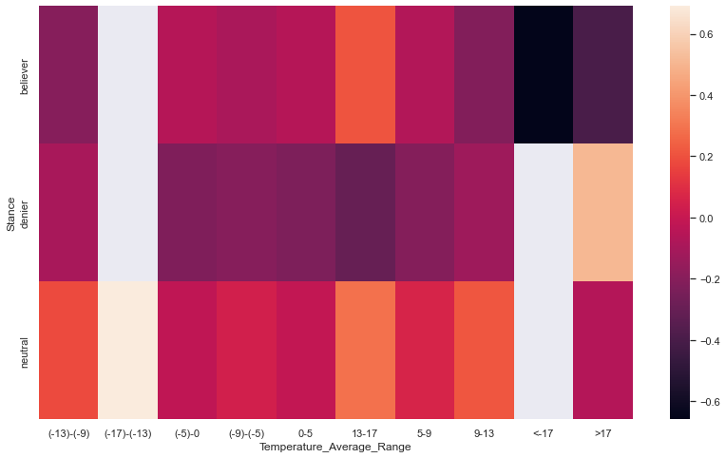
HEAT MAPS
Above heat map shows that, when the temperature deviation has a extreme change around <-17 and >17 degree celsius there are more number of people who believed that the climate changes are due to man made with a negative statement and there were no deniers too.
When the temperature average is in between 0 to 9 and 13 to 17 there were lot of deniers who does not believe in man made climate change.
When the temperature is >17 there were neutral tweets which neither believe nor denial the climate changes due to man made.

Slide 10
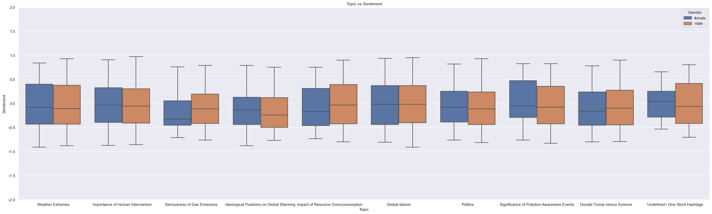
BOX PLOT
A method for graphically depicting groups of numerical data through their quartiles is a box plot.
For the above box plot, we considered several topics to do the sentimental analysis(Scales -1 to 1) with hue as the gender. If Sentiment is near to +1 - It is leaned to Positive Sentiment and the sentiment is -1 - It is leaned to the negative Sentiment, and the 0 being the neutral.

Slide 11
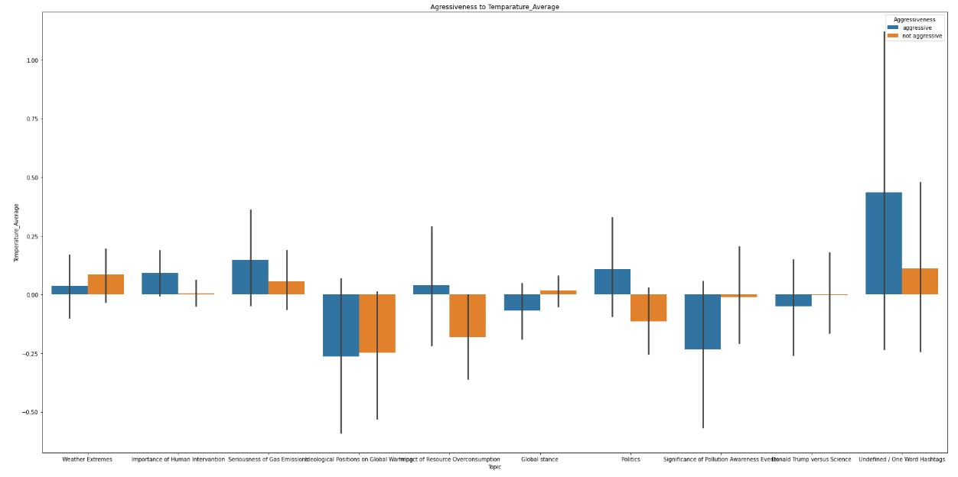
BAR CHART It has categorical data with bars proportional to the values that they represent. The aggressiveness of the tweet on the topic importance of Human Intervantion is high than non-aggressiveness of the tweet, whereas the aggressiveness of the tweet on the topic Positions on Global Warming is low than non-aggressiveness of the tweet.

Slide 12
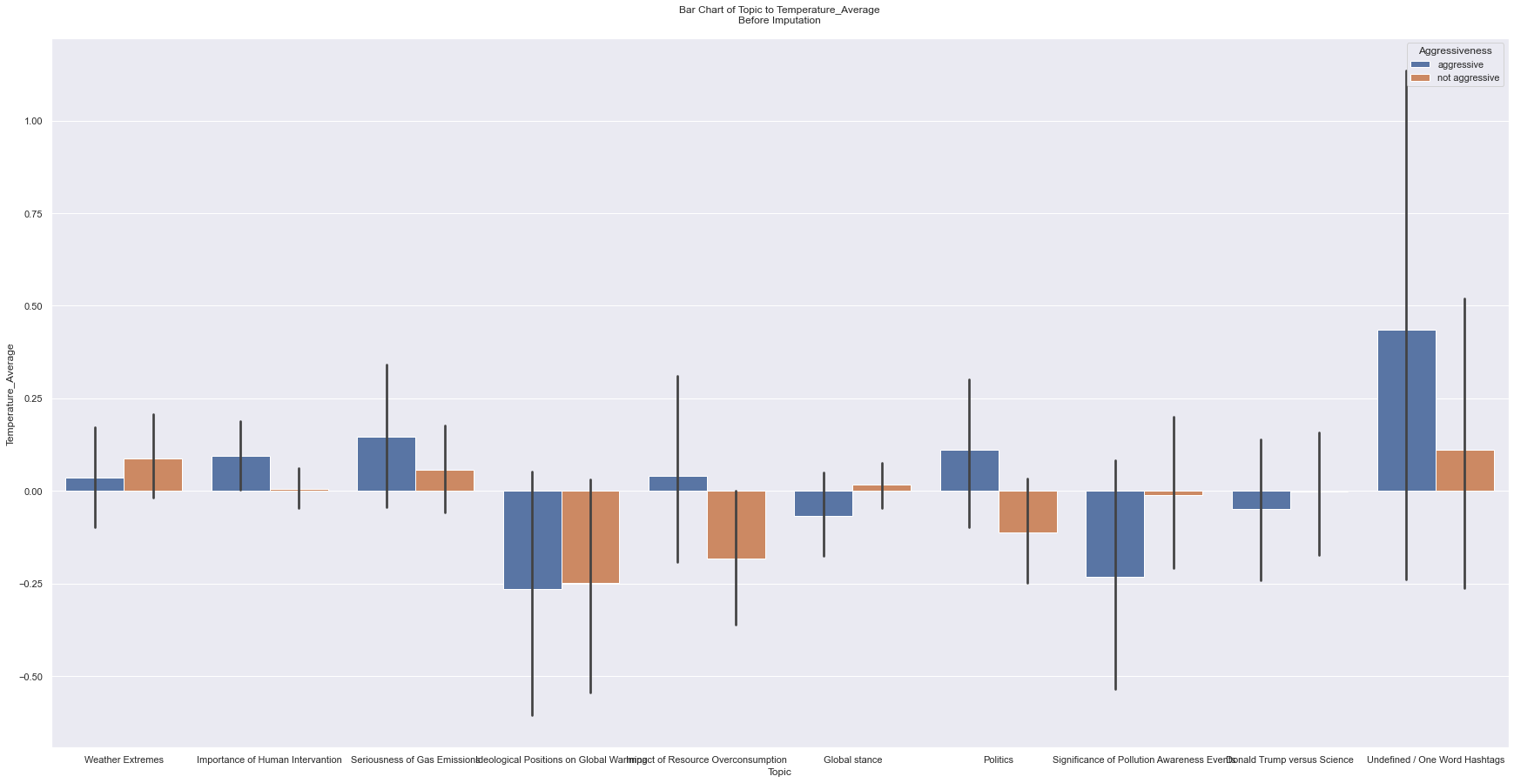
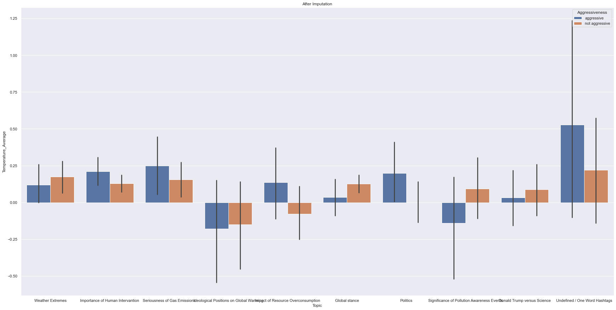
VISUALIZATION WITH AND WITHOUT KNN IMPUTATION
BAR CHART
Using statistical imputation
Using KNN imputator

Slide 13
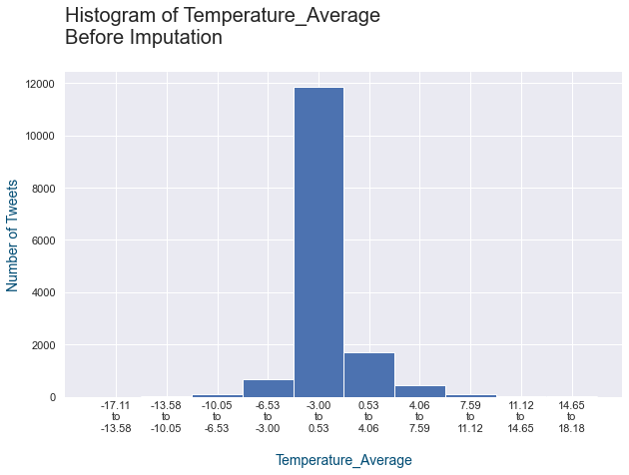
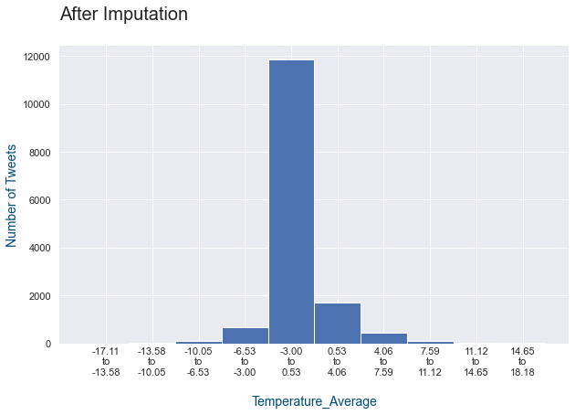
HISTOGRAM
Using statistical imputation
Using KNN imputator

Slide 14
CONCLUSION
Overall it can be concluded that, the people are more aggressive when the temperature average difference is higher during 2006 and 2008 and the topic is related to extreme weather change and the tweets of the people also tend to negative sentiment. Also males are more aggressive compared to female while explaining their concern on the climate change.

Slide 15
RECOMMENDATIONS
1. The analysis can be more accurate if the dataset explains whether the topic given are directly related to the climate change.
2. More information about the Temperature difference and the time, location of the tweets.
3. The analysis would be more accurate if the dataset has other numerical columns explaining about the climate change and the sentiment analysis.
4. More information about the Sentiment and its impact with the climate change.

