Slide 1
BACSE106: Operating Systems
Module 3:
Process Synchronization

Slide 2
Module 3: Process Synchronization
Background
The Critical-Section Problem
Peterson’s Solution
Synchronization Hardware
Semaphores
Classic Problems of Synchronization
Monitors
Synchronization Examples
Atomic Transactions

Slide 3
Objectives
To introduce the critical-section problem, whose solutions can be used to ensure the consistency of shared data
To present both software and hardware solutions of the critical-section problem
To introduce the concept of an atomic transaction and describe mechanisms to ensure atomicity

Slide 4
Interprocess Communication
Processes within a system may be independent or cooperating
Cooperating process can affect or be affected by other processes, including sharing data
Reasons for cooperating processes:
Information sharing
Computation speedup
Modularity
Convenience
Cooperating processes need interprocess communication (IPC)
Two models of IPC
Shared memory
Message passing

Slide 5
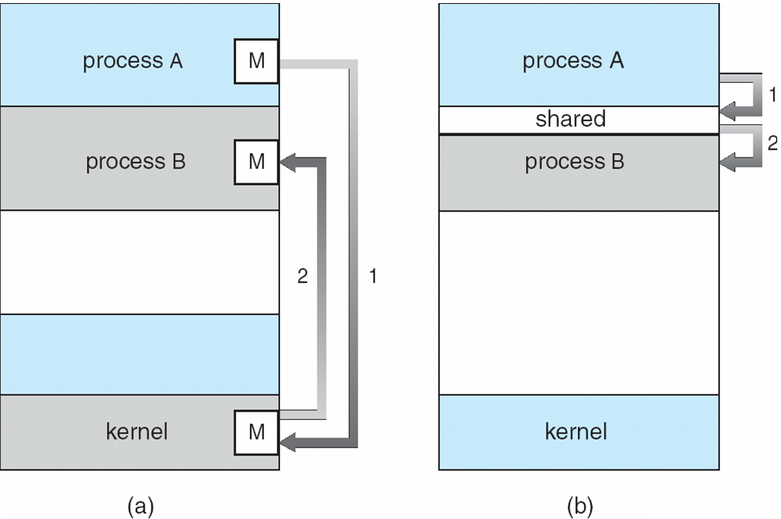
Communications Models

Slide 6
Cooperating Processes
Independent process cannot affect or be affected by the execution of another process
Cooperating process can affect or be affected by the execution of another process
Advantages of process cooperation
Information sharing
Computation speed-up
Modularity
Convenience

Slide 7
Producer-Consumer Problem
Paradigm for cooperating processes, producer process produces information that is consumed by a consumer process
unbounded-buffer places no practical limit on the size of the buffer
bounded-buffer assumes that there is a fixed buffer size

Slide 8
Bounded-Buffer – Shared-Memory Solution
Shared data
#define BUFFER_SIZE 10
typedef struct {
. . .
} item;
item buffer[BUFFER_SIZE];
int in = 0;
int out = 0;
Solution is correct, but can only use BUFFER_SIZE-1 elements

Slide 9
Bounded-Buffer – Producer
while (true) { /* Produce an item */
while (((in = (in + 1) % BUFFER SIZE) == out)
; /* do nothing -- no free buffers */
buffer[in] = item;
in = (in + 1) % BUFFER SIZE;
}

Slide 10
Bounded Buffer – Consumer
while (true) {
while (in == out)
; // do nothing -- nothing to consume
// remove an item from the buffer
item = buffer[out];
out = (out + 1) % BUFFER SIZE;
return item;
}

Slide 11
Interprocess Communication – Message Passing
Mechanism for processes to communicate and to synchronize their actions
Message system – processes communicate with each other without resorting to shared variables
IPC facility provides two operations:
send(message) – message size fixed or variable
receive(message)
If P and Q wish to communicate, they need to:
establish a communication link between them
exchange messages via send/receive
Implementation of communication link
physical (e.g., shared memory, hardware bus)
logical (e.g., logical properties)

Slide 12
Synchronization
Message passing may be either blocking or non-blocking
Blocking is considered synchronous
Blocking send has the sender block until the message is received
Blocking receive has the receiver block until a message is available
Non-blocking is considered asynchronous
Non-blocking send has the sender send the message and continue
Non-blocking receive has the receiver receive a valid message or null

Slide 13
Buffering
Queue of messages attached to the link; implemented in one of three ways
1. Zero capacity – 0 messages Sender must wait for receiver (rendezvous)
2. Bounded capacity – finite length of n messages Sender must wait if link full
3. Unbounded capacity – infinite length Sender never waits

Slide 14
Concurrent Execution
Concurrent execution has to give the same results as serial execution.
Concurrent execution with shared data leads us to speak about synchronization.
To get data consistency we should have mechanism to avoid data inconsistency problem.
Synchronization as embedded system topic we have to speak about producer consumer problem

Slide 15
Maintaining data consistency requires mechanisms to ensure the orderly execution of cooperating processes
Suppose that we wanted to provide a solution to the consumer-producer problem that fills all the buffers. We can do so by having an integer count that keeps track of the number of full buffers. Initially, count is set to 0.
It is incremented by the producer after it produces a new buffer and is decremented by the consumer after it consumes a buffer.

Slide 16
Producer Consumer Problem
The producer-consumer problem illustrates the need for synchronization in systems where many processes share a resource.
In the problem, two processes share a fixed-size buffer. One process produces information and puts it in the buffer, while the other process consumes information from the buffer.
These processes do not take turns accessing the buffer, they both work concurrently.
It is also called bounded buffer problem

Slide 17
Producer
while (true) {
/* produce an item and put in nextProduced */
while (counter == BUFFER_SIZE)
; // do nothing
buffer [in] = nextProduced;
in = (in + 1) % BUFFER_SIZE;
counter++;
}

Slide 18
Consumer
while (true) {
while (counter == 0)
; // do nothing
nextConsumed = buffer[out];
out = (out + 1) % BUFFER_SIZE;
counter--;
/* consume the item in nextConsumed */
}

Slide 19
Race Condition
counter++ could be implemented as register1 = counter register1 = register1 + 1 counter = register1
counter-- could be implemented as register2 = counter register2 = register2 - 1 count = register2
Consider this execution interleaving with “count = 5” initially:
S0: producer execute register1 = counter {register1 = 5} S1: producer execute register1 = register1 + 1 {register1 = 6} S2: consumer execute register2 = counter {register2 = 5} S3: consumer execute register2 = register2 - 1 {register2 = 4} S4: producer execute counter = register1 {count = 6 } S5: consumer execute counter = register2 {count = 4}

Slide 20
Now we have arrived at the incorrect state "counter == 4", indicating that four buffers are full, If we reversed the order of the statements at S4 and S5, we would arrive at the incorrect state "counter —— 6".
We would arrive at this incorrect state because we allowed both processes
to manipulate the variable counter concurrently.
A situation like this, where several processes access and manipulate the same data concurrently and the outcome of the execution depends on the particular order in which the access takes place, is called a race condition.
To avoid the race condition, we need to ensure that only one process at a time can be manipulating the variable counter. To make such a guarantee, we require that the processes be synchronized in some way.

Slide 21
Critical Section Problem
Consider system of n processes {p₀, p₁, … p_{n-1}}
Each process has critical section segment of code
Process may be changing common variables, updating table, writing file, etc
When one process in critical section, no other may be in its critical section
Critical section problem is to design protocol to solve this
Each process must ask permission to enter critical section in entry section, may follow critical section with exit section, then remainder section
Especially challenging with preemptive kernels

Slide 22
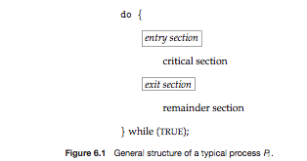
Critical Section
General structure of process p_{i} is

Slide 23
Solution to Critical-Section Problem
1. Mutual Exclusion - If process P_{i} is executing in its critical section, then no other processes can be executing in their critical sections
2. Progress - If no process is executing in its critical section and there exist some processes that wish to enter their critical section, then the selection of the processes that will enter the critical section next cannot be postponed indefinitely
3. Bounded Waiting - After a process has made a request to enter it’s CS, there is a bound on the number of times that the other processes are allowed to enter their CS
otherwise the process will suffer from starvation
Of course also no deadlock (no cycles)

Slide 24
Peterson’s solutions: Algorithm 1
Process Pi:
repeat
while(turn!=i){};
CS
turn:=j;
RS
forever
An execution view of Algorithm 1
Process P0: Process P1:
repeat repeat
while(turn!=0); while(turn!=1);
CS CS
turn:=1; turn:=0;
RS RS
forever forever

Slide 25
Algorithm 1 (cont.)
The shared variable turn is initialized (to 0 or 1) before executing any Pi
Pi’s critical section is executed iff turn = i
Pi is busy waiting if Pj is in CS: mutual exclusion is satisfied
Progress requirement is not satisfied since it requires strict alternation of CSs
If a process requires its CS more often then the other, it cannot get it.

Slide 26
Algorithm 2
Flag[i]=flag[j]=false
Process Pi:
repeat
flag[i]:=true;
while(flag[j]);
CS
flag[i]:=false;
RS
forever
Flag[i]=flag[j]=false
Process Pj:
repeat
flag[j]:=true;
while(flag[i]);
CS
flag[j]:=false;
RS
forever

Slide 27
Keep 1 Bool variable for each process: flag[0] and flag[1]
Pi signals that it is ready to enter it’s CS by: flag[i]:=true
Mutual Exclusion is satisfied but not the progress requirement
If we have the sequence:
T0: flag[0]:=true
T1: flag[1]:=true
Both process will wait forever to enter their CS: we have a deadlock

Slide 28
Algorithm 3 (Peterson’s algorithm)
Process Pi:
repeat
flag[i]:=true; // want in
turn:=j; // let the other in
while
(flag[j]&turn=j){};
CS
flag[i]:=false; // do not want in
RS
forever

Slide 29
Initialization: flag[0]:=flag[1]:=false turn:= 0 or 1
Willingness to enter CS specified by flag[i]:=true
If both processes attempt to enter their CS simultaneously, only one turn value will last
Exit section: specifies that Pi is unwilling to enter CS
Execution view of Algorithm 3
Process P0: Process P1:
repeat repeat
flag[0]:=true; flag[1]:=true;
turn:= 1; turn:= 0;
while(flag[1]&turn=1){}; while(flag[0]&turn=0){};
CS CS
flag[0]:=false; flag[1]:=false;
RS RS
forever forever

Slide 30
Synchronization Hardware
Many systems provide hardware support for critical section code
Uniprocessors – could disable interrupts
Currently running code would execute without preemption
mutual exclusion is preserved but efficiency of execution is degraded
The reason is that while in CS, we cannot interleave execution with other processes that are in RS
Generally too inefficient on multiprocessor systems
Operating systems using this not broadly scalable
Modern machines provide special atomic hardware instructions
Atomic = non-interruptable
mutual exclusion is not preserved
Either test memory word and set value
Or swap contents of two memory words

Slide 31
Hardware solutions: interrupt disabling/enabling
Process Pi:
repeat
disable interrupts
critical section
enable interrupts
remainder section
forever

Slide 32
Solution to Critical-section Problem Using Locks
do {
acquire lock
critical section
release lock
remainder section
} while (TRUE);

Slide 33
TestAndSet Instruction
Definition:
boolean TestAndSet (boolean *target)
{
boolean rv = *target;
*target = TRUE;
return rv:
}

Slide 34
Solution using TestAndSet
Shared boolean variable lock, initialized to FALSE
Solution:
do {
while ( TestAndSet (&lock ))
; // do nothing
// critical section
lock = FALSE;
// remainder section
} while (TRUE);

Slide 35
Swap Instruction
Definition:
void Swap (boolean *a, boolean *b)
{
boolean temp = *a;
*a = *b;
*b = temp:
}

Slide 36
Solution using Swap
Shared Boolean variable lock initialized to FALSE; Each process has a local Boolean variable key
Solution:
do {
key = TRUE;
while ( key == TRUE)
Swap (&lock, &key );
// critical section
lock = FALSE;
// remainder section
} while (TRUE);

Slide 37
Bounded-waiting Mutual Exclusion with TestandSet()
do {
waiting[i] = TRUE;
key = TRUE;
while (waiting[i] && key)
key = TestAndSet(&lock);
waiting[i] = FALSE;
// critical section
j = (i + 1) % n;
while ((j != i) && !waiting[j])
j = (j + 1) % n;
if (j == i)
lock = FALSE;
else
waiting[j] = FALSE;
// remainder section
} while (TRUE);

Slide 38
Semaphore
A semaphore is hardware or a software variable whose value indicates the status of a common resource. Its purpose is to lock the resource being used.
A process which needs the resource will check the semaphore for determining the status of the resource followed by the decision for proceeding.
In multitasking operating systems, the activities are synchronized by using the semaphore techniques.
Example, say we have four rooms with identical locks and keys. The semaphore count - the count of keys - is set to 4 at beginning (all four rooms are free), then the count value is decremented as people are coming in. If all rooms are full, ie. there are no free keys left, the semaphore count is 0. Now, when eq. one person leaves the rooms, semaphore is increased to 1 (one free key), and given to the next person in the queue.
"A semaphore restricts the number of simultaneous users of a shared resource up to a maximum number. Threads can request access to the resource (decrementing the semaphore), and can signal that they have finished using the resource (incrementing the semaphore)."

Slide 39
Synchronization tool that does not require busy waiting
Semaphore S – integer variable
Two standard operations modify S: wait() and signal()
Originally called P() and V()
Less complicated
Can only be accessed via two indivisible (atomic) operations
wait (S) {
while S <= 0
; // no-op
S--;
}
signal (S) {
S++;
}

Slide 40
Semaphore as General Synchronization Tool
Counting semaphore – integer value can range over an unrestricted domain
Binary semaphore – integer value can range only between 0 and 1; can be simpler to implement
Also known as mutex locks
Can implement a counting semaphore S as a binary semaphore
Provides mutual exclusion
Semaphore mutex; // initialized to 1
do {
wait (mutex);
// Critical Section
signal (mutex);
// remainder section
} while (TRUE);

Slide 41
Semaphore Implementation
Must guarantee that no two processes can execute wait () and signal () on the same semaphore at the same time
Thus, implementation becomes the critical section problem where the wait and signal code are placed in the critical section
Could now have busy waiting in critical section implementation
But implementation code is short
Little busy waiting if critical section rarely occupied
Note that applications may spend lots of time in critical sections and therefore this is not a good solution

Slide 42
Semaphore Implementation with no Busy waiting
With each semaphore there is an associated waiting queue
Each entry in a waiting queue has two data items:
value (of type integer)
pointer to next record in the list
Two operations:
block – place the process invoking the operation on the appropriate waiting queue
wakeup – remove one of processes in the waiting queue and place it in the ready queue

Slide 43
Semaphore Implementation with no Busy waiting (Cont.)
Implementation of wait:
wait(semaphore *S) {
S->value--;
if (S->value < 0) {
add this process to S->list;
block();
}
}
Implementation of signal:
signal(semaphore *S) {
S->value++;
if (S->value <= 0) {
remove a process P from S->list;
wakeup(P);
}
}

Slide 44
Deadlock and Starvation
Deadlock – two or more processes are waiting indefinitely for an event that can be caused by only one of the waiting processes
Let S and Q be two semaphores initialized to 1
P₀ P₁
wait (S); wait (Q);
wait (Q); wait (S);
. .
. .
. .
signal (S); signal (Q);
signal (Q); signal (S);
Starvation – indefinite blocking
A process may never be removed from the semaphore queue in which it is suspended
Priority Inversion – Scheduling problem when lower-priority process holds a lock needed by higher-priority process
Solved via priority-inheritance protocol

Slide 45
Classical Problems of Synchronization
Classical problems used to test newly-proposed synchronization schemes
Bounded-Buffer Problem
Readers and Writers Problem
Dining-Philosophers Problem

Slide 46
Bounded-Buffer Problem
N buffers, each can hold one item
Semaphore mutex initialized to the value 1
Semaphore full initialized to the value 0
Semaphore empty initialized to the value N

Slide 47
Bounded Buffer Problem (Cont.)
The structure of the producer process
do {
// produce an item in nextp
wait (empty);
wait (mutex);
// add the item to the buffer
signal (mutex);
signal (full);
} while (TRUE);
The producer must wait for an empty space in the buffer
We must make sure that the producer and the consumer make changes to the shared buffer in a mutually exclusive manner

Slide 48
Bounded Buffer Problem (Cont.)
The structure of the consumer process
do {
wait (full);
wait (mutex);
// remove an item from buffer to nextc
signal (mutex);
signal (empty);
// consume the item in nextc
} while (TRUE);
The consumer must wait for a filled space in the buffer
We must make sure that the producer and the consumer make changes to the shared buffer in a mutually exclusive manner

Slide 49
Readers/Writers Problem
W
R
R
R
Motivation: Consider a shared database
Two classes of users:
Readers – never modify database
Writers – read and modify database
Is using a single lock on the whole database sufficient?
Like to have many readers at the same time
Only one writer at a time

Slide 50
Readers/Writers Problem
A database is to be shared among several concurrent processes. Some of these processes may want only to read the database, whereas others may want to update the database
We distinguish between these two types of processes by referring to the former as readers and to the latter as writers
Obviously, if two readers access the shared data simultaneously, nothing bad will happen
However, if a writer and some other process (either a reader or a writer) access the database simultaneously, chaos may ensue

Slide 51
Readers/Writers Problem
To ensure that these difficulties do not arise, we require that the writers have exclusive access to the shared database
There are several variations of this problem, all involving priorities
The first and simplest one, referred to as the first readers/writers problem, requires that no reader will be kept waiting unless a writer has already obtained permission to use the shared object (i.e., no reader should wait for other readers to finish simply because a writer is waiting) NOTE: writers may starve
The second readers/writers problem requires that, once a writer is ready, that writer performs its write as soon as possible (i.e., if a writer is waiting, no new readers may start reading) NOTE: readers may starve

Slide 52
Readers-Writers Problem (Cont.)
The structure of a writer process
do {
wait (wrt) ;
// writing is performed
signal (wrt) ;
} while (TRUE);
A writer will wait if either another writer is currently writing or one or more readers are currently reading

Slide 53
Readers-Writers Problem (Cont.)
The structure of a reader process
do {
wait (mutex) ;
readcount ++ ;
if (readcount == 1)
wait (wrt) ;
signal (mutex)
// reading is performed
wait (mutex) ;
readcount - - ;
if (readcount == 0)
signal (wrt) ;
signal (mutex) ;
} while (TRUE);
A reader will wait only if a writer is currently writing. Note that if readcount == 1, no reader is currently reading and thus that is the only time that a reader has to make sure that no writer is currently writing (i.e., if readcount > 1, there is at least one reader reading and thus the new reader does not have to wait)
We must make sure that readers update the shared variable readcount in a mutually exclusive manner

Slide 54
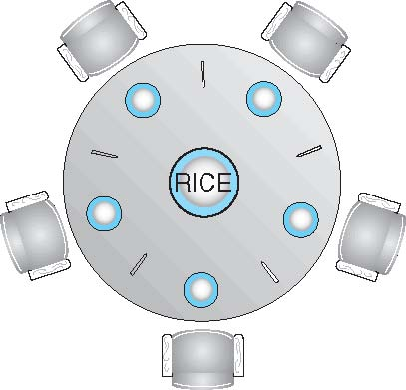
Dining-Philosophers Problem
Philosophers spend their lives thinking and eating
Don’t interact with their neighbors, occasionally try to pick up 2 chopsticks (one at a time) to eat from bowl
Need both to eat, then release both when done
In the case of 5 philosophers
Shared data
Bowl of rice (data set)
Semaphore chopstick [5] initialized to 1

Slide 55
Dining-Philosophers Problem Algorithm
The structure of Philosopher i:
do {
wait ( chopstick[i] );
wait ( chopStick[ (i + 1) % 5] );
// eat
signal ( chopstick[i] );
signal (chopstick[ (i + 1) % 5] );
// think
} while (TRUE);
This solution guarantees that no two neighbors can be eating simultaneously (i.e., mutual exclusion)
What is the problem with this algorithm?
This solution could create a deadlock. How?
A philosopher must wait for his/her left and right chopsticks to be available before he/she can start eating

Slide 56
Problems with Semaphores
Incorrect use of semaphore operations:
signal (mutex) …. wait (mutex)
wait (mutex) … wait (mutex)
Omitting of wait (mutex) or signal (mutex) (or both)
Deadlock and starvation

Slide 57
Monitors
A high-level abstraction that provides a convenient and effective mechanism for process synchronization
Goal of OS is to share resources amongst many programs.
Separate schedulers should be created for each class of resource.
Each scheduler contains local data + procedures that programs may use to acquire and release resources. Such a collection of data + procedures is a monitor.
Abstract data type, internal variables only accessible by code within the procedure
Only one process may be active within the monitor at a time If more than one program attempts to enter at the same time, only one will succeed, and the remaining programs will remain on a queue.
But not powerful enough to model some synchronization schemes

Slide 58
monitor monitor-name
{
// shared variable declarations
procedure P1 (…) { …. }
procedure Pn (…) {……}
Initialization code (…) { … }
}
}

Slide 59
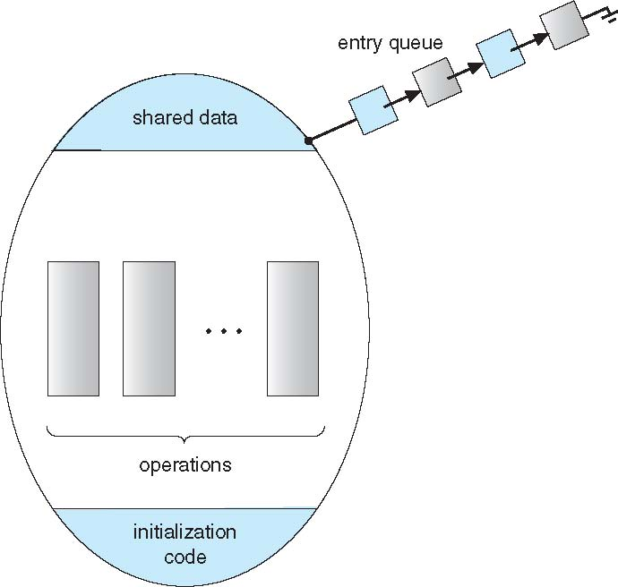
Schematic view of a Monitor
The initialization component contains the code that is used exactly once when the monitor is created
The monitor procedures are procedures that can be called from outside of the monitor.
The monitor entry queue contains all threads that called monitor procedures but have not been granted permissions.
Shared Data

Slide 60
Condition Variables
condition x, y;
Two operations on a condition variable:
x.wait () – a process that invokes the operation is suspended until x.signal ()
If a procedure calls wait, the calling program will block until some other procedure calls signal.
x.signal () – resumes one of processes (if any) that invoked x.wait ()
When a procedure calls signal, then the lock on the monitor is also released, and another program that previously called wait will run immediately.
If no x.wait () on the variable, then it has no effect on the variable.

Slide 61
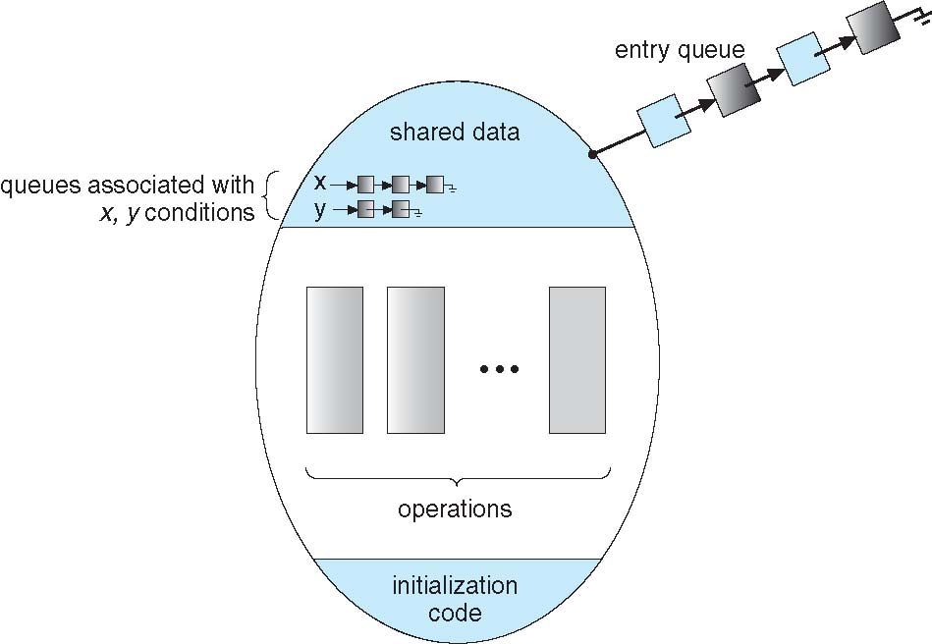
Monitor with Condition Variables

Slide 62
Condition Variables Choices
If process P invokes x.signal (), with Q in x.wait () state, what should happen next?
If Q is resumed, then P must wait
Options include
Signal and wait – P waits until Q leaves monitor or waits for another condition
Signal and continue – Q waits until P leaves the monitor or waits for another condition
Both have pros and cons – language implementer can decide
Monitors implemented in Concurrent Pascal compromise
P executing signal immediately leaves the monitor, Q is resumed
Implemented in other languages including Mesa, C#, Java

Slide 63
Solution to Dining Philosophers
monitor DiningPhilosophers
{
enum { THINKING; HUNGRY, EATING) state [5] ;
condition self [5];
void pickup (int i) {
state[i] = HUNGRY;
test(i);
if (state[i] != EATING) self [i].wait;
}
void putdown (int i) {
state[i] = THINKING;
// test left and right neighbors
test((i + 4) % 5);
test((i + 1) % 5);
}

Slide 64
Solution to Dining Philosophers (Cont.)
void test (int i) {
if ( (state[(i + 4) % 5] != EATING) &&
(state[i] == HUNGRY) &&
(state[(i + 1) % 5] != EATING) ) {
state[i] = EATING ;
self[i].signal () ;
}
}
initialization_code() {
for (int i = 0; i < 5; i++)
state[i] = THINKING;
}
}

Slide 65
Solution to Dining Philosophers (Cont.)
Each philosopher i invokes the operations pickup() and putdown() in the following sequence:
DiningPhilosophers.pickup (i);
EAT
DiningPhilosophers.putdown (i);
No deadlock, but starvation is possible

Slide 66
Monitor Implementation Using Semaphores
Variables
semaphore mutex; // (initially = 1)
semaphore next; // (initially = 0)
int next_count = 0;
Each procedure F will be replaced by
wait(mutex);
…
body of F;
…
if (next_count > 0)
signal(next)
else
signal(mutex);
Mutual exclusion within a monitor is ensured

Slide 67
Monitor Implementation – Condition Variables
For each condition variable x, we have:
semaphore x_sem; // (initially = 0)
int x_count = 0;
The operation x.wait can be implemented as:
x-count++;
if (next_count > 0)
signal(next);
else
signal(mutex);
wait(x_sem);
x-count--;

Slide 68
Monitor Implementation (Cont.)
The operation x.signal can be implemented as:
if (x-count > 0) {
next_count++;
signal(x_sem);
wait(next);
next_count--;
}

Slide 69
Resuming Processes within a Monitor
If several processes queued on condition x, and x.signal() executed, which should be resumed?
FCFS frequently not adequate
conditional-wait construct of the form x.wait(c)
Where c is priority number
Process with lowest number (highest priority) is scheduled next

Slide 70
A Monitor to Allocate Single Resource
monitor ResourceAllocator
{
boolean busy;
condition x;
void acquire(int time) {
if (busy)
x.wait(time);
busy = TRUE;
}
void release() {
busy = FALSE;
x.signal();
}
initialization code() {
busy = FALSE;
}
}

Slide 71
Synchronization Examples
Solaris
Windows XP
Linux
Pthreads

Slide 72
Solaris Synchronization
Implements a variety of locks to support multitasking, multithreading (including real-time threads), and multiprocessing
Uses adaptive mutexes for efficiency when protecting data from short code segments
Starts as a standard semaphore spin-lock
If lock held, and by a thread running on another CPU, spins
If lock held by non-run-state thread, block and sleep waiting for signal of lock being released
Uses condition variables
Uses readers-writers locks when longer sections of code need access to data
Uses turnstiles to order the list of threads waiting to acquire either an adaptive mutex or reader-writer lock
Turnstiles are per-lock-holding-thread, not per-object
Priority-inheritance per-turnstile gives the running thread the highest of the priorities of the threads in its turnstile

Slide 73
Windows XP Synchronization
Uses interrupt masks to protect access to global resources on uniprocessor systems
Uses spinlocks on multiprocessor systems
Spinlocking-thread will never be preempted
Also provides dispatcher objects user-land which may act mutexes, semaphores, events, and timers
Events
An event acts much like a condition variable
Timers notify one or more thread when time expired
Dispatcher objects either signaled-state (object available) or non-signaled state (thread will block)

Slide 74
Linux Synchronization
Linux:
Prior to kernel Version 2.6, disables interrupts to implement short critical sections
Version 2.6 and later, fully preemptive
Linux provides:
semaphores
spinlocks
reader-writer versions of both
On single-cpu system, spinlocks replaced by enabling and disabling kernel preemption

Slide 75
Pthreads Synchronization
Pthreads API is OS-independent
It provides:
mutex locks
condition variables
Non-portable extensions include:
read-write locks
spinlocks

