Slide 1



Electrochemical De-fluorination and Magnetic Polishing of PFAS using Continuous Flow Reactors
Team ID: GEN26-A0H-I125
Team Name: Team Phoenix Domain 3
Amrita Vishwa Vidyapeetham, Coimbatore Campus
Date: 11th October 2026

Slide 2
Presentation Outline
Problem Statement
Problem Understanding
Existing Gaps & Challenges
Our Proposed Solution
Technical Approach
Innovation & Uniqueness
Feasibility & Scalability
Cost for Product
Use Cases
Impacts and Benefits
Sustainable Development Goals
Individual Member Contribution

Slide 3

Problem Statement
Persistent PFAS contamination in industrial and drinking-water systems poses a critical environmental challenge due to the exceptional strength of C–F bonds, which makes conventional treatment methods largely ineffective for complete destruction. Existing technologies such as activated carbon and ion exchange primarily transfer PFAS from water to a concentrated solid or brine waste, rather than eliminating the contaminant. Advanced destruction processes can require high energy, expensive catalysts, or complex operating conditions, limiting their practical deployment in India. Therefore, there is a pressing need to develop a low-energy, scalable and economically viable treatment system capable of not merely removing PFAS, but promoting its progressive C–F bond cleavage and defluorination, while minimizing secondary waste and hazardous transformation products.

Slide 4
Problem Understanding
PFAS are human synthesized substances consisting of C-F region and a functional group.Communities using wells and water supplies that are exposed to industries, airports and fire fighting training areas are affected the most as PFAS contaminated water can lead to permanent liver damage if ingested.
Exceptionally strong C-F bond in PFAS make it extremely difficult to get rid of using conventional water treatment techniques.
PFAS affect users and stakeholders by raising human health risks—including cancer, immune suppression, reproductive/developmental harm, thyroid and liver effects—and by persisting and bioaccumulating in water, food, soil, and biota, which makes exposure chronic and hard to avoid.

Slide 5
Existing Gaps & Challenges
Activated Carbon can be used to adsorb PFAS from the wastewater but it does not destruct the C-F bond present in the PFAS.
Electrochemical Reduction using Ti4O7, PbO2 and BDD requires high anodic potential which increases costs and reduces percentage PFAS destructed.
CeO2/Ti is effective in reducing costs and increasing efficiency but cross contamination due to Cu/Ti corrossion causes nanotoxicity.
Main challenge that remains unsolved is that there is no clear cut way to destruct PFAS while avoiding high energy costs, low efficiency and nanoparticle toxicity.

Slide 6
Our Proposed Solution
An Integrated Three-Stage PFAS Treatment Strategy
| SELECTIVE CAPTURE & PRECONCENTRATION Immobilized
Quaternary Ammonium Sorbent Sequesters anionic PFAS from wastewater through electrostatic interactions, followed by elution to obtain a concentrated contaminant stream.
| ELECTROCHEMICAL DESTRUCTION CeO2-Modified Titanium Electrode Employs an applied electrical potential to facilitate PFAS degradation, targeting C–F bond cleavage and defluorination.
| MAGNETIC POLISHING & RECOVERY Fe3O4@ZIF-8 Composite
Provides supplementary adsorption of residual contaminants, with magnetic separation enabling potential sorbent recovery and reuse.
Proposed train works as a capture → destroy → polish system
The main user value is lower PFAS exposure risk with a more practical treatment workflow

Slide 7
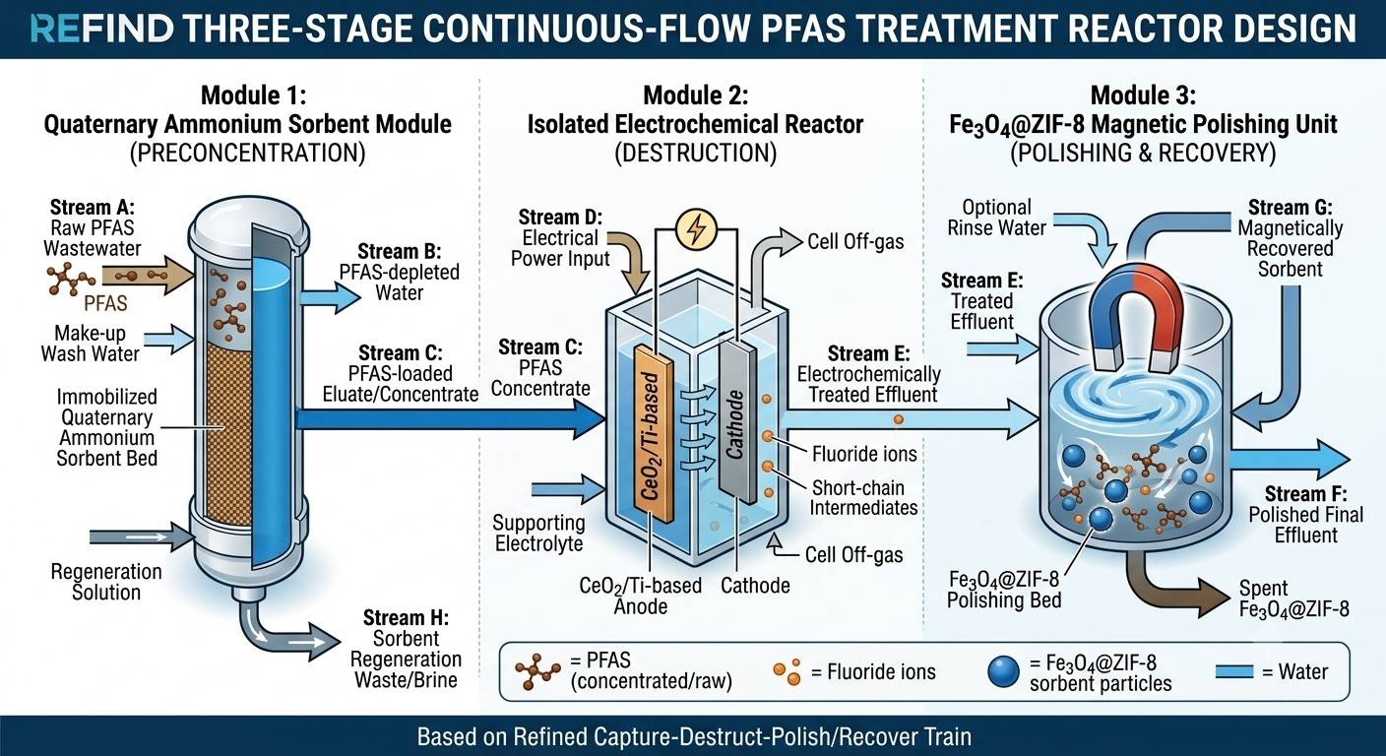
Technical Approach
Wastewater undergoes pre-concentration, electrochemical defluorination and metal polishing via successive continuous flow reactions
Process Setup
Module 1: Quarternary Module 2: Electrochemical Reactor Ammonium Sorbent
Module 3: Fe3O4@ZIF-
8

Slide 8
Innovation & Uniqueness
Key Innovation: A functionally integrated treatment architecture that segregates capture, destruction, and polishing to minimize material interference and support process optimization and future scalability.
It reduces the risk of nanoparticle toxicity by treating PFAS concentrated solution instead of wastewater. It also captures short chain PFAS and Fluoroalkyl radicals using Fe3O4@ZIF-8 Composite.
It derives an effective way to overcome limitations of existing solutions by using them in unison.

Slide 9
Feasibility & Scalability
Feasibility: Our project proposes an electrochemical method for PFAS destruction using cerium oxide (CeO2). It aims to break strong carbon–fluorine (C–F) bonds at a relatively low operating potential. The process explores the catalytic properties of CeO to support PFAS degradation. Its performance depends on electrode material, applied potential, pH, and treatment time.
Scalability: Expanding the CeO-assisted electrochemical treatment system from a small prototype to an industrial-scale wastewater treatment unit. Increasing reactor capacity and using multiple electrodes to treat larger volumes of wastewater. Optimizing the distribution of cerium oxide (CeO) on electrode surfaces for improved performance. Maintaining suitable operating potential and treatment time during scale-up. Designing modular treatment units that can be connected as wastewater volume increases.
Risks: Incomplete Mineralization, Short Chain PFAS may slip through.

Slide 10
Cost for Product (Optional)
Development or hardware cost: [Add estimate]
Hosting or maintenance cost: [Add estimate] Estimated total: [Add amount and currency]

Slide 11
Use Cases (compulsorily 3 use cases must be there)
Use case 1: Wastewater treatment plants
Use case 2: Textile industries
Use case 3: Firefighting and Aviation training centres

Slide 12
Impacts and Benefits
The proposal gives users a capture -> destroy -> polish treatment train that reduces PFAS exposure risk while making the electrochemical step more practical by treating a concentrated stream rather than dilute wastewater
It supports cleaner water for reuse/discharge, lowers treatment burden through preconcentration, and helps water operators manage PFAS more safely in real-world matrices where short-chain PFAS and co-contaminants complicate treatment
Measurable outputs should include higher PFAS removal/defluorination, lower energy use per volume treated, reduced residual PFAS/byproducts after polishing, and verified fluoride balance plus lower toxicity in the final effluent

Slide 13
Sustainable Development Goals (SDGs)
SDG Number | Target Number | Goal Name | Connection
SDG 9 | Target [9] | Industry, Innovation and Infrastructure | Deals with industry wastewater problems
SDG 14 | Target [14] | Life under water | Life under water is negatively affected due to PFAS

Slide 14
Individual Member Contribution
Member | Contribution or responsibility
S Sahana | Proposed Solution and Uniqueness of the Idea
Naman Goyal | Key Challenges and Existing Solutions
Varunya R | Problem Statement and Understanding
R Subashini | Feasibility and Use Cases

Slide 15
Yukti ID
Yukti ID
IR2026-1051944

