Slide 1

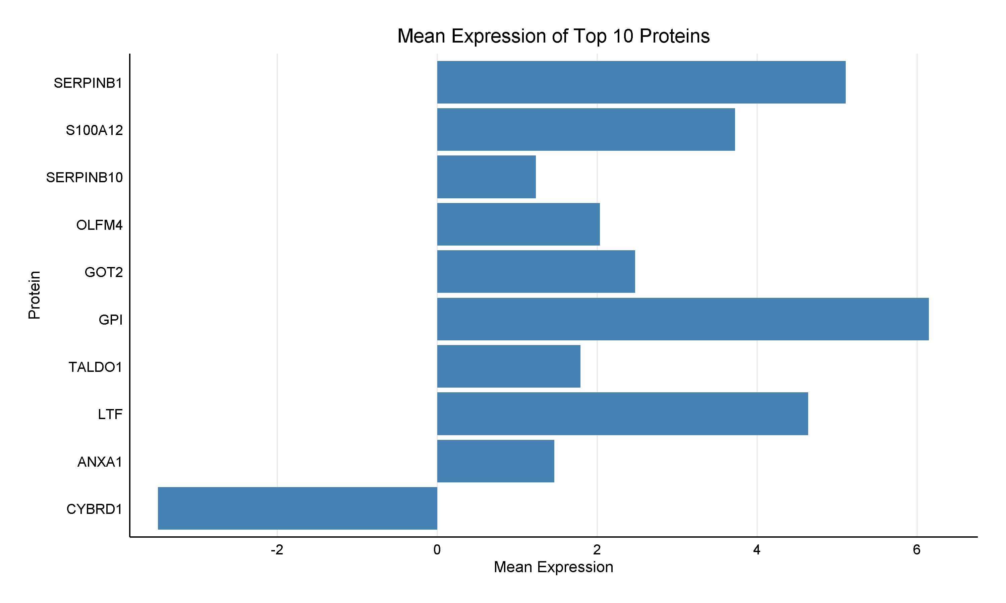
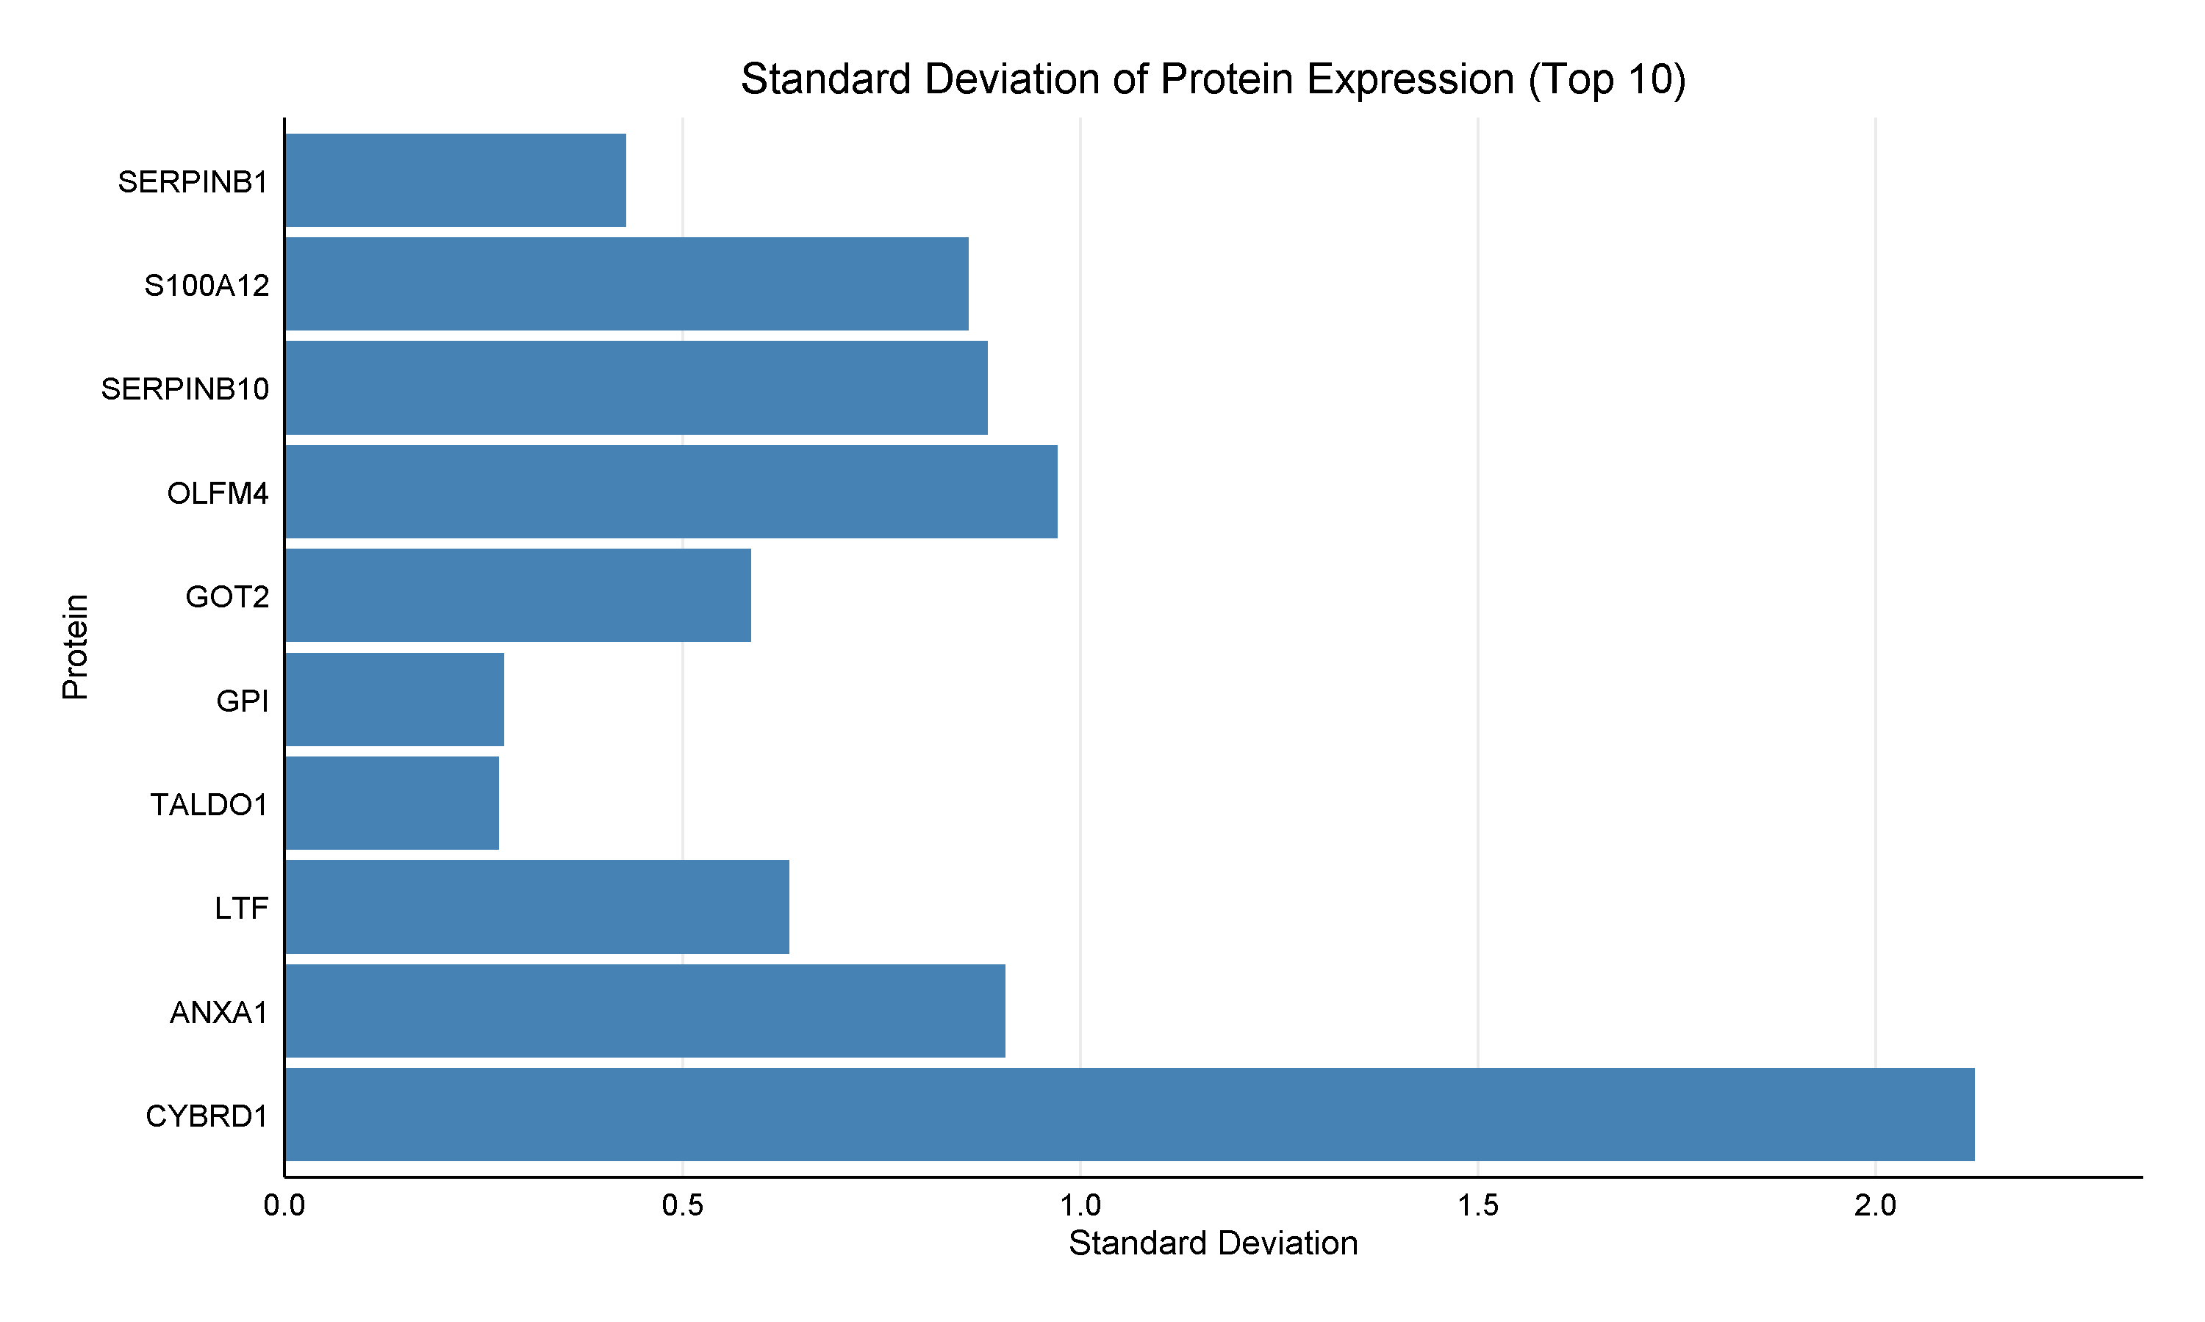

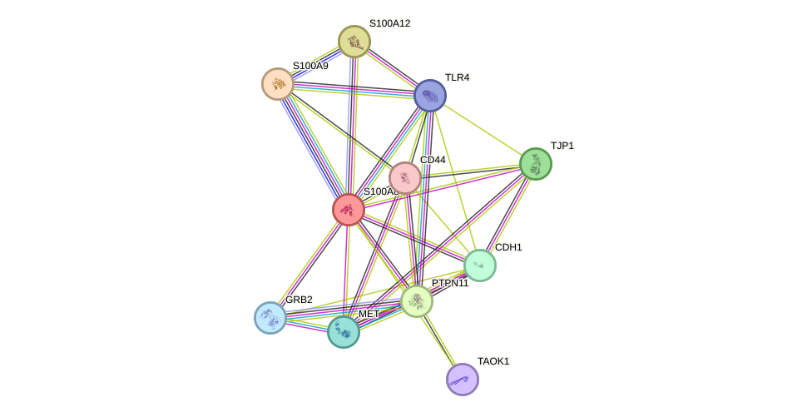
Analyzing Host Immune Response to Campylobacter jejuni: A Bioinformatics Approach to Biomarker and Drug Target Identification
Divya Ramesh and Iosif Vaisman | School of Systems Biology, George Mason University
Abstract
Antibiotic Analysis and Drug relevance
GeneCards was used to identify key antibiotics for C. jejuni, including Azithromycin, Erythromycin, and Metronidazole, with the latter showing potential in combination therapies
While Azithromycin and Erythromycin are established treatments, other antibiotics like cycloheximide and doxorubicin are either toxic or not used clinically
Figure 2:
Mean and Standard Deviation of Top 10 proteins based on Random Forest Feature Selection
Campylobacter jejuni is a major cause of bacterial gastroenteritis, impacting millions annually. This project identified key proteins involved in the host response using the GEO database which were further analysed using the STRING database to map interactions among 20 critical proteins. Cross-referencing of antibiotics from GeneCards with identified proteins highlighted the ongoing challenge of antibiotic resistance. The research also identified essential biomarkers through random forest analysis in R, comparing the accuracy of top 10 proteins from the initial GEO/STRING list and supplementary data. The findings underscore the value of targeting host response proteins and bacterial factors to develop novel treatments, supporting the use of Azithromycin and Erythromycin and exploring Metronidazole for enhanced therapeutic strategies.
Keywords: C. jejuni, Biomarkers, Antibiotic resistance, Host response proteins
Identification of Essential Biomarkers
Random Forest in R identified the top 10 proteins from the supplementary table, with mean and standard deviation calculated for top 10
Random Forest classification compared the top 10 proteins from the supplementary table and the compiled 20 proteins list, assessing AUC.
Performed random forest feature selection to identify the top 10 proteins, calculated their mean and standard deviation, and visualized the results through plots
The top 10 proteins that can act as biomarkers are SERPINB1, S100A12, SERPINB10, OLFM4, GOT2, GPI, TALDO1, LTF, ANXA1, CYBRD1
Based on random forest classification of the top 10 proteins from both the compiled protein list and the supplementary table, AUC comparisons showed relatively low performance for both sets, with the supplementary table protein set achieving higher accuracy than the compiled protein list set.
Significance
Results
The project identifies key proteins involved in the host response to Campylobacter jejuni infection, offering insights into molecular markers that could help understand the infection process
By using databases like STRING and GeneCards, the project explores protein-protein interactions, uncovering central proteins that may mediate host-pathogen interactions
The use of random forest feature selection provides a statistical framework for understanding protein expression patterns in response to infection
The study suggests potential therapeutic targets and alternative antibiotic strategies, to improve treatment efficacy for C. jejuni infections
 | AUC
Project protein | 0.67
Supplementary table proteins | 0.75
Table 2: Comparison of AUC for Project and Supplementary Table Proteins
Figure 1:
STRING protein-protein interaction showcasing multiple networks related to C. jejuni infection response
Conclusion
Materials and Methods
The integration of these newly identified proteins with our initial set resulted in a final compilation of 20 proteins
The functional classification and the disease association of the identified proteins showed significant involvement in four key shared pathways: actin dynamics regulation, immune system signaling, Toll-Like Receptor signaling, and matrix metalloproteinase pathways
This study offers a comprehensive analysis of the molecular responses to Campylobacter jejuni infection and identifies potential therapeutic targets for treatment. The use of databases such as GEO and STRING facilitated the identification of key proteins and their interactions, providing a deeper understanding of the host-pathogen relationship
Erythromycin and Azithromycin continues to be an effective treatment option, while metronidazole presents an alternative that could be used in combination therapies to combat resistant strains
The Machine Learning results show partial overlap with the findings of the paper’s statistical analysis, highlighting some alignment with the two approaches
Data Mining Statistics
Retrieved from the GEO database (GSE147629), with detailed analysis of host immune response to C. jejuni
Identified proteins included ELANE, MMP9, ACTR2, ACTR3, LCN2, MPO, S100A8, S100A9, CXCL8, and TNF
Antibiotic | Associated protein
Azithromycin | CXCL8
Erythromycin | MMP9, MPO, CXCL8, LTF
Fluoroquinolones | CXCL8, LTF
Tetracycline | None
Doxycycline | None
Chloramphenicol | None
Metronidazole | S100A8, LTF
Cycloheximide | MMP9, CXCL8, TNF, CD44, TLR2, CTSG
Doxorubicin | MPO, TNF, CD44
Herbimycin A | MMP9, CXCL8, TNF
Among these frequently occurring drugs, Azithromycin, Erythromycin and potentially Metronidazole are the most relevant for campylobacter treatment. Azithromycin and Erythromycin is already a known treatment, while Metronidazole has shown some efficacy, especially in combination therapies
Table 1:
Cross-referencing of compiled antibiotics, associated proteins and its function
Protein-Protein Interaction
A STRING database analysis revealed additional interacting proteins ARPC5, ARPC4, ARPC3, ARPC2, WAS, WASL, CTSG, LTF, TLR2, and CD44
The expanded network of 20 proteins provided a comprehensive view of molecular interactions critical to infection response pathways
References
Agarwala, R., Barrett, T., Beck, J., Benson, D. A., Bollin, C., Bolton, E., Bourexis, D., Brister, J. R., Bryant, S. H., Canese, K., Charowhas, C., Clark, K., Dicuccio, M., Dondoshansky, I., Federhen, S., Feolo, M., Funk, K., Geer, L. Y., Gorelenkov, V., … Zbicz, K. (2016). Database resources of the National Center for Biotechnology Information. Nucleic Acids Research, 44(D1), D7–D19. https://doi.org/10.1093/nar/gkv1290
Andersen, S. R., Shukri, N. M., Boel, J., & Saadbye, P. (2006). Metronidazole resistance in Campylobacter jejuni from poultry meat. Journal of Food Protection, 69(4), 932–934. https://doi.org/10.4315/0362-028X-69.4.932
Azli, B., Razak, M. N., Omar, A. R., Mohd Zain, N. A., Abdul Razak, F., & Nurulfiza, I. (2022). Metagenomics Insights Into the Microbial Diversity and Microbiome Network Analysis on the Heterogeneity of Influent to Effluent Water. Frontiers in Microbiology, 13(April), 1–20. https://doi.org/10.3389/fmicb.2022.779196
Elmi, A., Nasher, F., Dorrell, N., Wren, B., & Gundogdu, O. (2021). Revisiting Campylobacter jejuni Virulence and Fitness Factors: Role in Sensing, Adapting, and Competing. Frontiers in Cellular and Infection Microbiology, 10(February), 1–15. https://doi.org/10.3389/fcimb.2020.607704
Gao, F., Tu, L., Chen, M., Chen, H., Zhang, X., Zhuang, Y., Luo, J., & Chen, M. (2023). Erythromycin resistance of clinical Campylobacter jejuni and Campylobacter coli in Shanghai, China. Frontiers in Microbiology, 14(May). https://doi.org/10.3389/fmicb.2023.1145581
Hamosh, A., Scott, A. F., Amberger, J., Bocchini, C., Valle, D., & McKusick, V. A. (2002). Onlined Mendelian Inheritance in Man (OMIM), a knowledgebase of human genes and genetic disorders. Nucleic Acids Research, 30(1), 52–55. https://doi.org/10.1093/nar/30.1.52
Kemper, L., & Hensel, A. (2023). Campylobacter jejuni: targeting host cells, adhesion, invasion, and survival. Applied Microbiology and Biotechnology, 107(9), 2725–2754. https://doi.org/10.1007/s00253-023-12456-w
Ko, K. K. K., Chng, K. R., & Nagarajan, N. (2022). Metagenomics-enabled microbial surveillance. Nature Microbiology, 7(4), 486–496. https://doi.org/10.1038/s41564-022-01089-w
Maruyama, R., Yasumoto, K., Mizusawa, N., Iijima, M., Yasumoto-Hirose, M., Iguchi, A., Hermawan, O. R., Hosono, T., Takada, R., Song, K. H., Shinjo, R., Watabe, S., & Yasumoto, J. (2024). Metagenomic analysis of the microbial communities and associated network of nitrogen metabolism genes in the Ryukyu limestone aquifer. Scientific Reports, 14(1), 1–14. https://doi.org/10.1038/s41598-024-54614-8
Nam, N. N., Dang, H., Do, K., The, K., Trinh, L., & Lee, N. Y. (2023). Metagenomics : An Effective Approach for Exploring Microbial. Foods, 12, 2140.
Functional Classification and Disease Association
The analysis of 20 proteins showed their roles in cytoskeletal organization, immune function, and enzymatic activity
These proteins were linked to conditions such as immune dysfunction and cancer, and were involved in pathways crucial for actin dynamics, immune signaling, and tissue remodeling in C. jejuni infection

