Slide 1






AGRICULTURE × ARTIFICIAL INTELLIGENCE
CropSure
Early detection and management of crop diseases and pest infestations
Image-based disease detection
Weather & risk forecasting
Smart farm-level advisories
Expert validation & monitoring
Team / Project: [Logic Builder] • [Members] • [Sahana R K and Prathiksha]

Slide 2




Problem & Existing Challenges
Farmer observes symptoms
Searches manually
Waits for expert
Lab testing
Delayed decision
Crop damage
“Farmers need timely, reliable and locally relevant crop-health intelligence.”
Delayed disease identification
Limited access to experts
No localized risk prediction
Fragmented agricultural data
Wrong or late diagnosis means delayed treatment, excess pesticide use, higher costs and yield loss.
Reactive, not preventive
Limited follow-up monitoring
CropSure | 2 / 7

Slide 3


Solution: One Crop-Health Intelligence Platform
Image AI
Follow-up monitoring
Pest traps & sensors
CropSure
Multilingual advisory
Weather data
Expert validation
Crop & field info
Hotspot maps
CropSure | 3 / 7

Slide 4

How It Works & AI Disease Detection
1. Farmer uploads crop image
2. AI analyzes visible symptoms
3. Disease / pest identification
4. Confidence & risk assessment
5. Weather, crop, soil & history analysis
6. Risk forecasting
7. Expert validation when required
8. IPDM recommendation
9. Farmer follows advisory
10. Follow-up monitoring & feedback
Crop: Tomato
Diagnosis: Early Blight
85%
Risk: HIGH
Screenshot: crop image detection
confidence score
Insert > Pictures, then place over this frame
Symptoms: dark concentric leaf spots, yellowing around lesions.
High-risk cases go to expert or lab confirmation.
CropSure | 4 / 7

Slide 5
Risk Forecasting & Hotspot Mapping
Weather, temperature, humidity, rainfall
Crop stage & variety
Soil condition
Local pest / disease history
Previous field observations
Sensor & pest-trap data
LOW
MEDIUM
Low
Medium
High
HIGH
Hotspots • field-level alerts • historical patterns • targeted extension visits
CropSure | 5 / 7

Slide 6

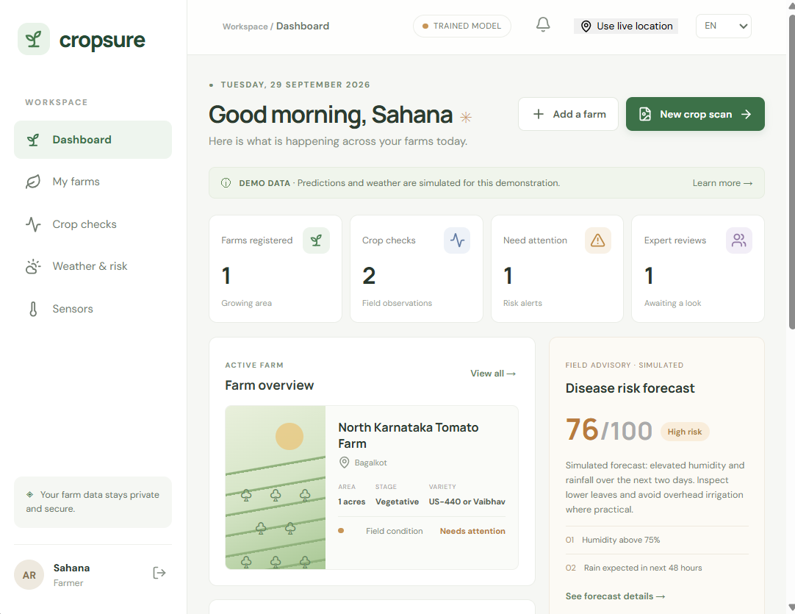
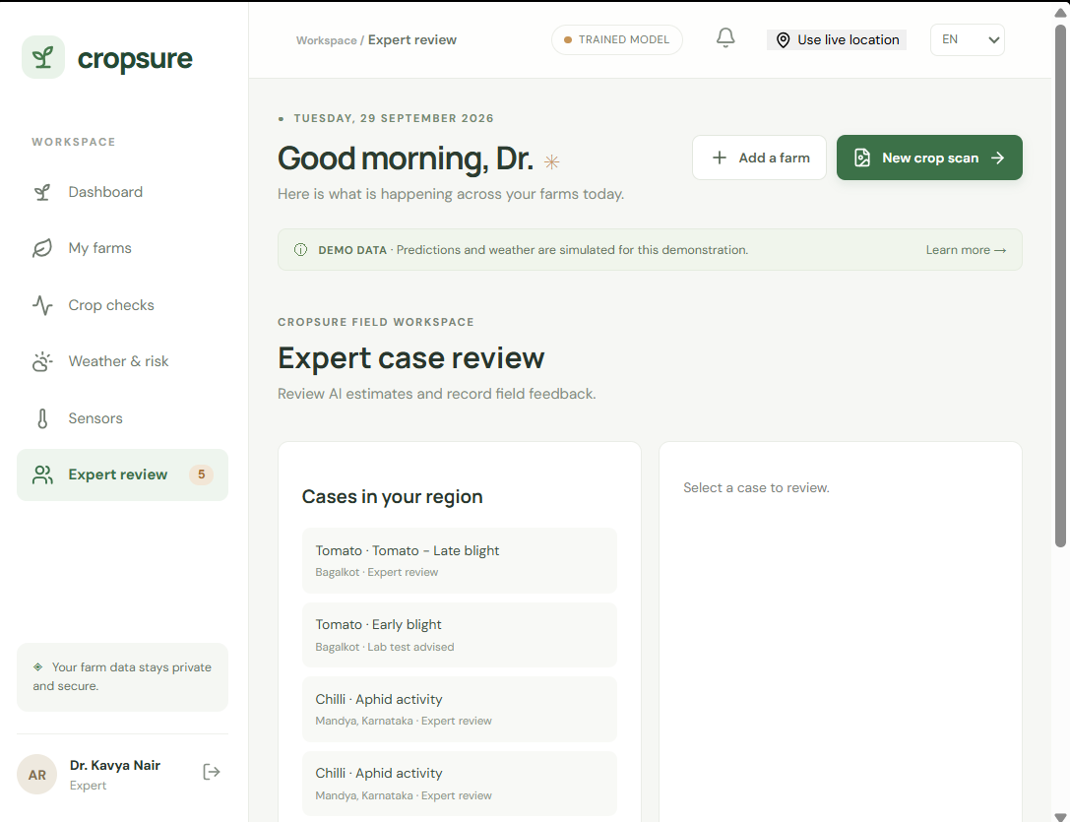
Expert Validation, Advisory & Dashboards
AI Prediction
Expert Review
Diagnosis Confirmation
Advisory
Follow-up
Expert notes
Lab referral when necessary
Safe input recommendations
Integrated pest & disease management
Multilingual advisories
Post-intervention monitoring
Screenshot: Farmer dashboard
Screenshot: Official dashboard
Insert > Pictures, then place over this frame
Insert > Pictures, then place over this frame
AI supports experts and farmers. It does not replace professional diagnosis.
CropSure | 6 / 7

Slide 7
Impact, Beneficiaries & Future Scope
“CropSure transforms crop-health management from reactive diagnosis into proactive, data-driven farm-level intelligence.”
Early Detection
Better Decisions
Targeted Intervention
Reduced Loss
Improved Productivity
WHO BENEFITS
Farmers
Experts
Officials
Govt & Labs
Instant, local crop advice
Faster case validation
Targeted field visits
Early outbreak tracking
EXPECTED BENEFITS
FUTURE SCOPE
Earlier detection • reduced losses • targeted pesticide use • faster extension response • wider surveillance • preventive planning • lower costs • better decisions • farmer-expert-lab coordination
More crops and diseases • regional models • IoT sensors and pest-trap analysis • satellite data • more Indian languages • learning from expert-confirmed cases • links to departments and labs
Detect Early. Predict Risk. Act Smart.

