Slide 1
A Sensory-Safe Game for Neurodiverse Players
CSE7101- Capstone Project
Review-2
Batch Number: CAI_25
Roll Number | Student Name
Under the Supervision of,
Dr.Mohammed Akheela Khanum
Dr./Mr./Ms./Prof.
Professor / Associate Professor / Assistant Professor
School of Computer Science and Engineering
Presidency University
20221CAI0159 | Monisha S
20221CAI0133 | Sahana
20221CAI0142 | Bhargavi U
Name of the Program: B.Tech
Name of the HoD: Dr. Zafar Ali Khan
Name of the Program Project Coordinator: Ms. Suma N G
Name of the School Project Coordinators: Dr. Sampath A K , Dr. Geetha A

Slide 2
Problem Statement Number: 155
Category: Software
Problem Description: Individuals with neurodevelopmental disorders, particularly Autism Spectrum Disorder (ASD) and Attention-Deficit/Hyperactivity Disorder (ADHD), often face challenges in engaging with mainstream digital games. Popular endless runner games are designed with fast-paced action, sudden sensory inputs, complex visual effects, and punitive mechanics that can cause sensory overload, heightened anxiety, or difficulty sustaining attention for neurodiverse players.
This creates an accessibility gap in the gaming industry, where entertainment and cognitive benefits of gaming are not equally available to individuals with sensory sensitivities, attention regulation difficulties, and unique processing needs.

Slide 3
Content
Abstract
Literature Survey
Objectives
Existing Methods and Drawbacks
Proposed Method and Feasibility Study
Architecture Design
Hardware and Software Details
Timeline of the Project
References

Slide 4
Abstract
People with neurodiversity, like those dealing with Autism Spectrum Disorder or ADHD, run into all sorts of problems when they try playing regular digital games. Overstimulation hits them hard, controls get way too complicated, and there's just not enough inclusive design out there. You know, it makes sense. This study puts forward this sensor-based setup for safe gaming.
It uses motion sensors, touch ones, and even stuff from the environment to make things accessible, calming, and actually fun. Basically, built in Unity, the game engine, and you can hook up Arduino sensors if you want for spotting gestures or movements. Oh, and the whole environment keeps visuals simple to avoid overload, throws in soothing sounds, and adds positive reinforcement to keep it going.
The prototype works better for inclusion and comfort than your standard games. This adds to the research on serious games and accessibility, giving a fresh way to design safe spaces just for neurodiverse folks.

Slide 5
Literature Survey
Several research efforts have explored the role of serious games in supporting neurodiverse players.
Serious Games for Neurodiverse Players :Serious games are designed with purposes beyond entertainment, such as therapy, education, and cognitive training.For example, game-based interventions have been developed to assist children with autism in recognizing emotions or to help individuals with ADHD strengthen focus. However, most of these works remain task-specific and do not provide a holistic environment for relaxation and safe interaction.
Motion- and Gesture-Based Interaction :Gesture-controlled games using devices such as Microsoft Kinect or camera-based tracking allow players to use body movements instead of traditional controllers. This is particularly beneficial for individuals with limited fine motor skills.Nevertheless, most gesture-based interventions are structured as rehabilitation exercises rather than open-ended, calming experiences, which limits their scope in inclusive entertainment.
EEG and Neurofeedback Games :EEG-based games measure brain activity to monitor attention and focus levels. Neurofeedback approaches reward players when they maintain attention, providing a form of cognitive training. Despite their potential, EEG-based games often require expensive hardware and are limited to laboratory or clinical settings, reducing accessibility for broader neurodiverse communities.

Slide 6
Objectives..
Creating a sensory-safe gaming environment with customizable sound, visuals, and pacing.
To provide a low-stimulation mode featuring calming audio and simplified visuals.
To design attention-supportive gameplay with short tasks, clear goals, and adjustable difficulty.
To encourage positive reinforcement using retry options, progress indicators, and rewards.
Ensuring accessibility and inclusivity with simplified controls and clear text/visual guidance.
Blend engaging gameplay mechanics with soothing visuals and audio for relaxation.
Deliver a safe, enjoyable platform that supports both entertainment and cognitive engagement.

Slide 7
Existing Methods and Drawbacks
Existing Methods
Proloquo2Go
Otsimo Special Education
Aquapark.io
Dexteria VMI
Otsimo Special Education
Drawbacks
Many existing apps are either too stimulating or lack personalization.
Competitive mechanics and time pressure increase stress and anxiety.
Limited feedback systems reduce motivation and confidence.

Slide 8
Proposed Methods & Feasibility
F
Proposed Methods
Calm Gameplay
Customizable Settings
Minimal Interface
Non-competitive Tasks
Positive Feedback
Feasibility Study
Resource Feasibility
Technical Feasibility
Pilot Testing
Scalability

Slide 9
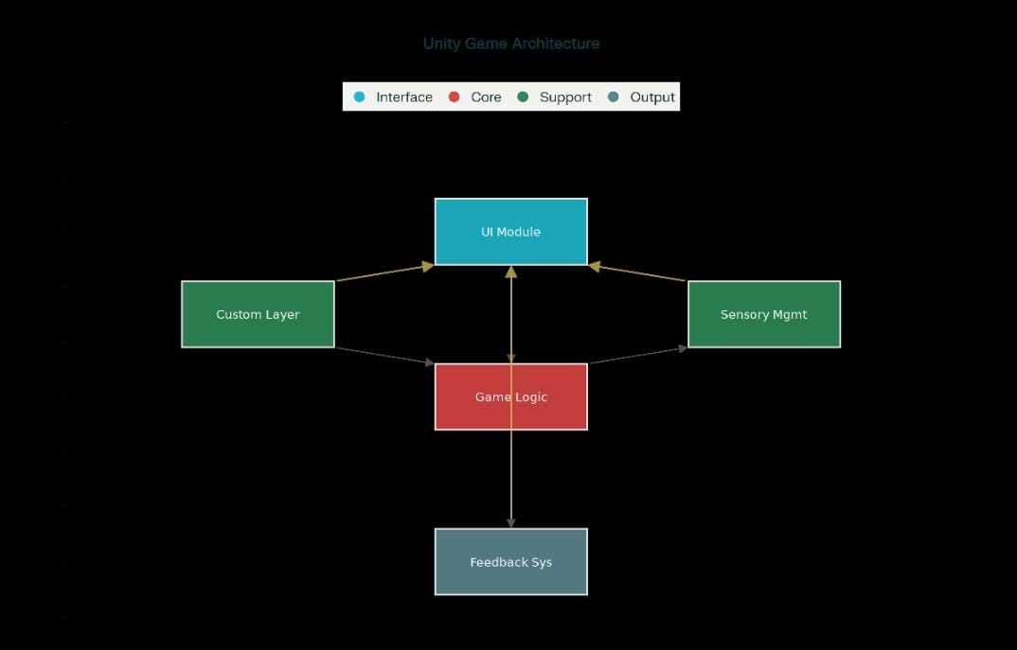
Architecture Design

Slide 10
Github Link
Github Link:
https://github.com/Sahanasoudri/CalmQuest

Slide 11
Software Requirements
VS Code → For game development, coding, and project debugging.
GitHub → For version control, collaboration, and maintaining the project repository.
Android Studio → For building and testing the mobile version of the platform.
Figma / Canva → UI/UX design, wireframing, and graphics creation.
Blender → For creating 2D/3D game assets and animations.

Slide 12
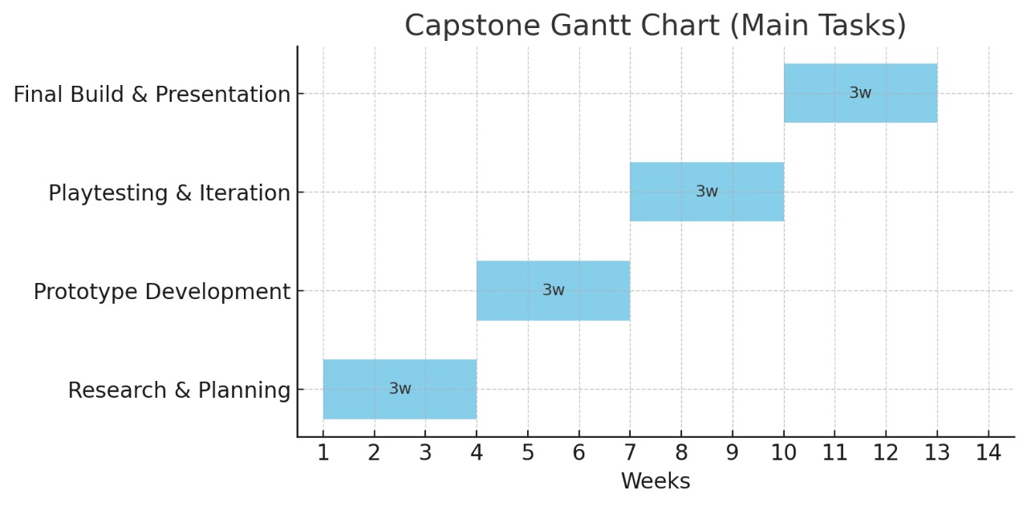
Timeline of the Project (Gantt Chart)

Slide 13
References (IEEE Paper format)
[1]. M. A. Ocaña Pretel and L. Andrade-Arenas, "Video game prototype to improve Mental Health problems," 2021 2nd Sustainable Cities Latin America Conference (SCLA), Medellin, Colombia, 2021.
[2]. C. Piazzalunga, P. Molino "Development and Validation of an iPad-based Serious Game for Emotion Recognition and Attention Tracking towards Early Identification of Autism," 2023 11th International Conference on Affective Computing and Intelligent Interaction Workshops and Demos (ACIIW), Cambridge, MA, USA, 2023.
[3]. F. Sanuki, N. Nakphu, A. Tahara "Comparison of brain activity in success and failure in single and multitask game," 2021 13th Biomedical Engineering International Conference (BMEiCON), Ayutthaya, Thailand, 2021.

Slide 14


