Slide 1
Empathetic dialogue systems
2021/05/21
Sahand Sabour
2020280401
Conversational AI Group, Tsinghua University

Slide 2
List of Contents
Introduction to Dialogue Systems
Empathy in Dialogue Systems
Recent Work and Existing Problems
Research Motivation
Expected Contributions
Research Plan

Slide 3




Introduction to Dialogue Systems
Dialogue System (DS): a computer system intended to have dialogues with humans.
Task-oriented → help the user carry out a task (domain-specific)
Non-task-oriented → provide entertainment and companionship (open-domain)
Hey Siri!
I had so much fun today
Sounds great! What did you do?
Watched a great movie!
I love movies!

Slide 4
Future of Dialogue Systems
The main objective of building a dialogue system is to model human behavior.
A main attribute of human conversations is the ability to express empathy.
When people tell us about their lives and their situation, we think about how we would feel if we were in the same situation as them and what we want to hear in that situation.
We feel sad when someone tells us they’ve lost their parents.
We feel happy when our friends tells us they won a competition.
In order for dialogue systems to be great companions, they need to know empathy.

Slide 5
Empathy
What is Empathy?
The ability that enables an individual to experience the feeling of another person [1].
A complex multi-dimensional construct with two broad aspects of affect and cognition [2].
The ability to perceive, understand, and react appropriately to the situation’s context, the implicit emotions, and attitudes of others [3].

Slide 6
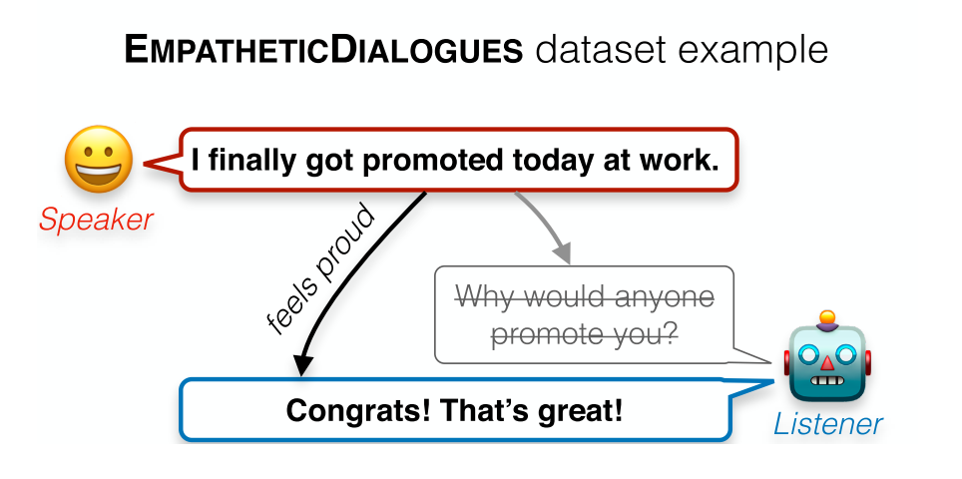
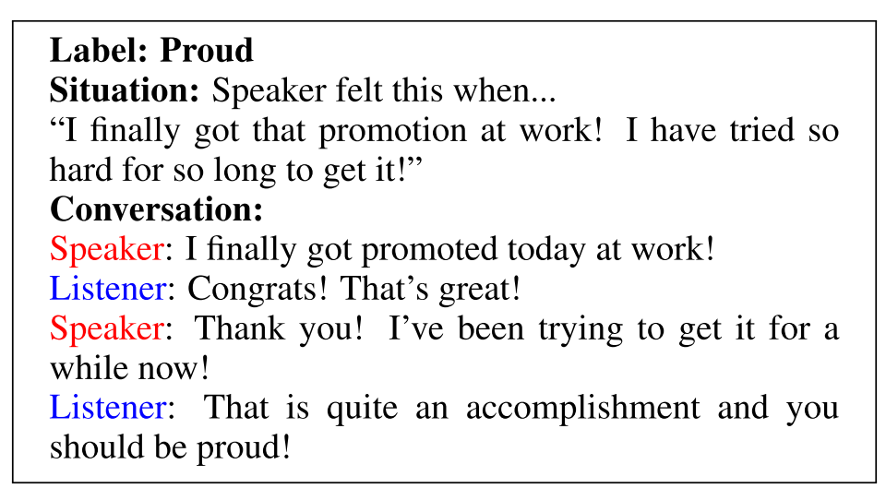
Recent work
Empathetic Dialogues (2019) [4]
Each conversation has an emotion label and the context of the situation.
The conversations are around 5-8 turns of dialogue between workers.
Problems
The conversations are short.
Most of the conversations are low-quality.

Slide 7
Recent work
Empathetic response generation by
predicting user’s sentiment (Happybot, 2019) [5]
looking at the emotion history (Emptransfo, 2020) [6]
mimicing user’s emotions (MIME, 2020) [7]
Empathy for providing support (EPITOME) [8, 9]
Mechanisms for expressing empathy in mental health support
Emotional Reaction
Interpretation
Exploration
Notes:
have a specific goal for generating empathetic responses.: have empathy when empathy is needed

Slide 8
Existing Problems
There is no large-scale high quality dataset for empathy.
Crowdsourcing for data collection is costly and requires significant labor.
There are no suitable annotation schemes for automatic data collection.
Most of the recent work does not have a specific target for using empathy.
No consideration of whether empathy is needed nor how much empathy is needed.
No analysis on the effectiveness of the generated responses.
There are no solid evaluation methods for empathy.
Existing work conducts human evaluation by asking for a score from 1-5 for empathy.
Current automatic metrics are unable to give an empathy score.
Notes:
have a specific goal for generating empathetic responses.: have empathy when empathy is needed

Slide 9
Research Motivation
A main attribute of human conversations is the ability to express empathy.
But why do we, as humans, have empathy for others?
To demonstrate our understanding of the situation → build trust
To provide support, acknowledgement, and affirmation
make the other person feel better when they are sad.
make the other person appreciate sharing good news with you when they are happy.

Slide 10
Research Motivation
Empathy for Emotional Support
Online support groups allow for thousands of people to connect and share their experience; however, many individuals go unnoticed when they post on these platforms [10].
There’s a specific target to acheived → providing emotional support for those who need it.
The effect on users could be analyzed.
The user shows signs of feeling better about a topic they were sad about.
The user shows signs of appreciation or interest in the conversation after sharing something they are happy about.
Different support methods could be used to address various situations.
Provide reassurance when the user is having anxiety about an upcoming exam.
Talk about one’s own experience when the user has failed a class.

Slide 11
Expected Contributions
Part 1:
Create an Empathetic Dataset
It should capture the natural dialogue between two humans.
The dialogues should cover topics of various types of emotions.
It should be large-scale.
Create an Empathy Evaluation Scheme.
It should assess different aspects of empathy (such as coherence, emotional relevance, etc.)
Provides a clear definition for each aspect.
Demonstrates a reusable scale for future work.

Slide 12
Expected Contributions
Part 2:
Create an Empathetic Model.
Understands the user’s situation.
Explores for more information if the situation is not clear.
Identifies what type and what level of empathy is needed.
Responds in an engaging manner.
Avoids toxicity and judgments.

Slide 13
Research Plan
Creating an Empathetic Dataset and Empathy Evaluation Scheme
Objective | Start Date | Expected End Date | Status
Data collection | 2021-05 | 2021-06 | 90% complete
Literature Review | 2020-12 | 2021-07 | 60% complete
Human Annotation | 2021-07 | 2021-08 | Not started
Classifier for large-scale annotation | 2021-07 | 2021-08
Experiments | 2021-07 | 2021-09
Human Evaluation | 2021-08 | 2021-09

Slide 14
Research Plan
Creating an Empathetic Model
A Reinforcement Learning framework with
Natural Language Understanding unit (for detecting dialog acts, emotions, etc.)
Response generation unit (for generating candidate empathetic responses).
User simulator unit (for predicting how the user would feel after generated responses)
Objective | Start Date | Expected End Date
Literature Review | 2020-12 | 2021-10
Theoretical Proposal | 2020-09 | 2021-10
Experiments | 2021-10 | 2021-12
Human Evaluation | 2021-12 | 2022-01
Master's Thesis | 2022-01 | 2022-04

Slide 15
Thanks for Your Attention
Any questions?

Slide 16
References
[1] Stephen Turner, 2012. The Strength of Weak Empathy. Journal of Science in Context.
[2] Mark H Davis et al. 1980. A multidimensional approach to individual differences in empathy. Journal of Personality and Social Psychology.
[3] Sevgi Cos ̧kun Keskin. From what isn’t Empathy to Empathic Learning Process, 2014. Proceedings of Social and Behavioral Sciences.
[4] Rashkin, H., Smith, E., Li, M. Boureau, Y., 2019. Towards Empathetic Open-domain Conversation Models: A new benchmark and dataset. arXiv preprint arXiv:1811.00207.
[5] Shin, J. Xu, P., Madotto, A., Fung, P., 2019. HappyBot: Generating Empathetic Dialogue Responses by Improving User Experience Look-ahead. arXiv:1906.08487.
[6] Zandie, R., Mahoor, M., 2020. EmpTransfo: A Multi-head Transformer Architecture for Creating Empathetic Dialog systems. arXiv:2003.02958.
[7] Majumder, N., Hong, P., Peng, S., Lu, J., Ghosal, D., Gelbukh, A., Mihaleca, R., Poria, S., 2020. MIME: MIMicking Emotions for Empathetic Response Generation. arXiv:2010.01454.

Slide 17
References
[8] Sharma, A., Miner, A.S., Atkins, D.C. and Althoff, T., 2020. A Computational Approach to Understanding Empathy Expressed in Text-Based Mental Health Support. arXiv preprint arXiv:2009.08441.
[9] Ashish Sharma, Inna W Lin, Adam S Miner, David C Atkins, andTim Althoff. Towards facilitating empathic conversations in online men-tal health support: A reinforcement learning approach. arXiv preprint arXiv:2101.07714, 2021.
[10] Zijian Wang and David Jurgens. It’s going to be okay: Measuring Access toSupport in Online Communities. InProceedings of the 2018 Conference onEmpirical Methods in Natural Language Processing, pages 33–45, Strouds-burg, PA, USA, 2018. Association for Computational Linguistics.

