Slide 1
Automatic Stroke Detecting System
Capstone Project
Sahan Kavinda
DSA_0395

Slide 2
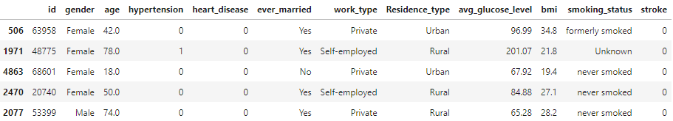
Data Source : https://www.kaggle.com/datasets/fedesoriano/stroke-prediction-dataset
Data table,

Slide 3
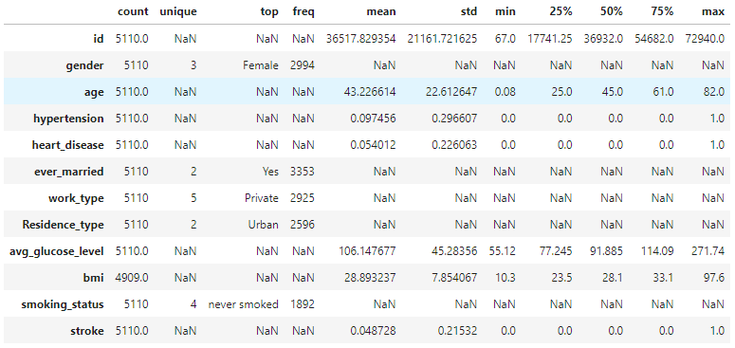
Described data,

Slide 4
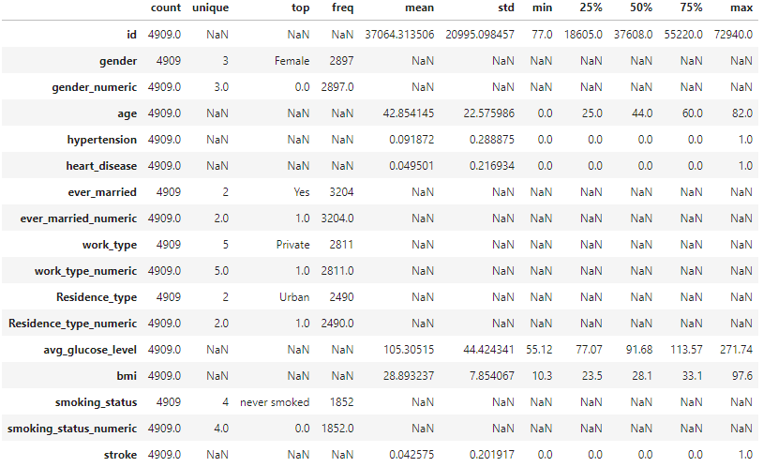
Described data after Exploratory Data Analysis

Slide 5
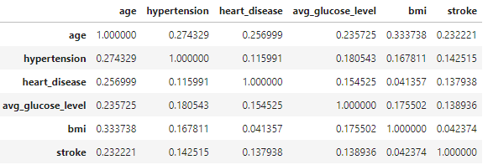
Correlation matrix,

Slide 6
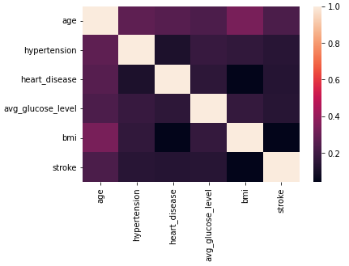
Heat map,

Slide 7
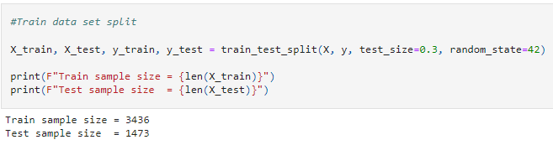
Train data split

Slide 8
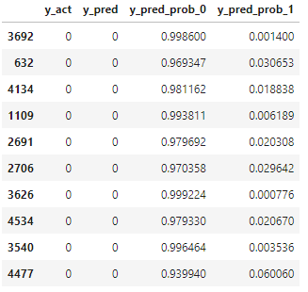
Used ML model : Logistic Regression
Results data frame for test samples :

Slide 9
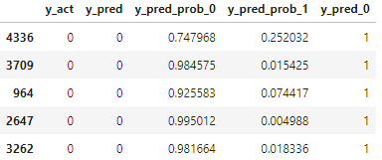
One hot encode prediction

Slide 10
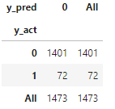
Confusion matrix
Accuracy : 0.9511201629327902 (95%)

Slide 11
Thank You

