Slide 1

Analysis of DISORDER Sleep Dataset
An Exploratory and Predictive Study
Prepared by: Sahar Alshahrani
Data Science department
December 2024
Instructor: Dr. Ayman Qahmash

Slide 2
INTRODUCTION
  This statistical project aims to study the factors affecting sleep quality, which is a crucial element for overall health and daily performance. The project analyses diverse data, including age, gender, physical activity, stress level, and blood pressure, to achieve accurate predictions and clear insights into how these factors influence sleep quality. The findings will help identify the most impactful factors, enabling the development of effective recommendations to improve sleep patterns.

Slide 3
Objectives
  Explore and clean the Sleep Quality dataset.
  Conduct descriptive analysis of attributes.
  Investigate relationships between attributes and their effect on sleep quality.
  Build and evaluate predictive models.
  Identify key factors influencing sleep quality.

Slide 4
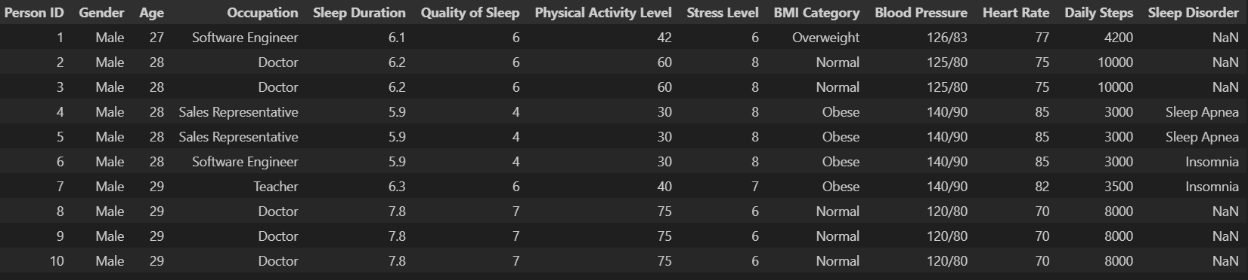
Explore and clean the disorder Sleep dataset

Slide 5
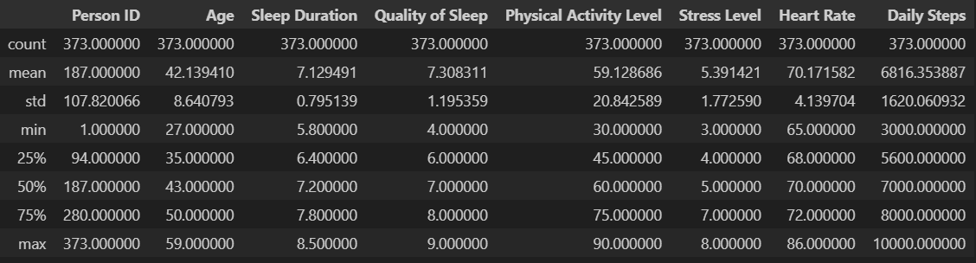
Explore and clean the disorder Sleep dataset

Slide 6
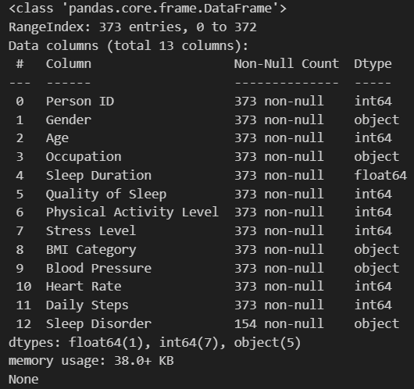
Explore and clean the disorder Sleep dataset

Slide 7
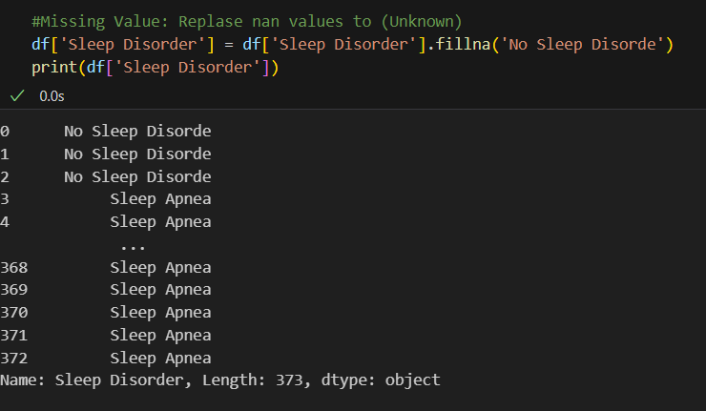
Explore and clean the disorder Sleep dataset

Slide 8
Dataset Overview
The dataset contains the following columns:
Person ID (Unique Identifier)
Gender, Age, Occupation
Sleep Duration, Quality of Sleep, Sleep Disorder
Physical Activity Level, Stress Level
BMI Category, Blood Pressure, Heart Rate, Daily Steps

Slide 9
Descriptive Analysis
Distribution of Age, Gender, and BMI Category analyzed.
Boxplots and histograms plotted for numerical variables.
Sleep Duration and Quality of Sleep distributions explored.

Slide 10
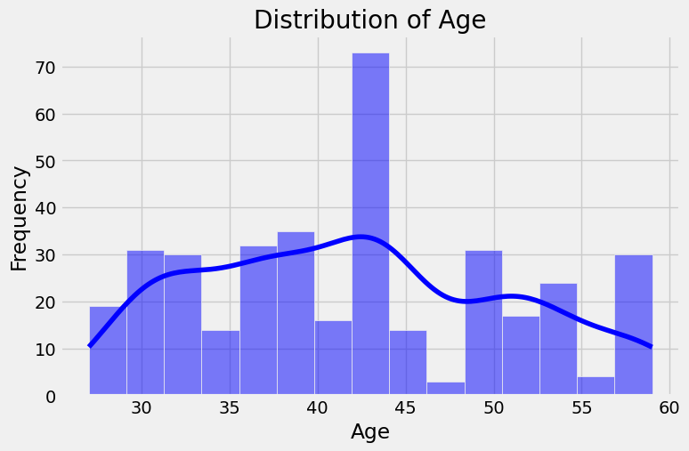
Distribution of Age
The age distribution shows a peak around the mid-40s, suggesting that the majority of the individuals in the dataset belong to this age group. The variability across other age ranges ensures a diverse representation, though the data is slightly skewed toward middle-aged participants. This distribution allows for meaningful insights into sleep quality trends across different age categories

Slide 11
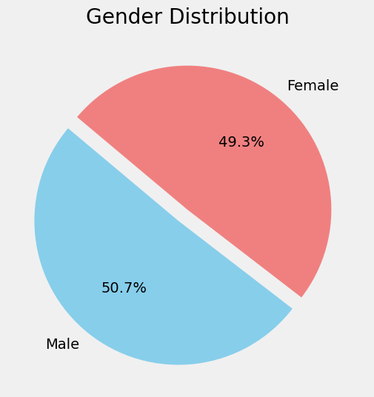
Distribution of gender
Male: 49.3%
Female: 50.7%

Slide 12
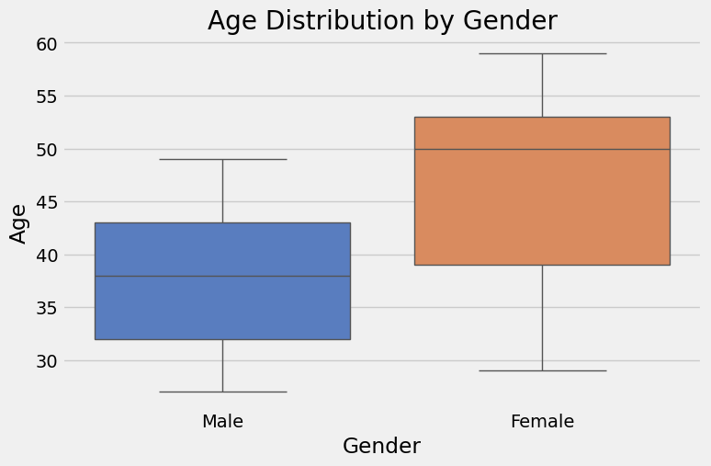
Distribution of Age by gender
Male:
The median age is slightly below 40.
Female:
The median age is around 45.

Slide 13
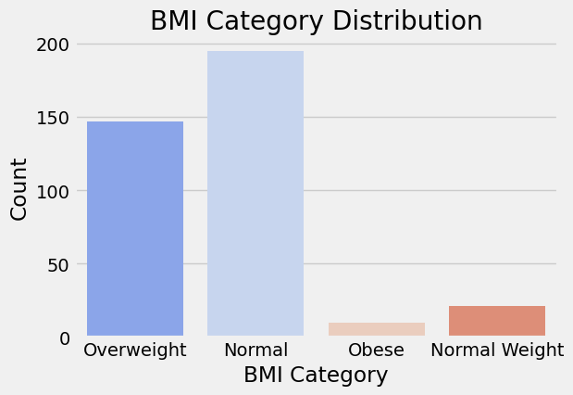
Distribution of BMI Category
BMI | CATEGORY
 | Normal
18.5-24.9 | Normal Weight
25-29.9 | Overweight
30 or higher | Obese
Use the Bar Plot to find out how many people are in each BMI category

Slide 14
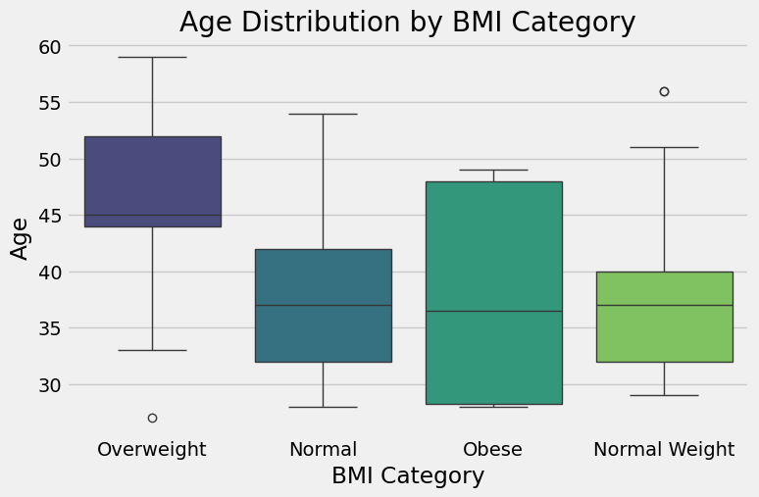
Distribution of BMI Category
Use the Bar Plot to find out how many people are in each BMI category

Slide 15
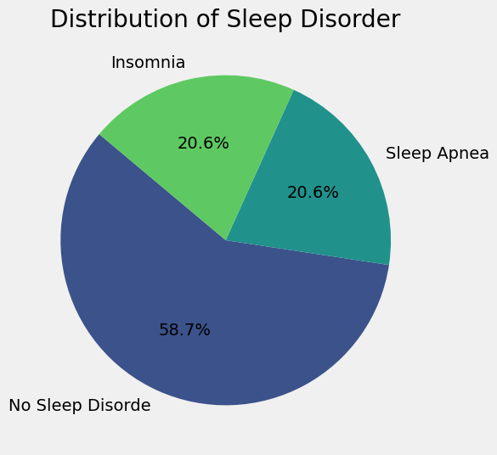
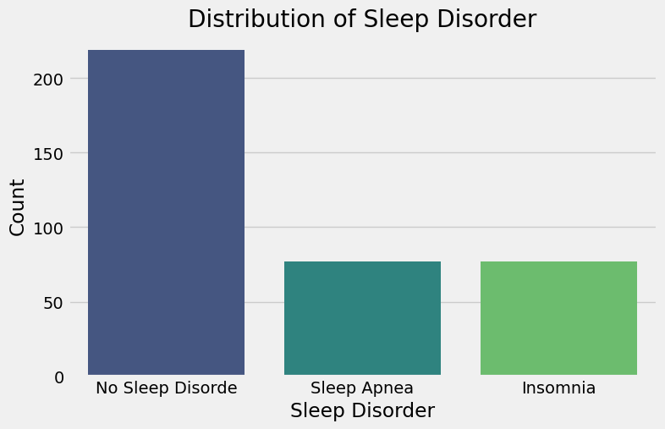
Distribution of sleep disorder
To understand the percentage of people who suffer from sleep apnea, whether insomnia or sleep disorder, compared to those who do not suffer

Slide 16
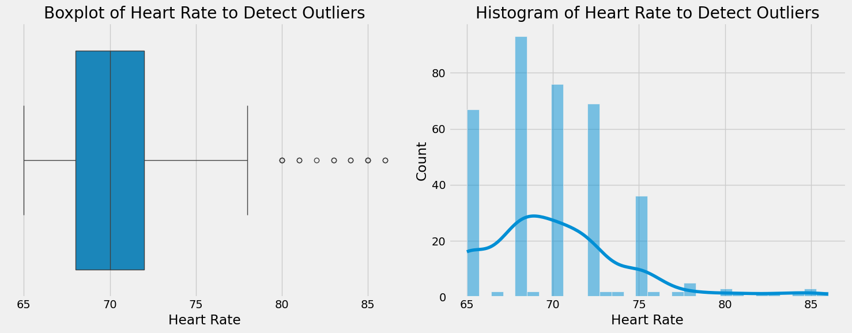
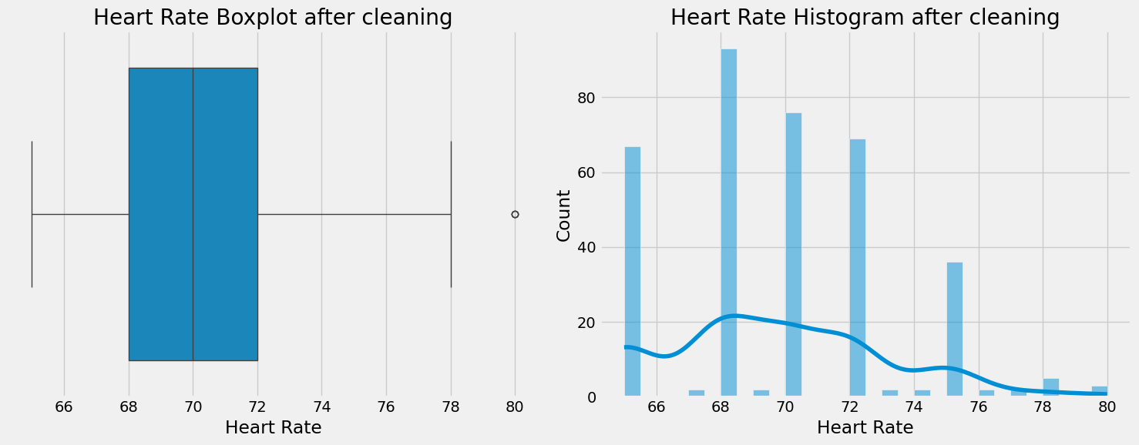
Outliers :
Quartile was applied to identify and remove outliers.

Slide 17
Correlation Analysis
Investigated the relationship between:
Stress Level and Sleep Quality.
BMI Category and Sleep Disorders.
Used heatmaps visualize correlations.

Slide 18
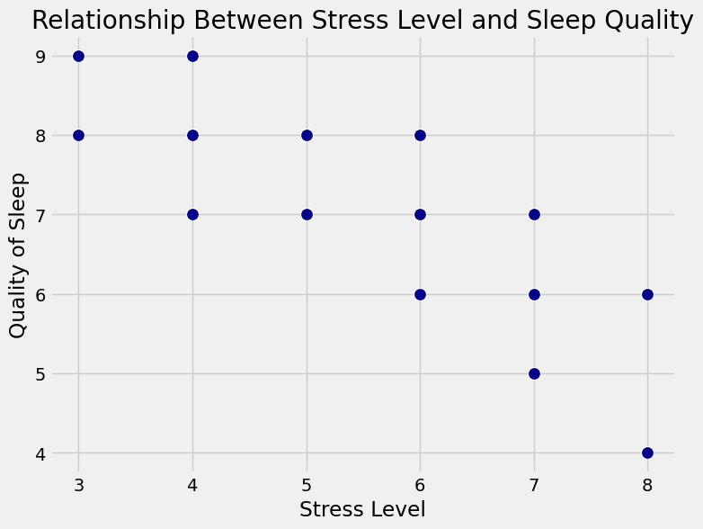
relationship between Stress Level and Sleep Quality
Scatter plot to investigate the relationship between Stress Level and Sleep Quality

Slide 19
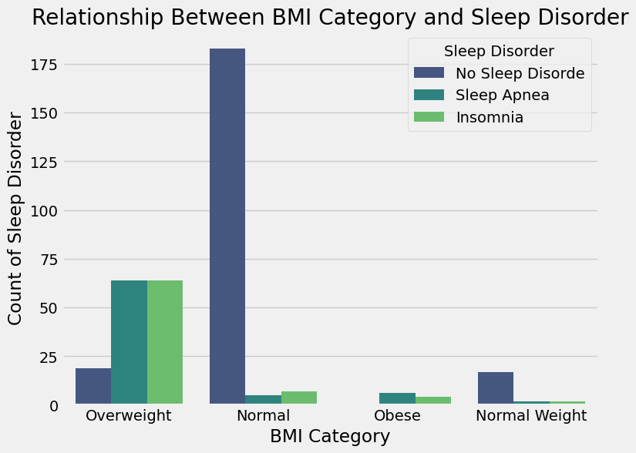
relationship between BMI Category and Sleep Disorder
Bar plot to investigate the relationship between BMI Category and Sleep Disorder

Slide 20
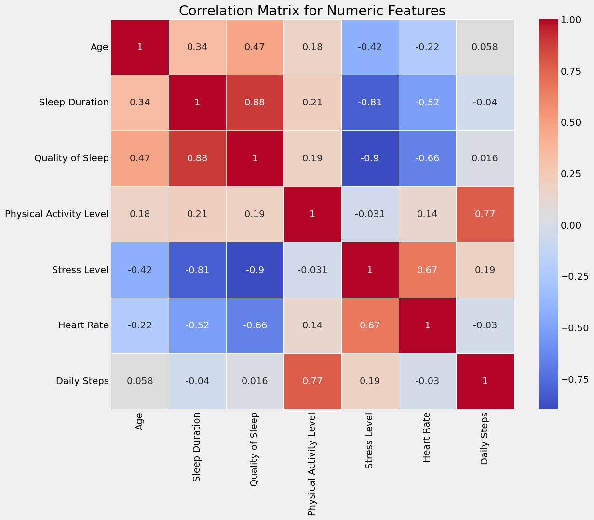
Correlation Heat map

Slide 21
Predictive Models
Models compared: Logistic Regression, Random Forest and Gradient Boosting.
Logistic Regression showed the highest performance.
Evaluations based on Accuracy, Recall, and F1-Score.

Slide 22
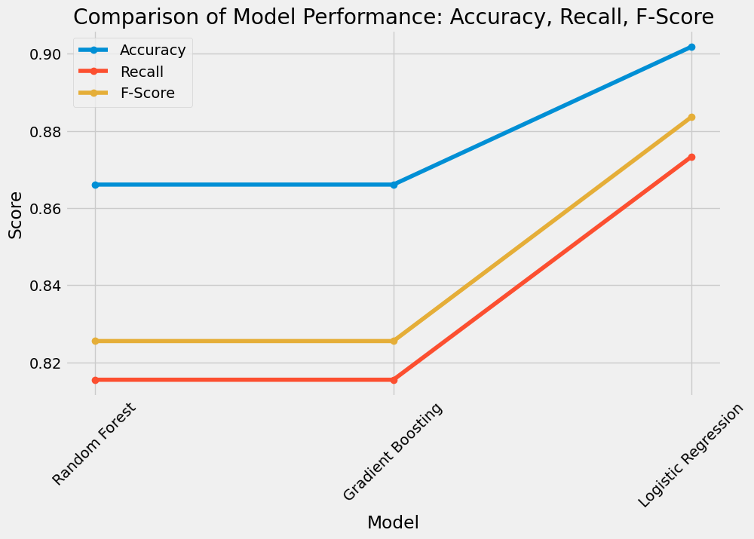
Models compared
Accuracy | Recall | F-Score | Model
0.866071 | 0.815523 | 0.825543 | Random Forest
0.866071 | 0.815523 | 0.825543 | Gradient Boosting
0.901786 | 0.873330 | 0.883598 | Logistic Regression
Logistic Regression is considered the best model because it has the highest values ​​of precision, recall, and F-Score compared to Random Forest and Gradient Boosting.

Slide 23
Conclusions
Model Performance: Logistic Regression performed the best in terms of accuracy, recall, and F-score, indicating its superior ability to predict sleep disorders compared to Random Forest and Gradient Boosting, which showed slightly lower results.
Key Features: Factors like stress level, physical activity, and BMI category significantly impact sleep quality and sleep disorders. Additionally, age and gender play a role in predicting sleep outcomes.
Practical Implications: Understanding these relationships can help design better interventions for improving sleep quality by addressing factors like stress and physical activity levels.
Future Recommendations: Future models could benefit from incorporating additional features and exploring advanced algorithms or ensemble methods for enhanced accuracy.
In summary, Logistic Regression is the most reliable model for predicting sleep disorders in this dataset, but further model refinement could improve predictions.

Slide 24
Any question ?
Prerped by: Sahar Alshahrani

