Slide 1

INTERNSHIP ASSIGNMENT
Build a Mini SciAgents: Multi-Agent Scientific Hypothesis Discovery
Based on: SciAgents — Automating Scientific Discovery
Ghafarollahi & Buehler, arXiv:2409.05556, MIT, 2024
Student: Qinghe Lou

Slide 2


The Challenge: Bridging Disciplines
Scientific breakthroughs often remain hidden in the specialized fields. SciAgents addresses this by:
•
Treating scientific knowledge as a Knowledge Graph.
•
Using specialized LLM agents to "walk the graph."
•
Connecting seemingly distant concepts
•
Generating testable, non-obvious hypotheses without human intervention.

Slide 3






The Multi-Agent Roles
Generator
Expander
Critic
Analyzes graph topology to find non-obvious paths and constructs the "Bridge Hypothesis" across domains.
Develops the step-by-step mechanism and proposes actionable experiments to test the theory.
Performs a peer review, identifying confounding variables and logical gaps in the proposed pathway.

Slide 4


Architectural Trade-off Decisions
Linear Pipeline
In-Situ Refinement
Generator → Expander → Critic
Recursive Feedback Loop
To systematically evaluate 3 concept pairs under strict token and quota limits, the code implements a sequential execution model.
The MIT paper uses a "Swarm" of intelligence where agents talk back-and-forth. This is computationally expensive but ideal for accuracy.
Notes:
This slide compares the two SciAgents architectures described in the paper.
Section 2.1 uses a structured multi-agent pipeline, where each agent performs a predefined role in a fixed sequence, such as hypothesis generation, expansion, and critique. This approach is reliable and easier to control because the workflow is explicitly programmed.
Section 2.2 extends this idea into an autonomous agentic system. Instead of a fixed pipeline, agents dynamically coordinate through a manager agent, share memory, and decide which agent or tool should act next. This creates a more flexible and self-organizing research workflow.
My implementation follows Section 2.1 much more closely. I implemented a sequential multi-agent pipeline using a scientific knowledge grap. The system contains three specialized agents: a hypothesis generator, a expander, and a critic agent for scientific review. Each agent receives the previous agent’s structured output through Pydantic schemas, which mirrors the structured reasoning workflow described in the paper.It uses fixed orchestration rather than autonomous agent coordination.

Slide 5
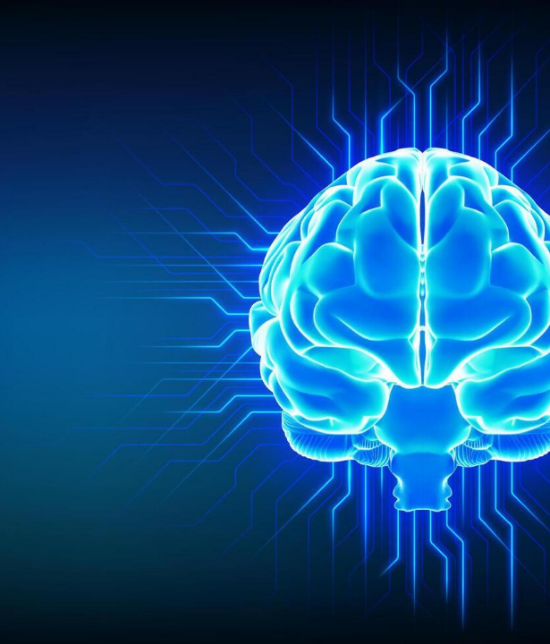
In-Situ Learning
Beyond Linear Processing:
True SciAgents behavior involves real-time feedback loops where agents refine their outputs based on peer critique.
•
Validation: Critic identifies logical fallacies.
•
Refinement: Expander rewrites the mechanism to address the bottleneck.
•
Optimization: The final output is an "evolved" hypothesis that survived self-correction.

Slide 6

Temperature Strategy: The Funnel
Creative Leap
Precise Mapping
Strict Review
Generator: Higher temperature allows for "non-obvious" semantic jumps across the graph topology, encouraging innovation.
Expander: Reduced randomness ensures that the biological mechanisms and experimental steps remain grounded in science and logical sequences.
Critic: Deterministic setting ensures maximum logical consistency and severe scrutiny, acting as a filter against hallucinated scientific claims.
"The funnel strategy allows for creative discovery at the top, while enforcing deterministic accuracy at the bottom."
Notes:
temperature is a hyperparameter that controls the randomness, creativity, and predictability of the model's generated text.

Slide 7

Case 1: Sleep Deprivation and Natural Killer Cells
Pathway:
Hypothesis:
Sleep Deprivation
↓
Sympathetic Nervous System
↓
Norepinephrine
↓
Natural Killer Cells
Hypothesis: Chronic sleep deprivation may cause long-term impairment of Natural Killer (NK) cells through sustained norepinephrine signaling, potentially creating an epigenetic “memory” that reduces immune surveillance even after sleep recovery.
Evaluation:
Plausibility: Partially
Non-obvious: Maybe
Notes:
For the first pair, I connected Sleep Deprivation and Natural Killer Cells. The graph discovered a pathway through the sympathetic nervous system and norepinephrine signaling. The hypothesis proposes that chronic sleep deprivation does more than temporarily suppress immunity—it may epigenetically reprogram NK cells and create long-term immune dysfunction. I considered this partially plausible because the biological pathway is known, but the epigenetic mechanism is still speculative. The connection is only moderately novel because sleep and immunity are already strongly linked.

Slide 8
Case 2: REM Sleep Disruption and Microglial Activation
Pathway:
Hypothesis:
REM Sleep Disruption
↓
Circadian Desynchronization
↓
Neurotransmitter Changes
↓
Microglial Clock Genes
↓
Epigenetic Remodeling
↓
Microglial Activation
Chronic REM sleep disruption may reprogram microglial circadian clock genes, creating a persistent pro-inflammatory state that contributes to neurodegeneration.
Evaluation:
Plausibility: Yes
Non-obvious: Yes
Notes:
The second pair connected REM sleep disruption to microglial activation through circadian desynchronization and epigenetic remodeling. The hypothesis suggests that chronic REM disruption changes the internal clock of microglia, making them more likely to stay in an inflammatory state. I think the connection is plausible because it connects sleep, circadian biology, epigenetics, and neuroinflammation into one mechanism. I rated it non-obvious because the relationship is not immediately obvious without graph exploration.

Slide 9
Case 3: Glymphatic System and Dendritic Cells
Pathway:
Hypothesis:
Glymphatic Dysfunction
↓
Oxidative Stress
↓
NF-kB Activation
↓
IL-6
↓
HPA Axis
↓
Cortisol
↓
Dendritic Cells
Impaired glymphatic clearance may indirectly suppress dendritic cell function through chronic inflammation and cortisol signaling, reducing effective immune responses in the brain.
Evaluation:
Plausibility: Partially
Non-obvious: Yes
Notes:
For the third run, I connected the glymphatic system and dendritic cells. The graph found a long path involving oxidative stress, inflammatory signaling, the HPA axis, and cortisol. The resulting hypothesis suggests that impaired waste clearance in the brain could eventually suppress dendritic cell function. I considered this novel because most people would not naturally connect glymphatic clearance and dendritic cells. However, I only rated it partially plausible because the mechanism requires many intermediate steps and assumptions.

Slide 10
Lessons & Technical Surprises
Graph found connections I wouldn't have made myself, but longer graph paths were not always better.
The Critic is Essential: While the Generator finds the "Bridge," the Critic prevents pseudo-science by enforcing biological constraints.
Structural Data: Pydantic schemas were crucial to ensure the multi-agent swarm didn't break during context passing.
Notes:
The most interesting part of this project was not actually the final hypotheses, but how the system generated and evaluated them. I was surprised that the graph could find meaningful connections between concepts that appear unrelated at first glance. I found the Critic agent to be the most valuable component. Without the Critic, many hypotheses looked convincing simply because they were written fluently. The Critic consistently identified unsupported assumptions and logical gaps.

Slide 11
Limitations & Future Work
Small manually-created graph: with limited coverage, missing concepts and relationships
Simplified pipeline: Original SciAgents includes more sophisticated in-situ learning
Subjective evaluation: I assessed plausibility and novelty as a computer science student rather than as a neuroscience expert.
LLM Hallucination: Agents sometimes assumed direct linear pathways where biology has complex feedback loops; human oversight is still key.
Notes:
The first limitation is the knowledge graph itself. I manually created a relatively small graph, so the quality of the results depends heavily on the concepts and relationships I included.PIPELINE. SUBJECTIVE. Another limitation is that large language models sometimes produce mechanisms that sound scientifically detailed but are difficult to verify. This is why the Critic agent is important.

Slide 12


Thank you for listening.

