Slide 1
MULTI-AGENT CLINICAL REASONING
The Tumor Board
ONCOLOGIST
Two specialized agents, one treatment plan
PATHOLOGIST
A two-agent system that discusses real, published cancer cases on open-source LLMs — and reasons toward a joint treatment plan.
Woody June 2026

Slide 2


PROBLEM STATEMENT
Why a board — and which cases
One case, two lenses
Where the cases come from
Real cancer decisions are never made alone. A tumor board puts an oncologist, a pathologist, and others on the same case — each reading it differently. The plan emerges from structured disagreement, then synthesis.
Three cases drawn from real, peer-reviewed teaching series (Academic Pathology PCME; Cancer Imaging tumor-board series, via PMC). Anonymized and realistic — no real-patient data, nothing invented. Each was chosen to stress a different part of the system.
This system replicates that with two agents. The Oncologist reasons about staging, treatment, and prognosis. The Pathologist reads what the tissue actually shows.
A
Breast HER2 Equivocal IHC resolved by FISH — handling an ambiguous biomarker correctly.
B
NSCLC EGFR L858R A driver mutation that should redirect first-line therapy — domain knowledge + auditability.
Design rule: each agent must be able to say something the other cannot. That asymmetry is the whole point.
C
Synchronous SCLC + NSCLC Pathology rewrites the whole plan. Imaging is shown to the oncologist only — cross-modality.

Slide 3
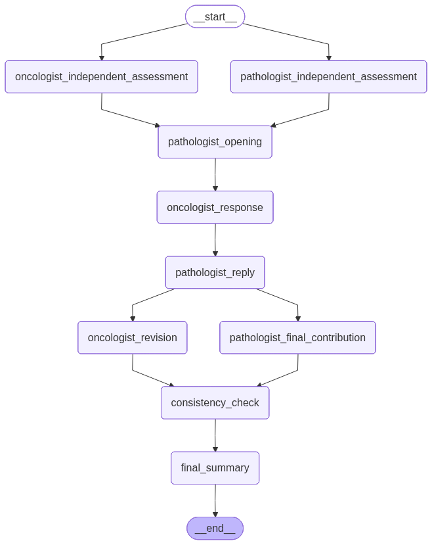
ARCHITECTURAL DESIGN
A structured, isolation-aware pipeline
Two models, two roles
Oncologist on Qwen3-VL (vision-capable); Pathologist on DeepSeek-V3.2. Orchestrated as a LangGraph state machine.
Structured 5-round protocol
Not free chat. A mandatory clarifying question and a revision force the agents to engage and converge.
Context isolation
Paired steps run in parallel and never see each other. Independence makes agreement meaningful and divergence visible.
Grounded + audited
Case-fidelity rules: use only what's in the packet — “not reported” ≠ “absent.” A Board Chair validates both summaries against it.
Compiled LangGraph · 9 nodes, rendered from the graph

Slide 4
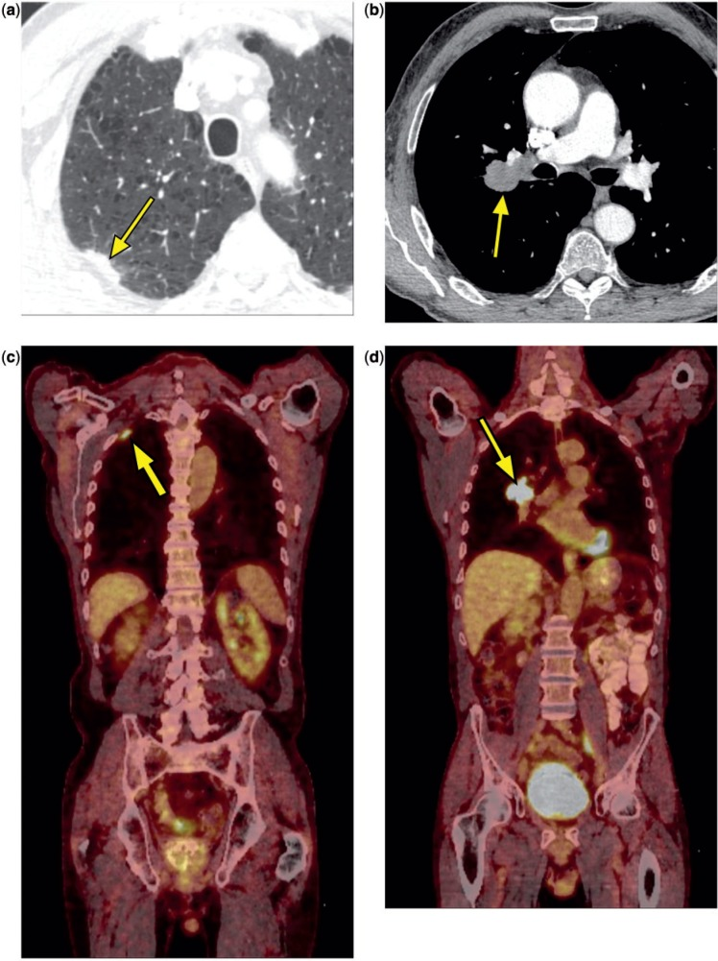
RESULT EVALUATION
Case in focus: a cross-modality showcase
C
Synchronous SCLC + NSCLC
Recap. 74-year-old, 60 pack-year smoker. CT/PET shows two right-upper-lobe lesions — a slow-growing 2.6 cm peripheral nodule (present 3 years) and a new 4 cm perihilar mass, both FDG-avid. Separate biopsies: perihilar = small-cell (SCLC); peripheral = adenosquamous (NSCLC).
The question. One cancer that spread, or two separate primaries? It decides everything — extensive-stage SCLC (palliative chemo) vs. limited SCLC + early NSCLC (potentially curable).
R2 · Oncologist treat the aggressive SCLC first with chemoradiation, then resect the slower-growing NSCLC once it responds.
CT / PET — two FDG-avid lesions (arrows)
R3 · Pathologist two histologically distinct primaries confirmed; molecular/PD-L1 on the NSCLC still missing — conserve core-biopsy tissue and get it first.
Cross-modality by design. The oncologist (Qwen-VL) reads the scan directly; the pathologist works from text only.
R4 · Board Chair concurs with treating SCLC first, but flags the oncologist’s invented N0–1 / Stage IIA–IIIB staging as speculative — nodal status is “not reported.”
A
Breast HER2
RESOLVED
B
NSCLC EGFR L858R
AUDITABLE
IHC 2+ (equivocal) → reflex FISH (ratio 3.7) → HER2-positive, ER/PR-negative. Both agents resolved the chain and avoided the triple-negative trap.
EGFR L858R → osimertinib is first-line; the oncologist wrongly gated it behind a PD-L1 ≥50% rule. The Board Chair caught that, then slipped itself — fabricating a fake “N3b” sub-stage. Visible only because every turn is logged.
Note: Cards B and C reflect the latest run (2026-06-11). The system is non-deterministic — exact staging slips and position changes vary run to run; earlier runs showed different but analogous behavior.

Slide 5



PRINCIPLE
Beyond model choice: modality and grounding
Does the model choice matter? Yes — the axes that matter are modality fit and grounded knowledge, not which model is “smarter.” Qwen and DeepSeek gave near-identical clinical content, differing mainly in voice — Qwen patient-facing, DeepSeek neutral and report-like.
Cross-modality availability
Domain knowledge = training data
The oncologist must read imaging — that requires a vision-capable model. Qwen3-VL can see the CT/PET; a text-only model literally cannot. Role assignment is constrained by modality first.
The fabricated “N3b” sub-stage wasn’t bad reasoning — it’s encoded clinical fact being wrong. Prompts shape behavior and persona; they can't install correct facts.
The architecture must route each input to a model that can actually consume it.
The real fixes: fine-tuning and a knowledge base (RAG) that puts the staging table in front of the model — with a citation.
The takeaway. Choose models for modality fit, ground them in real clinical references, and log every turn — so the errors that remain are visible and fixable, not silent.

Slide 6


WHAT I LEARNED · WHAT'S NEXT
From talking agents to grounded ones
The hard part isn't getting agents to talk. It's controlling what each one knows — and proving the output is grounded.
Done
Next
Role & persona prompting
Domain grounding
Each agent reasons from a genuine, non-overlapping lens — not a chatbot in a costume.
RAG over AJCC / NCCN / WHO plus targeted fine-tuning — fix facts at the source, auditable by citation.
Post-validation as its own step
Context isolation by structure
A checking node instead of “don't say X” rules that bias the output (the pink-elephant problem).
Independence prevents one agent's hallucination from becoming the other's “fact.” Context is cognition; the graph is the access policy.
Guaranteed structured output
Critical fields — stage, biomarker, regimen — always parseable, so they're always checkable.

Slide 7
Thank you
Next: a live walkthrough of the system in action.
Woody The Tumor Board · June 2026

