Slide 1
ASSIGNMENT REPORT
Build a Tool Specification Discoverer & Optimizer
Discoverer + Optimizer for reliable LLM tool-use
Based on ToolUniverse · Gao et al., arXiv:2509.23426 · Harvard Medical School, 2025

Slide 2
THE CHALLENGE
The bottleneck isn't reasoning — it's the tool spec
An LLM can only invoke a tool correctly if its specification is clear.
z
My system, in one line
A vague parameter name → the model guesses the wrong argument
Discoverer
plain English → structured spec + stub
Optimizer
test feedback → a more reliable spec
!
An ambiguous description → it calls a different tool entirely
!
A wrong type → the call is malformed and fails
!
2

Slide 3
Q1 · HOW DOES IT WORK
One pipeline, two halves, eight components
NL
description
DISCOVERER
ToolSpec
+ stub
OPTIMIZER
Better spec
+ report
Discoverer components
Optimizer components
PatternRetriever
SpecGenerator
StubGenerator
StaticValidator
TestPromptGen
InvocationTester
FailureDiagnoser
SpecRewriter
Three decisions I committed to early
Disk-cache every LLM call (reproducible, never pay twice) · Judge correctness with pure logic (no LLM-as-judge) · Diagnose to the field path (parameters[0].type, not “bad spec”)
3

Slide 4
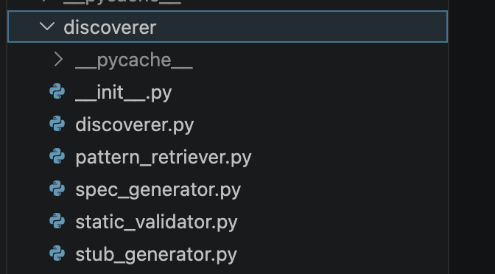
Q1 · ARCHITECTURE
Discoverer — what each stage produces & passes on
tool_descriptions
.json
1
no LLM
2
LLM
3
no LLM
4
no LLM
PatternRetriever
SpecGenerator
StubGenerator
StaticValidator
pattern_retriever.py
spec_generator.py
stub_generator.py
static_validator.py
reads 3 seed specs,
ranks by keyword overlap
few-shot prompt →
structured spec
template signature
+ docstring from spec
schema · snake_case ·
stub↔spec match
top-3 seeds
(in memory)
discovered_specs/
{name}.json
discovered_stubs/
{name}.py
discovery_report
.json
■ = file written to disk ■ = LLM call (only stage 2) ■ = pure code
Result: 11/11 valid specs. The discovered_specs/*.json become the canonical input for every downstream phase — baseline, optimization, degradation.
4

Slide 5
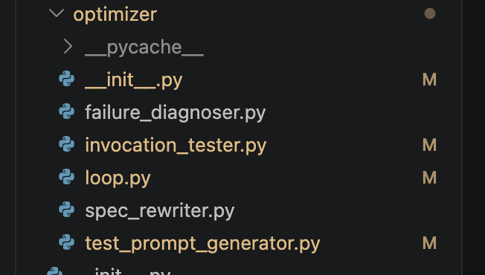
Q1 · ARCHITECTURE
Optimizer — the loop, the guard, the files it writes
discovered_specs/
{name}.json
1
LLM
2
no LLM
3
LLM
4
no LLM
TestPromptGen
InvocationTester
FailureDiagnoser
SpecRewriter
test_prompt_generator.py
invocation_tester.py
failure_diagnoser.py
spec_rewriter.py
5 tricky prompts
(adaptive each round)
compete vs 10;
check name/args/types
blame the exact
field + propose fix
change ONLY
that one field
loop ≤ 3 rounds — re-test on the SAME prompts
Writes to disk:
optimized_specs/{name}.json
optimization_report.json
logs/optimization.jsonl
🛡 Do-No-Harm Guard re-test candidate before commit; reject if it regresses
the improved spec
before/after per tool
every iteration record
Three exit states: target_reached (fixed) · no_harm_guard (stop, would regress) · needs_redesign (escalate to Discoverer)
5

Slide 6
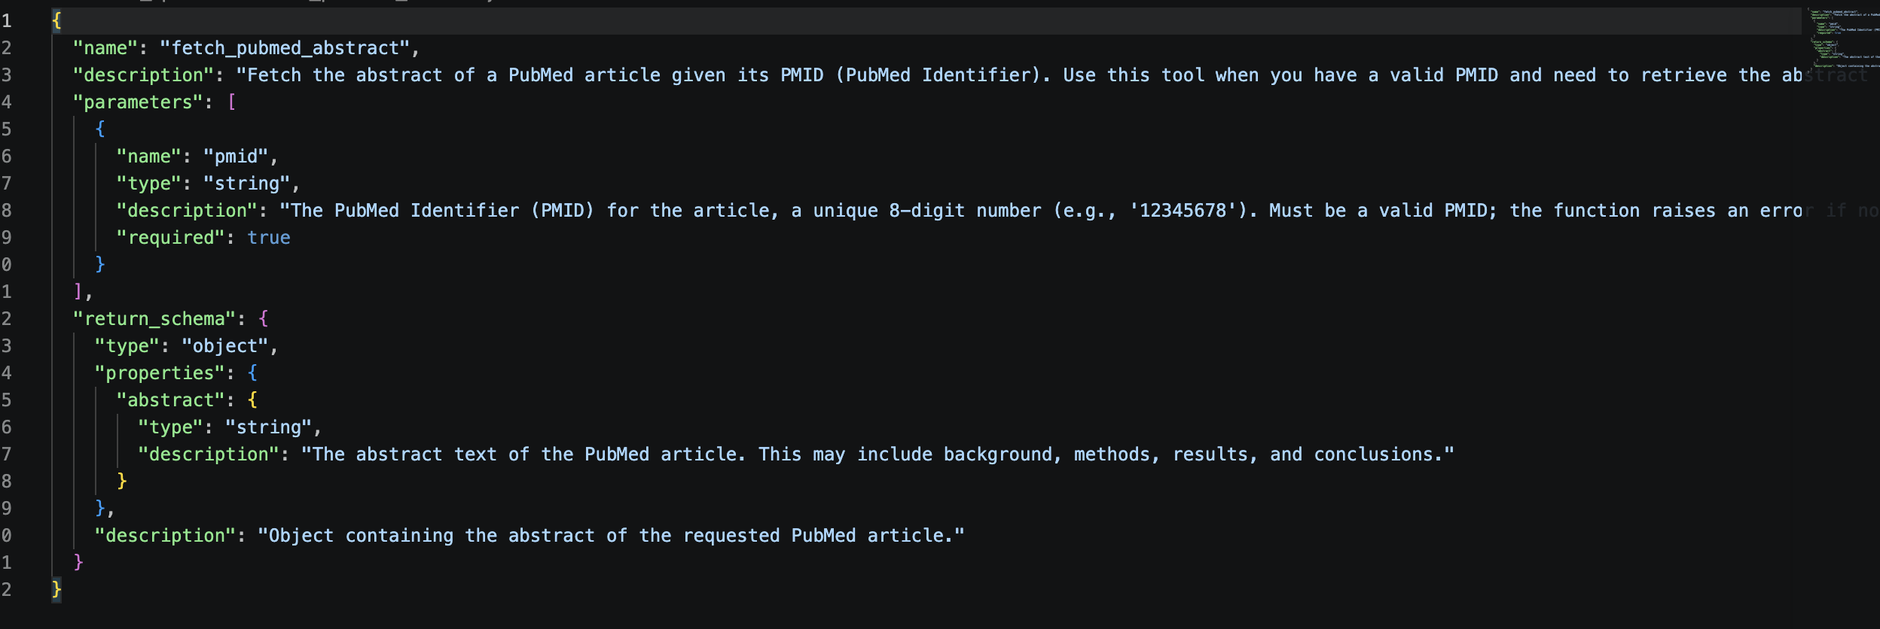
Q1 · HOW DOES IT WORK
End-to-end: one sentence in, a usable spec out
INPUT · 11 plain words
What the Discoverer added on its own
“a tool that fetches the abstract of a PubMed paper given its PMID”
snake_case name — a clean callable identifier
when-NOT-to-use clause — “use get_metadata for titles” — prevents mis-routing
format hint on the param — “8-digit number, e.g. 12345678”
full return schema — so the caller knows the output shape
11 / 11 tool specs generated and validated on the first try
6

Slide 7
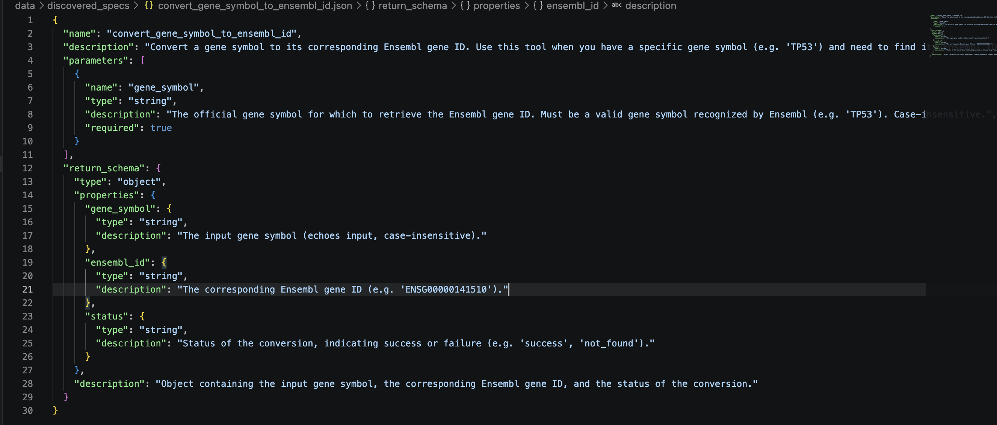
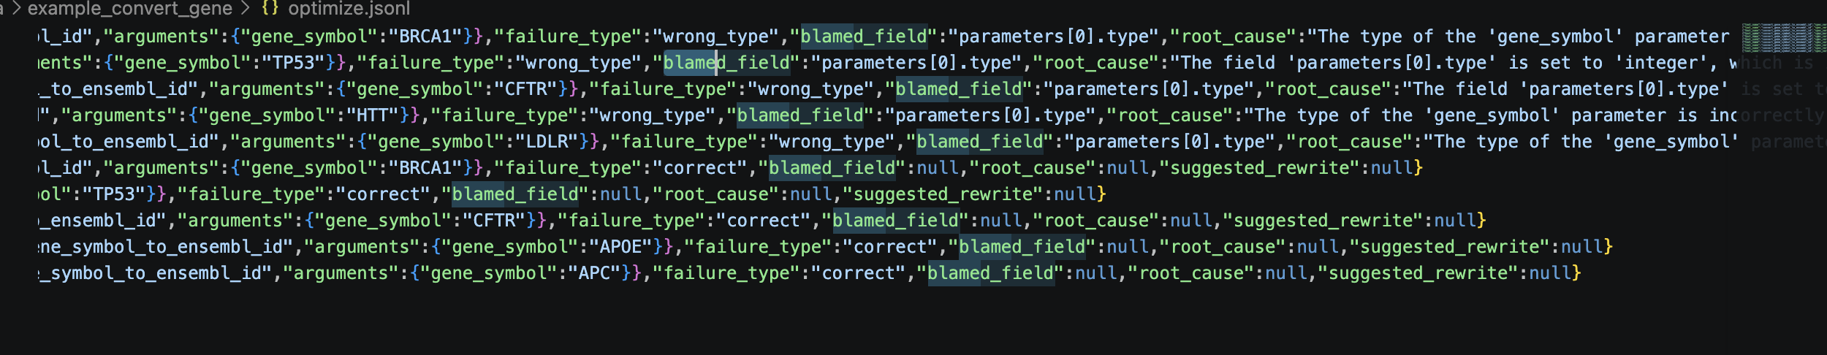
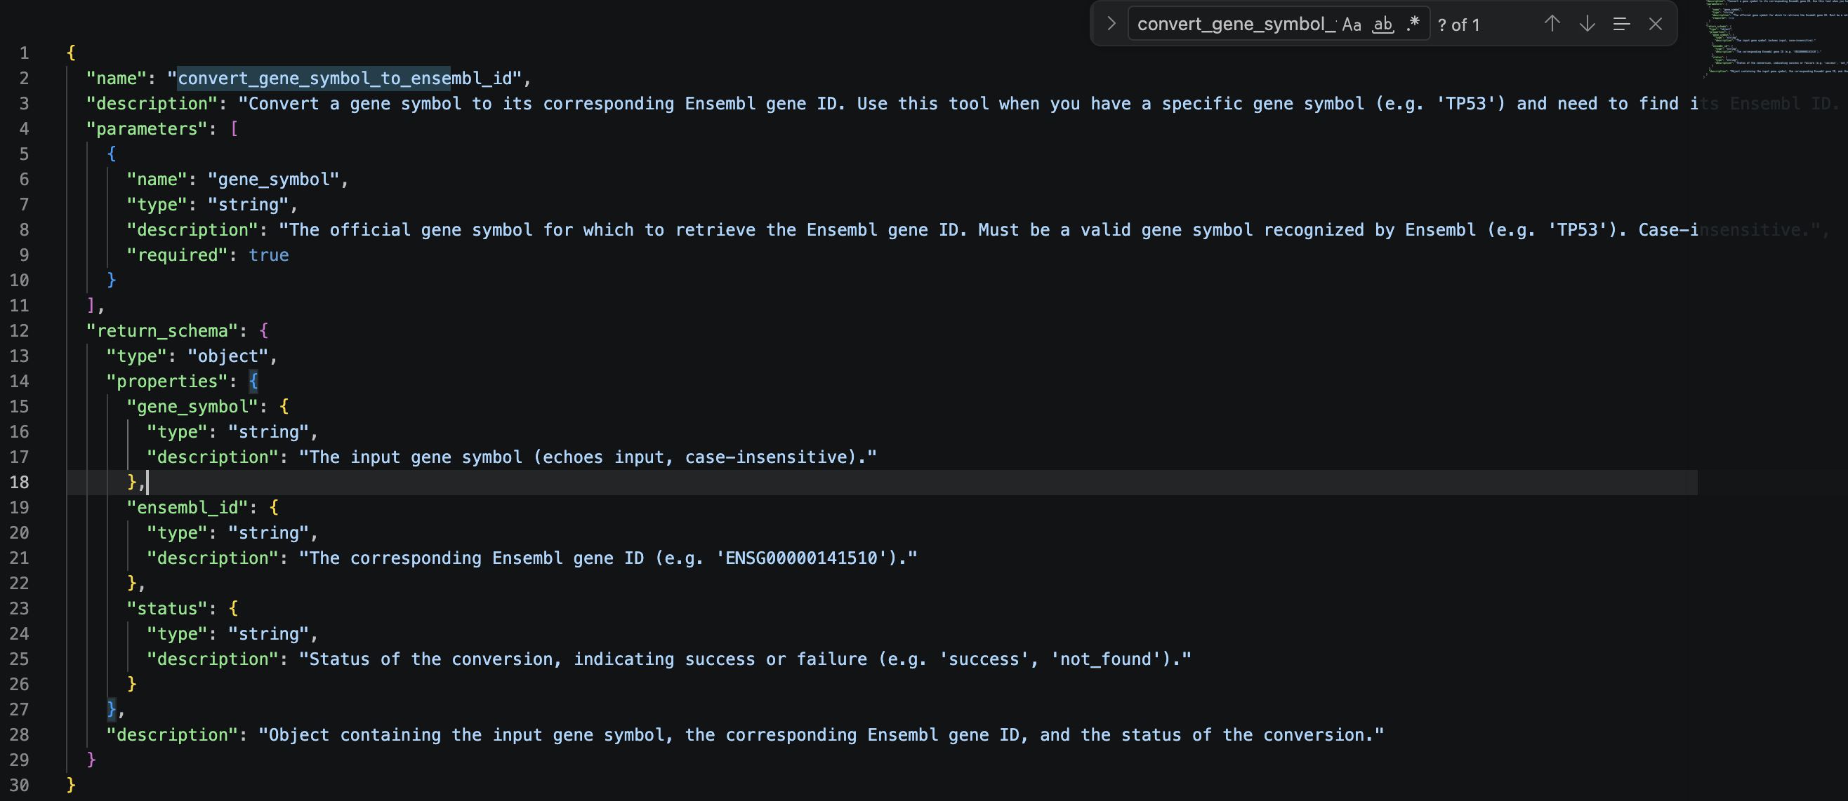
Q1 · concrete example

Slide 8
Q1 · HOW DOES IT WORK
The Optimizer: a 4-step loop, ≤ 3 rounds
1
Generate 5 deliberately tricky prompts — never echo the param names
One real loop — compute_tanimoto_similarity
Round 0 3 / 5 correct
2
Test spec competes against the other 10; judge name + args + types
2 prompts went to the wrong tool
diagnose → blamed_field = description
3
Diagnose LLM names the exact field at fault + a fix
rewrite → add “two specific molecules,
e.g. ibuprofen & naproxen” (one field only)
4
Rewrite change ONLY that one field, then re-loop
↻ re-loop on the same prompts
Round 1 5 / 5 correct ✓ stop
Maps to the assignment verbatim: “check right tool name, right arguments, right types” and “rewrite only that part.”
on held-out prompts: 60% → 80%
7

Slide 9
Q2 · DOES IT WORK
Before / after — and why the headline is misleading
89.1% → 90.9%
My reaction: “+1.8 pp — does that actually prove the Optimizer works?”
overall · +1.8 pp · 0 regressed
The data behind it — baseline accuracy of all 11 specs
rank_drug_compounds
40%
8 / 11
compute_tanimoto_similarity
60%
fetch_pubmed_abstract
80%
already at 100%
→ ceiling effect:
nothing to fix
8 other tools
100%
So the small gain isn’t weakness — it’s two things: (1) the Discoverer was already strong, and (2) the few failures left are non-spec problems (e.g. rank_drug_compounds: the user never supplies the data).
8

Slide 10
Q1 · concrete example
So I injected fixable bugs — 66 controlled cells
MY THINKING If natural specs are too clean, manufacture damage and see what the Optimizer recovers.
bug scenario
tools damaged
fully recovered
ONLY
wrong_type
7 / 11
7 / 7
1 of 6
wrong_type + empty
5 / 11
5 / 5
wrong_type + misleading
6 / 11
5 / 6
bug types
actually damage
the spec
wrong_param_name
0 / 11
—
misleading_description
0 / 11
—
add_fake_required_param
0 / 11
—
Type errors break 7/11 — Optimizer recovers all 7. The others? The LLM just absorbs them.
ONE EXAMPLE
convert_gene_symbol_to_ensembl_id: flip parameters[0].type string→integer → 100% → 0% → Optimizer fixes that one field → 100%
9

Slide 11
Q3 · WHAT I LEARNED · KEY FINDING
LLM tolerance to spec defects is wildly asymmetric
Type error
CATASTROPHIC
So what?
7/11 tools crash, −58 pp avg
The LLM has redundant signals — tool name + parameter list — so it self-heals any single missing one.
But a wrong
type cannot be worked around.
That scopes the Optimizer’s value precisely to type errors — narrow, but 100% there.
Wrong param name
ABSORBED
LLM infers from the description
Wrong description
ABSORBED
LLM infers from the tool name
Fake parameter
SILENTLY IGNORED
LLM just drops the extra arg
A finding in itself — not all spec fields carry equal weight.
10

Slide 12
Q2 · DOES IT WORK · LAYER 3
Then it backfired — and I built a guard
MY THINKING Add 4 overlapping tools so “pick the right tool” is finally under real pressure (15-tool competition).
Without guard
−2.5 pp → +5.0 pp
8 confusable tools
88%
one spec diverged 80% → 20% across 3 unchecked rounds
0 regressions · runtime 222 s → 12.5 s (~18×)
With Do-No-Harm Guard
8 confusable tools
95%
Why it diverged — a different failure
re-test each rewrite before commit; reject anything that regresses
Two intrinsically similar tools have no single “correct” description. Each rewrite perturbs behaviour, so edits diverge instead of converge. A type error has one right answer; semantic confusion does not.
11

Slide 13
Q3 · WHAT I LEARNED · THE BOUNDARY
Is +1.8pp just a ceiling effect? I tested both ends
MY THINKING Make specs WORSE on purpose — from the input side (B1) and the Discoverer side (B2).
Main line
B1 · weak input
B2 · weak Discoverer
rich desc + few-shot
vague descriptions
rich desc, zero-shot
89.1% → 90.9%
89% → 64%
71% → 76.4%
+1.8 pp
+0.0 pp
+5.5 pp
ceiling — little to fix
e.g. compare_items: 4/5 prompts stolen by specialist tools — unfixable
field-level fixed, structural flagged
Same boundary from two directions: the Optimizer fixes field-level defects; structural defects need a redesign, not a rewrite.
12

Slide 14
Q3 · WHAT I LEARNED · THE PAYOFF
I made the system know its own boundary
The methodology trap I hit
Three end states it never confuses
The Optimizer tests itself with prompts it wrote for the spec — so they flatter it.
target_reached
compare_items: 100% self-test vs 20% held-out
fixed it
Fix: judge needs_redesign on a held-out prompt set, never on self-tests.
no_harm_guard
a change would regress — stop safely
3 / 5
0 / 1
needs_redesign
structural defects
correctly flagged
false positives
(healthy control)
not mine to fix — send back to Discoverer
13

Slide 15
Q3 · WHAT I LEARNED
What actually makes a tool spec “good”
Correct types first
Distinctiveness > prose
Redundant signals help
The only field the LLM can’t infer around. Get types right before anything else.
Tools must be separable. A beautiful description loses to a name clash.
Name + params + description give the LLM fallback paths — lean on them.
Failure modes the Optimizer could NOT fix
✕
Missing user data — rank_drug_compounds stuck at 40% — the prompt has no scores to pass.
✕
Task refusal — ambiguous query + no data → the LLM refuses to call anything. Needs dialogue, not a rewrite.
✕
Structural / vague identity — an over-broad tool — needs redesign upstream, not field edits.
14

Slide 16
THE THREAD THAT CONNECTS IT ALL
How my thinking evolved
Built it
Discoverer + Optimizer, end to end
Doubted it
“+1.8pp — is that even real?”
Stress-tested it
66-cell degradation → type errors 7/7
Broke it
confusion made it diverge −60pp
Guarded it
do-no-harm → +5pp, 0 regressions
Bounded it
B1 & B2 — field-level vs structural
Taught it limits
needs_redesign: it knows what it can’t fix
The deliverable isn’t “it improved accuracy.” It’s a precise map of when this kind of optimizer helps — and when it can’t.
15

Slide 17
Three answers, one sentence each
How does it work?
By the numbers
NL → Discoverer (spec + stub) → Optimizer’s 4-step loop with field-level diagnosis.
11+4 tools
66 degradation cells
Does it work?
+1.8pp natural; type errors 7/7; confusion −2.5 → +5pp with the guard — verified from both ends.
8 experiment phases
100 unit tests passing
What did I learn?
The Optimizer is scoped to field-level defects — and now it knows that, reporting needs_redesign for the rest.
~$3 total API cost
16

Slide 18
Thank you

