Slide 1
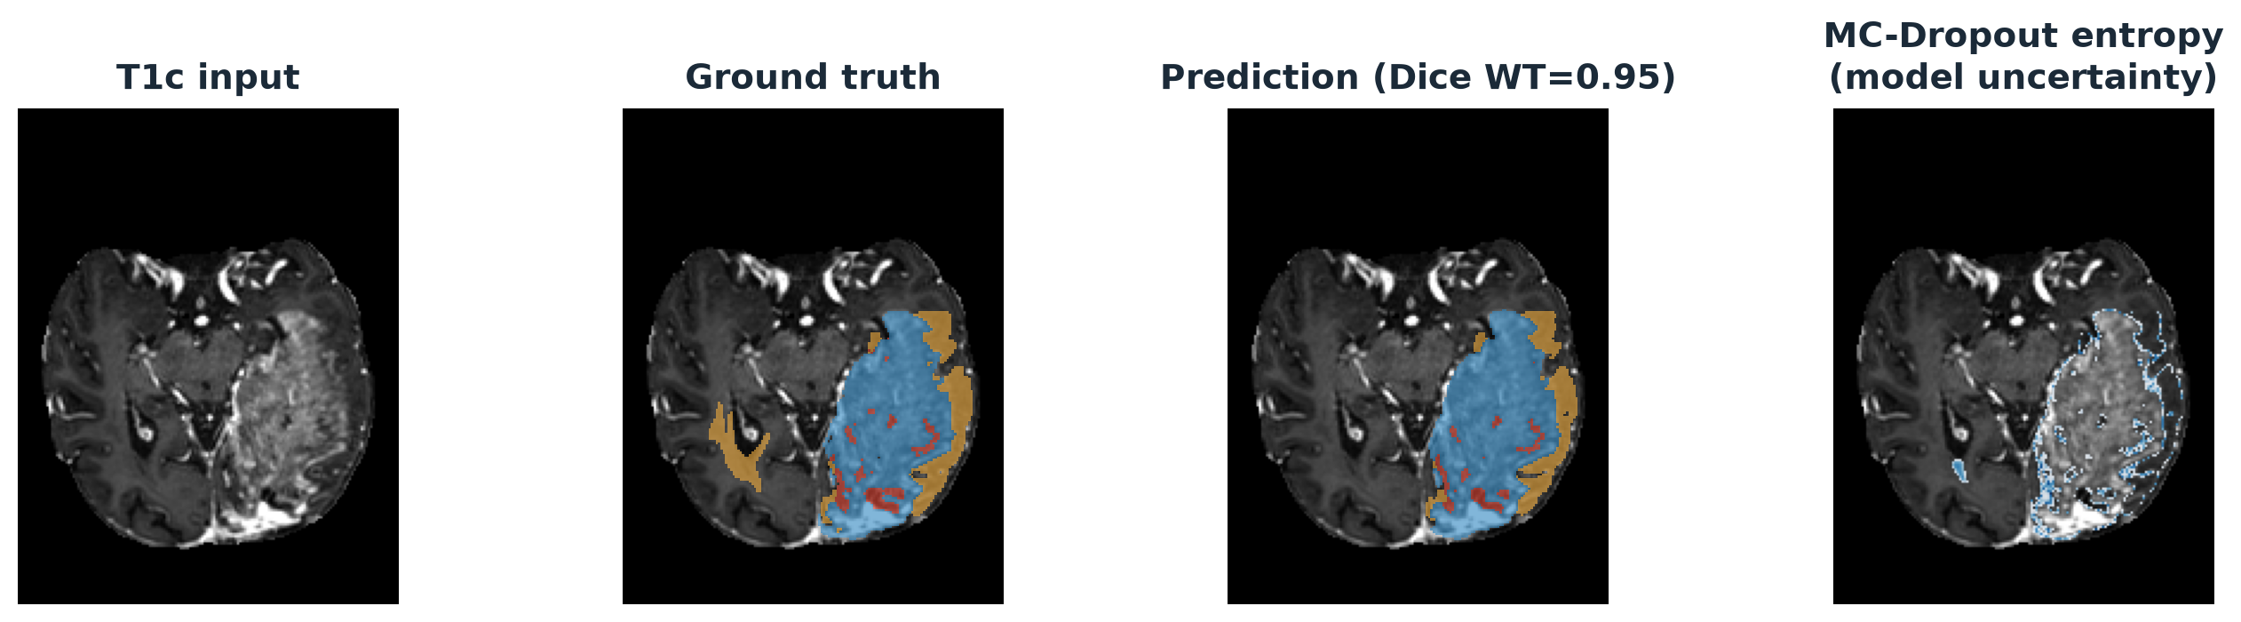
Uncertainty-Aware Brain
Tumor Segmentation
3D Attention U-Net with Monte Carlo Dropout — BraTS 2024 GLI
Method Section
Sahar Ifrah · Hadas Avraham

Slide 2
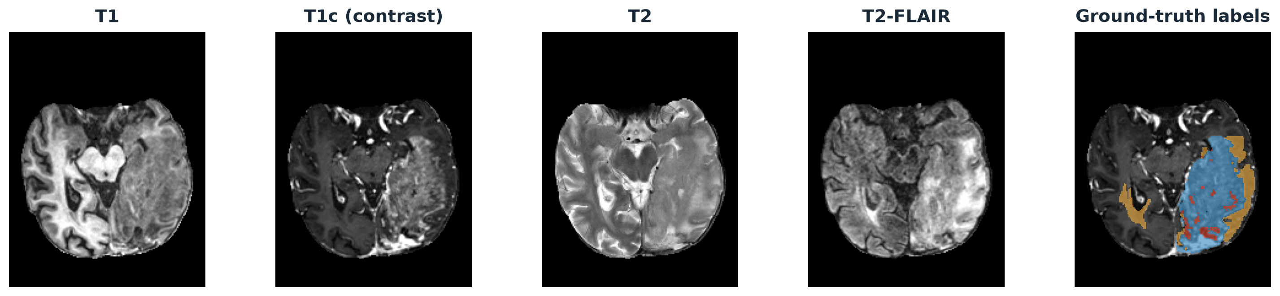
DATA
Dataset — BraTS 2024 GLI
▸ 1,621 training subjects (1,350 core + 271 additional) + 188 official validation subjects (no ground truth released)
▸ 4 co-registered MRI modalities per subject: T1, T1c (contrast), T2, T2-FLAIR
▸ Pre-registered to the SRI24 atlas and skull-stripped — 182×218×182 voxels, 1 mm isotropic
▸ Persistent 80/20 split used throughout: 1,297 train / 324 held-out validation
BraTS 2024 GLI — Attention U-Net + MC Dropout
02

Slide 3
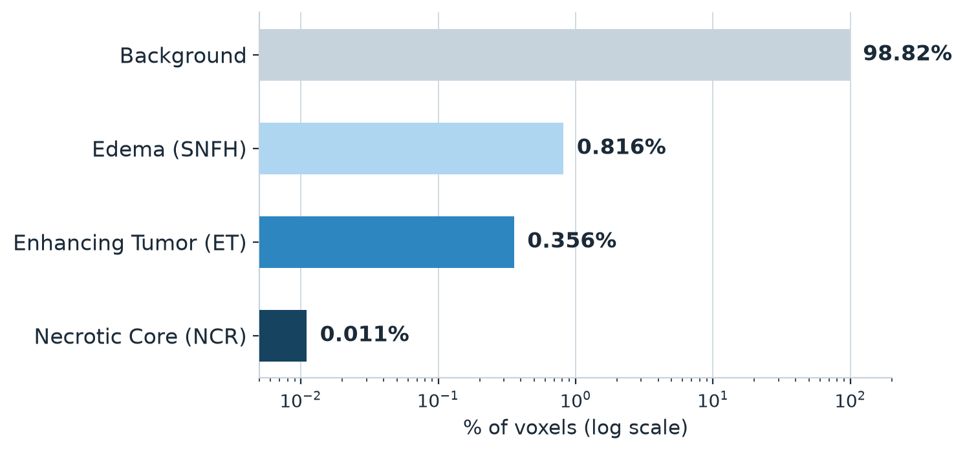
DATA
Labels & Class Imbalance
▸ 3 evaluated sub-regions: Tumor Core (TC), Whole Tumor (WT), Enhancing Tumor (ET)
▸ Derived from 4 voxel labels — background, necrotic core, edema, enhancing tumor
▸ Severe imbalance: background is 98.8% of voxels; the smallest tumor class is 0.01%
▸ Preprocessing: max-normalize → crop to brain bbox → resize to 160×208×160
Region color key
Necrotic Core (NCR)
Edema (SNFH)
Enhancing Tumor (ET)
BraTS 2024 GLI — Attention U-Net + MC Dropout
03

Slide 4
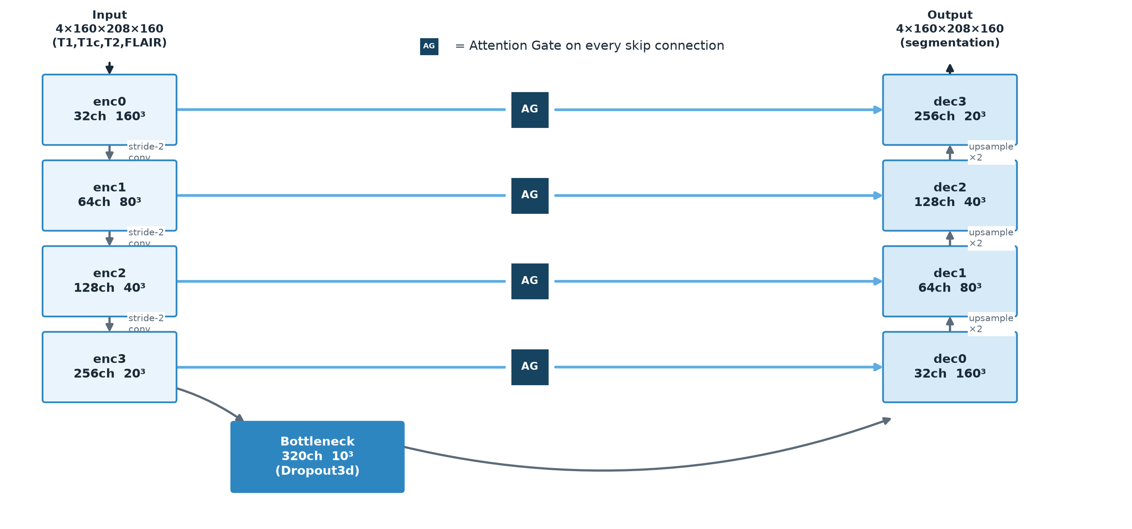
MODEL
3D Attention U-Net Backbone
▸ Encoder–decoder: 4 downsampling stages + bottleneck, learned stride-2 convs (not max-pool)
▸ InstanceNorm3D + LeakyReLU throughout · 21.8M parameters
▸ Every skip connection passes through a learned Attention Gate (AG), not a plain concat
▸ MC Dropout in the bottleneck + 2 deepest decoder blocks → enables uncertainty at inference
BraTS 2024 GLI — Attention U-Net + MC Dropout
04

Slide 5
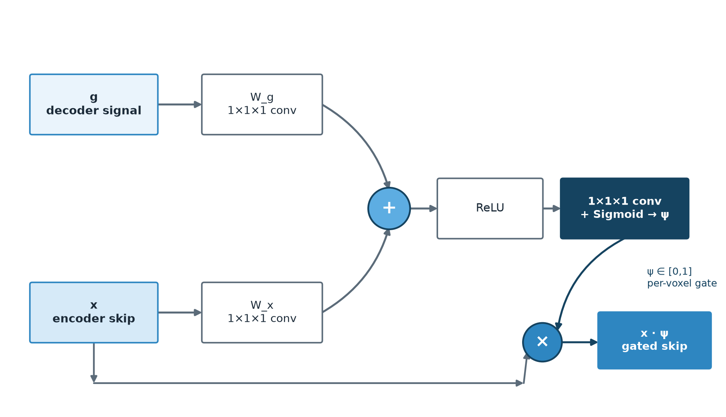
MODEL
Attention Gate — Learning Where to Look
▸ Additive attention (Bahdanau-style), computed independently per voxel
▸ Not transformer self-attention: no Q/K/V, no cross-position mixing
▸ Combines decoder context g + encoder skip x → sigmoid gate ψ ∈ [0,1] → scales the skip
▸ Learned end-to-end from the segmentation loss alone — no extra supervision needed
Why it matters: attention gates suppress background-dominated regions of each skip connection before it reaches the decoder — the biggest gain lands on the smallest, hardest region (Enhancing Tumor Dice 0.850 → 0.861).
BraTS 2024 GLI — Attention U-Net + MC Dropout
05

Slide 6
METHOD
Hyperparameter Selection
▸ Batch size 1 (full 160×208×160 volume) → drives InstanceNorm instead of BatchNorm
▸ 5-epoch linear warmup before cosine annealing — avoids early destabilization at full LR
▸ Dropout confined to the bottleneck + 2 deepest blocks — uncertainty without hurting fine detail
Hyperparameter | Value
Optimizer | AdamW
Learning rate | 2e-4 peak, after warmup
Weight decay | 1e-4
Batch size | 1 (full volume)
LR schedule | 5-epoch warmup → cosine (T_max=80)
Loss function | Dice Focal Loss (γ=2.0, background excluded)
Dropout probability | 0.15 — bottleneck + dec3 + dec2 only
Gradient clipping | max_norm = 1.0
Early stopping | patience = 35 epochs (max 300)
Init features | 32 (21.8M parameters total)
BraTS 2024 GLI — Attention U-Net + MC Dropout
06

Slide 7
METHOD
Evaluation Methodology
▸ Every reported number reuses the same persistent 324-subject held-out split — no leakage
▸ Region-wise Dice + 95th-percentile Hausdorff Distance (HD95), computed for TC / WT / ET
▸ Two inference modes compared: single deterministic pass vs 20-pass MC Dropout averaging
▸ Published baselines run through the identical split via adapter pipelines — a true head-to-head
324
20
0.008
0.896
held-out validation subjects
MC Dropout passes at inference
Expected Calibration Error (ECE)
AUROC — entropy as error detector
BraTS 2024 GLI — Attention U-Net + MC Dropout
07

Slide 8
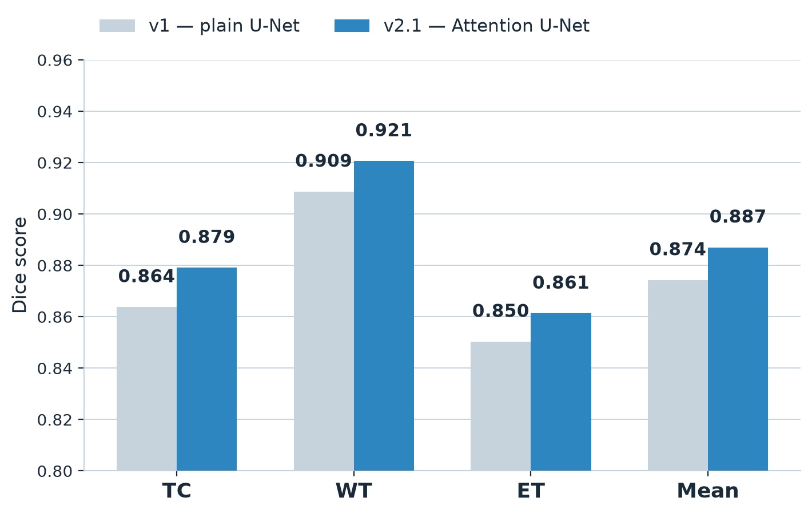
RESULTS
Segmentation Accuracy — Attention Gates Help
▸ v2.1 (Attention U-Net) beats the v1 plain U-Net on every metric and every region
▸ +1.3 pts mean Dice (0.874 → 0.887) · HD95 mean −16% (5.83mm → 4.92mm)
▸ Largest relative gain on Enhancing Tumor — exactly the region attention gates target
BraTS 2024 GLI — Attention U-Net + MC Dropout
08

Slide 9
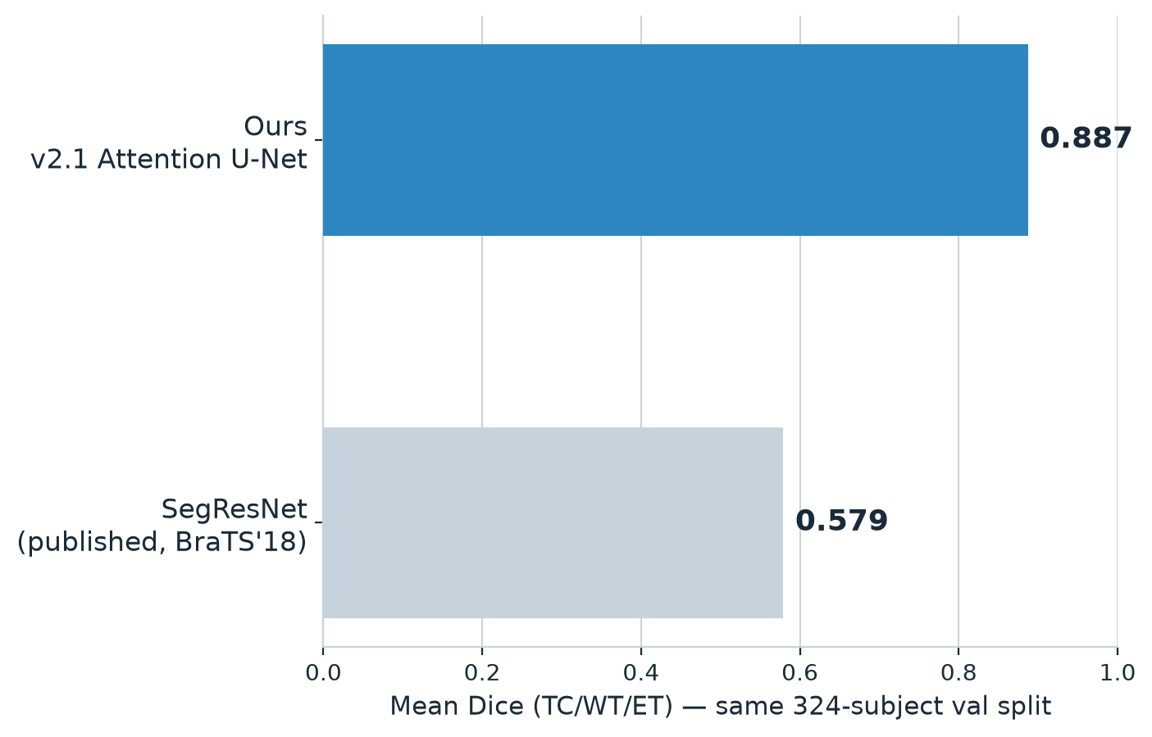
RESULTS
Head-to-Head vs a Published Baseline
▸ SegResNet (MONAI's published BraTS bundle, trained on BraTS 2018) evaluated on our identical 324-subject split
▸ Our model scores +0.31 mean Dice higher — a true head-to-head, not a literature-numbers comparison
▸ Expected: SegResNet never saw BraTS 2024 post-treatment scans (surgical cavities, radiation effects)
BraTS 2024 GLI — Attention U-Net + MC Dropout
09

Slide 10
RESULTS
Uncertainty That Flags Its Own Mistakes
▸ MC Dropout entropy is ~7× higher on false positives than on correct predictions
▸ Well calibrated: voxel confidence tracks empirical accuracy (ECE = 0.008)
▸ Example subject: Dice TC/WT/ET = 0.97 / 0.95 / 0.94 — entropy concentrates on the prediction's edges
BraTS 2024 GLI — Attention U-Net + MC Dropout
10

Slide 11
SUMMARY
Key Takeaways
Data
1,621 multi-modal BraTS 2024 GLI subjects, preprocessed to a fixed 160×208×160 grid with a persistent 80/20 split.
Model
3D U-Net with attention-gated skip connections (21.8M params) and MC Dropout for built-in uncertainty.
Results
Mean Dice 0.887 / HD95 4.92mm — beats the plain-U-Net baseline and a published model on the same data, with well-calibrated, error-flagging uncertainty.
BraTS 2024 GLI — Attention U-Net + MC Dropout
11

