Slide 1
MULTI-REGION BRAIN TUMOR SEGMENTATION
Uncertainty-Aware Glioma Segmentation
with Monte Carlo Dropout
BraTS 2024 — Adult Glioma, Post-Treatment (GLI)
Sahar Ifrah · Hadas Avraham
3D U-Net → Attention U-Net · PyTorch + MONAI

Slide 2
INTRODUCTION
The Problem, and Why Uncertainty Matters
The task
The innovation
▸ Segment adult diffuse gliomas from multi-parametric brain MRI into three clinically-defined sub-regions:
· Tumor Core (TC)
· Whole Tumor (WT)
· Enhancing Tumor (ET)
▸ Post-treatment scans (BraTS 2024 GLI) — surgical cavities, radiation effects, pseudoprogression, not just raw pre-op tumor.
▸ A segmentation mask alone doesn't say where the model might be wrong.
▸ Monte Carlo Dropout: keep dropout active at inference, run N stochastic forward passes, and read the spread as a per-voxel uncertainty map.
▸ Goal: uncertainty that's actually usable — high entropy should mean "look here," not just noise.
Two model generations
▸ v1 — plain 3D U-Net established the pipeline + MC Dropout innovation. Mean Dice 0.874.
▸ v2.1 — Attention U-Net attention-gated skip connections + stronger augmentation, targeting the hardest, smallest regions (ET, NCR). Mean Dice 0.887 — current best.
BraTS 2024 GLI — Multi-Region Glioma Segmentation
2

Slide 3
THE DATA
BraTS 2024 GLI — Multi-Parametric MRI
Dataset
Label convention
▸ 1,621 training subjects 1,350 base + 271 additional
▸ 188 validation subjects official BraTS val set, no labels released
▸ 4 MRI modalities / subject T1n, T1c, T2w, T2-FLAIR
▸ Pre-registered (SRI24), skull-stripped, 1mm isotropic no registration/skull-removal needed; verified no NaN/Inf
Label | Region | Eval group
0 | Background | —
1 | Necrotic Core (NCR) | TC
2 | Edema (SNFH) | WT only
3 | Enhancing Tumor (ET) | TC, WT, ET
Raw label 4 (old-convention ET) remapped to 3 during preprocessing.
Severe class imbalance + preprocessing pipeline
▸ Background 98.82% of voxels
▸ Edema 0.816%
▸ Enhancing Tumor 0.356%
▸ Necrotic Core 0.011% — the rarest class by far
▸ Normalize each modality by its global training-set max → [0, 1]
▸ Remap label 4 → 3 (unify ET convention)
▸ Tight-crop to brain bounding box, then center-crop/pad to 160×208×160 (divisible by 16 for U-Net pooling)
BraTS 2024 GLI — Multi-Region Glioma Segmentation
3

Slide 4
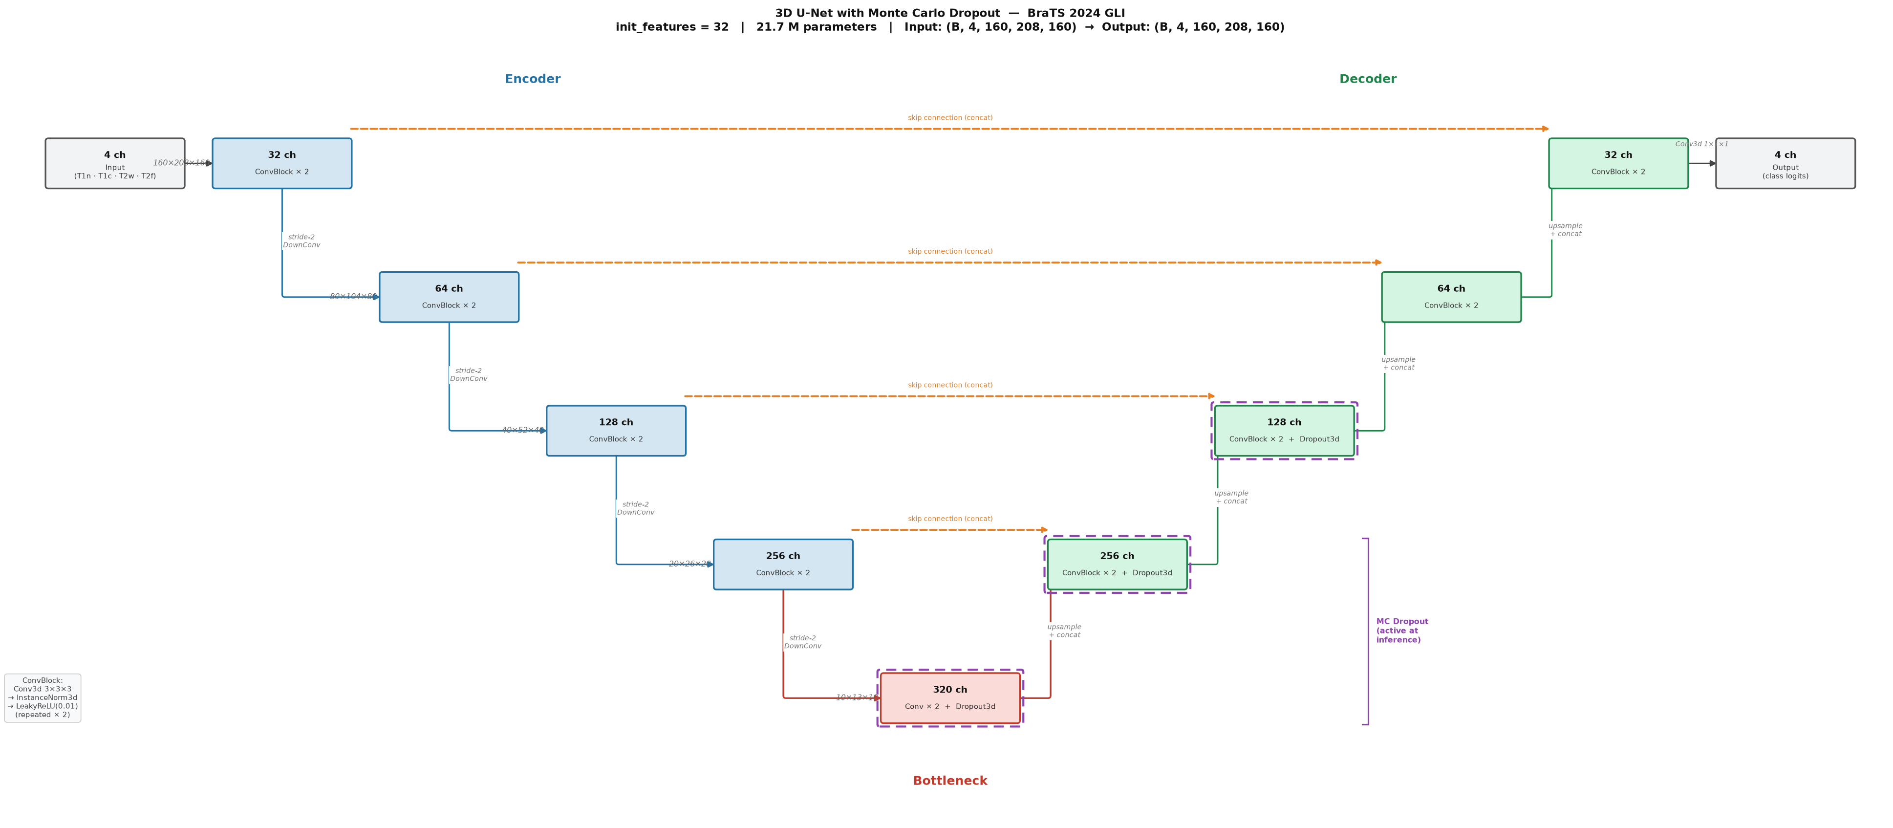
MODEL
Attention U-Net + Monte Carlo Dropout (v2.1)
▸ 4 encoder stages + bottleneck + 4 decoder ConvBlock = Conv3d 3×3×3 → InstanceNorm3d → LeakyReLU, ×2. Stride-2 DownConv (not MaxPool) for learned downsampling.
▸ Attention gate on every skip decoder signal + encoder skip combined additively, squashed to a per-voxel sigmoid mask — suppresses background-dominated regions of the skip before it reaches the decoder. Not transformer attention: no Q/K/V, no cross-voxel mixing.
▸ MC Dropout, p=0.15 bottleneck + two deepest decoder blocks only — concentrates stochasticity where the receptive field is largest.
▸ 21.8M parameters attention gates add negligible overhead vs. v1's 21.7M
Base topology shown (v1). v2.1 keeps this encoder/decoder/bottleneck shape and adds an attention gate on every skip connection.
BraTS 2024 GLI — Multi-Region Glioma Segmentation
4

Slide 5
TRAINING
Loss, Optimization, Augmentation
Loss & optimization
Augmentation (train only)
▸ DiceFocalLoss γ=2.0, background excluded — focal term concentrates the loss on hard/rare classes (NCR, ET) given the 99% background imbalance
▸ AdamW lr=2e-4, weight_decay=1e-4
▸ Schedule 5-epoch linear warmup → cosine annealing (T_max=80)
▸ Batch size 1, mixed precision (AMP) InstanceNorm (not BatchNorm); gradient clipping at max_norm=1.0
▸ Independent random flip on each of the 3 spatial axes (p=0.5 each)
▸ Per-modality intensity scale ~U[0.85, 1.15] (p=0.5)
▸ Per-modality intensity shift ~U[-0.10, 0.10] (p=0.5)
▸ Additive Gaussian noise N(0, 0.01) (p=0.20)
▸ Clipped back to [0, 1] after each op — validation never augmented
Persistent validation split + training outcome
▸ 1,297 train / 324 val subjects split saved once to val_split.json, reloaded on every run/resume — the held-out set never drifts
▸ Best checkpoint: epoch 108 mean val Dice 0.8870
▸ Early stopping patience=35 training reached epoch 143 (34/35, one short of triggering) before being interrupted — a strong but not fully converged result
BraTS 2024 GLI — Multi-Region Glioma Segmentation
5

Slide 6
INFERENCE
Deterministic vs. Monte Carlo Dropout
Two inference modes
What comes out
▸ Deterministic standard eval-mode forward pass — one segmentation mask, no uncertainty estimate
▸ MC Dropout (N passes) force the model into train() mode so Dropout3d layers stay stochastic, but run under torch.no_grad() — no gradients, just noise
▸ Run N stochastic forward passes, keep an online mean of the softmax probabilities (peak memory ≈ 2 volumes, not N)
▸ Mean prediction argmax of the averaged softmax → the final segmentation, essentially identical Dice to the deterministic pass
▸ Predictive entropy H = −Σ p̄·log(p̄) computed from the mean prediction — the "entropy of the mean," the standard MC-Dropout uncertainty estimate
▸ High entropy → the N stochastic passes disagreed → flag for review
Why bother, if Dice barely changes?
▸ MC-mean Dice (0.8872) vs. deterministic Dice (0.8870) — essentially identical. That's expected: dropout is placed to generate calibrated uncertainty, not to boost raw accuracy.
▸ The value is the entropy map itself: false positives get ~7× the predictive entropy of true positives (slide 9) — a usable signal for flagging voxels a clinician should double-check, not just a diagnostic curiosity.
BraTS 2024 GLI — Multi-Region Glioma Segmentation
6

Slide 7
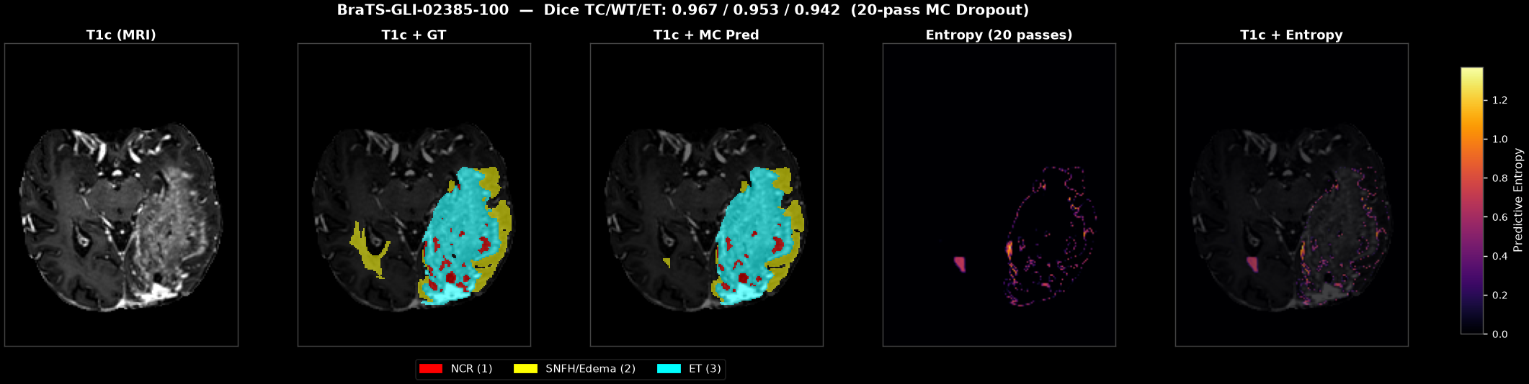
QUALITATIVE EXAMPLE
MRI, Ground Truth, Prediction, and Uncertainty
▸ Left to right: raw T1c MRI → ground truth overlay → 20-pass MC-Dropout prediction overlay → entropy map (brighter = more uncertain) → entropy overlaid on the scan.
▸ Uncertainty concentrates almost exactly on the tumor boundary and the small isolated lesion the model is least sure about — not scattered randomly.
BraTS 2024 GLI — Multi-Region Glioma Segmentation
7

Slide 8
RESULTS
v1 (Plain U-Net) vs. v2.1 (Attention U-Net)
Model — Mode | Dice TC | Dice WT | Dice ET | Dice Mean | HD95 TC | HD95 WT | HD95 ET | HD95 Mean
v1 — plain U-Net | 0.8638 | 0.9087 | 0.8503 | 0.8743 | 5.65 | 6.11 | 5.74 | 5.83
v2.1 — Attention U-Net (det.) | 0.8791 | 0.9206 | 0.8613 | 0.8870 | 4.83 | 4.87 | 5.06 | 4.92
v2.1 — MC Dropout (20 passes) | 0.8794 | 0.9205 | 0.8616 | 0.8872 | 4.81 | 4.88 | 5.04 | 4.91
▸ v2.1 improves on every metric +1.3 pts mean Dice, ~16% lower mean HD95 vs. v1 — same parameter budget (~21.7-21.8M), same evaluation protocol (324-subject holdout).
▸ Biggest relative gain on ET 0.8503 → 0.8613 — exactly the small, hard region attention gates were added to help.
▸ MC Dropout barely moves the point estimate +0.0002 mean Dice — expected, since dropout here is placed to generate calibrated uncertainty (slide 9), not to boost raw accuracy. The mean prediction and the deterministic pass are essentially the same segmentation.
BraTS 2024 GLI — Multi-Region Glioma Segmentation
8

Slide 9
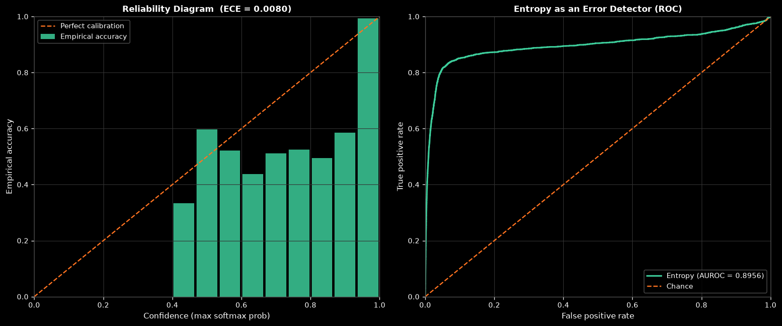
UNCERTAINTY & CALIBRATION
Is the Uncertainty Map Actually Useful?
Region | Mean Entropy
TN (correct bg) | 0.0002
TP (correct tumor) | 0.0285
FP (false positive) | 0.1960
FN (false negative) | 0.1112
▸ FP entropy ≈ 6.9× TP entropy the model flags mistakes with far higher uncertainty — same as v1 (~6×), holds after the attention upgrade
▸ ECE = 0.0080 softmax confidence is well calibrated
▸ AUROC = 0.8956 entropy alone strongly predicts misclassified voxels — usable to flag regions for review
(50 val subjects, brain-mask restricted, for the calibration analysis; entropy-by-region from 10 example subjects, 20 MC passes)
BraTS 2024 GLI — Multi-Region Glioma Segmentation
9

Slide 10
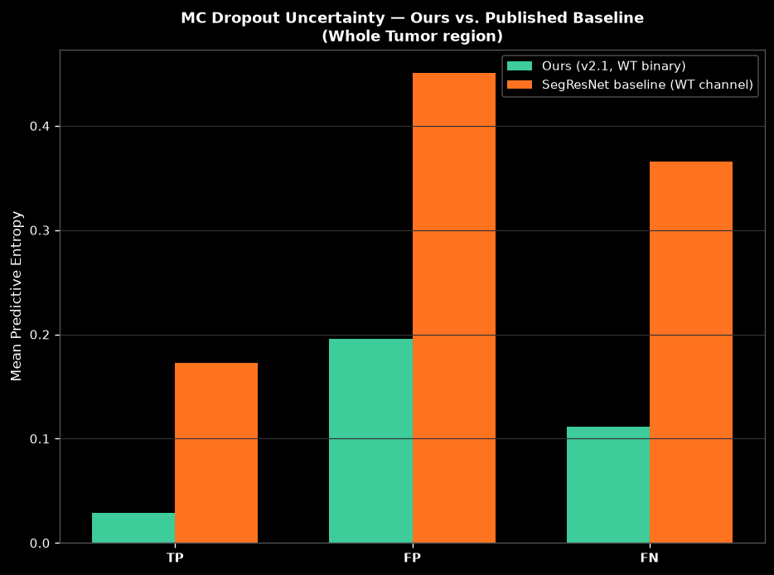
BASELINE COMPARISON
vs. Published, Pretrained BraTS Models
Same 324-subject val split, real downloaded checkpoints, adapter pipeline (channel reorder, normalization, sliding-window inference, MC Dropout) — a true head-to-head, not a literature-numbers comparison.
Model — Mode | Dice Mean | HD95 Mean
v2.1 (ours) — Deterministic | 0.8870 | 4.92
SegResNet (BraTS 2018, published) | 0.5791 | 18.09
MedNeXt (BraTS 2024 winner, published) | in progress | —
▸ SegResNet (MONAI bundle, trained on BraTS 2018) scores far lower on our data (0.58 vs 0.887) — expected: it never saw BraTS 2024's post-treatment scans (surgical cavities, radiation effects, pseudoprogression).
▸ Its MC-dropout uncertainty is also much blunter FP/TP entropy ratio 2.6× vs. our 6.9× — a model trained on your actual domain gives a sharper uncertainty signal, not just better accuracy.
▸ MedNeXt the actual BraTS-winning architecture, trained on real BraTS 2024 data — evaluation running now; two real bugs (axis-order mismatch, a label-remap assumption) were caught and fixed before trusting the numbers.
BraTS 2024 GLI — Multi-Region Glioma Segmentation
10

Slide 11
CONCLUSION
Where This Lands, and What's Next
What we showed
Limitations & next steps
▸ Attention gates measurably help v2.1 beats v1 on every metric, with the largest gain on the smallest/hardest region (ET)
▸ MC Dropout uncertainty is genuinely calibrated ECE 0.008, AUROC 0.896 — not just a visualization, a usable error-flagging signal
▸ We outperform published, pretrained baselines head-to-head on our own val split, not just on paper — and our uncertainty is sharper too
▸ Training not fully converged interrupted at epoch 143/300, one epoch short of early stopping — resumable, room for further improvement
▸ MedNeXt comparison in progress closest domain match of any public checkpoint — will complete the baseline picture
▸ Single dataset, internal holdout BraTS 2024 challenge closed before official leaderboard submission was possible
Bottom line: a better architecture and a genuinely trustworthy uncertainty estimate — not just a higher Dice score.
BraTS 2024 GLI — Multi-Region Glioma Segmentation
11

Slide 12
Thank You
Questions?
Sahar Ifrah · Hadas Avraham

