Slide 1
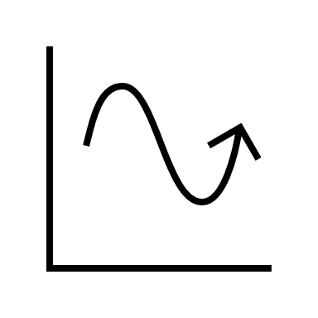




















Slide 2

A Profile of Permanent Resident (PR) Immigrants
₂₀₁₅ ₋ ₂₀₂₃
Comprehensive Analysis of Canada's Immigration Trends
Comprehensive Analysis of Canada's Immigration Trends - Immigration Landscape
Sahar Latifi

Slide 3
A profile of permanent residents in Canada
A Profile of Permanent Resident (PR) Immigrants
₂₀₁₅ ₋ ₂₀₂₃
₂₀₁₅ ₋ ₂₀₂₃
Comprehensive Analysis of Canada's Immigration Trends - Country-Specific Immigration trends
Sahar Latifi
Design by: Sahar Latifi

Slide 4

Vancouver Crime Analysis – Overview
2003-2023
Sahar Latifi
Sahar Latifi
Design by: Sahar Latifi

Slide 5
Vancouver Crime Analysis – Overview
2003-2023

Slide 6
Vancouver Crime Analysis – Overview
2003-2023

Slide 7
Vancouver Crime Analysis – Overview
2003-2023

Slide 8
Vancouver Crime Analysis – Overview
2003-2023

Slide 9
Vancouver Crime Analysis – Overview
2003-2023

Slide 10
Vancouver Crime Analysis – Overview
2003-2023

Slide 11
Vancouver Crime Analysis – Overview
2003-2023

Slide 12
Vancouver’s CrimeSpace: Historical Trends in Crime Rates, 2003 to 2022

Slide 13
Vancouver's Crime Breakdown: Patterns & Trends from 2003 to 2023

Slide 14
Vancouver's Crime Breakdown: Patterns & Trends from 2003 to 2023

Slide 15
Canada’s Immigration Analysis | 2015 - 2023
A Profile of Permanent Resident Immigrants
₂₀₁₅ ₋ ₂₀₂₃
A profile of permanent residents in Canada
₂₀₁₅ ₋ ₂₀₂₃
Gender
Distribution
Sahar Latifi
Design by: Saar Latifi

Slide 16
Canada’s Immigration Analysis | 2015 - 2023
A profile of permanent residents in Canada
₂₀₁₅ ₋ ₂₀₂₃
Gender
Distribution
Sahar Latifi
Design by: Saar Latifi

Slide 17
A Profile of Permanent Resident (PR) Immigrants
₂₀₁₅ ₋ ₂₀₂₃
Comprehensive Analysis of Canada's Immigration Trends - Provincial Immigration Trends
Sahar Latifi
Design by: Saar Latifi

