Slide 1
Constrained Horn Clauses and their Applications
Lecture 4
Orna Grumberg, Technion

Slide 2
Condition Synthesis Realizability via
Constrained Horn Clauses
Bat-chen Rothenberg, Orna Grumberg, Yakir Vizel, Eytan Singher
NFM 2023

Slide 3
Condition Synthesis
Receives as input a partial program, where conditions are missing in conditional branches (e.g., if/while statements), and a specification
As assertions in the code
A solution to this problem is a set of conditions to fill-in the holes such that the resulting program meets the specification.
Motivation: automated program repair
Notes:
Perhaps mention the motivation after the example on the next slide

Slide 4
Doomed initial states
An initial state is called doomed if it eventually reaches an error state along every run of the program.
For a doomed initial state σ, there is no way to make the program safe by forcing σ (via conditions) to follow one computation or another. It will lead to a failure anyway.
The problem is unrealizable iff there exists a doomed initial state

Slide 5
Correctness Evidance
Condition synthesis
problem
CoSyn
Unrealizable
+ doomed initial state
Realizable
+ range of conditions for each hole

Slide 6
Reduction to CHC
The problem is unrealizable iff there exists a doomed initial state.
To check for the existence of a doomed initial state, COSYN uses a reduction to Constrained Horn Clauses (CHC).

Slide 7
Reduction to CHC – cont.
A state is doomed at location l if along every path from l to the assertion, the assertion fails.
Our reduction calculates doomed states backwards, starting from the negation of the assertion.

Slide 8
Condition Synthesis Running Example
abs(x):
res = 0
if (?)
res = x
else
res = -x
assert (res>= 0)
l_{i}
res = 0
Control-Flow-Graph
(CFG)
l₁
? ¬
?
l₃
l₂
res = -x
res = x
l₄
res < 0
l_{err}

Slide 9
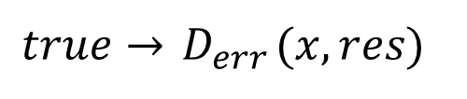
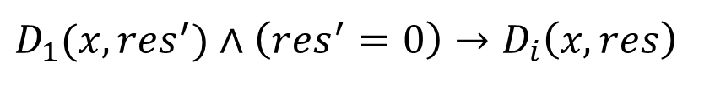
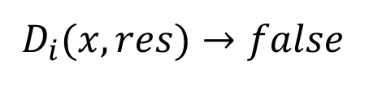
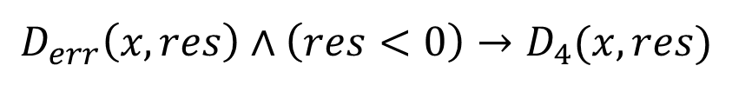
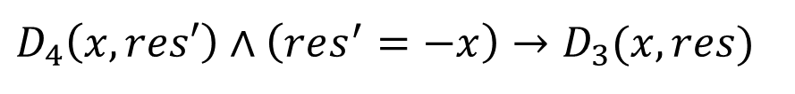
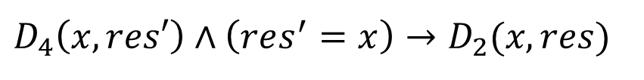
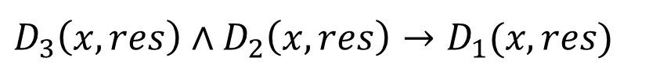
Condition Synthesis Running Example
l_{i}
D_{i}
$${ D}_{i}(x,res)→false$$
res = 0
$$D_{1}({x,res}^{′})∧\left(res^{′}=0\right)→D_{i}\left(x,res\right)$$
l₁
D₁
$$D_{3}\left(x,res\right)∧D_{2}\left(x,res\right)→D_{1}(x,res)$$
¬?
?
l₃
D₃
l₂
D₂
$$D_{4}\left(x,res′\right)∧\left(res^{′}=−x\right)→D_{3}(x,res)$$
res = -x
res = x
$$D_{4}\left(x,res′\right)∧\left(res^{′}=x\right)→D_{2}(x,res)$$
l₄
D₄
res < 0
$$D_{err}\left(x,res\right)∧\left(res<0\right)→D_{4}(x,res)$$
l_{err}
D_{err}
$$true→{ D}_{err}(x,res)$$

Slide 10

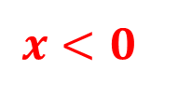




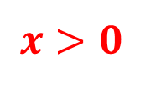
Condition Synthesis Running Example
l_{i}
D_{i}
$$false$$
$${ D}_{i}(x,res)→false$$
res = 0
$$D_{1}({x,res}^{′})∧\left(res^{′}=0\right)→D_{i}\left(x,res\right)$$
l₁
D₁
$$false$$
$$D_{3}\left(x,res\right)∧D_{2}\left(x,res\right)→D_{1}(x,res)$$
¬?
?
$$x<0$$
$$x>0$$
l₃
D₃
l₂
D₂
$$D_{4}\left(x,res′\right)∧\left(res^{′}=−x\right)→D_{3}(x,res)$$
res = -x
res = x
$$D_{4}\left(x,res′\right)∧\left(res^{′}=x\right)→D_{2}(x,res)$$
l₄
D₄
$$res<0$$
res < 0
$$D_{err}\left(x,res\right)∧\left(res<0\right)→D_{4}(x,res)$$
l_{err}
D_{err}
$$true$$
CHC is realizable!
$$true→{ D}_{err}(x,res)$$

Slide 11

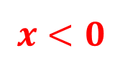


Condition Synthesis Running Example
l₁
D₁
$$false$$
¬?
?
$$x>0$$
D₃
l₃
l₂
D₂
$$x<0$$
How to find the range of conditions for L1?
Freedom is obtained from non-reachable states at l₁ and
from states that are not doomed at either l₂ or l₃
Notes:
Freedom is obtained from non-reachable states at D1 and from states that are not doomed at either F or T (don’t cares).
Intuitively not(D1) represents the reachable states at D1

Slide 12





Condition Synthesis Running Example
l₁
D₁
$$false$$
¬?
?
$$ψ_{f}$$
$$ψ_{t}$$
$$x>0$$
D₃
l₃
l₂
D₂
$$x<0$$
Every predicate $ψ$ s.t.
$ψ_{f}→$ $ψ$ $→ψ_{t}$
is a solution
${ Note: ψ}_{f},$ $ψ$ $,ψ_{t}$ are all conditions that send control to l₂
Notes:
Freedom is obtained from non-reachable states at D1 and from states that are not doomed at neither F or T (don’t cares).
Intuitively not(D1) represents the reachable states at D1

Slide 13
Combination with SyGuS
SyGuS is a prominent framework for program synthesis with respect to a formal specification. It limits the search-space to a user-defined grammar G.
While CoSyn in itself cannot provide a solution within a specific grammar, it can be combined with a SyGuS solver to enhance its performance.

Slide 14
Combination with SyGuS
Condition synthesis
problem
CoSyn
Unrealizable
+ doomed initial state
Realizable
+ range of conditions
for each hole
Grammar G

Slide 15
Combination with SyGuS
It is possible to split the synthesis of different holes into different SyGuS queries!
Condition synthesis
problem
CoSyn
Unrealizable
Unrealizable
Unrealizable
Realizable
SyGuS
+ range of conditions for each hole
Grammar G
Realizable
+ solution in grammar
Notes:
Range of condition is the specification for SyGuS.
We emphasize that the implications in the different locations are independent, thus allowing synthesis of the conditions separately, one by one. Separate synthesis of conditions cannot be done trivially in regular SYGUS, due to the dependency between conditions in the synthesized program.
Both CoSyn and SyGuS can timeout, of course.
Timeout is of course also an option

Slide 16
Conclusion
We present a novel approach for the (un)realizability of the condition synthesis problem
via the existence of initial doomed states
via reduction to CHCs
CoSyn accompanies its results with evidences
We show that combining CoSyn with SyGus results in
Definite result for the unrealizable cases
More syntactically appealing conditions for the realizable cases

Slide 17
Questions?

Slide 18
Application 2 of CHCs

Slide 19
CTL* verification and Synthesis using
Existential Constrained Horn Clauses (EHC)
Mishel Carelli and Orna Grumberg
ATVA 2024

Slide 20
Setting:
Infinite-state programs with FO-CTL* specification
e.g. AF(a ≤ b), EG(a = b)
Goal:
Verification of a program with respect to CTL*
Synthesis of a partial program to a full program which satisfy the CTL* specification

Slide 21
Difference between the two applications
CTL* specification as opposed to assertions
In partial programs, conditions and assertions may be missing
Needs to use Existential Horn Clauses rather than the standard CHC
Computing is done forward, not backward

Slide 22
Limitation of Horn clauses
CHCs are not sufficient to check liveness and existential properties (e.g. AFp, EGp).
Existentially quantified Horn Clauses (EHC) are a special type of Horn-like clauses that allow
existential quantification and
well-foundedness (nonexistance of infinite decreasing chain)
In this work, we reduce the problems of CTL* verification and partial synthesis to the problem of EHC satisfiability.

Slide 23
Summary
We developed a translation from the CTL* verification problem to the problem of EHC satisfiability
We developed a translation from CTL* partial synthesis problem to the problem of EHC satisfiability
Both translations are sound and complete

Slide 24
Not implemented
The EHC solver is not active anymore
Possible alternative for future work: pfwCSP by Unno, Terauchi, Koskinen
The authors conjectured that pfwCSP and EHC are inter-reducible

Slide 25
Summary
In this series of talks we saw
A theory modular approach to solving CHCs
Based on CHC solvers as a blackbox
A non-standard use of CHCs for synthesis
A variation of CHCs (EHC) that can do much more than standard CHCs
BUT – need a working solver

Slide 26
Thank you!

