Slide 1
Constrained Horn Clauses and their Applications
Lecture 3
Orna Grumberg, Technion

Slide 2
Bit-Precise CHC Satisfiability Using Theory-Modular Reasoning
Omer Rappoport, Orna Grumberg, Yakir Vizel
ATVA 2026

Slide 3






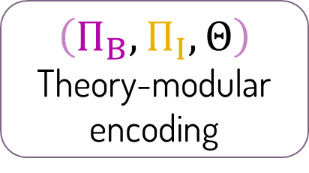
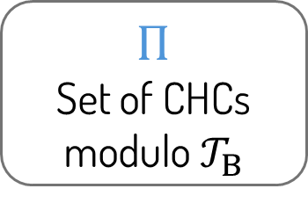
The Mosaic framework
SAT
$$Π$$
Set of CHCs modulo $𝒯_{B}$
Encoder
Safe
Program
bit-vector
fragment
integer
$$\text{fragment}$$
interface constraints
UNSAT
$$\left(Π_{B},Π_{I},Θ\right)$$
Theory-modular encoding
Theory-Modular Encoder
Theory-Modular CHC solver
Buggy
Specification

Slide 4

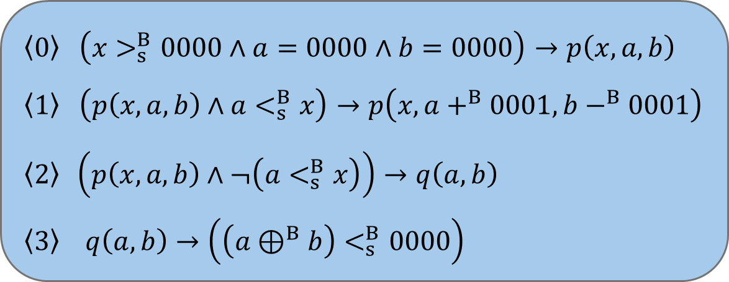
Encoding, step 1: partition
$Π$:
$$\left\langle 0\right\rangle \left(x>_{s}^{B}0000∧a=0000∧b=0000\right)→p\left(x,a,b\right)$$
$$\left\langle 1\right\rangle \left(p\left(x,a,b\right)∧a<_{s}^{B}x\right)→p\left(x,a+^{B}0001,b−^{B}0001\right)$$
$$\left\langle 2\right\rangle \left(p\left(x,a,b\right)∧¬\left(a<_{s}^{B}x\right)\right)→q\left(a,b\right)$$
$$\left\langle 3\right\rangle q\left(a,b\right)→\left(\left(a⊕^{B}b\right)<_{s}^{B}0000\right)$$

Slide 5
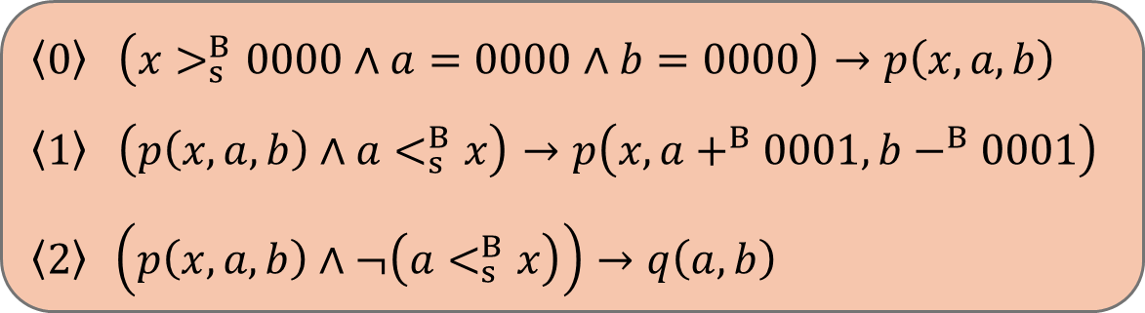


Encoding, step 1: partition
$→$ integer fragment
$$\left\langle 0\right\rangle \left(x>_{s}^{B}0000∧a=0000∧b=0000\right)→p\left(x,a,b\right)$$
$$\left\langle 1\right\rangle \left(p\left(x,a,b\right)∧a<_{s}^{B}x\right)→p\left(x,a+^{B}0001,b−^{B}0001\right)$$
$$\left\langle 2\right\rangle \left(p\left(x,a,b\right)∧¬\left(a<_{s}^{B}x\right)\right)→q\left(a,b\right)$$
$→$ bit-vector fragment
$$\left\langle 3\right\rangle q\left(a,b\right)→\left(\left(a⊕^{B}b\right)<_{s}^{B}0000\right)$$
Heuristic: clauses whose function applications are purely arithmetic $→$ integer fragment

Slide 6



Encoding, step 2: the bit-vector fragment
$→$ integer fragment
$$\left\langle 0\right\rangle \left(x>_{s}^{B}0000∧a=0000∧b=0000\right)→p\left(x,a,b\right)$$
$$\left\langle 1\right\rangle \left(p\left(x,a,b\right)∧a<_{s}^{B}x\right)→p\left(x,a+^{B}0001,b−^{B}0001\right)$$
$$\left\langle 2\right\rangle \left(p\left(x,a,b\right)∧¬\left(a<_{s}^{B}x\right)\right)→q\left(a,b\right)$$
$Π_{B}$:
Predicate renaming
$$\left\langle 3\right\rangle q^{B}\left(a,b\right)→\left(\left(a⊕^{B}b\right)<_{s}^{B}0000\right)$$

Slide 7
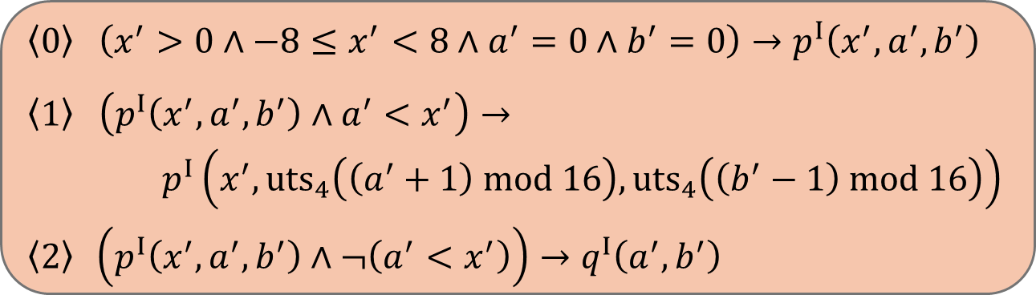



Encoding, step 3: the integer fragment
$Π_{I}$:
$$x^{′}↾_{B}$$
$$\left\langle 0\right\rangle \left(x^{′}>0∧−8≤x^{′}<8∧a^{′}=0∧b^{′}=0\right)→p^{I}\left(x^{′},a^{′},b^{′}\right)$$
$$\left\langle 1\right\rangle \left(p^{I}\left(x^{′},a^{′},b^{′}\right)∧a^{′}<x^{′}\right)→$$
$p^{I}\left(x^{′},{uts}_{4}\left(\left(a^{′}+1\right) mod 16\right),{uts}_{4}\left(\left(b^{′}−1\right) mod 16\right)\right)$
$$\left\langle 2\right\rangle \left(p^{I}\left(x^{′},a^{′},b^{′}\right)∧¬\left(a^{′}<x^{′}\right)\right)→q^{I}\left(a^{′},b^{′}\right)$$
Predicate renaming
Variable renaming
Constraint translations
Domain restrictions
$Π_{B}$:
$$\left\langle 3\right\rangle q^{B}\left(a,b\right)→\left(\left(a⊕^{B}b\right)<_{s}^{B}0000\right)$$

Slide 8
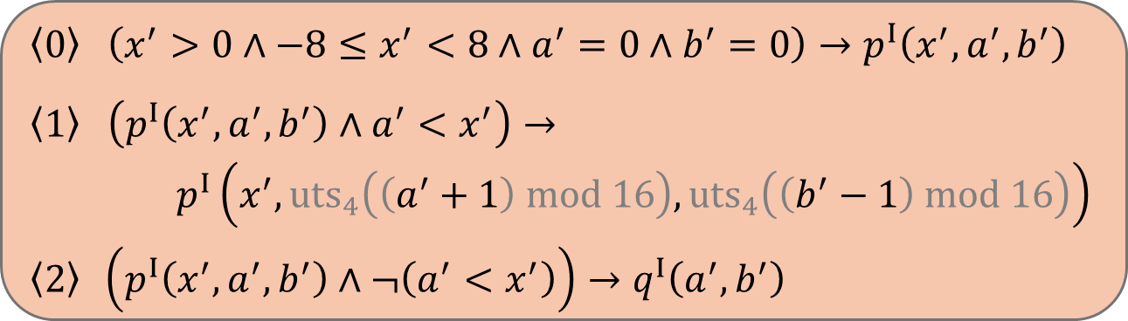
Encoding, step 3: the integer fragment
$Π_{I}$:
$$x^{′}↾_{B}$$
$$\left\langle 0\right\rangle \left(x^{′}>0∧−8≤x^{′}<8∧a^{′}=0∧b^{′}=0\right)→p^{I}\left(x^{′},a^{′},b^{′}\right)$$
$$\left\langle 1\right\rangle \left(p^{I}\left(x^{′},a^{′},b^{′}\right)∧a^{′}<x^{′}\right)→$$
$p^{I}\left(x^{′},{uts}_{4}\left(\left(a^{′}+1\right) mod 16\right),{uts}_{4}\left(\left(b^{′}−1\right) mod 16\right)\right)$
$$\left\langle 2\right\rangle \left(p^{I}\left(x^{′},a^{′},b^{′}\right)∧¬\left(a^{′}<x^{′}\right)\right)→q^{I}\left(a^{′},b^{′}\right)$$
Predicate renaming
Variable renaming
Constraint translations
Domain restrictions
$Π_{B}$:
$$\left\langle 3\right\rangle q^{B}\left(a,b\right)→\left(\left(a⊕^{B}b\right)<_{s}^{B}0000\right)$$
Optimization: eliminate modulo and uts operations where overflow is impossible

Slide 9
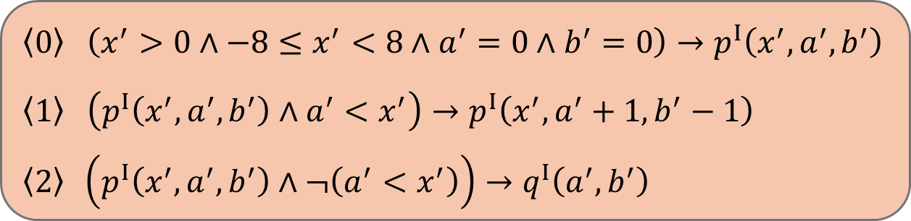

Encoding, step 4: interface constraints
$Π_{I}$:
$$\left\langle 0\right\rangle \left(x^{′}>0∧−8≤x^{′}<8∧a^{′}=0∧b^{′}=0\right)→p^{I}\left(x^{′},a^{′},b^{′}\right)$$
$$\left\langle 1\right\rangle \left(p^{I}\left(x^{′},a^{′},b^{′}\right)∧a^{′}<x^{′}\right)→ p^{I}\left(x^{′},a^{′}+1,b^{′}−1\right)$$
$$\left\langle 2\right\rangle \left(p^{I}\left(x^{′},a^{′},b^{′}\right)∧¬\left(a^{′}<x^{′}\right)\right)→q^{I}\left(a^{′},b^{′}\right)$$
$Π_{B}$:
$$\left\langle 3\right\rangle q^{B}\left(a,b\right)→\left(\left(a⊕^{B}b\right)<_{s}^{B}0000\right)$$
$$Θ=\left\{q^{I}⇝q^{B}\right\}$$

Slide 10










Semantics: derivations across fragments
local
$Π_{I}$:
$$p^{I}\left(1,0,0\right)$$
$$\left\langle 0\right\rangle \left(x^{′}>0∧−8≤x^{′}<8∧a^{′}=0∧b^{′}=0\right)→p^{I}\left(x^{′},a^{′},b^{′}\right)$$
$$\left\langle 1\right\rangle \left(p^{I}\left(x^{′},a^{′},b^{′}\right)∧a^{′}<x^{′}\right)→ p^{I}\left(x^{′},a^{′}+1,b^{′}−1\right)$$
$$\left\langle 2\right\rangle \left(p^{I}\left(x^{′},a^{′},b^{′}\right)∧¬\left(a^{′}<x^{′}\right)\right)→q^{I}\left(a^{′},b^{′}\right)$$
local
$$p^{I}\left(1,1,−1\right)$$
local
$$q^{I}\left(1,−1\right)$$
external
$$q^{B}\left(0001,1111\right)$$
$Π_{B}$:
Derivation
$$\left\langle 3\right\rangle q^{B}\left(a,b\right)→\left(\left(a⊕^{B}b\right)<_{s}^{B}0000\right)$$
$$Θ=\left\{q^{I}⇝q^{B}\right\}$$
$$0001⊕^{B}1111=1110<_{s}^{B}0000$$
Query Check

Slide 11
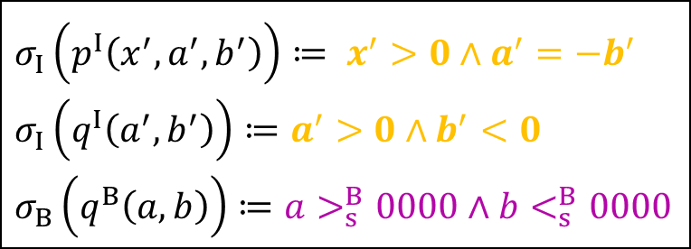


Semantics: theory-modular solutions
$Π_{I}$:
$$\left\langle 0\right\rangle \left(x^{′}>0∧−8≤x^{′}<8∧a^{′}=0∧b^{′}=0\right)→p^{I}\left(x^{′},a^{′},b^{′}\right)$$
$$\left\langle 1\right\rangle \left(p^{I}\left(x^{′},a^{′},b^{′}\right)∧a^{′}<x^{′}\right)→ p^{I}\left(x^{′},a^{′}+1,b^{′}−1\right)$$
$$\left\langle 2\right\rangle \left(p^{I}\left(x^{′},a^{′},b^{′}\right)∧¬\left(a^{′}<x^{′}\right)\right)→q^{I}\left(a^{′},b^{′}\right)$$
$$σ_{I}\left(p^{I}\left(x^{′},a^{′},b^{′}\right)\right)≔ x^{′}>0∧a^{′}=−b^{′}$$
$$σ_{I}\left(q^{I}\left(a^{′},b^{′}\right)\right)≔a^{′}>0∧b^{′}<0$$
$$σ_{B}\left(q^{B}\left(a,b\right)\right)≔a>_{s}^{B}0000∧b<_{s}^{B}0000$$
$Π_{B}$:
$$\left\langle 3\right\rangle q^{B}\left(a,b\right)→\left(\left(a⊕^{B}b\right)<_{s}^{B}0000\right)$$
Satisfying
Interpretation
$$Θ=\left\{q^{I}⇝q^{B}\right\}$$
Local satisfaction: $σ_{B}⊨_{𝒯_{B}}Π_{B}$ and $σ_{I}⊨_{𝒯_{I}}Π_{I}$
Interface constraint satisfaction: $⊨_{𝒯_{B}}τ_{I⇝B}\left(σ_{I}\left(q^{I}\right)\right)→σ_{B}\left(q^{B}\right)$

Slide 12

Correctness
Let $Π$ be a set of CHCs modulo $𝒯_{B}$ and let $\left(Π_{B},Π_{I},Θ\right)$ be a theory-modular encoding of $Π$.
Theorem: $Π$ is satisfiable iff $\left(Π_{B},Π_{I},Θ\right)$ is satisfiable.
Decidability: the decidability of CHC-SAT modulo $𝒯_{B}$ is not compromised.

Slide 13

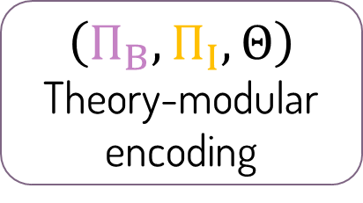
The Mosaic framework
SAT
$$Π$$
Set of CHCs modulo $𝒯_{B}$
Encoder
Safe
Program
bit-vector
fragment
integer
$$\text{fragment}$$
interface constraints
UNSAT
$$\left(Π_{B},Π_{I},Θ\right)$$
Theory-modular encoding
Theory-Modular Encoder
Theory-Modular CHC solver
Buggy
Specification

Slide 14
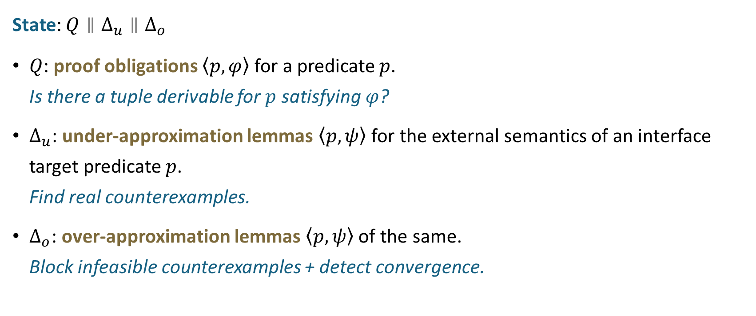
MosaicSolve: state
State: $Q∥Δ_{u}∥Δ_{o}$
$Q$: proof obligations $\left\langle p,φ\right\rangle$ for a predicate $p$. Is there a tuple derivable for $p$ satisfying $φ$?
$Δ_{u}$: under-approximation lemmas $\left\langle p,ψ\right\rangle$ for the external semantics of an interface target predicate $p$. Find real counterexamples.
$Δ_{o}$: over-approximation lemmas $\left\langle p,ψ\right\rangle$ of the same. Block infeasible counterexamples + detect convergence.

Slide 15

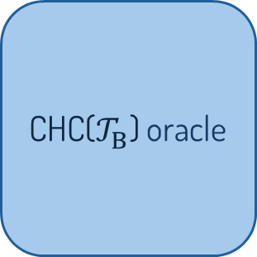

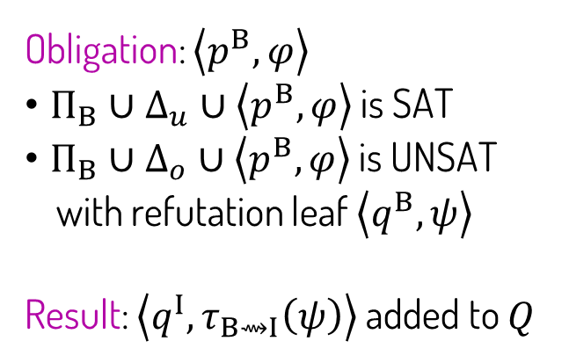






MosaicSolve: moves
$$Π_{B}$$
$$Θ$$
$$Π_{I}$$
Obligation: $\left\langle p^{B},φ\right\rangle$
$Π_{B}∪Δ_{u}∪\left\langle p^{B},φ\right\rangle$ is SAT
$Π_{B}∪Δ_{o}∪\left\langle p^{B},φ\right\rangle$ is UNSAT
with refutation leaf $\left\langle q^{B},ψ\right\rangle$
Result: $\left\langle q^{I},τ_{B⇝I}\left(ψ\right)\right\rangle$ added to $Q$
CHC($𝒯_{B}$) oracle
CHC($𝒯_{I}$) oracle
$$q^{B}$$
$$q^{I}$$
$\left\langle q^{B},ψ\right\rangle$ ?
$\left\langle q^{I},τ_{B⇝I}\left(ψ\right)\right\rangle$ ?
Query: generates a new obligation when an existing one cannot be resolved.

Slide 16
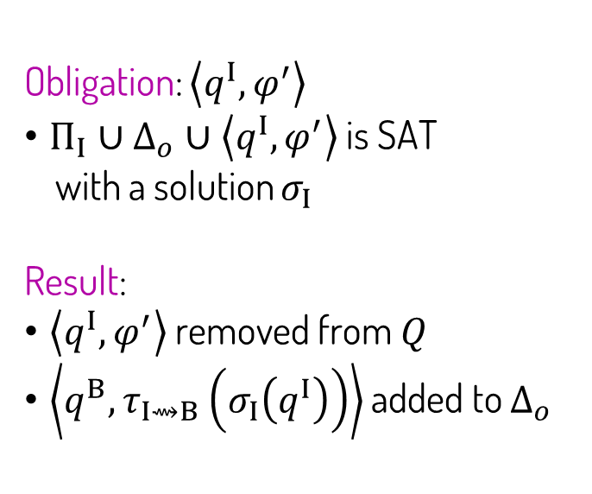


MosaicSolve: moves
Obligation: $\left\langle q^{I},φ^{′}\right\rangle$
$Π_{I}∪Δ_{o}∪\left\langle q^{I},φ^{′}\right\rangle$ is SAT
with a solution $σ_{I}$
Result:
$\left\langle q^{I},φ^{′}\right\rangle$ removed from $Q$
$\left\langle q^{B},τ_{I⇝B}\left(σ_{I}\left(q^{I}\right)\right)\right\rangle$ added to $Δ_{o}$
$$Π_{B}$$
$$Θ$$
$$Π_{I}$$
CHC($𝒯_{B}$) oracle
CHC($𝒯_{I}$) oracle
$$q^{B}$$
$$q^{I}$$
$$\left\langle q^{B},τ_{I⇝B}\left(σ_{I}\left(q^{I}\right)\right)\right\rangle$$
$$\left\langle q^{I},σ_{I}\left(q^{I}\right)\right\rangle$$
Query: generates a new obligation when an existing one cannot be resolved.
NegAnswer: discharges an obligation if it can be answered negatively using the current over- approximations.

Slide 17
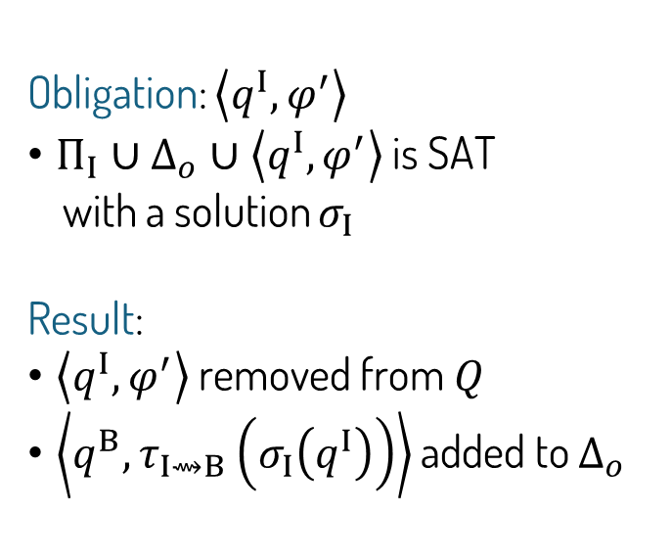
MosaicSolve: moves
Obligation: $\left\langle q^{I},φ^{′}\right\rangle$
$Π_{I}∪Δ_{o}∪\left\langle q^{I},φ^{′}\right\rangle$ is SAT
with a solution $σ_{I}$
Result:
$\left\langle q^{I},φ^{′}\right\rangle$ removed from $Q$
$\left\langle q^{B},τ_{I⇝B}\left(σ_{I}\left(q^{I}\right)\right)\right\rangle$ added to $Δ_{o}$
$$Π_{B}$$
$$Θ$$
$$Π_{I}$$
CHC($𝒯_{B}$) oracle
CHC($𝒯_{I}$) oracle
$$q^{B}$$
$$q^{I}$$
$$\left\langle q^{B},τ_{I⇝B}\left(σ_{I}\left(q^{I}\right)\right)\right\rangle$$
$$\left\langle q^{I},σ_{I}\left(q^{I}\right)\right\rangle$$
Query: generates a new obligation when an existing one cannot be resolved.
NegAnswer / PosAnswer: discharges an obligation if it can be answered negatively / positively using the current over- / under-approximations.
Sat / Unsat: terminate when the initial obligation can be resolved.

Slide 18

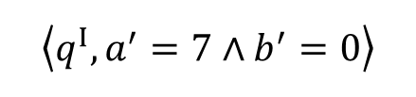


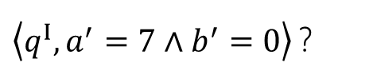
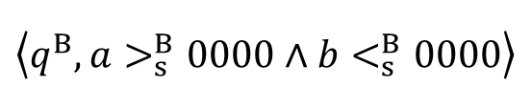

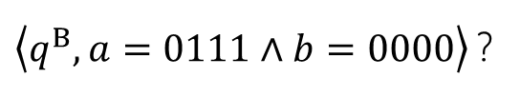

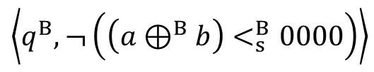

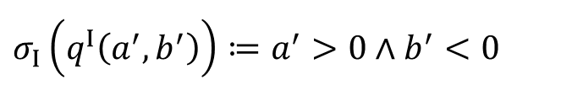
MosaicSolve: worked run
$$Q$$
$$Δ_{u}$$
$$Δ_{o}$$
$$\left\langle q^{B},¬\left(\left(a⊕^{B}b\right)<_{s}^{B}0000\right)\right\rangle$$
$$\left\langle q^{B},a>_{s}^{B}0000∧b<_{s}^{B}0000\right\rangle$$
$$\left\langle q^{I},a^{′}=7∧b^{′}=0\right\rangle$$
$Π_{I}$:
$$\left\langle 0\right\rangle \left(x^{′}>0∧−8≤x^{′}<8∧a^{′}=0∧b^{′}=0\right)→p^{I}\left(x^{′},a^{′},b^{′}\right)$$
$$\left\langle 1\right\rangle \left(p^{I}\left(x^{′},a^{′},b^{′}\right)∧a^{′}<x^{′}\right)→ p^{I}\left(x^{′},a^{′}+1,b^{′}−1\right)$$
$$\left\langle 2\right\rangle \left(p^{I}\left(x^{′},a^{′},b^{′}\right)∧¬\left(a^{′}<x^{′}\right)\right)→q^{I}\left(a^{′},b^{′}\right)$$
$\left\langle q^{I},a^{′}=7∧b^{′}=0\right\rangle$ ?
✗
$$σ_{I}\left(q^{I}\left(a^{′},b^{′}\right)\right)≔a^{′}>0∧b^{′}<0$$
$Π_{B}$:
$$\left\langle 3\right\rangle q^{B}\left(a,b\right)→\left(\left(a⊕^{B}b\right)<_{s}^{B}0000\right)$$
$\left\langle q^{B},a=0111∧b=0000\right\rangle$ ?
SAT

Slide 19
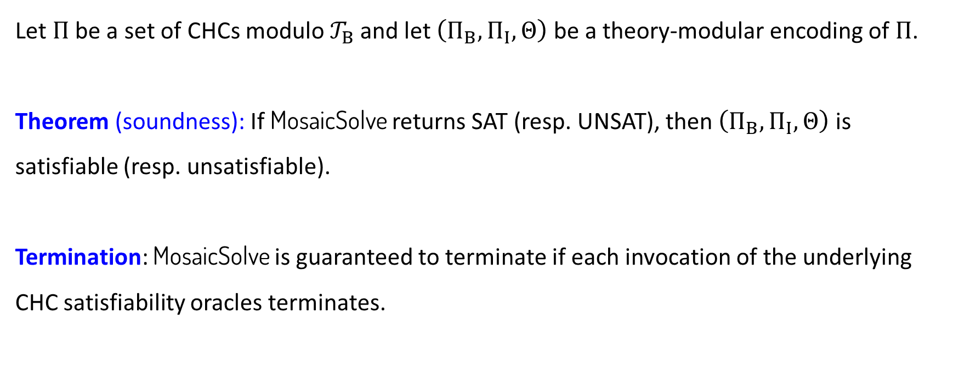
Soundness and termination
Let $Π$ be a set of CHCs modulo $𝒯_{B}$ and let $\left(Π_{B},Π_{I},Θ\right)$ be a theory-modular encoding of $Π$.
Theorem (soundness): If MosaicSolve returns SAT (resp. UNSAT), then $\left(Π_{B},Π_{I},Θ\right)$ is satisfiable (resp. unsatisfiable).
Termination: MosaicSolve is guaranteed to terminate if each invocation of the underlying CHC satisfiability oracles terminates.

Slide 20
Evaluation: setup
Implementation
Prototype on top of Z3
Spacer instantiates both CHC-SAT oracles
Benchmarks
11 small programs that originate from the "Bit Twiddling Hacks" collection [Anderson, Stanford], composed with simple arithmetic loops
Benchmarks evaluated for increasing bit-widths (timeout: 2 hours)
Configurations
BV: all CHCs in the bit-vector fragment
IA: all CHCs translated to the integer fragment
BV+IA: our theory-modular reasoning

Slide 21
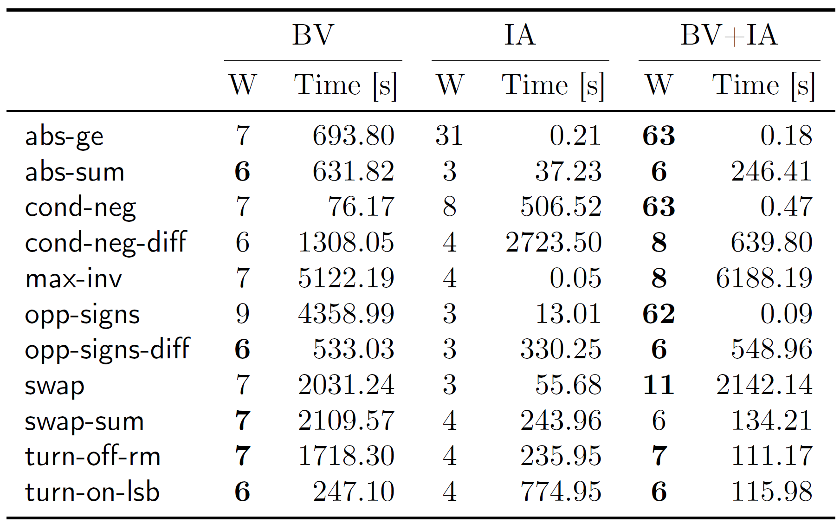

Evaluation: results
BV+IA achieves the largest bit-width on most benchmarks, often by a substantial margin
9
3
62
Performance of BV, IA, and BV+IA.
Maximal bit-width (W) and runtime.
Bold indicates the largest W.

Slide 22
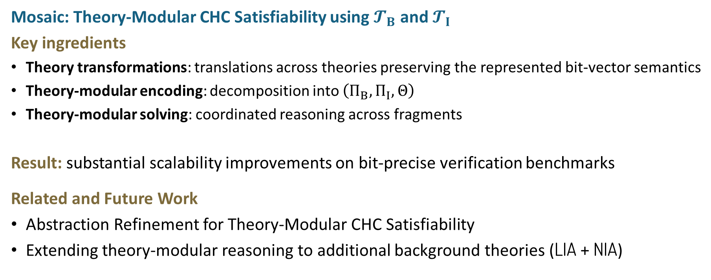
Conclusion
Mosaic: Theory-Modular CHC Satisfiability using $𝓣_{B}$ and $𝓣_{I}$
Key ingredients
Theory transformations: translations across theories preserving the represented bit-vector semantics
Theory-modular encoding: decomposition into $\left(Π_{B},Π_{I},Θ\right)$
Theory-modular solving: coordinated reasoning across fragments
Result: substantial scalability improvements on bit-precise verification benchmarks
Related and Future Work
Abstraction Refinement for Theory-Modular CHC Satisfiability
Extending theory-modular reasoning to additional background theories (LIA + NIA)

Slide 23
Questions?

Slide 24
Application 1 of CHCs

Slide 25
Condition Synthesis Realizability via
Constrained Horn Clauses
Bat-chen Rothenberg, Orna Grumberg, Yakir Vizel, Eytan Singher
NFM 2023

Slide 26
Condition Synthesis
Receives as input a partial program, where conditions are missing in conditional branches (e.g., if/while statements), and a specification
As assertions in the code
A solution to this problem is a set of conditions to fill-in the holes such that the resulting program meets the specification.
Motivation: automated program repair
Notes:
Perhaps mention the motivation after the example on the next slide

Slide 27

Condition Synthesis Running Example
sum_abs(x,y):
sum = 0 if (x >= 0)
sum = sum + x
else
sum = sum - x
if ( ?? )
sum = sum + y
else
sum = sum – y
assert (sum >= 0)
The problem is realizable!
hole
possible solution: y >= 0
specification

Slide 28
Our Algorithm
We present a novel algorithm, called COSYN, for determining the realizability of a condition synthesis problem, with an emphasis on proving unrealizability efficiently.
Cosyn can handle programs with multiple holes.
Cosyn can handle programs with loops.

Slide 29
Doomed initial states
An initial state is called doomed if it eventually reaches an error state along every run of the program.
For a doomed initial state σ, there is no way to make the program safe by forcing σ (via conditions) to follow one computation or another. It will lead to a failure anyway.
The problem is unrealizable iff there exists a doomed initial state

Slide 30


Condition Synthesis Running Example
x=0 , y=-3
sum_abs(x,y):
sum = 0 if (x >= 0)
sum = sum + x
else
sum = sum - x
if ( ?? )
sum = sum + y
else
sum = sum + y
assert (sum >= 0)
x=0 , y=-3, sum=0
x=0 , y=-3, sum=0
Problem is unrealizable!
x=0 , y=-3 , sum=0
x=0 , y=-3 , sum=-3
x=0 , y=-3 , sum=-3
x=0 , y=-3 , sum=-3
x=0 , y=-3 , sum=-3
Notes:
If there were several holes it would have to fail on *all* paths to the assertion.

Slide 31
Correctness Evidance
Condition synthesis
problem
CoSyn
Unrealizable
+ doomed initial state
Realizable
+ range of conditions for each hole

Slide 32
Condition Synthesis Running Example
sum_abs(x,y):
sum = 0 if (x >= 0)
sum = sum + x
else
sum = sum - x
if ( ?? )
sum = sum + y
else
sum = sum – y
assert (sum >= 0)
possible range of solutions:
\psi_f: sum-y<0 & sum>=0
\psi_t:
Problem is realizable!

Slide 33
Reduction to CHC
The problem is unrealizable iff there exists a doomed initial state.
To check for the existence of a doomed initial state, COSYN uses a reduction to Constrained Horn Clauses (CHC).

Slide 34
End of lecture 3

