Slide 1
Constrained Horn Clauses and their Applications
Orna Grumberg
Technion

Slide 2
From Program Verification to Constrained Horn Clauses

Slide 3
Who Finds the Invariant?
From Floyd (1967) → Constrained Horn Clauses → LLMs
1967
2000s
today
a human writes it
a solver finds it
one more guesser
Notes:
30 minutes. The whole talk is about one object: the invariant. Three eras, three answers to who supplies it.

Slide 4
Program Verification
Given
a program and
a formal specification – a logical formula
does the program satisfy the specification?
Not decidable!
Floyd, Hoare (late 1960’s) suggested methods to verify input-output specifications

Slide 5




Program Verification
Program
Formal Verifier
Safe
Specification
Buggy

Slide 6
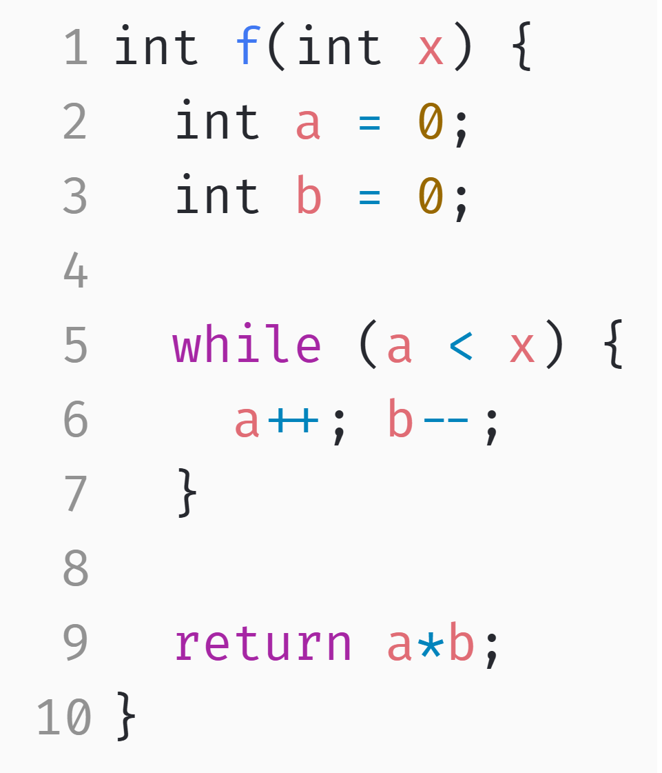
An Example of Verification Problem
Input-output specification:
If Pre holds at the beginning, then Post holds at the end
Pre: $x>0$
Post: $a∗b<0$

Slide 7
Program Verification (Floyd method)
$ℓ_{0}$: $entry$
Pre:: X > 0
Pre
$ℓ_{1}$: $a≔0 ; b≔0$
Inv
$ℓ_{2}$: $a<x ?$
Inv:: ??
$$true$$
Post
$ℓ_{3}$: $a≔a+1$ ;
$b≔b−1$
$$false$$
$ℓ_{4}$: r$eturn(a∗b$)
Post:: a*b < 0
Control Flow Graph

Slide 8
Program Verification (Floyd method)
$ℓ_{0}$: $entry$
Pre:: x > 0
We prove:
Initiation: Pre∧ ( a=0 ∧ b=0 ) → Inv(x, 0, 0)
Consecution: Inv(x, a, b) ∧ a < x ∧ a’ = a+1 ∧ b’=b-1 → Inv(x, a’, b’)
Safety: Inv ∧ ¬(a < x) → Post
$ℓ_{1}$: $a≔0 ; b≔0$
$ℓ_{2}$: $a<x ?$
Inv:: ??
$$true$$
$ℓ_{3}$: $a≔a+1$ ;
$b≔b−1$
$$false$$
The program satisfies ⟨ Pre, Post ⟩
Inv is an inductive invariant: It holds whenever the program execution reaches $ℓ_{2}$
$ℓ_{4}$: r$eturn(a∗b$)
Post:: a*b < 0
Control Flow Graph

Slide 9
Program Verification (Floyd method)
$ℓ_{0}$: $entry$
Pre:: x > 0
We prove:
Initiation: Pre∧ ( a=0 ∧ b=0 ) → Inv(x, 0, 0)
Consecution: Inv(x, a, b) ∧ a < x ∧ a’ = a+1 ∧ b’=b+1 → Inv(x, a’, b’)
Safety: Inv ∧ ¬(a < x) → Post
$ℓ_{1}$: $a≔0 ; b≔0$
$ℓ_{2}$: $a<x ?$
Inv:: ??
$$true$$
$ℓ_{3}$: $a≔a+1$ ;
$b≔b−1$
Is a+b=0 a good inductive invariant?
$$false$$
$ℓ_{4}$: r$eturn(a∗b$)
Post:: a*b < 0
Control Flow Graph

Slide 10
Program Verification (Floyd method)
$ℓ_{0}$: $entry$
Pre:: x > 0
Is a+b=0 a good inductive invariant?
NO!
When initially x=-5 then the loop terminates immediately with a=b=0. Now, a*b=0, not a*b<0 as needed
A correct invariant: $x>0∧a+b=0$
Finding invariant is hard!
$ℓ_{1}$: $a≔0 ; b≔0$
$ℓ_{2}$: $a<x ?$
Inv:: ??
$$true$$
$ℓ_{3}$: $a≔a+1$ ;
$b≔b−1$
$$false$$
$ℓ_{4}$: r$eturn(a∗b$)
Post:: a*b < 0
Control Flow Graph

Slide 11
Let the machine find the invariant for us
Model checking, symbolic verification, and Constrained Horn Clauses

Slide 12
AUTOMATION
Two ways to make it automatic
Restrict until decidable
Keep programs — hand it to a solver
Model checking (Clarke, Emerson, Sifakis, early 1980s)
finite-state model + temporal-logic property
answers yes, or no with a counterexample
But programs are not finite state
Represent the program and the specification symbolically — as logical formulas.
Reduce verification to: is this formula satisfiable?
Let very strong solvers answer the question.
SAT → SMT → CHCs
the invariant becomes the unknown that the solver is asked to find
Notes:
Do not linger. The point is only: one road restricts the problem, the other keeps it and buys a better search.

Slide 13
Back to Program Verification
Program
Formal Verifier
Safe
Specification
Buggy

Slide 14
Program Verification via CHCs
Satisfiability Checking
Encoding
SAT
Program
$$x>0→p\left(x,0\right)$$
$$\left(p\left(x,y\right)∧x>0\right)→p\left(x,y+1\right)$$
$$\left(p\left(x,y\right)∧¬\left(x>0\right)\right)→q\left(y\right)$$
$$⋮$$
Safe
Encoder
CHC Solver
Set of Constrained Horn Clauses (CHCs)
UNSAT
Specification
Buggy

Slide 15
Constrained Horn Clauses (CHCs)
A constrained Horn clause is a first order logic formula of the form:
where
$ℬ\left[\overline{x}\right]≔p_{1}\left({\overline{x}}_{1}\right)∧⋯∧p_{k}\left({\overline{x}}_{k}\right)∧φ$
$ℋ\left[\overline{x}\right]$ is either $p_{k+1}\left({\overline{x}}_{k+1}\right)$ or$φ′$
Example: $∀x,y,z. \left(p_{1}\left(x,y\right)∧p_{2}\left(y,z\right)∧z=x+y\right)→p_{3}\left(x,z\right)$
$$∀\overline{x}. ℬ\left[\overline{x}\right]→ℋ\left[\overline{x}\right]$$
body
head
uninterpreted predicate
constraint
Notes:
Another example: $∀x,y,z. p_{3}\left(x,z\right)→x≤z$ "The predicate symbols $p_{1},…,p_{k}$ are uninterpreted, but the constraint $φ$ already has a meaning. That meaning is provided by a background theory."

Slide 16
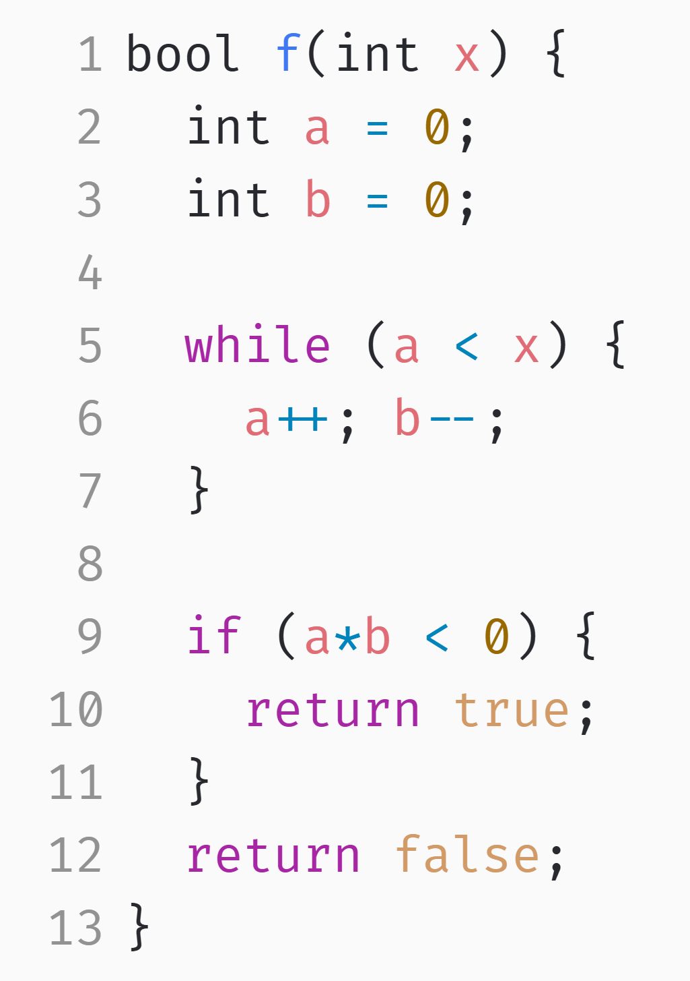
An Example Verification Problem
Pre: $x>0$
Post: $a∗b<0$

Slide 17
An Example Verification Problem
Encoding
$$p$$
$$\left(x>0∧a=0∧b=0\right)→p\left(x,a,b\right)$$
$$\left(p\left(x,a,b\right)∧a<x\right)→p\left(x,a+1,b−1\right)$$
$$\left(p\left(x,a,b\right)∧¬\left(a<x\right)\right)→q\left(x,a,b\right)$$
$$q\left(x,a,b\right)→\left(a∗b<0\right)$$
Encoder
$$q$$
Set of CHCs
Pre: $x>0$
Post: $a∗b<0$

Slide 18

Derivations
$$\left(x>0∧a=0∧b=0\right)→p\left(x,a,b\right)$$
$$\left(p\left(x,a,b\right)∧a<x\right)→p\left(x,a+1,b−1\right)$$
$$\left(p\left(x,a,b\right)∧¬\left(a<x\right)\right)→q\left(x,a,b\right)$$
$$q\left(x,a,b\right)→\left(a∗b<0\right)$$
$$p\left(1,0,0\right)$$
$$p\left(1,1,−1\right)$$
$$q\left(1,1,−1\right)$$
$$1∗−1<0$$
$$Π$$
Derivation
Query Check
Intuitively, $Π$ is satisfiable if all derivations satisfy the query.
Dually, $Π$ is unsatisfiable if there exists a derivation leading to a query violation.
Notes:
A derivation corresponds to an execution of the program.

Slide 19
Proving Satisfiability with Interpretations
Enumerating all derivations is usually infeasible.
Instead, CHC solvers search for symbolic interpretations of the uninterpreted predicates that satisfy all CHCs.
$$\left(x>0∧a=0∧b=0\right)→p\left(x,a,b\right)$$
$$\left(p\left(x,a,b\right)∧a<x\right)→p\left(x,a+1,b−1\right)$$
$$\left(p\left(x,a,b\right)∧¬\left(a<x\right)\right)→q\left(x,a,b\right)$$
$$q\left(x,a,b\right)→\left(a∗b<0\right)$$
$$p\left(x,a,b\right)↦ x>0∧a+b=0$$
$$q\left(x,a,b\right)↦ a>0∧b<0$$
$$Π$$
Satisfying
Interpretation I
I(p) is an inductive invariant!

Slide 20
THE SAME OBJECT, SIXTY YEARS APART
Floyd’s obligations are the three CHCs
1967 · the user supplies Inv
today · the solver supplies p
Pre ∧ init → Inv
Inv ∧ guard ∧ body → Inv′
Inv ∧ ¬guard → Post
x>0 ∧ a=0 ∧ b=0 → p(x,a,b)
p(x,a,b) ∧ a<x → p(x,a+1,b−1)
p(x,a,b) ∧ ¬(a<x) → a*b<0
Same three obligations — only who produces the invariant changed.

Slide 21
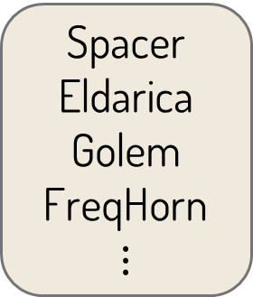
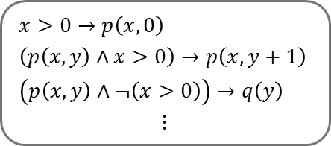
Program Verification via CHCs
Satisfiability Checking
Encoding
SAT
Program
$$x>0→p\left(x,0\right)$$
$$\left(p\left(x,y\right)∧x>0\right)→p\left(x,y+1\right)$$
$$\left(p\left(x,y\right)∧¬\left(x>0\right)\right)→q\left(y\right)$$
$$⋮$$
Safe
Encoder
CHC Solver
CHC set
UNSAT
Spacer
Eldarica
Golem
FreqHorn
$$⋮$$
Specification
Buggy

Slide 22
Applications
program
property
SAT
A set of CHCs
hardware
property
UNSAT
concurrent system
property

Slide 23
BE HONEST ABOUT THIS
What FM guarantees — and what it does not
SAT → meets its spec on all behaviors. UNSAT → a bug, with a counterexample.
Guaranteed — but only relative to three things:
The encoding
The specification
Termination
does the model say what the code does?
is it the property we wanted?
CHC solving is undecidable — it may never answer
Exactly where an LLM can help — and where it must not be trusted!
Notes:
A wrong spec makes 'verified' meaningless. Say this out loud.

Slide 24
Can LLM help us find invariants?
Notes:
The talk proper has ended. This is an appendix — drop it entirely if you are short of time. Nothing earlier depends on it.

Slide 25
The loop, concretely
LLM
Checker
Proof
candidate
valid
or any generator
not valid — send back the failed candidate + counterexample
The dark box is the central building block. The pale box is replaceable.
Not valid → the same information Floyd’s checks gave a human.

Slide 26
Conclusion
This talk presents a very limited view of what formal verification is: an invariant finding for proving a program correctness
Floyd method and solvers can handle program with much richer structures
More complex specifications
Recent works apply LLM in different ways to assist formal methods
NOT to replace them
They do not guarantee correctness unless they are checked by a formal checker

Slide 27
Questions?
a human writes it
1967
a solver finds it
2000
an LLM guesses it — a solver still checks it
Now

