Slide 1
Constrained Horn Clauses and their Applications
Lecture 2
Orna Grumberg, Technion

Slide 2
Bit-Precise CHC Satisfiability Using Theory-Modular Reasoning
Omer Rappoport, Orna Grumberg, Yakir Vizel
ATVA 2026

Slide 3




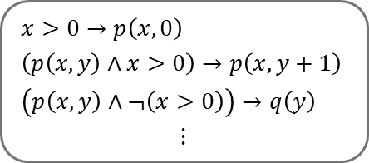

Program verification via CHCs
Satisfiability Checking
Encoding
SAT
Program
$$x>0→p\left(x,0\right)$$
$$\left(p\left(x,y\right)∧x>0\right)→p\left(x,y+1\right)$$
$$\left(p\left(x,y\right)∧¬\left(x>0\right)\right)→q\left(y\right)$$
$$⋮$$
Safe
Encoder
CHC Solver
Set of CHCs modulo a single theory $𝓣$
UNSAT
Specification
Buggy

Slide 4

Constrained Horn Clauses (CHCs)
A constrained Horn clause is a first order logic formula of the form:
where
$ℬ\left[\overline{x}\right]≔p_{1}\left({\overline{x}}_{1}\right)∧⋯∧p_{k}\left({\overline{x}}_{k}\right)∧φ$
$ℋ\left[\overline{x}\right]$ is either $p_{k+1}\left({\overline{x}}_{k+1}\right)$ or $φ^{′}$
Example: $∀x,y,z. \left(p_{1}\left(x,y\right)∧p_{2}\left(y,z\right)∧z=x+y\right)→p_{3}\left(x,z\right)$
$$∀\overline{x}. ℬ\left[\overline{x}\right]→ℋ\left[\overline{x}\right]$$
body
head
uninterpreted predicate
constraint
Notes:
Another example: $∀x,y,z. p_{3}\left(x,z\right)→x≤z$ "The predicate symbols $p_{1},…,p_{k}$ are uninterpreted, but the constraint $φ$ already has a meaning. That meaning is provided by a background theory."

Slide 5
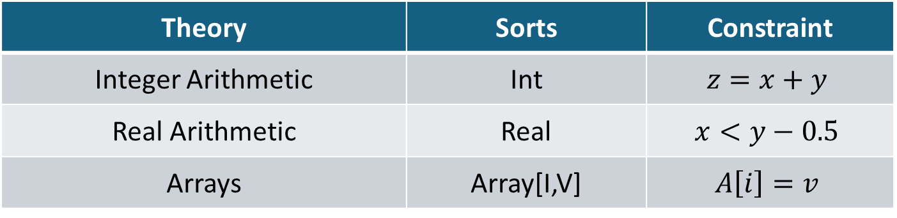
Background theories
CHCs are formulated with respect to a background theory, which defines the sorts and semantics of the constraints.
Theory | Sorts | Constraint
Integer Arithmetic | Int | $$z=x+y$$
Real Arithmetic | Real | $$x<y−0.5$$
Arrays | Array[I,V] | $$A\left[i\right]=v$$

Slide 6
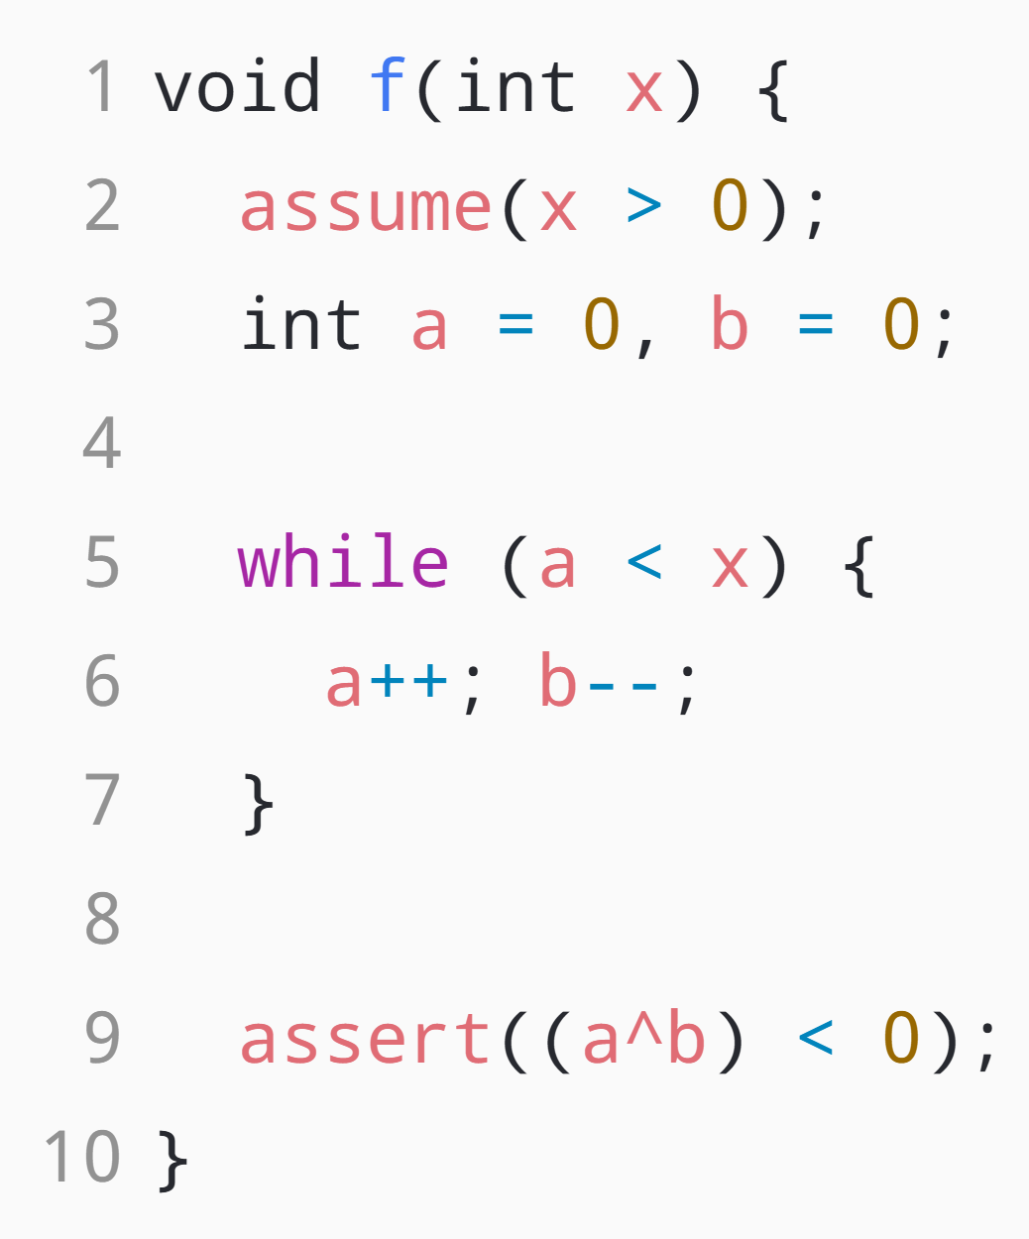
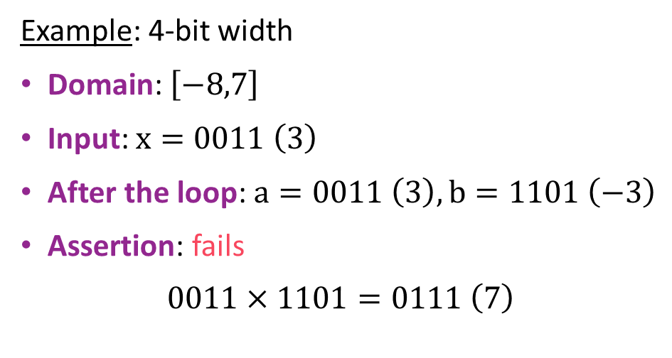

Bit-precise verification
In reality, machine integers are represented as finite binary arrays.
Example: 4-bit width
Domain: $\left[−8,7\right]$
Input: $x=0011 \left(3\right)$
After the loop: $a=0011 \left(3\right), b=1101 \left(−3\right)$
Assertion: fails
$$0011×1101=0111 \left(7\right)$$
a$∗$b
overflow
Note: Integers behave differently than bit vectors

Slide 7
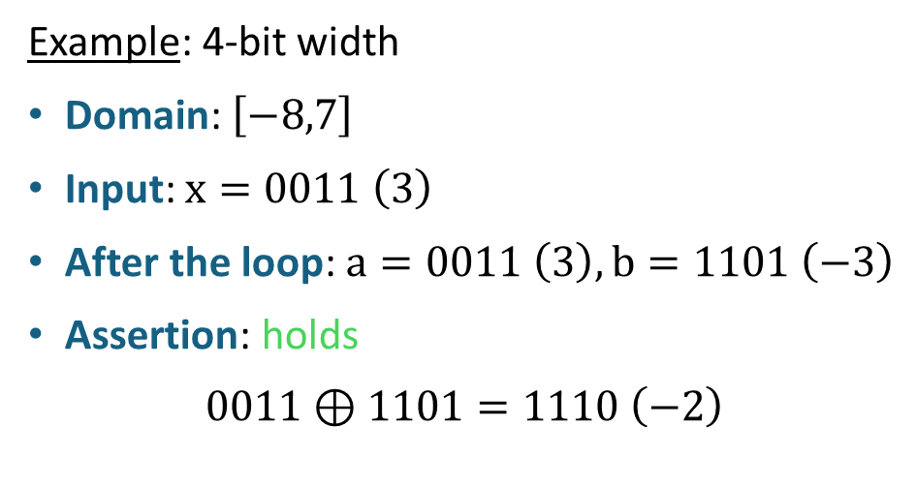
Bit-precise verification
In reality, machine integers are represented as finite binary arrays.
Example: 4-bit width
Domain: $\left[−8,7\right]$
Input: $x=0011 \left(3\right)$
After the loop: $a=0011 \left(3\right), b=1101 \left(−3\right)$
Assertion: holds
$$0011⊕1101=1110 \left(−2\right)$$

Slide 8




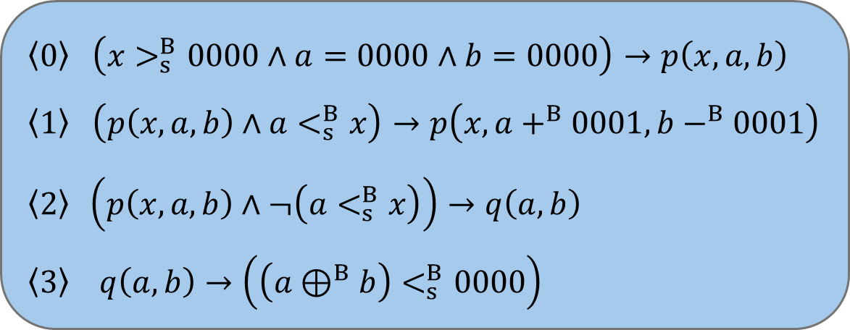
Option 1: encode modulo $𝒯_{B}$
Not scalable
Spacer reaches width 9 in 2 hours
The theory of fixed-size bit-vectors
$$\left\langle 0\right\rangle \left(x>_{s}^{B}0000∧a=0000∧b=0000\right)→p\left(x,a,b\right)$$
$$\left\langle 1\right\rangle \left(p\left(x,a,b\right)∧a<_{s}^{B}x\right)→p\left(x,a+^{B}0001,b−^{B}0001\right)$$
$$\left\langle 2\right\rangle \left(p\left(x,a,b\right)∧¬\left(a<_{s}^{B}x\right)\right)→q\left(a,b\right)$$
$$\left\langle 3\right\rangle q\left(a,b\right)→\left(\left(a⊕^{B}b\right)<_{s}^{B}0000\right)$$
$$p$$
$$q$$
$x,a,b$ have sort BV[4]
Notes:
"Sound by construction — but CHC solvers generalize poorly over bit-vectors, even on the purely arithmetic part. Two hours buys you nine bits."

Slide 9


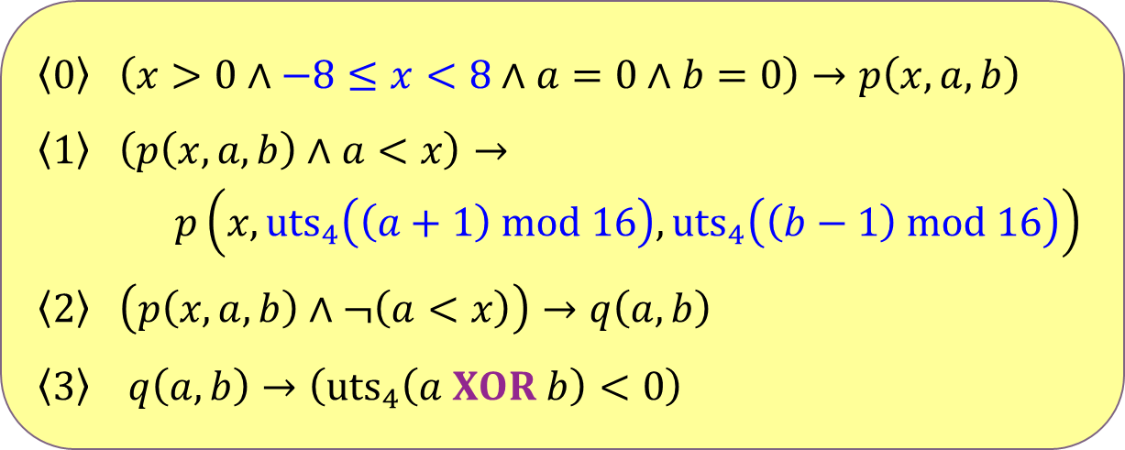

Option 2: encode modulo $𝒯_{I}$
The theory of integer arithmetic
$$\left\langle 0\right\rangle \left(x>0∧−8≤x<8∧a=0∧b=0\right)→p\left(x,a,b\right)$$
$$\left\langle 1\right\rangle \left(p\left(x,a,b\right)∧a<x\right)→$$
$p\left(x,{uts}_{4}\left(\left(a+1\right) mod 16\right),{uts}_{4}\left(\left(b−1\right) mod 16\right)\right)$
$$\left\langle 2\right\rangle \left(p\left(x,a,b\right)∧¬\left(a<x\right)\right)→q\left(a,b\right)$$
$$\left\langle 3\right\rangle q\left(a,b\right)→\left({uts}_{4}\left(a XOR b\right)<0\right)$$
$$p$$
$$q$$
$x,a,b$ have sort Int
$${uts}_{4}\left(t\right)=ite\left(t<8,t,t−16\right)$$

Slide 10

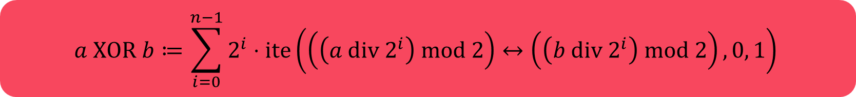

Option 2: encode modulo $𝒯_{I}$
Not scalable
Spacer reaches width 3 in 2 hours
The theory of integer arithmetic
$$\left\langle 0\right\rangle \left(x>0∧−8≤x<8∧a=0∧b=0\right)→p\left(x,a,b\right)$$
$$\left\langle 1\right\rangle \left(p\left(x,a,b\right)∧a<x\right)→$$
$p\left(x,{uts}_{4}\left(\left(a+1\right) mod 16\right),{uts}_{4}\left(\left(b−1\right) mod 16\right)\right)$
$$\left\langle 2\right\rangle \left(p\left(x,a,b\right)∧¬\left(a<x\right)\right)→q\left(a,b\right)$$
$$\left\langle 3\right\rangle q\left(a,b\right)→\left({uts}_{4}\left(a XOR b\right)<0\right)$$
$$a XOR b≔\sum_{i=0}^{n−1}{2^{i}⋅ite\left(\left(\left(a div 2^{i}\right) mod 2\right)↔\left(\left(b div 2^{i}\right) mod 2\right),0, 1\right)}$$
$$p$$
$$q$$
$x,a,b$ have sort Int
$${uts}_{4}\left(t\right)=ite\left(t<8,t,t−16\right)$$

Slide 11
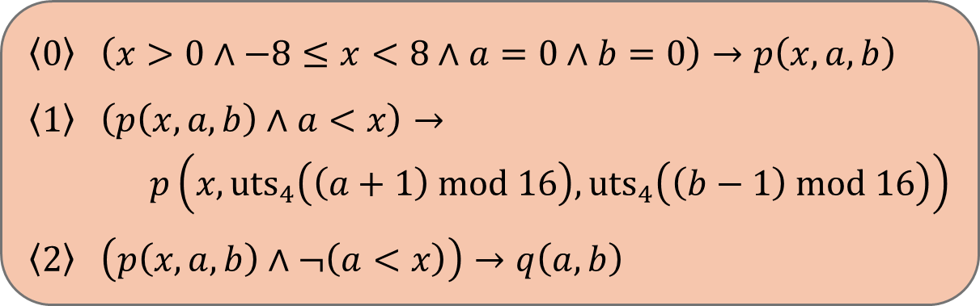
Key idea: don't commit to one theory
Our approach: Leveraging the complementary strengths of both $𝒯_{B}$ and $𝒯_{I}$
$$\left\langle 0\right\rangle \left(x>0∧−8≤x<8∧a=0∧b=0\right)→p\left(x,a,b\right)$$
$$\left\langle 1\right\rangle \left(p\left(x,a,b\right)∧a<x\right)→$$
$p\left(x,{uts}_{4}\left(\left(a+1\right) mod 16\right),{uts}_{4}\left(\left(b−1\right) mod 16\right)\right)$
$$\left\langle 2\right\rangle \left(p\left(x,a,b\right)∧¬\left(a<x\right)\right)→q\left(a,b\right)$$
$$p$$
sort Int
interface constraint
$$q$$
$$\left\langle 3\right\rangle q\left(a,b\right)→\left(\left(a⊕^{B}b\right)<_{s}^{B}0000\right)$$
sort BV[4]

Slide 12


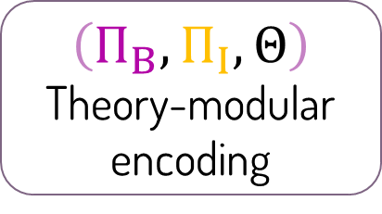
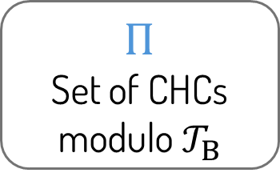
The Mosaic framework
SAT
$$Π$$
Set of CHCs modulo $𝒯_{B}$
Encoder
Safe
Program
bit-vector
fragment
integer
$$\text{fragment}$$
interface constraints
UNSAT
$$\left(Π_{B},Π_{I},Θ\right)$$
Theory-modular encoding
Theory-Modular Encoder
Theory-Modular CHC solver
Buggy
Specification

Slide 13
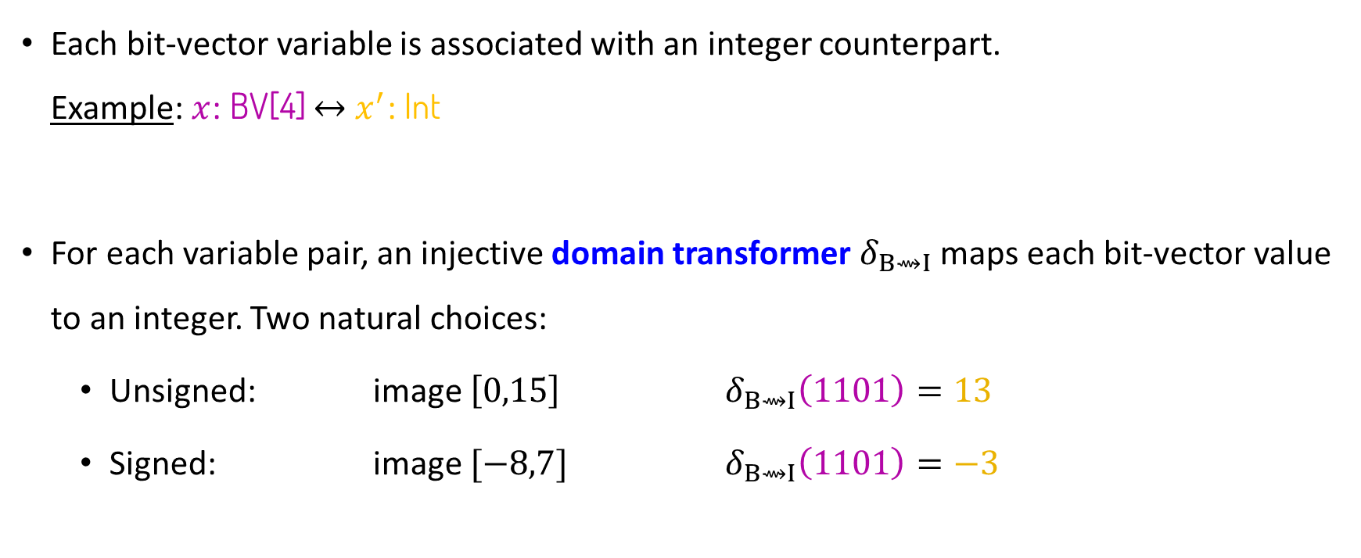
Relating values across theories
Each bit-vector variable is associated with an integer counterpart. Example: $x$: BV[4] $↔$ $x^{′}$: Int
For each variable pair, an injective domain transformer $δ_{B⇝I}$ maps each bit-vector value to an integer. Two natural choices:
Unsigned: image $\left[0,15\right]$ $δ_{B⇝I}\left(1101\right)=13$
Signed: image $[−8,7]$ $δ_{B⇝I}\left(1101\right)=−3$
Notes:
"Every bit-vector variable gets an integer twin — the prime marks the integer side from here on. A domain transformer δ fixes what each bit-pattern means as an integer — one per variable, always injective, so distinct patterns stay distinct. Two natural readings: unsigned or two's complement — 1101, which is b after our loop, is thirteen or minus three. Our example is signed; the per-variable choice is a small heuristic, backup slide if anyone asks. Next: what it takes for a formula translation to respect this mapping."

Slide 14









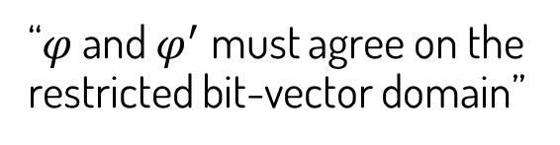
What makes a translation correct
A theory transformer $τ_{B⇝I}$ from $𝒯_{B}$ to $𝒯_{I}$ translates every quantifier-free bit-vector formula $φ$ into a quantifier-free integer formula $φ^{′}=τ_{B⇝I}\left(φ\right)$ such that:
$$δ_{B⇝I}\left(⟦φ⟧\right)=\left(⟦φ^{′}⟧\right)↾_{B}$$
$τ_{I⇝B}$ is defined dually.
$$φ≔x>_{s}^{B}0101$$
$$φ^{′}≔x^{′}>5$$
$$δ_{B⇝I}\left(𝔻_{B}\right)$$
$$𝔻_{I}$$
$$𝔻_{B}$$
$$δ_{B⇝I}$$
“$φ$ and $φ^{′}$ must agree on the restricted bit-vector domain”
$$⟦φ^{′}⟧$$
$$⟦φ⟧$$
$$δ_{B⇝I}\left(⟦φ⟧\right)$$

Slide 15
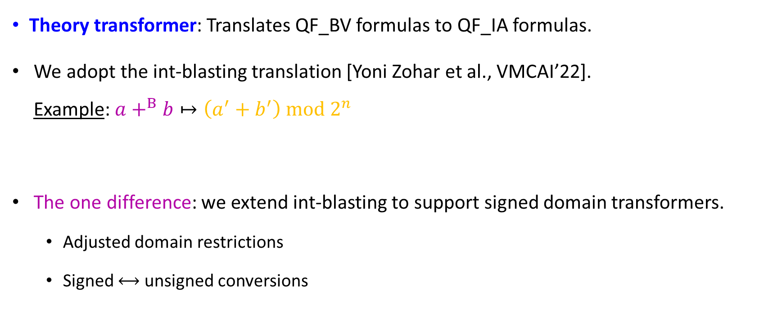

$τ_{B⇝I}$: bit-vectors to integers
Theory transformer: Translates QF_BV formulas to QF_IA formulas.
We adopt the int-blasting translation [Yoni Zohar et al., VMCAI’22]. Example: $a+^{B}b↦\left(a^{′}+b^{′}\right) mod 2^{n}$
The one difference: we extend int-blasting to support signed domain transformers.
Adjusted domain restrictions
Signed $⟷$ unsigned conversions

Slide 16
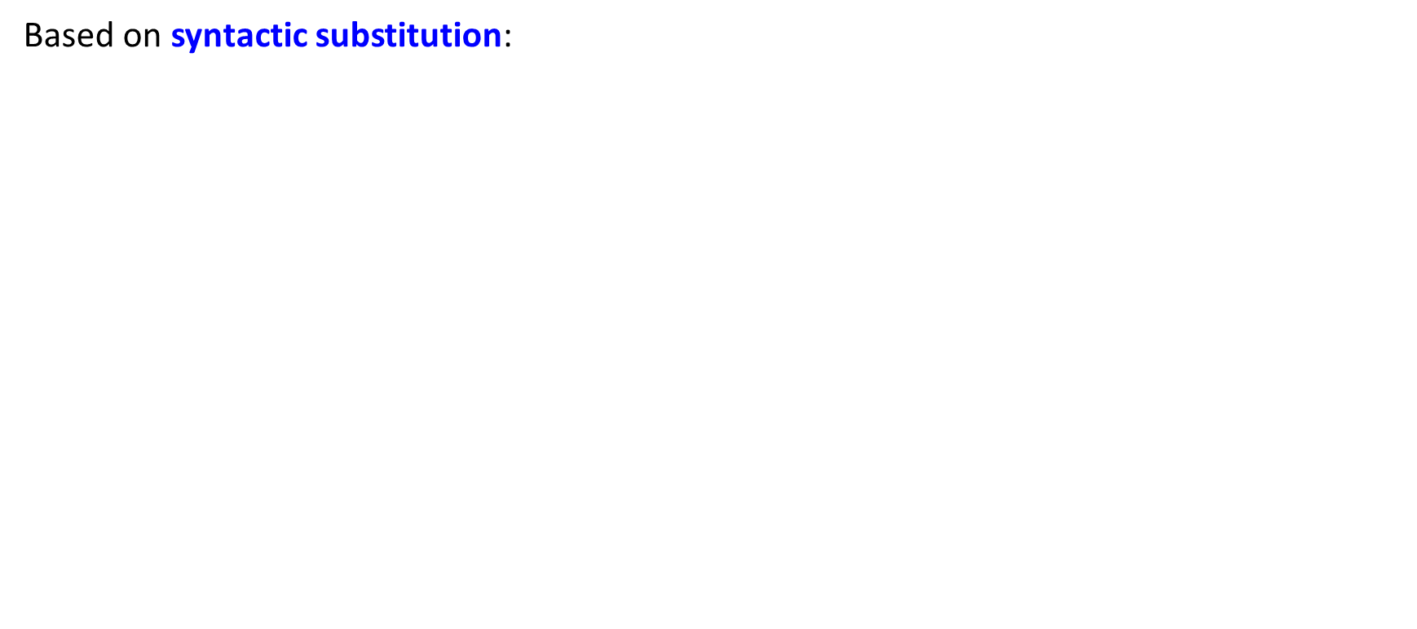





$τ_{I⇝B}$: integers to bit-vectors
We define a custom translation
Based on syntactic substitution:
$$x<_{s}^{B}y+^{B}0001$$
$$x^{′}<y^{′}+1$$
$$↦$$
Problem: overflow changes the semantics
Consider the integer assignment:
$x^{′}=7$, $y^{′}=7$
The integer formula is satisfied:
$$7<7+1$$
Corresponding bit-vector assignment:
$x=0111$, $y=0111$
The bit-vector formula is not satisfied:
$0111≮_{s}^{B}0111+^{B}0001$ ($=−8$)

Slide 17
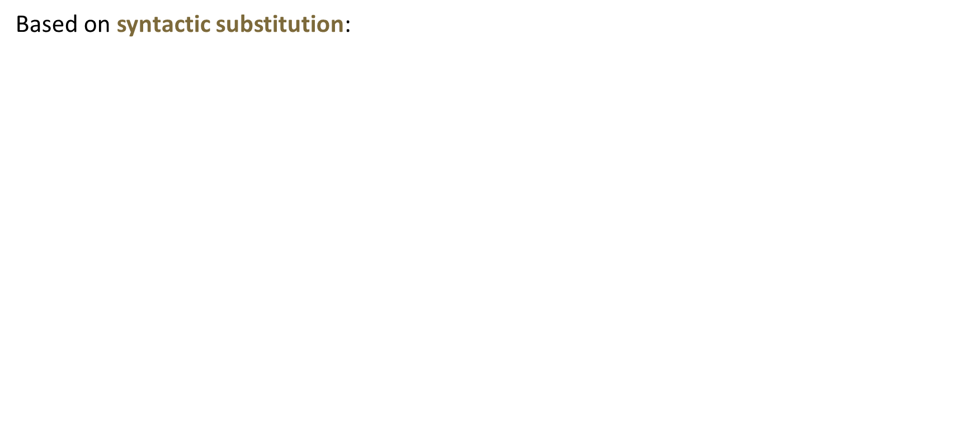


$τ_{I⇝B}$: integers to bit-vectors
We define a custom translation
Based on syntactic substitution:
$$sext(x,1)<_{s}^{B}sext(y,1)+^{B}00001$$
$$x^{′}<y^{′}+1$$
$$↦$$
Problem: overflow changes the semantics
Consider the integer assignment:
$x^{′}=7$, $y^{′}=7$
The integer formula is satisfied:
$$7<7+1$$
Corresponding bit-vector assignment:
$x=0111$, $y=0111$
The bit-vector formula is not satisfied:
$0111≮_{s}^{B}0111+^{B}0001$ ($=−8$)
Solution: sign-extend variables and constants by the minimal width that prevents overflow.
The bit-vector formula is satisfied: $00111<_{s}^{B}00111+^{B}00001$ ($=8$)

Slide 18

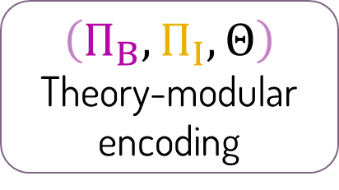
The Mosaic framework
SAT
$$Π$$
Set of CHCs modulo $𝒯_{B}$
Encoder
Safe
Program
bit-vector
fragment
integer
$$\text{fragment}$$
interface constraints
UNSAT
$$\left(Π_{B},Π_{I},Θ\right)$$
Theory-modular encoding
Theory-Modular Encoder
Theory-Modular CHC solver
Buggy
Specification

Slide 19

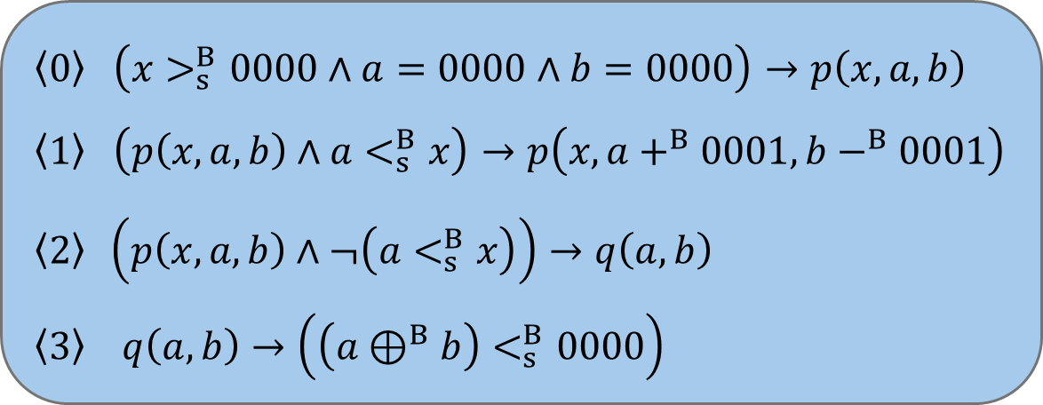
Encoding, step 1: partition
$Π$:
$$\left\langle 0\right\rangle \left(x>_{s}^{B}0000∧a=0000∧b=0000\right)→p\left(x,a,b\right)$$
$$\left\langle 1\right\rangle \left(p\left(x,a,b\right)∧a<_{s}^{B}x\right)→p\left(x,a+^{B}0001,b−^{B}0001\right)$$
$$\left\langle 2\right\rangle \left(p\left(x,a,b\right)∧¬\left(a<_{s}^{B}x\right)\right)→q\left(a,b\right)$$
$$\left\langle 3\right\rangle q\left(a,b\right)→\left(\left(a⊕^{B}b\right)<_{s}^{B}0000\right)$$

Slide 20
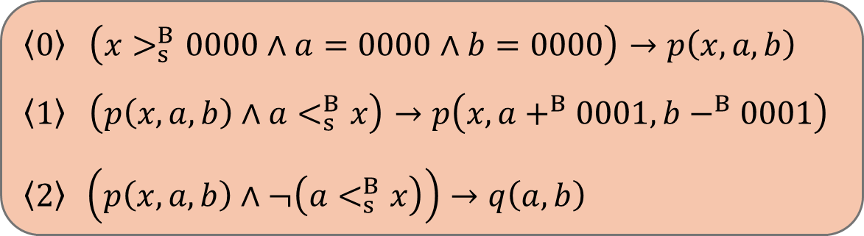


Encoding, step 1: partition
$→$ integer fragment
$$\left\langle 0\right\rangle \left(x>_{s}^{B}0000∧a=0000∧b=0000\right)→p\left(x,a,b\right)$$
$$\left\langle 1\right\rangle \left(p\left(x,a,b\right)∧a<_{s}^{B}x\right)→p\left(x,a+^{B}0001,b−^{B}0001\right)$$
$$\left\langle 2\right\rangle \left(p\left(x,a,b\right)∧¬\left(a<_{s}^{B}x\right)\right)→q\left(a,b\right)$$
$→$ bit-vector fragment
$$\left\langle 3\right\rangle q\left(a,b\right)→\left(\left(a⊕^{B}b\right)<_{s}^{B}0000\right)$$
Heuristic: clauses whose function applications are purely arithmetic $→$ integer fragment

Slide 21



Encoding, step 2: the bit-vector fragment
$→$ integer fragment
$$\left\langle 0\right\rangle \left(x>_{s}^{B}0000∧a=0000∧b=0000\right)→p\left(x,a,b\right)$$
$$\left\langle 1\right\rangle \left(p\left(x,a,b\right)∧a<_{s}^{B}x\right)→p\left(x,a+^{B}0001,b−^{B}0001\right)$$
$$\left\langle 2\right\rangle \left(p\left(x,a,b\right)∧¬\left(a<_{s}^{B}x\right)\right)→q\left(a,b\right)$$
$Π_{B}$:
Predicate renaming
$$\left\langle 3\right\rangle q^{B}\left(a,b\right)→\left(\left(a⊕^{B}b\right)<_{s}^{B}0000\right)$$

Slide 22
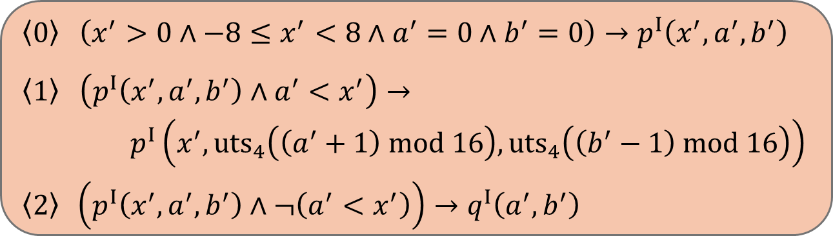



Encoding, step 3: the integer fragment
$Π_{I}$:
$$x^{′}↾_{B}$$
$$\left\langle 0\right\rangle \left(x^{′}>0∧−8≤x^{′}<8∧a^{′}=0∧b^{′}=0\right)→p^{I}\left(x^{′},a^{′},b^{′}\right)$$
$$\left\langle 1\right\rangle \left(p^{I}\left(x^{′},a^{′},b^{′}\right)∧a^{′}<x^{′}\right)→$$
$p^{I}\left(x^{′},{uts}_{4}\left(\left(a^{′}+1\right) mod 16\right),{uts}_{4}\left(\left(b^{′}−1\right) mod 16\right)\right)$
$$\left\langle 2\right\rangle \left(p^{I}\left(x^{′},a^{′},b^{′}\right)∧¬\left(a^{′}<x^{′}\right)\right)→q^{I}\left(a^{′},b^{′}\right)$$
Predicate renaming
Variable renaming
Constraint translations
Domain restrictions
$Π_{B}$:
$$\left\langle 3\right\rangle q^{B}\left(a,b\right)→\left(\left(a⊕^{B}b\right)<_{s}^{B}0000\right)$$

Slide 23
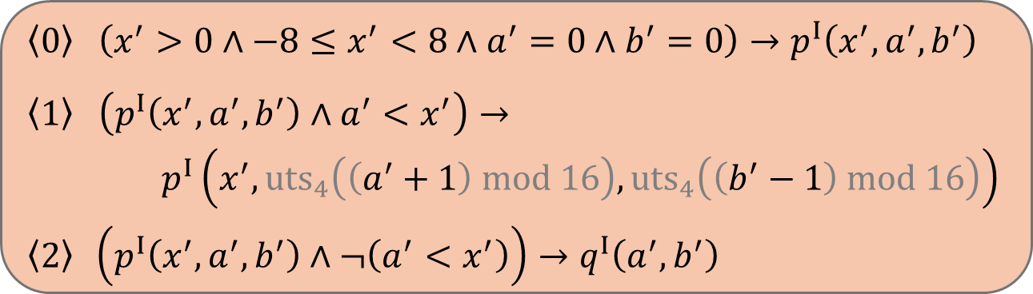
Encoding, step 3: the integer fragment
$Π_{I}$:
$$x^{′}↾_{B}$$
$$\left\langle 0\right\rangle \left(x^{′}>0∧−8≤x^{′}<8∧a^{′}=0∧b^{′}=0\right)→p^{I}\left(x^{′},a^{′},b^{′}\right)$$
$$\left\langle 1\right\rangle \left(p^{I}\left(x^{′},a^{′},b^{′}\right)∧a^{′}<x^{′}\right)→$$
$p^{I}\left(x^{′},{uts}_{4}\left(\left(a^{′}+1\right) mod 16\right),{uts}_{4}\left(\left(b^{′}−1\right) mod 16\right)\right)$
$$\left\langle 2\right\rangle \left(p^{I}\left(x^{′},a^{′},b^{′}\right)∧¬\left(a^{′}<x^{′}\right)\right)→q^{I}\left(a^{′},b^{′}\right)$$
Predicate renaming
Variable renaming
Constraint translations
Domain restrictions
$Π_{B}$:
$$\left\langle 3\right\rangle q^{B}\left(a,b\right)→\left(\left(a⊕^{B}b\right)<_{s}^{B}0000\right)$$
Optimization: eliminate modulo and uts operations where overflow is impossible

Slide 24
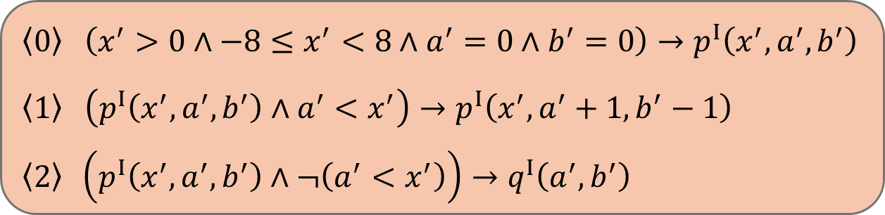

Encoding, step 4: interface constraints
$Π_{I}$:
$$\left\langle 0\right\rangle \left(x^{′}>0∧−8≤x^{′}<8∧a^{′}=0∧b^{′}=0\right)→p^{I}\left(x^{′},a^{′},b^{′}\right)$$
$$\left\langle 1\right\rangle \left(p^{I}\left(x^{′},a^{′},b^{′}\right)∧a^{′}<x^{′}\right)→ p^{I}\left(x^{′},a^{′}+1,b^{′}−1\right)$$
$$\left\langle 2\right\rangle \left(p^{I}\left(x^{′},a^{′},b^{′}\right)∧¬\left(a^{′}<x^{′}\right)\right)→q^{I}\left(a^{′},b^{′}\right)$$
$Π_{B}$:
$$\left\langle 3\right\rangle q^{B}\left(a,b\right)→\left(\left(a⊕^{B}b\right)<_{s}^{B}0000\right)$$
$$Θ=\left\{q^{I}⇝q^{B}\right\}$$

Slide 25










Semantics: derivations across fragments
local
$Π_{I}$:
$$p^{I}\left(1,0,0\right)$$
$$\left\langle 0\right\rangle \left(x^{′}>0∧−8≤x^{′}<8∧a^{′}=0∧b^{′}=0\right)→p^{I}\left(x^{′},a^{′},b^{′}\right)$$
$$\left\langle 1\right\rangle \left(p^{I}\left(x^{′},a^{′},b^{′}\right)∧a^{′}<x^{′}\right)→ p^{I}\left(x^{′},a^{′}+1,b^{′}−1\right)$$
$$\left\langle 2\right\rangle \left(p^{I}\left(x^{′},a^{′},b^{′}\right)∧¬\left(a^{′}<x^{′}\right)\right)→q^{I}\left(a^{′},b^{′}\right)$$
local
$$p^{I}\left(1,1,−1\right)$$
local
$$q^{I}\left(1,−1\right)$$
external
$$q^{B}\left(0001,1111\right)$$
$Π_{B}$:
Derivation
$$\left\langle 3\right\rangle q^{B}\left(a,b\right)→\left(\left(a⊕^{B}b\right)<_{s}^{B}0000\right)$$
$$Θ=\left\{q^{I}⇝q^{B}\right\}$$
$$0001⊕^{B}1111=1110<_{s}^{B}0000$$
Query Check

Slide 26
End of lecture 2

