Slide 1
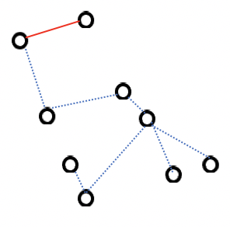
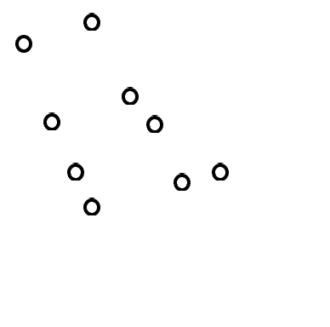
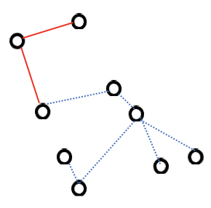
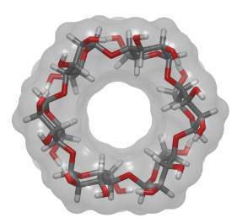
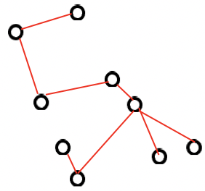
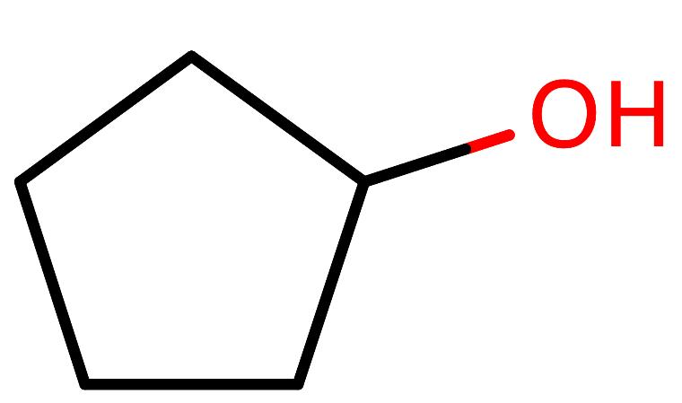




Physics-guided neural network (PGNN)
Graph Convolution Network (GCN)
Featurizer
Graph Conv
Graph gather
$$X_{0}={F_{0}}_{\left\{0…75\right\}}$$
$$X_{1}={F_{1}}_{\left\{0…75\right\}}$$
Max Pooling
Batch Normalization
, P
Dense layer
Dense layers
M
M
$$∆H$$
$$X_{N}={F_{N}}_{\left\{0…75\right\}}$$
A :
Adjacency Matrix
1D array
Concatenation
Graph Conv
Graph gather
GBNSR6
Amber Tools 2020
Physics-based model
P =
P1 , P2 , … , P15

