Slide 1
Model Workflow and Featurizer details
Sahar

Slide 2
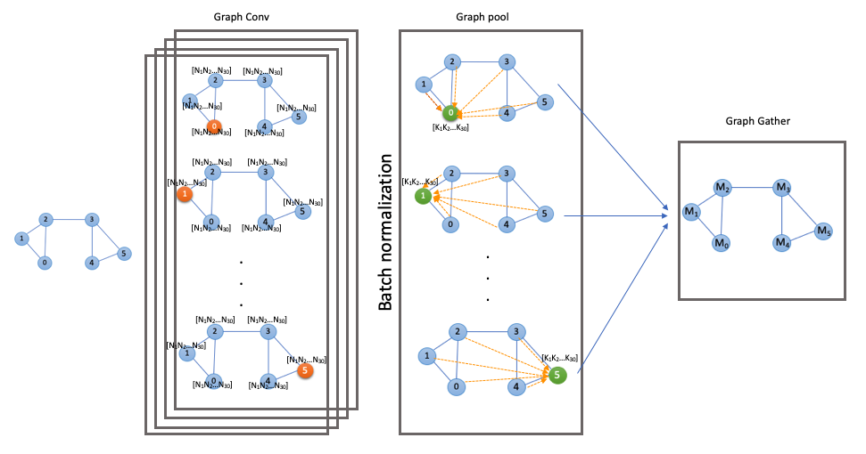

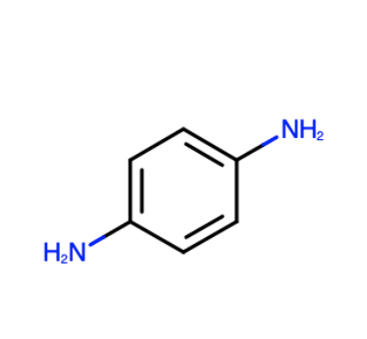

Graph Convolutional Neural Network
M x N
. . .
M
Dense layer
$$∆H$$
p-Phenylenediamine
Concatenate with M
gbnsr6
Amber
P1 , P2 , … , Pj
Physic’s parameters

Slide 3
Our GCNN model consists of multiple layers such as GraphConv, batch normalization, GraphPool, GraphGather and dense layer. GraphConv layer of the model, which is the first layer of the network, acts on the atom level of the input data. It accepts a feature matrix X of size M×N as input where M is the number of atoms in anmolecule and N is the number of features for each atom. Atoms in this model can be referred as nodes. This layer also accepts an adjacency matrix, A, of size M×M that is representing the overall structure of the graph. Each hidden layer of the GraphConv layer can be represented as H^{l}=f(H^{l−1},A) where H⁰ is the input matrix X and f is the propagation function and l is the number of hidden layers. We are using Tanh activation function for this model. The size of the matrix remains unchanged after GraphConv layer. The output of this layer is now the input of the batch normalization layer. In this layer, the data is normalized to have mean zero and standard deviation one. The output of this layer is then passed to GraphPool layer where data from local neighborhoods of a graph is gathered. This layer performs max-pooling over the feature vectors of atoms in a neighborhood and combine all atom features into a single fingerprint of the whole molecule. The output of this layer is a M×K matrix where K is the number of neighboring atoms of each atom. The maximum value that K can have is 10 which is the maximum allowed degree for each graph node. The output of GraphPool layer will go through Dense and normalization layers before entering GraphGather layer. This layer creates a graph level feature vector by combining all node-level feature vectors. The output of this layer is a vector of size M. Now at this level, we are concatenating the output vector M with vector P of size 15 that consists of physics parameters extracted from GBNSR6 and PBSA outputs. The resulting vector, MP, will go through another dense layer and the output is enthalpy prediction.

Slide 5
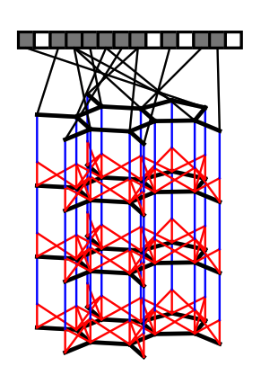
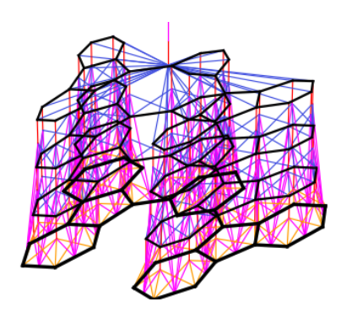
Dunevaud Graph Featurizer (ConvMolFeaturizer)
Atom_features: One_Host_encoding[symbol + degree + total number of Hydrogens(if not explicit hydrogen (QM8, QM9) + implicit valence + Formal Charge + Radical Electrons + Hybridization Type + if use chirality]
Bond features: bond type (single, double, triple, aromatic), is conjugated or not, is a ring or not, Chirality
First, a graph is constructed matching the topology of the molecule being fingerprinted, in which nodes represent atoms, and edges represent bonds. At each layer, information flows between neighbors in the graph. Finally, each node in the graph turns on one bit in the fixed-length fingerprint vector.

Slide 6
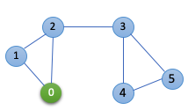
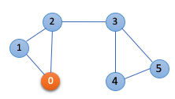
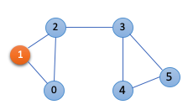
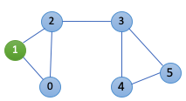
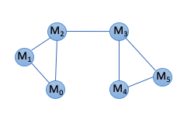
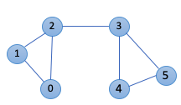
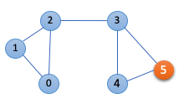
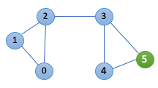
Graph Conv
Graph pool
[N₁N₂…N₃₀]
[N₁N₂…N₃₀]
[N₁N₂…N₃₀]
[N₁N₂…N₃₀]
[K₁K₂…K₃₀]
Graph Gather
[N₁N₂…N₃₀]
[N₁N₂…N₃₀]
[N₁N₂…N₃₀]
[N₁N₂…N₃₀]
[N₁N₂…N₃₀]
[K₁K₂…K₃₀]
[N₁N₂…N₃₀]
Batch normalization
[N₁N₂…N₃₀]
[N₁N₂…N₃₀]
. . .
. . .
[N₁N₂…N₃₀]
[N₁N₂…N₃₀]
[N₁N₂…N₃₀]
[N₁N₂…N₃₀]
[K₁K₂…K₃₀]
[N₁N₂…N₃₀]
[N₁N₂…N₃₀]

