Slide 1
cross

Slide 2
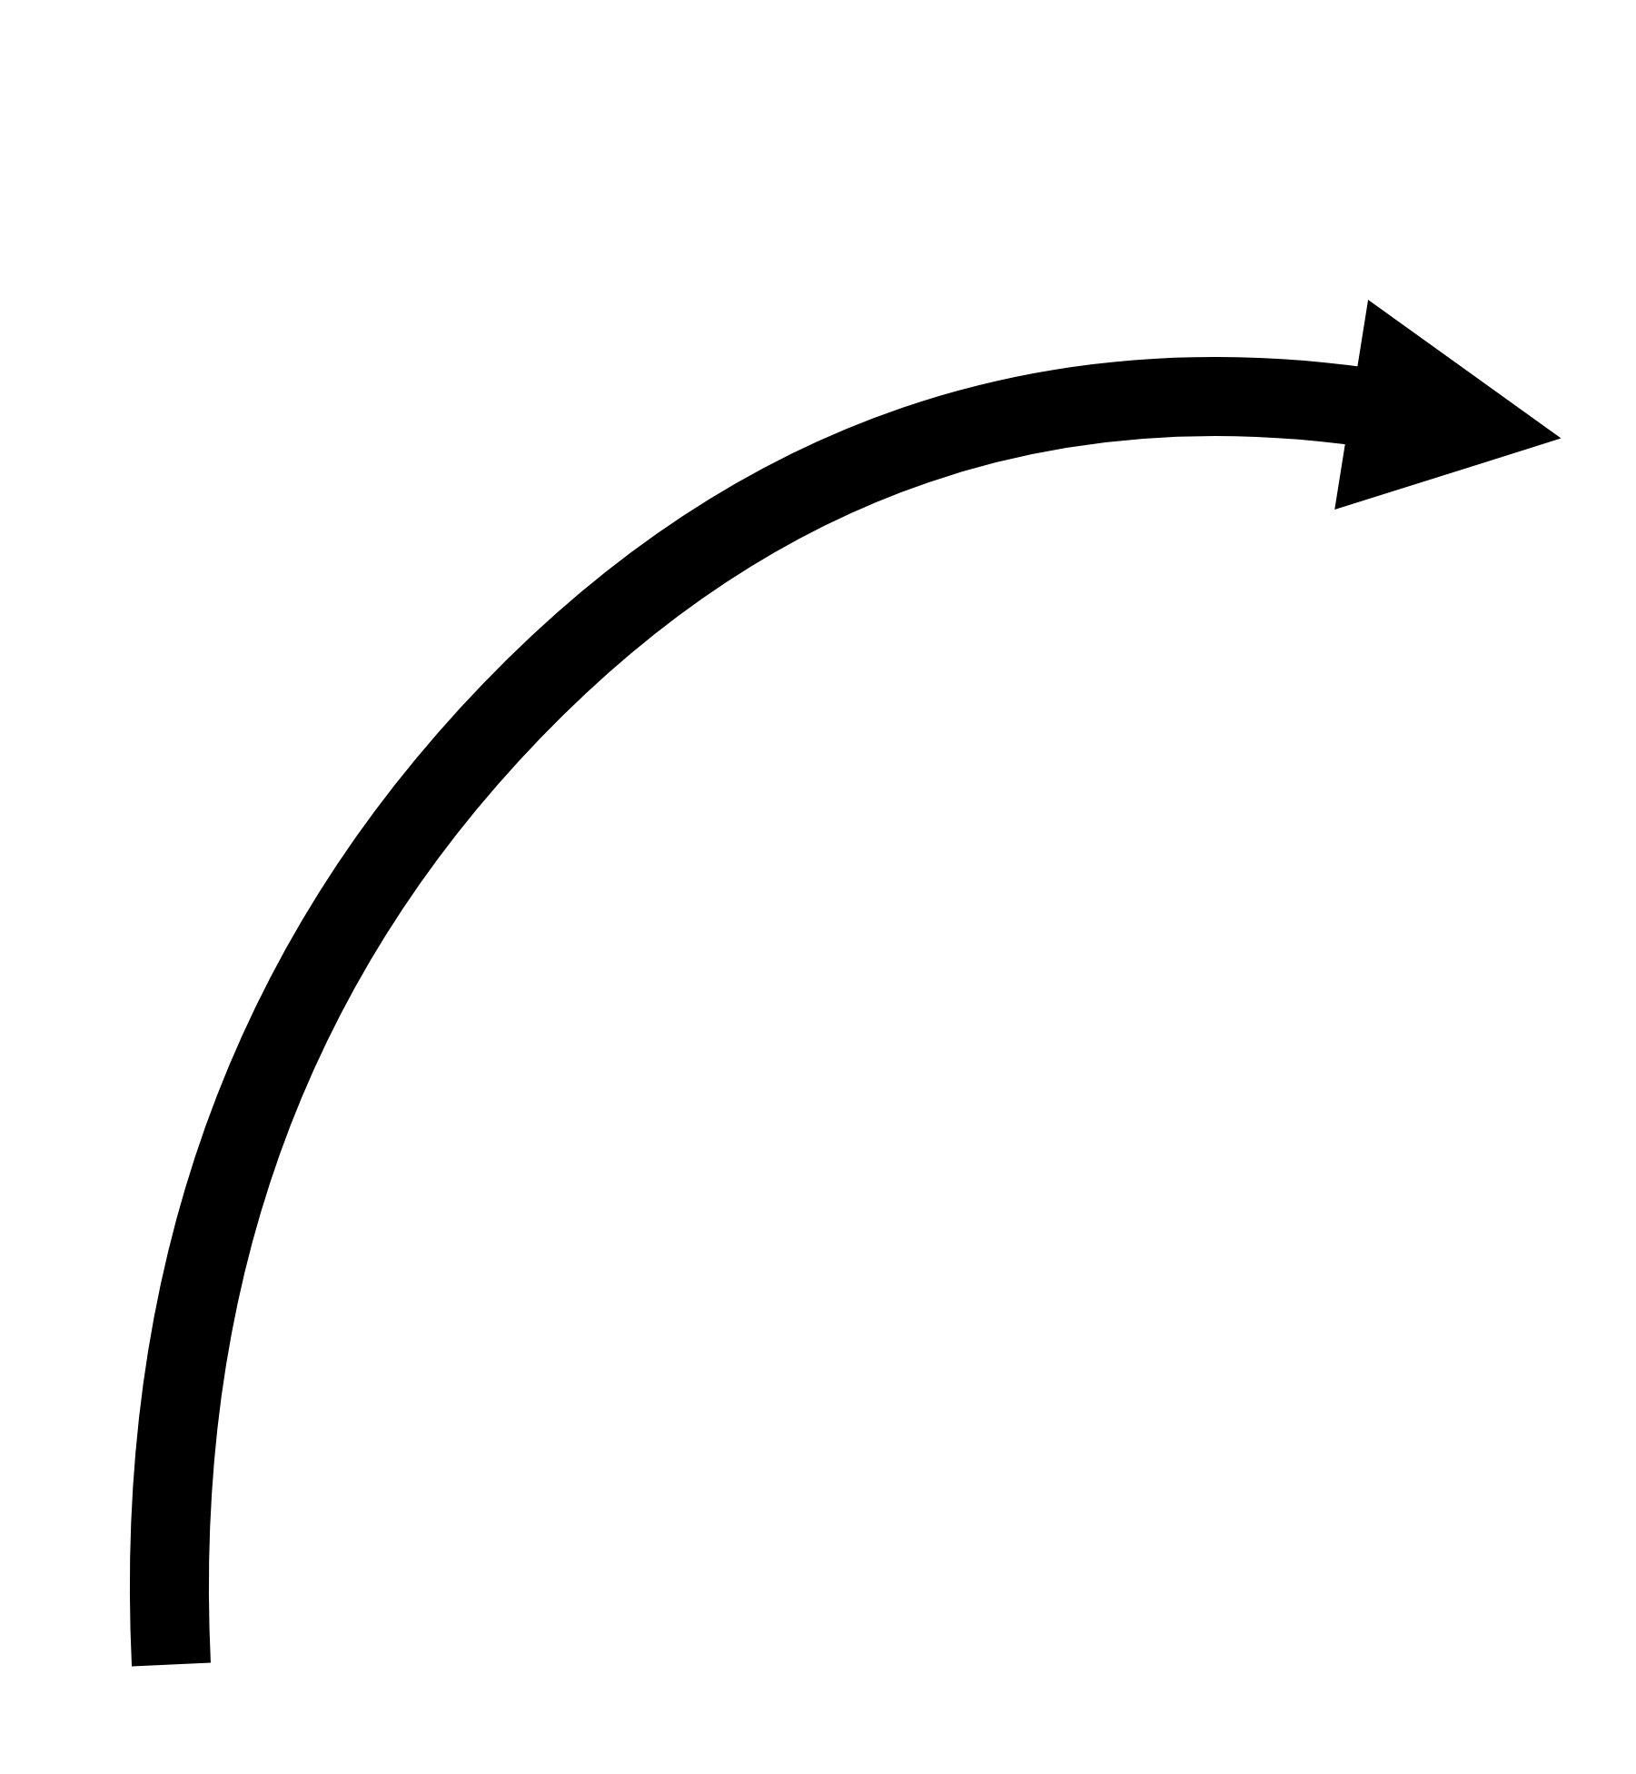
lock1
lock2
cross
lock3
lock4

Slide 3
lock1
lock2
cross
lock3
lock4

Slide 4
lock1
lock2
cross
lock3
lock4

Slide 5
lock1
lock2
cross
lock4
lock3

