Slide 1
Modeling Autonomous Vehicles at an Intersection without a Traffic Light
Yui Sahara Masaki Nakamura
Nakamura Laboratory
Notes:
Hello everyone! My name is Yui Sahara. I will talk about Modeling Autonomous vehicles at an intersection without a traffic light.

Slide 2
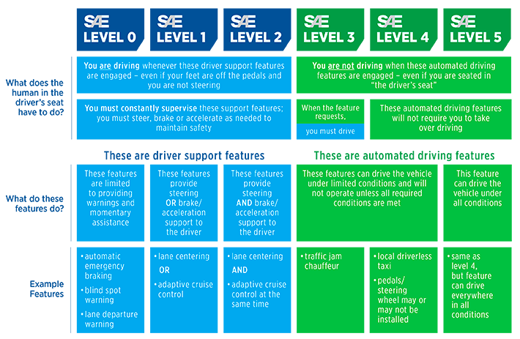
Introduction
Automatic driving technology is in rapid development.
Automatic driving technology is divided into five levels depending on the technology installed.
Reference : SAE Levels of driving automation
Notes:
Automatic driving technology is in rapid development. Automatic driving is divided into five levels depending on the technology installed. In Japan, gen- eral cars install level 2 supporting driver. In the future, Japan government will set a goal that the vehicles installed level 4 become popular.

Slide 3
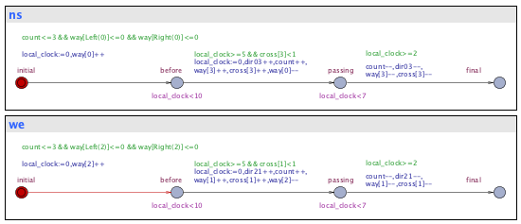
Object
Modeling the autonomous vehicles group control algorithms
Propose verification using formal methods
System Design
System Model
Modeling
Modeling Verification
Property
Verification Formula
Modeling
Notes:
If a lot of automatic driving cars are used in a city, some problems may occur. Thus, we need autonomous-vehicle group control algorithms. In this research, we verify the autonomous-vehicle group control algorithms with formal method.
Autonomous-vehicle systems support drivers to avoid conflict and to control safety. Cars are necessary for our lifestyles, but traffic accidents happen anytime. Therefore, we ought not drive car. Autonomous-vehicle is necessary for human life in the future. A collision avoidance systems were developed to protect drivers.

Slide 4
Modeling Verification
A type of automatic verification method that comprehensively investigates possible states on a system and finds design errors.
Perform time constraint verification with time automaton.
Notes:
In this research, we propose a method to verify whether the group control algorithm satisfies the safety such as deadlock avoidance and time constraint related to efficiency.
The group control algorithm of autonomous vehicle is described formally and the property is verified using model checking. The model checking method models the design of the behavior of the system and the property to be verified, respectively, and uses a tool to check if the system meets the property.

Slide 5
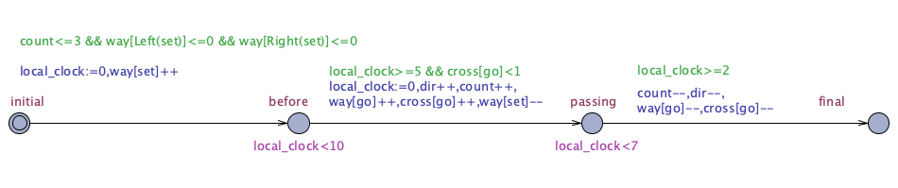
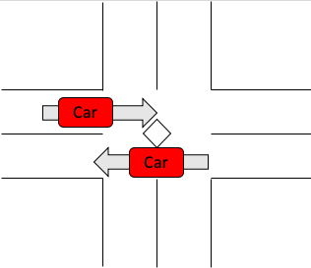
Model using UPPAAL
Timed Automaton of a intersection
Notes:
UPPAAL [1] is an integrated tool environment for modeling, simulation, and verification of real-time systems. UPPAAL provides graphical interface to describe timed automata and simulate and verify them. UPPAAL’s timed automata is an extension of usual timed automata. We declare local and global variables for data types and clocks. In UPPAAL, a system model consists of collection of timed automata. Global variables are declared for a system model. Timed automata [2] consist of a finite number of clock variables, a finite number of lo- cations, and transitions between locations. A clock variable stores time progress of continuous state of the system.
An intersection without a traffic light is one lane on one side(Fig.1). Cars that turn left can pass at the same time in this intersection.
We give a system model of intersections with several autonomous vehicles. There is a timed automata of intersection without traffic lights using UPPAAL(Fig.2). This is template of timed automata. Parameters are declared direction of cars, cars’ start points, and cars’ end points.

Slide 6
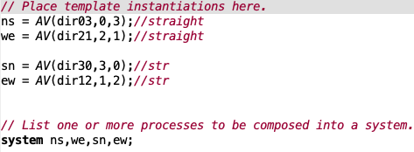
System declarations
Make timed automaton from template
There are 4 cars going straight
Notes:
System declarations make timed automata from template.

Slide 7
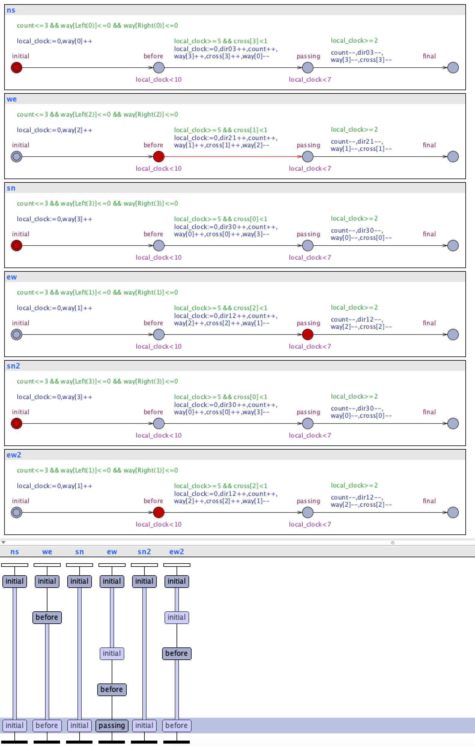
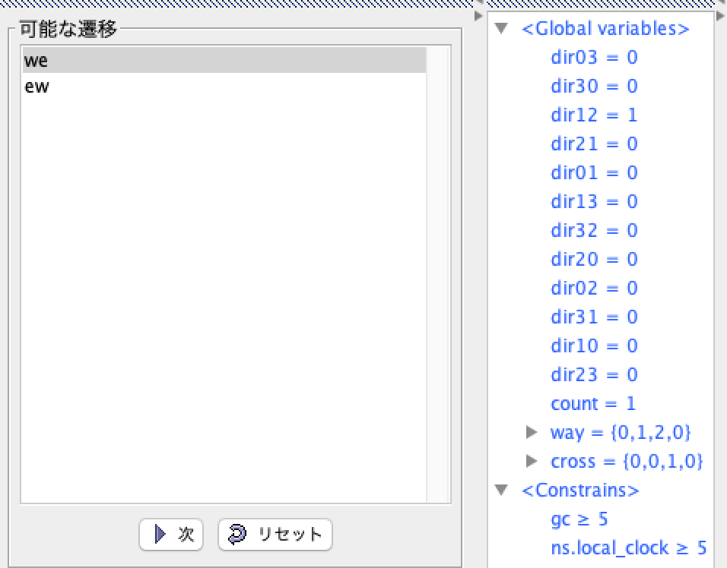
Simulation
Using simulation system
Notes:
Simulation system can check own system design behavior.

Slide 8
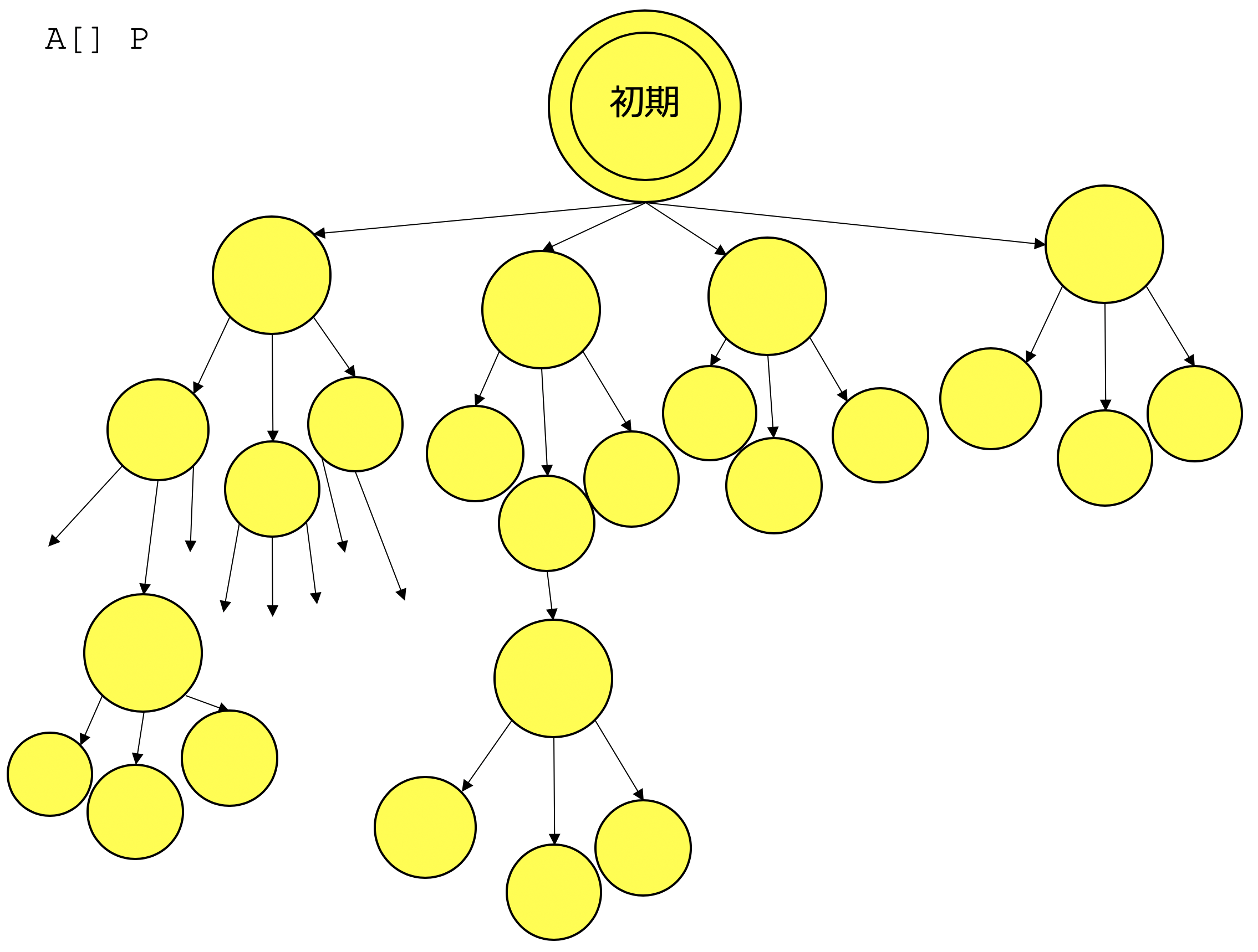
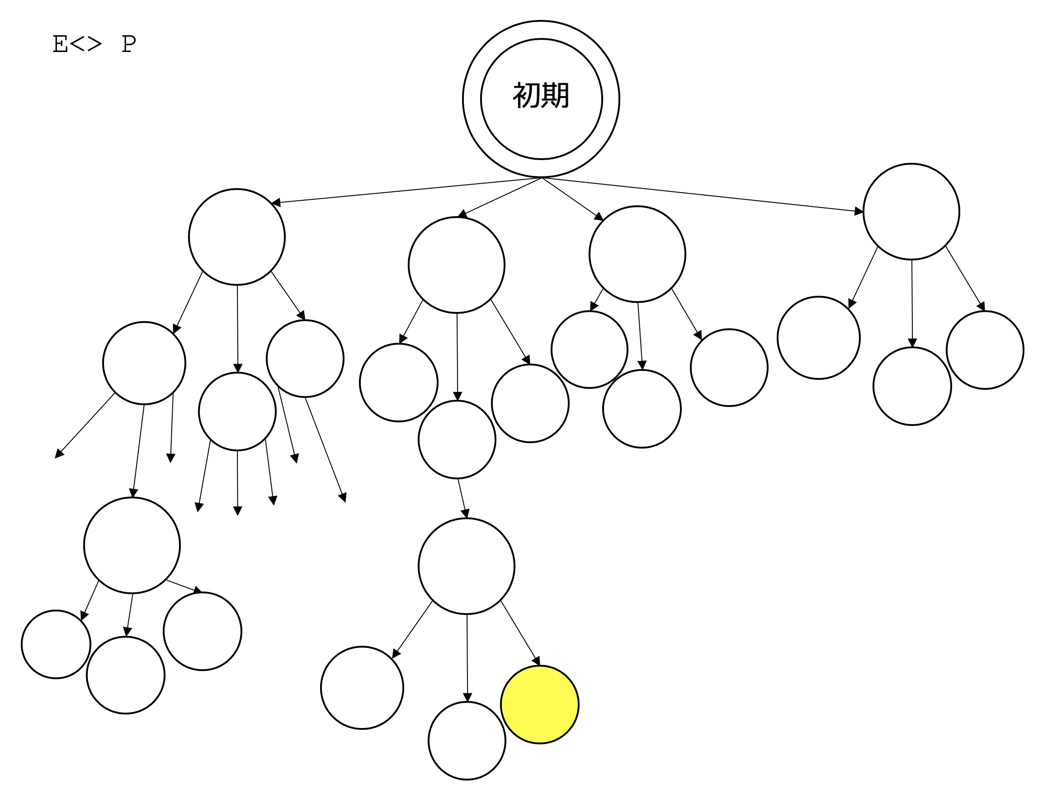
Verify
Verify a Intersection model
verify from two basic properties.
Notes:
In this study, we verify from two basic properties.
A「」 A property always holds in all execution examples.
E＜＞（Rhombus） A property holds for some execution examples.
This pictures show state transition diagram.
We verify the minimum time it takes for all the vehicles to cross the intersection once.
The minimum time can be verified from these two things by verifying whether it is possible to finish passing at the time specified by possibility E <>, and verifying that it does not finish earlier than the specified time with minimum property A [].

Slide 9
Conclusion
Modeling and verification autonomous-vehicle group control algorithms using UPPAAL.
Verify and modeling the behavior of autonomous vehicles at an intersection.
Notes:
We proposed a modeling and verification method of autonomous-vehicle group control algorithms using UPPAAL. We could verify and modeling the behavior of autonomous vehicles at an intersection.
In this study, we proposed a method for modeling and verifying an autonomous-vehicle group control algorithm using UPPAAL. At a single intersection, we could model the behavior of the vehicle and verify the deadlock and transit time. It is a future subject to make and verify a model of the city space which consists of a plurality of intersections, and to measure the passage time by another straight right turn left turn.

Slide 10
References
Kim Guldstrand Larsen and Paul Pettersson and Wang Yi, UPPAAL in a Nutshell, International Jour- nal of Software Tools for Technology Transfer, Vol.1, No.1-2, pp.134-152, 1997.
Timed Automata: Semantics, Algorithms and Tools, Johan Bengtsson and Wang Yi. In Lecture Notes on Concurrency and Petri Nets. W. Reisig and G. Rozenberg (eds.), LNCS 3098, Springer-Verlag, 2004.
Y. Sahara, M. Nakamura, ”Modeling and verification of autonomous-vehicle group control algorithms using UPPAAL”, Toyama Prefectural University, Japan, 2019.

Slide 11
Biography
Yui Sahara is graduate student in Nakamura Laboratory at Toyama Prefectural University in the Graduate School Engineering majoring Information Systems Engineering. She received Bachelor of Engineering from Toyama Prefectural University at 2019. Her recent work includes ”Modeling and verification of autonomous-vehicle group control algorithms using UPPAAL”(ISCIE, May, 2019). She is researching performance model verification of autonomous-vehicle group control algorithms using a model checking technique.

Slide 12
Thank you for listening!

