Slide 1

KURUKSHETRA 2.0​
TITLE PAGE
HACKFEST 2026
• Problem ID - PS16
• Problem Statement - Autonomous Vulnerability Triage & Evidence Engine
• Theme - Cyber & Blockchain
• Team ID - KH079
• Team name - Sudarshan_MITAOE
MIT ACSC • ALANDI, PUNE

Slide 2

KURUKSHETRA 2.0​
HACKFEST 2026
Sudarshan_MITAOE
Understanding the Problem
TITLE PAGE
CyberYukti is an autonomous vulnerability triage and deterministic evidence validation engine that reduces alert noise generated by scanning tools into verified, prioritized, and analyst-ready security cases.
Problem Analysis / Background
• Alert Fatigue: 1 real flaw triggers 10+ alerts across Trivy, Semgrep, and Nuclei.
• Stale & Ghost Findings: Up to 40% of scanner alerts flag libraries already patched in production or unexposed.
• Naive AI Risks: Generic LLM wrappers hallucinate fake CVEs and are vulnerable to prompt-injection attacks in scanner outputs.
Who It Affects
• Security Analysts (SOC, AppSec): Overwhelmed by alert volume and manual verification.
• DevSecOps Engineers: Blocked by false-positive security tickets that stall CI/CD.
• CISOs & Compliance Teams: Lack tamper-evident audit trails for SOC 2 / ISO 27001.
02
MIT ACSC • ALANDI, PUNE

Slide 3
KURUKSHETRA 2.0​
HACKFEST 2026
Sudarshan_MITAOE
Proposed solution
TITLE PAGE
Solution Overview
• Idea / Solution: Dual-rail autonomous engine combining deterministic sandbox probes with bounded AI explanation.
• Direct PS16 Alignment: Ingests multi-format scans, clusters duplicates (90.5% noise cut), safely probes sandbox targets, calculates math-based risk, and enforces human approval.
Innovation & Uniqueness
Existing Solutions / Similar Work
• Dual-Rail Zero-Trust: LLM never decides security truth; mathematical code handles validation and scoring.
• Dynamic Re-Prioritization: Live sandbox probes prove patched assets, auto-demoting priority (P2 → P3).
• Poison-Proof AI: 24-field quarantine sanitizer prevents prompt-injection hijacking.
• Conventional Tools (Jira, DefectDojo): Passive databases requiring manual verification.
• Commercial ASPMs (Snyk, Wiz): Proprietary reachability with vendor lock-in.
• CyberYukti Advantage: Cross-tool SAST × DAST × SCA reachability on open-source tools with SHA-256 hash chaining.
03
MIT ACSC • ALANDI, PUNE

Slide 4

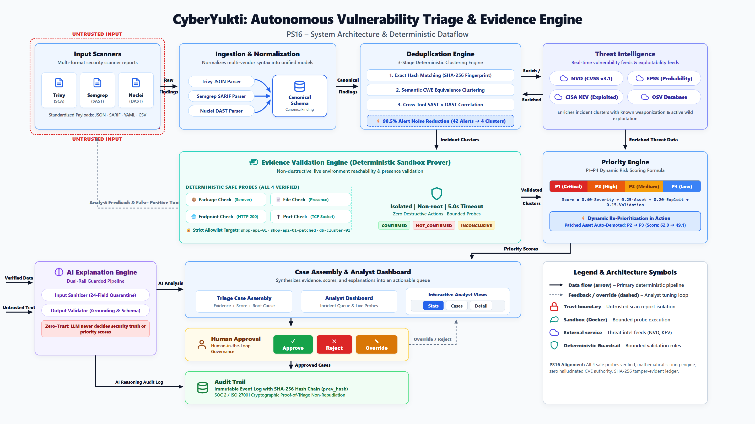
KURUKSHETRA 2.0​
HACKFEST 2026
Sudarshan_MITAOE
Technical Approach
TITLE PAGE
Technology Stack
• Languages & Frameworks: Python 3.12, FastAPI, Next.js 14, React 18, TypeScript, Tailwind CSS.
• Validation Libraries: Pydantic v2, Python packaging.version, HTTPX, Docker SDK.
• AI Engine: Dual-Rail Orchestrator (GPT-4o / Claude 3.5 / Local Mock) + Regex Sanitizer.
Working / Implementation Approach
1. Ingestion: Parsers normalize Trivy, Semgrep, Nuclei, SARIF, and CSV into CanonicalFinding objects.
2. Clustering: 3-tier dedup eliminates exact hash duplicates, generic CWEs, and correlates SAST routes with DAST endpoints.
3. Sandbox Probes: Safe, read-only probes inspect target manifests, sockets, and endpoints.
4. Deterministic Evaluation: Returns CONFIRMED, NOT_CONFIRMED, or INCONCLUSIVE.
5. Dynamic Risk: Math formula computes P1–P4 score, AI explains, and analyst approves or overrides.
04
MIT ACSC • ALANDI, PUNE

Slide 5
KURUKSHETRA 2.0​
HACKFEST 2026
Sudarshan_MITAOE
Feasibility, Viability & Impact
TITLE PAGE
Feasibility & Viability
Impact & Benefits
• Technical Feasibility: 100% operational; 90/90 automated tests pass across backend and frontend.
• Operational Viability: Runs containerized in Docker or lightweight CI/CD subprocess sandboxes.
• Risk & Mitigation: Read-only probes with hard 5.0s timeouts and target allowlists eliminate target crash risk. Dual-rail prompt sanitization blocks prompt-injection hijacking.
• 90.5% Noise Cut: 42 raw scanner alerts collapse into 4 actionable incident clusters.
• 31.5 Hours Saved: Saves ~25m per duplicate and ~45m per auto-probed patch ($3,150+ saved/cycle).
• Instant MTTR: Triage turnaround drops from days to seconds.
• Audit Ready: SHA-256 hash-chained ledger provides compliance non-repudiation.
AI/ML Details (if applicable)
• Architecture: Dual-Rail Guarded Pipeline (GPT-4o / Claude 3.5 / Local Mock Provider).
• Prompt Defense: 24-field sanitizer quarantines untrusted text in <UNTRUSTED> delimiters.
• Grounding Validator: Enforces strict JSON schema and verifies that all CVEs and CVSS numbers in the output exist in the input (16/16 adversarial injection tests passed).
05
MIT ACSC • ALANDI, PUNE

Slide 6
KURUKSHETRA 2.0​
HACKFEST 2026
Sudarshan_MITAOE
Research & References
TITLE PAGE
Research Conducted
• Standards: NIST SP 800-115 (Information Security Testing), OWASP Top 10 for LLMs (2025), FIRST EPSS v3, CISA KEV.
• Academic Papers & Frameworks: First.org EPSS probability modeling, GitLab multi-scanner deduplication heuristics.
References / Sources
GitHub Repository
• FIRST EPSS Framework: https://www.first.org/epss/
• CISA KEV Catalog: https://www.cisa.gov/known-exploited-vulnerabilities-catalog
• National Vulnerability Database (NVD): https://nvd.nist.gov/
• OWASP LLM Top 10: https://owasp.org/www-project-top-10-for-large-language-model-applications/
Team's public GitHub repository URL:
https://github.com/Sahas2711/CyberYukti
(Active Implementation Branch: person-2-evidence-engine)
06
MIT ACSC • ALANDI, PUNE

Slide 7
KURUKSHETRA 2.0​
HACKFEST 2026
Sudarshan_MITAOE
Build With
TITLE PAGE
Frontend
Backend
Frontend
• Next.js 14 (React 18 App Router)
• TypeScript 5.6 & Tailwind CSS 3.4
• Lucide Icons & Responsive Panels
• Live interactive probe execution
Backend
• FastAPI 0.115 & Python 3.12
• Pydantic v2 Strict Data Contracts
• Uvicorn ASGI with Lifespan state
• HTTPX Async HTTP Probe Client
Database & Ledger
• Thread-Safe In-Memory Case Store
• Synchronized Ingestion Cluster Index
• Cryptographic SHA-256 Hash Chain
• prev_hash Non-Repudiation
React / React Native / HTML / CSS / etc.
Node.js / Python / etc.
Database
AI/ML
Supabase / Firebase / MongoDB / etc.
Model / API /Framework
AI / ML Guardrails
• Dual-Rail Orchestrator (GPT-4o/Claude)
• 24-Field Prompt Quarantine Sanitizer
• Schema Output Grounding Validator
• 16/16 Adversarial Tests Passed
Tools & Validation
• Docker & Docker Compose Isolation
• Pytest (77 Python backend tests)
• Vitest (13 TypeScript tests)
• Trivy, Semgrep, Nuclei Parsers
Architecture Principles
• Dual-Rail Zero-Trust (Code proves, AI explains)
• Fail-Safe Bounded Probes (Timeouts = Inconclusive)
• Zero Autonomous Exploitation (No weaponization)
• 90.5% Alert Noise Elimination
Tools & Services
Architecture Principle
Docker & Docker Compose, Pytest (77 tests), Vitest (13 tests), HTTPX.
Modular / Scalable / Secure / API-Driven
07
MIT ACSC • ALANDI, PUNE

Slide 8
KURUKSHETRA 2.0​
HACKFEST 2026
Sudarshan_MITAOE
TITLE PAGE
THANK YOU
CyberYukti — Autonomous Vulnerability Triage & Evidence Engine
Questions & Answers • GitHub: https://github.com/Sahas2711/CyberYukti
07
MIT ACSC • ALANDI, PUNE

