Slide 1
DIGITAL LOGIC DESIGN PROJECT
Design and Simulation of an Adder and Subtractor
A gate-level arithmetic unit verified with truth tables and Logisim.
Team members:
Sahasra-2620030411
Rithvik-2620030483
Rithwik-2620030484
Bavesh-2620030486
Sravani-2620030488

Slide 2
01
Adder-subtractor circuits are fundamental arithmetic units used inside processors, calculators, and digital systems.
01
02
03
Design
Build
Verify
PROJECT START
Implement binary addition and subtraction using logic gates.
Translate the logic into a working Logisim circuit.
Check truth tables and input-output tests against expected arithmetic.
Introduction and objective
Adder-subtractors turn Boolean logic into arithmetic.
2

Slide 3







Theory and logic circuit
HALF ADDER TRUTH TABLE
A | B | Sum | Carry
0 | 0 | 0 | 0
0 | 1 | 1 | 0
1 | 0 | 1 | 0
1 | 1 | 0 | 1
Small gate-level blocks combine into one arithmetic path. Mode controls whether the circuit adds or subtracts.
GATE-LEVEL EQUATIONS
Half adder: ;
Full adder: ;
Half subtractor: ;
MODE & CARRY
Mode = 0 selects addition; Mode = 1 selects subtraction.
Outputs are Sum/Difference; the carry chain links the cascaded full-adder stages.
Combined design. XOR gates conditionally complement B, while Mode selects addition or two's-complement subtraction. starts at for addition and for subtraction; full adders pass the carry chain from least significant to most significant bit.
3

Slide 4
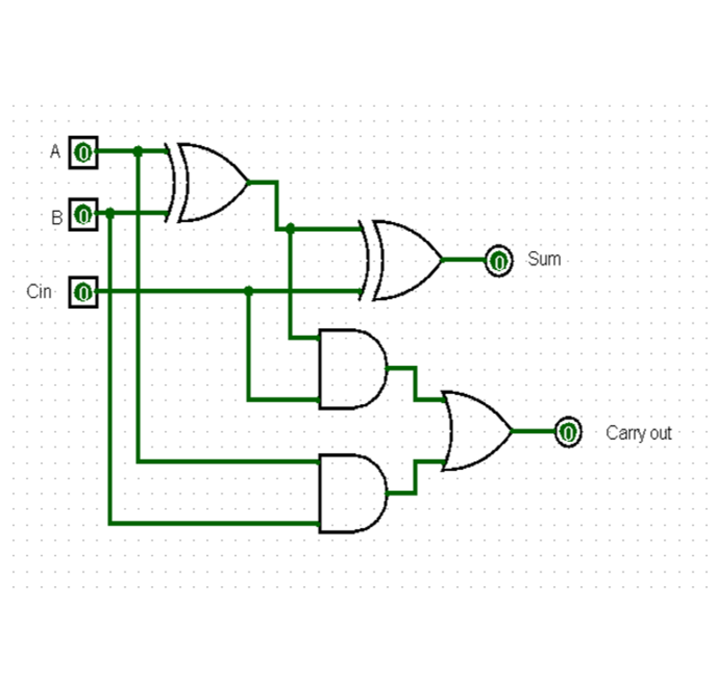
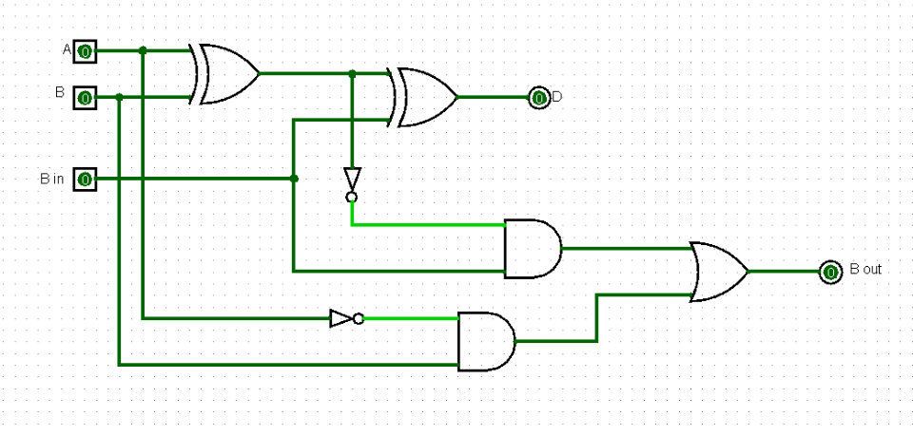
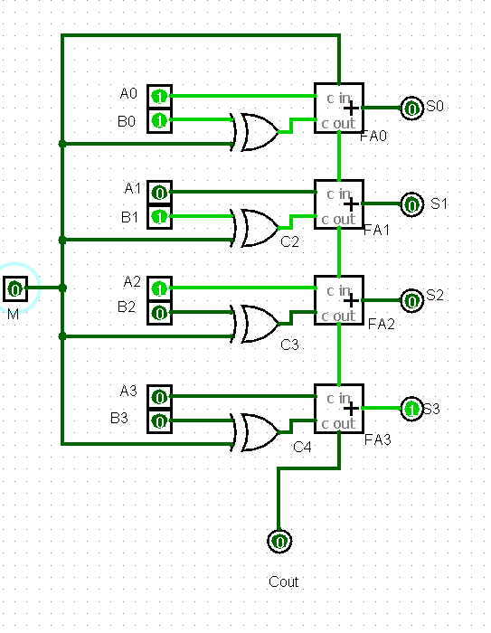
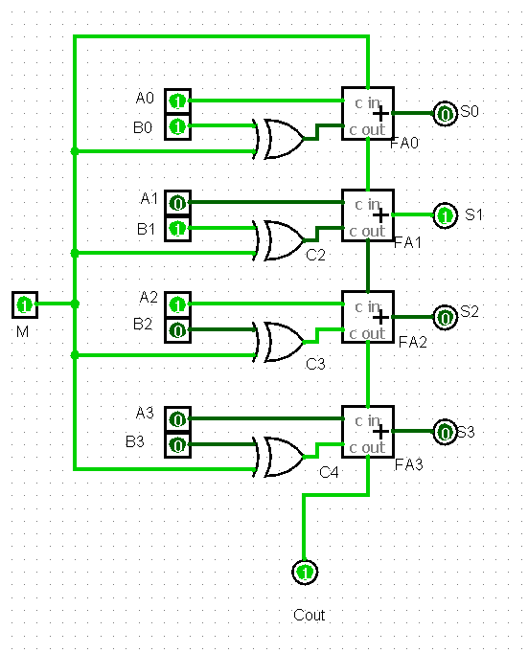
Circuit design in Logisim
Place input pins, XOR/AND/OR gates, full-adder stages, and output probes.
Connect the carry chain; feed Mode into the least-significant carry input.
Label inputs, outputs, carry, borrow, and operation mode.
Toggle inputs to observe live circuit behavior.
4

Slide 5
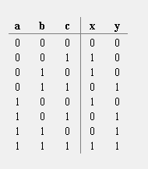
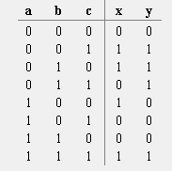
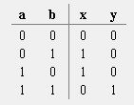
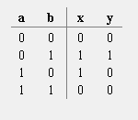
Simulation results
REPRESENTATIVE SIMULATION CASES
Representative cases define the expected arithmetic behavior. Replace the evidence placeholder with observed Logisim outputs when the team's file is available.
EXPECTED
OBSERVED
Truth-table behavior
Logisim output
[Insert real screenshot or measured output from the team's circuit.]
Full-Adder truth table
Full-Subtractor truth table
Each input combination maps to a defined result and carry or borrow signal.
Half adder truth table
Full subtractor truth table
5

Slide 6
FROM GATES TO SYSTEMS
Conclusion and applications
The project connects Boolean logic, circuit design, and simulation into a working arithmetic unit.
Where it is used
Possible improvements
Arithmetic logic units and CPUs
Calculators and counters
Embedded digital systems
Increase bit width
Add overflow detection
Reduce propagation delay
Compare faster adder architectures
Final takeaway
Truth tables and Logisim simulation verify the design before hardware implementation.
6

