Slide 1
Network Intrusion Detection System using LSTM-AE (Long Short Term Model Auto Encoder)

Slide 2
Layout of this Presentation
Objective
Base Paper
Problem Statement
Literature survey
Modules
Dataset
Work plan
Proposed Techniques (optional)
References

Slide 3
Motivation
The rise of sophisticated cyber threats requires more intelligent and adaptive security solutions.
Traditional IDS models struggle to keep up with dynamic attack patterns, leading to security vulnerabilities.
Enhancing IDS with real-time detection and adaptive capabilities will strengthen cybersecurity defenses.

Slide 4
Objective
To develop a predictive model for IDS with enhanced accuracy.
To identify and implement an efficient feature selection algorithm.
To evaluate and select the most suitable classification algorithms.
To construct an ensemble model that improves overall prediction accuracy.

Slide 5
Base paper
Vanlalruata Hnamte, Hong Nhung-Nguyen ,Jammal Hussain , and Yong Hwa-Kim ,”A Novel Two-Stage Deep Learning Model for Network Intrusion Detection: LSTM-AE”,IEEE Access
doi : 10.1109/ACCESS.2023.3266979
Indexed in: IEEE Access
Transaction Year : 13 April 2023

Slide 6
Problem Statement
Traditional IDS models lack adaptability and real-time response, making them ineffective against evolving and sophisticated cyber threats.

Slide 7
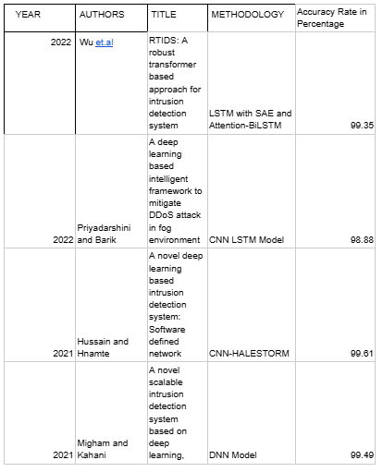
Literature survey

Slide 8
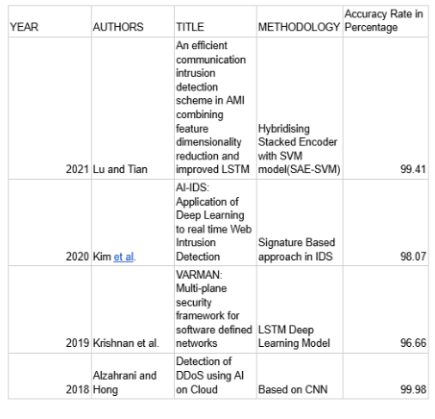
Literature survey

Slide 9
Modules
Module1: Data PreProcessing
- Data Cleaning
- Data Normalization
- Random Under sampling
Module2: Feature Extraction
AE (Auto Encoder)
LSTM(Long Short Term Memory)
Module3: Sequence Classification
LSTM Model
Evaluation Metrics
Module4: Model Comparison
CNN , DNN, ANN, RNN
Evaluation Metrics

Slide 10
Data Set
IDS 2018 Intrusion CSVs (CSE-CIC-IDS2018)
Shows DDoS Attacks of Various Formats from the University of New Brunswick

Slide 11
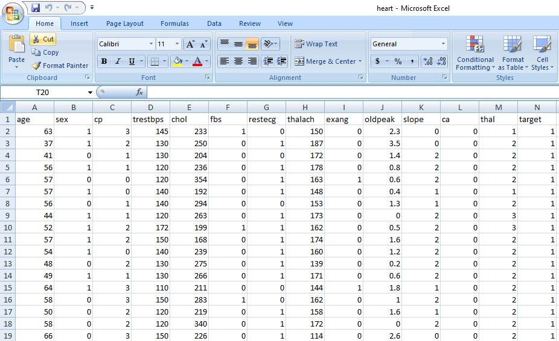

Slide 12
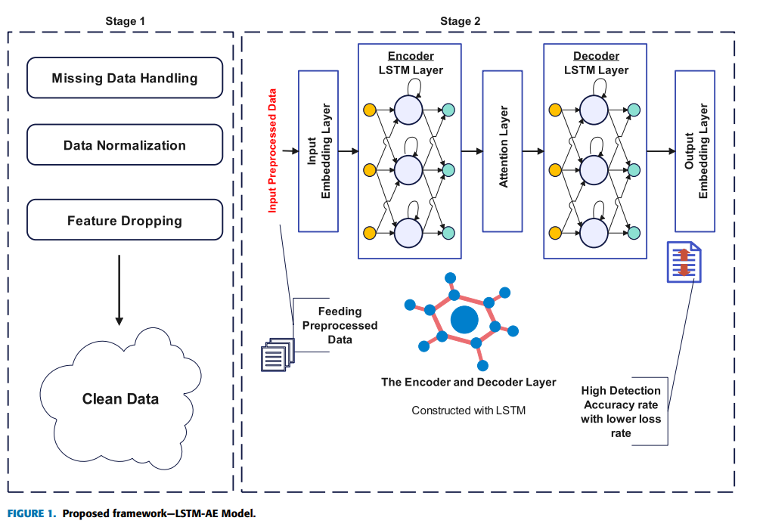
Proposed techniques

Slide 13
MODULE : 1

Slide 14
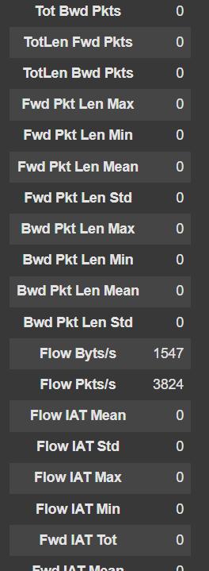
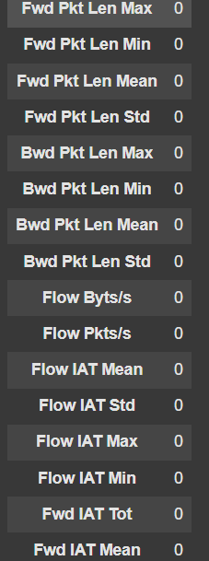
DATA PREPROCESSING
STEP 1 : DATA CLEANING PROCESS
Handled Missing Values:
Identified and removed rows containing null values.
Addressed Infinity Values:
Detected and eliminated infinite values to maintain data integrity.
Resolved NaN (Not-a-Number) Values:
Identified and removed all NaN values to ensure consistency in the dataset.

Slide 15
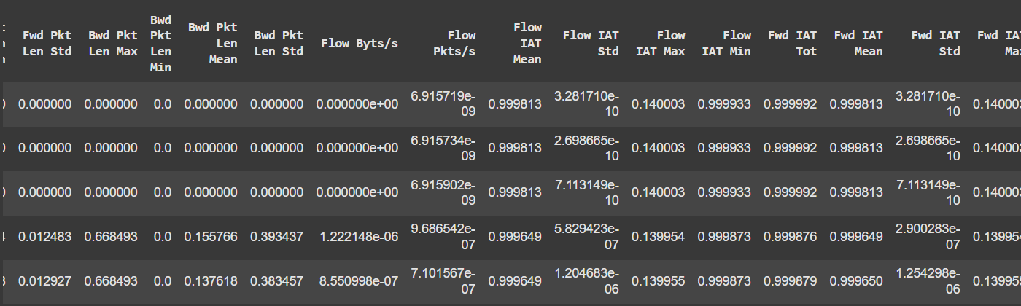
STEP 2 : DATA NORMALIZATION ( USING MIN – MAX SCALER )
We applied Min-Max Scaling using the fit_transform method to normalize the dataset, ensuring that all features are scaled within a specific range for better model performance.

Slide 16
Random Under sampling
Purpose: Handle imbalanced datasets in classification problems.
How it works: Randomly removes samples from the majority class to balance with the minority class.
Why use it:
Prevents model bias toward majority class
Improves recall/precision for minority class
Helps models learn both classes equally

Slide 17
MODULE 2

Slide 18

1)TIMESTAMP CREATION
We generated a timestamp that spans a duration of 10 seconds.
This timestamp represents a sequential time interval for better event tracking.
Each recorded point is aligned to maintain consistency in data processing.
This approach ensures precise time synchronization for analysis and modeling.
Also our data is sorted in ascending order according to timestamp feature.

Slide 19
2)MODEL CREATION
Autoencoder Components in Model
1.Encoder:
1D CNN (Conv1D + MaxPooling) to extract short-term dependencies.
BiLSTM layers to capture long-term dependencies.
An Attention Layer to focus on the most critical time steps.
The context vector (latent representation) is the compressed form of input.
2.Decoder:
RepeatVector expands the compressed representation across all time steps.
LSTMs reconstruct the sequence step-by-step.
Final TimeDistributed Dense layer outputs the reconstructed input.

Slide 20
How Autoencoder Works
1.Training with Reconstruction The model is trained using x_train as both the input and target (x_train, x_train). It learns to compress and reconstruct the sequence, capturing key patterns in the data.
2. Anomaly Detection with Reconstruction Error After training, the model detects anomalies by computing the reconstruction error (Mean Absolute Error - MAE). A high reconstruction error suggests the input is anomalous, while a low error indicates a normal sequence.
3. Feature Extraction The encoder part of the model captures a compressed representation of the input data, which can be used for tasks like classification, clustering, or further analysis.
4.Time-Series Forecasting The learned patterns help in predicting future sequences by extending the autoencoder into a forecasting model, where past sequences guide future predictions.

Slide 21
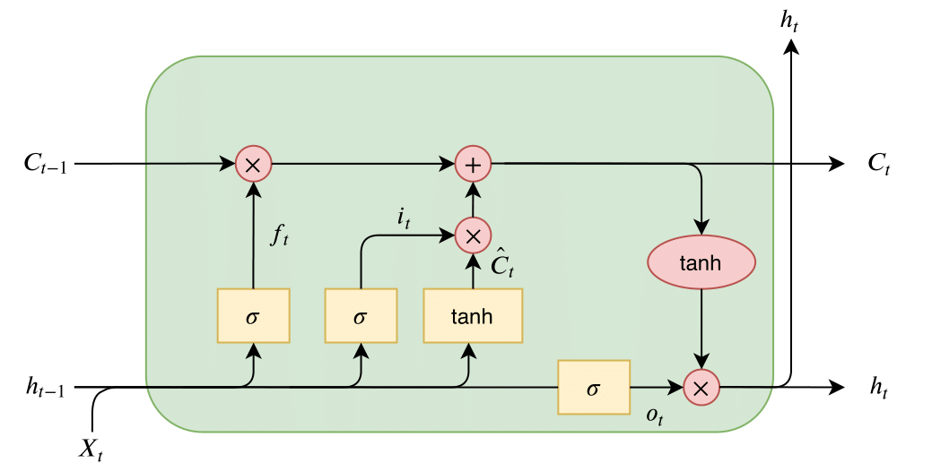
Working of LSTM

Slide 22
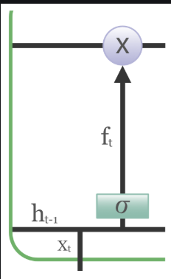
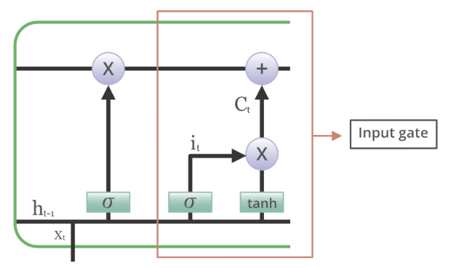
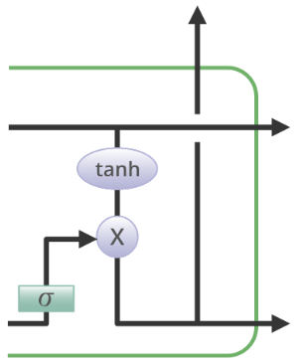
Forget Gate The information that is no longer useful in
the cell state is removed with the forget gate.
Input gate The addition of useful information to the
cell state is done by the input gate.
First, the information is regulated using the sigmoid
function and filter the values to be remembered similar
to the forget gate using inputs h_t-1 and x_t.
Output gate The task of extracting
useful information from the current
cell state to be presented as output
is done by the output gate.

Slide 23
How LSTM is different from RNN
It fails to store information for a longer period of time. At times, a reference to certain information stored quite a long time ago is required to predict the current output. But RNNs are absolutely incapable of handling such “long-term dependencies”.
There is no finer control over which part of the context needs to be carried forward and how much of the past needs to be ‘forgotten’.
Other issues with RNNs are exploding and vanishing gradients (explained later) which occur during the training process of a network through backtracking.

Slide 24
MODULE : 3

Slide 25
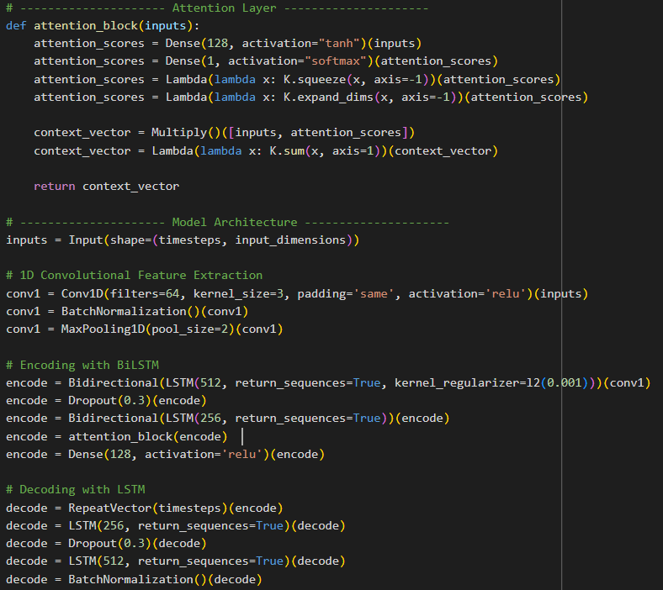
LSTM-AE Implementation

Slide 26
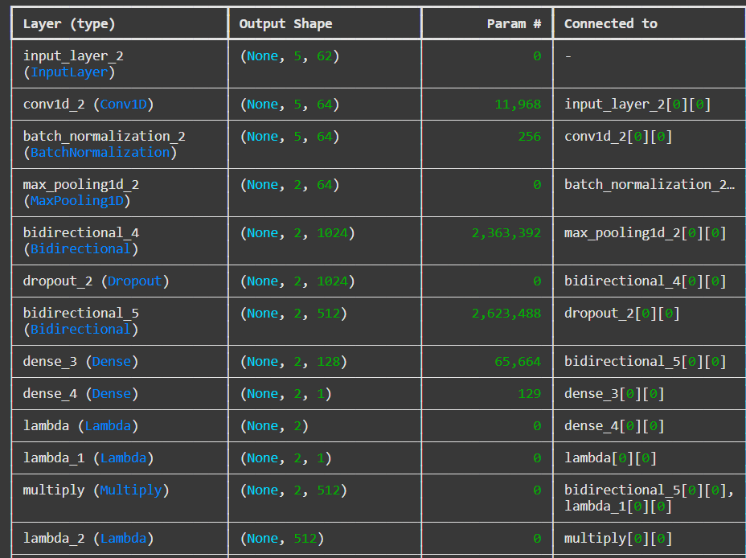
LSTM-AE Architecture

Slide 27
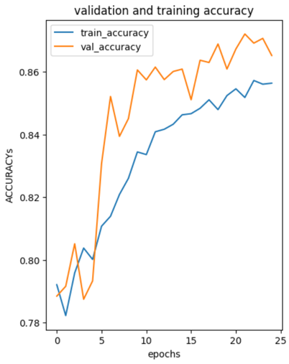
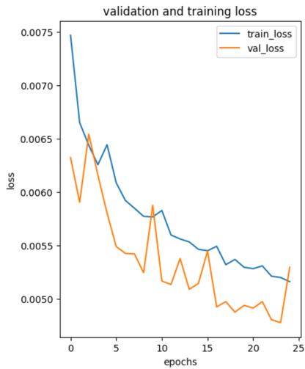
ACCURACY AND LOSS BEFORE RANDOM UNDERDSAMPLING

Slide 28
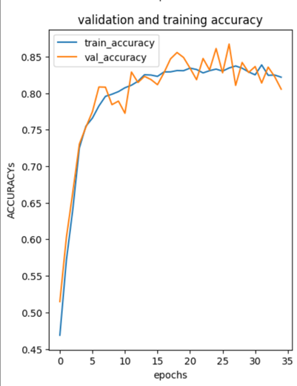
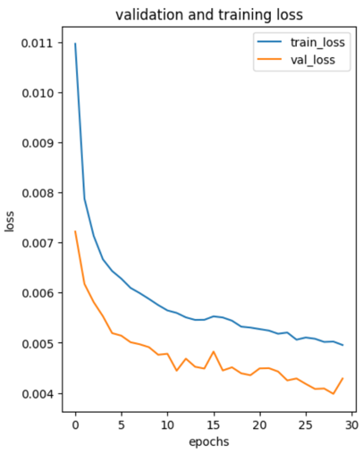
ACCURACY AND LOSS FUNCTION

Slide 29
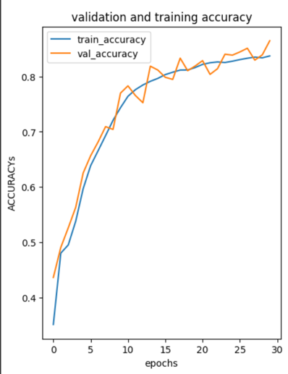
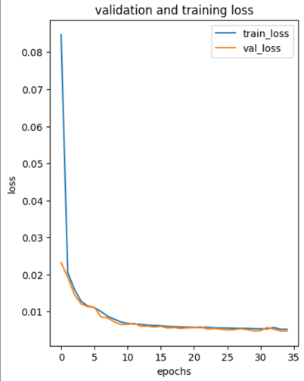
FINAL ACCURACY AND LOSS

Slide 30
MODULE – 4

Slide 31
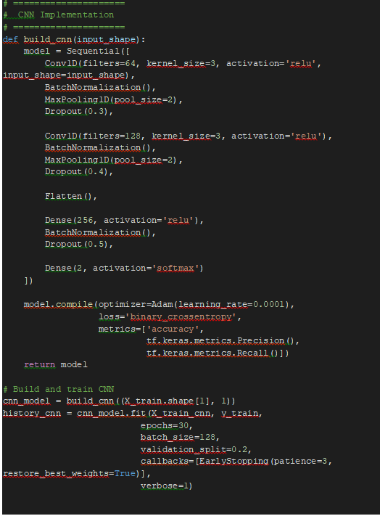
CNN(Convolutional neural network) IMPLEMENTATION

Slide 32
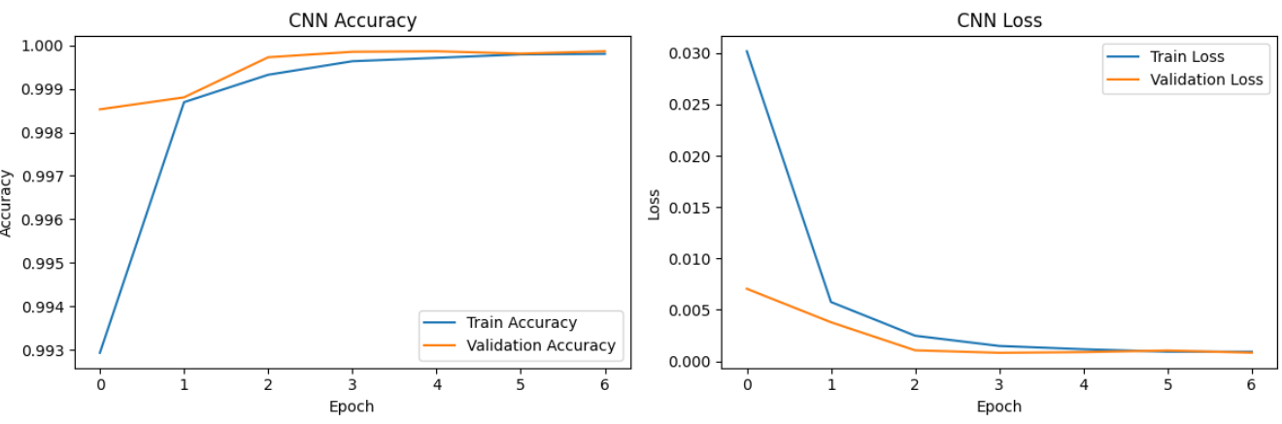
ACCURACY AND LOSS

Slide 33
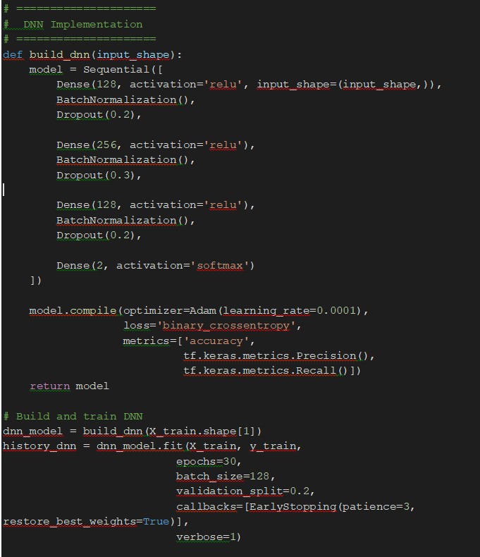
DNN(Deep neural network) Implementation

Slide 34
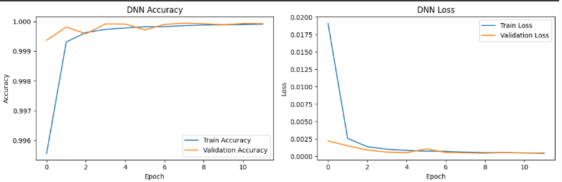
ACCURACY AND LOSS

Slide 35




EVALUATION METRICS FOR CNN AND DNN

Slide 36
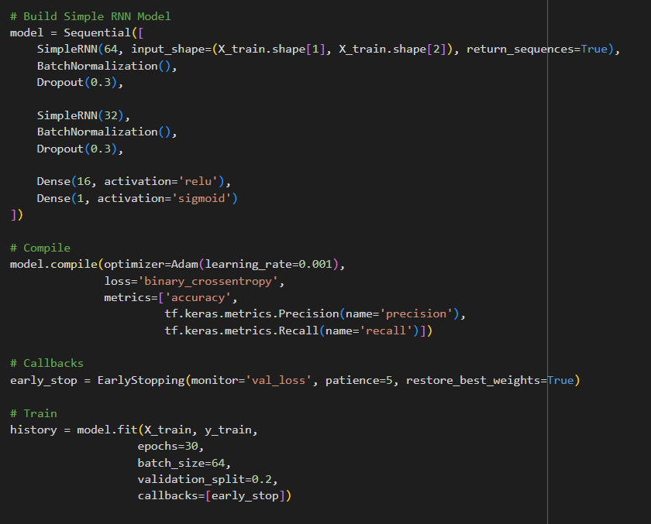
RNN (Recurrent neural network)IMPLEMENTATION

Slide 37
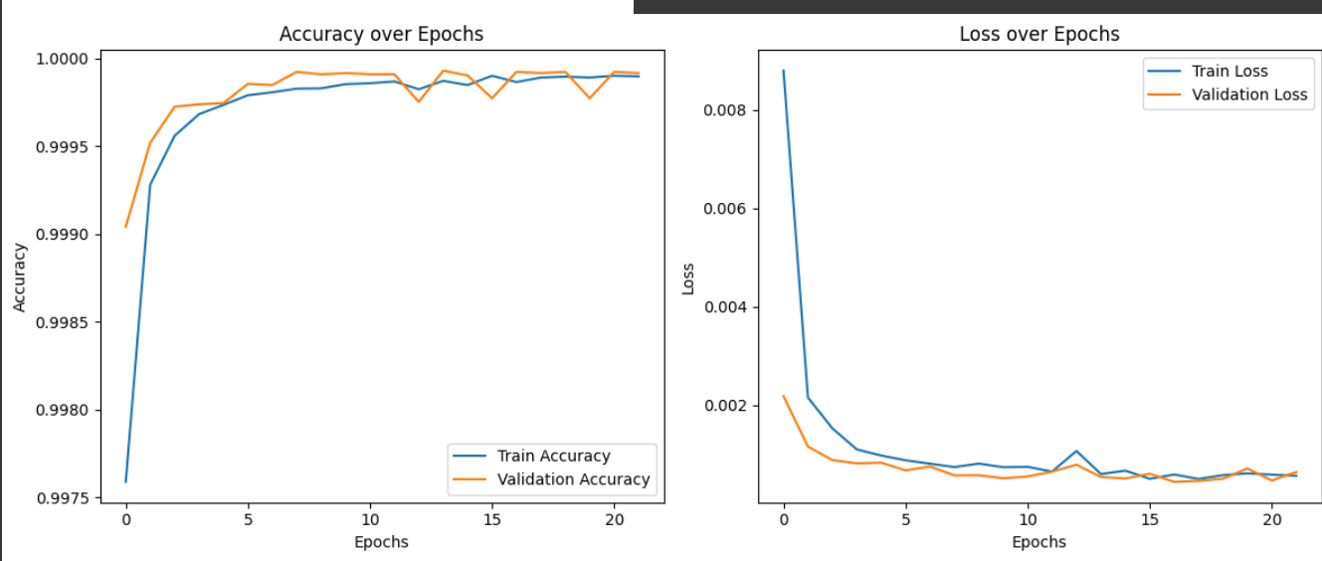
ACCURACY AND LOSS

Slide 38
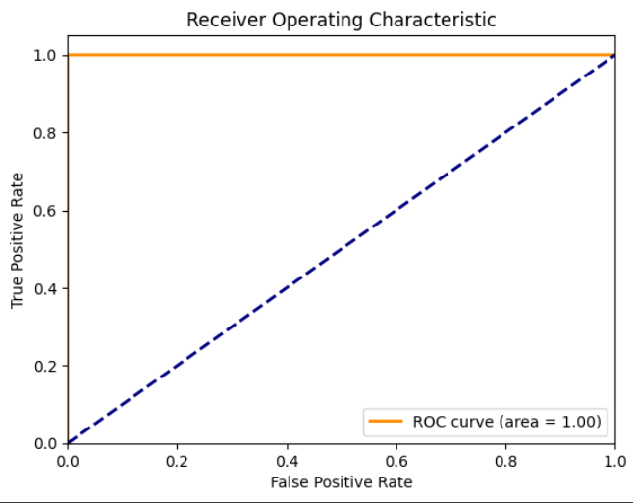
ROC CURVE

Slide 39
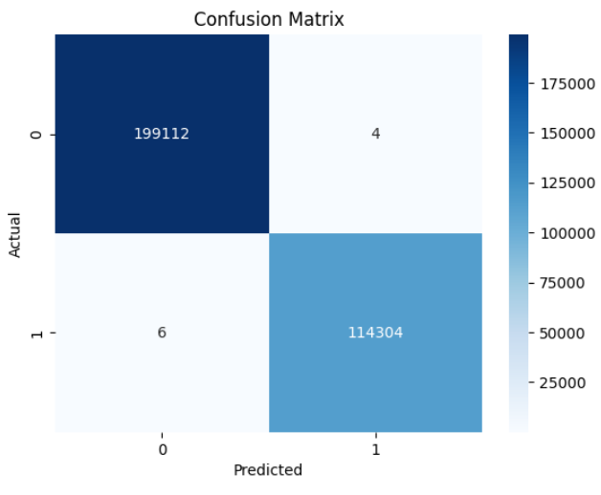
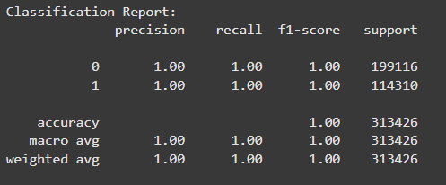
CONFUSION MATRIX

Slide 40
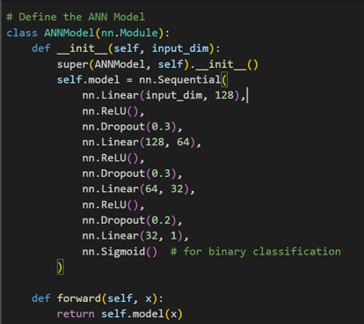
ANN(Artificial Neural Network) IMPLEMENTATION

Slide 41
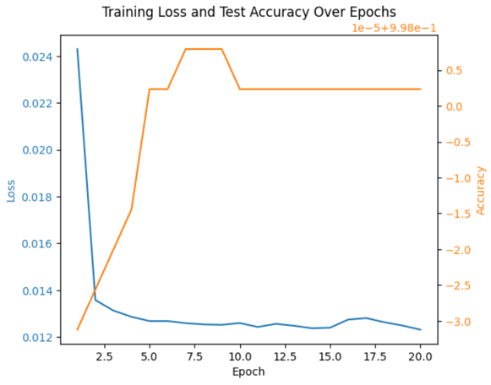
ACCURACY AND LOSS

Slide 42
Conclusion
This project presents a novel and effective approach to intrusion detection by integrating Long Short-Term Memory (LSTM) networks and Auto-Encoders (AE). The LSTM's ability to process sequential data makes it ideal for analyzing temporal patterns within network traffic, capturing dependencies that are vital for detecting cyber-attacks. Meanwhile, the AE enhances anomaly detection through dimensionality reduction, enabling the model to efficiently process complex attack patterns. By combining these two deep learning techniques, the model offers a scalable, adaptive solution to the evolving landscape of cybersecurity threats. Ultimately, this research provides valuable insights into building robust and real-time IDS systems, contributing to more effective network protection in dynamic environments.

Slide 43
References
[1]D. Chou and M. Jiang, ‘‘A survey on data-driven network intrusion detection,’’ ACM Comput. Surv., vol. 54, no. 9, pp. 1–36, Oct. 2021, doi: 10.1145/3472753.
[2] B. Mukherjee, L. T. Heberlein, and K. N. Levitt, ‘‘Network intrusion detection,’’ IEEE Netw., vol. 8, no. 3, pp. 26–41, May 1994, doi: 10.1109/65.283931.
[3] G. D. C. Bertoli, L. A. Pereira Jr., O. Saotome, A. L. D. Santos, F. A. N. Verri, C. A. C. Marcondes, S. Barbieri, M. S. Rodrigues, and J. M. P. D. Oliveira, ‘‘An end-to-end framework for machine learningbased network intrusion detection system,’’ IEEE Access, vol. 9, pp. 106790–106805, 2021, doi: 10.1109/ACCESS.2021.3101188.
[4] G. Apruzzese, L. Pajola, and M. Conti, ‘‘The cross-evaluation of machine learning-based network intrusion detection systems,’’ IEEE Trans. Netw. Service Manage., vol. 19, no. 4, pp. 5152–5169, Dec. 2022, doi: 10.1109/TNSM.2022.3157344.

Slide 44
Thank you

