Slide 1

Loan Underwriting Prediction Application for Financial Institutions
A Machine Learning-Based Solution for Financial Risk Analysis
Saheer Shaik
02080047

Slide 2
Problem Statement:
Challenges in Traditional Loan Underwriting
Current Challenges:
Manual loan evaluations are prone to bias and inconsistencies.
Inefficient processes delay decision-making.
Limited tools for providing transparent reasoning behind loan decisions.
Business Impact:
High risk of loan defaults due to inaccurate underwriting.
Loss of customer trust due to opaque decisions.
Reduced efficiency in high-volume loan evaluations.
Opportunity:
Use machine learning to bring automation, accuracy, and transparency to loan approvals.

Slide 3
Objective: Automate the loan underwriting process using machine learning to predict loan approvals based on financial risk factors.
Importance of the Project:
Reduces manual bias in decision-making.
Improves efficiency and accuracy for loan evaluations.
Explains decisions transparently using interpretable AI.
Target Audience:
Banking institutions, financial analysts, and decision-makers in the loan process.
Key Deliverables:
A robust machine learning model.
A user-friendly web interface for predictions.
Downloadable results with explanations for decision support.

Slide 4
Proposed Solution: Creating an automated prediction system.
Solution Highlights:
Machine learning model trained on 100,000+ applicant records.
Automated predictions for loan approval/rejection based on key risk factors.
User-friendly web interface for bankers to upload datasets and view predictions.
Explainable AI (XAI) for transparency in model decisions.
Key Features:
Scalable system for processing datasets of varying sizes.
SHAP explanations for top contributing factors.
Professional, easy-to-use interface tailored for banking workflows.

Slide 5
Tools and Services Used:
Languages & Libraries:
Python: Core programming language for model development and deployment.
Pandas, NumPy: Data pre-processing and manipulation.
Scikit-learn: Machine learning models and evaluation.
SHAP: Model explainability and interpretability.
Frameworks & Tools:
Flask: Web application development.
Matplotlib & Seaborn: Data visualization.
Development Tools:
Visual Studio Code: Code editing and debugging.
Jupyter Notebook: Prototyping and experimentation.
File Handling:
Excel (.xlsx): Input datasets.
Joblib: Model persistence and reusability.

Slide 6
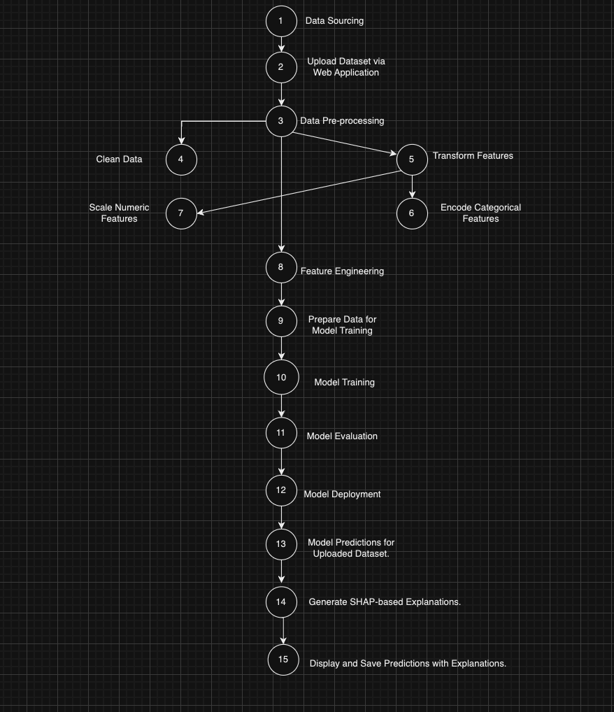
Logical Algorithm:
[Start] --> [Input Dataset] --> [Data Pre-processing] --> [Prediction] --> [Generate Explanation] --> [Output Results] --> [End]

Slide 7
Dataset and Key Features:
Dataset Overview:
Total Records: 100,001
Attributes: Credit Score, Annual Income, Loan Amount, Monthly Debt Payments, etc.
Key Features:
Numerical: Credit Score, Annual Income, Loan Amount, Monthly Surplus.
Categorical: Employment Status, Marital Status, Loan Purpose.
Engineered: IncomeToLoanRatio, CreditScore_IncomeToLoan.
Handling Class Imbalance:
Used SMOTEENN to oversample minority classes and undersample noise.

Slide 8
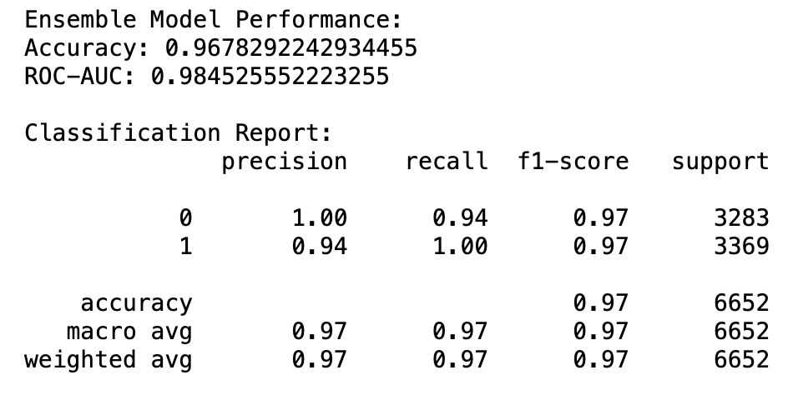
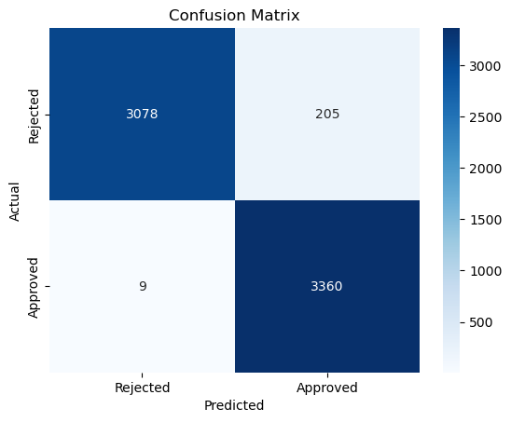
Model Used:
Voting Classifier combining Random Forest and Gradient Boosting for robustness.
Hyperparameter Tuning:
GridSearchCV optimized parameters for Random Forest.
Best Parameters:
n_estimators: 100
max_depth: 15
min_samples_split: 5
Evaluation Metrics:
Accuracy: 96.78%
ROC-AUC: 0.98
Confusion Matrix:
True Positives: 3360
True Negatives: 3078
False Positives: 205
False Negatives: 9
Performance Insights:
High accuracy in distinguishing approved vs. rejected loans.
Balanced sensitivity and specificity.

Slide 9
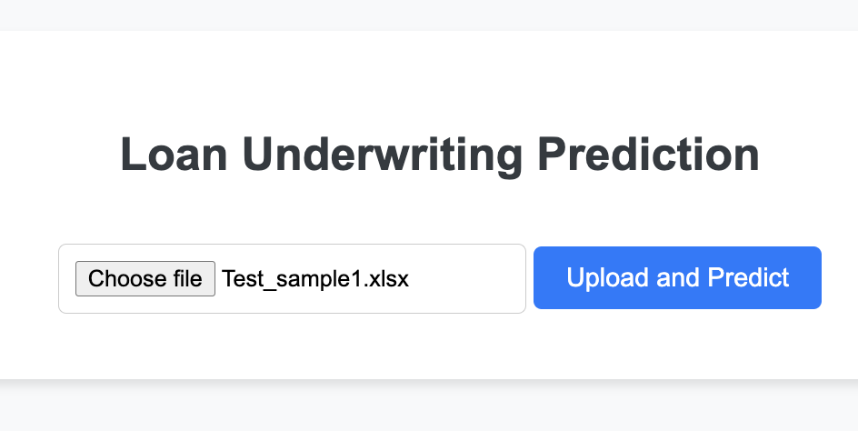
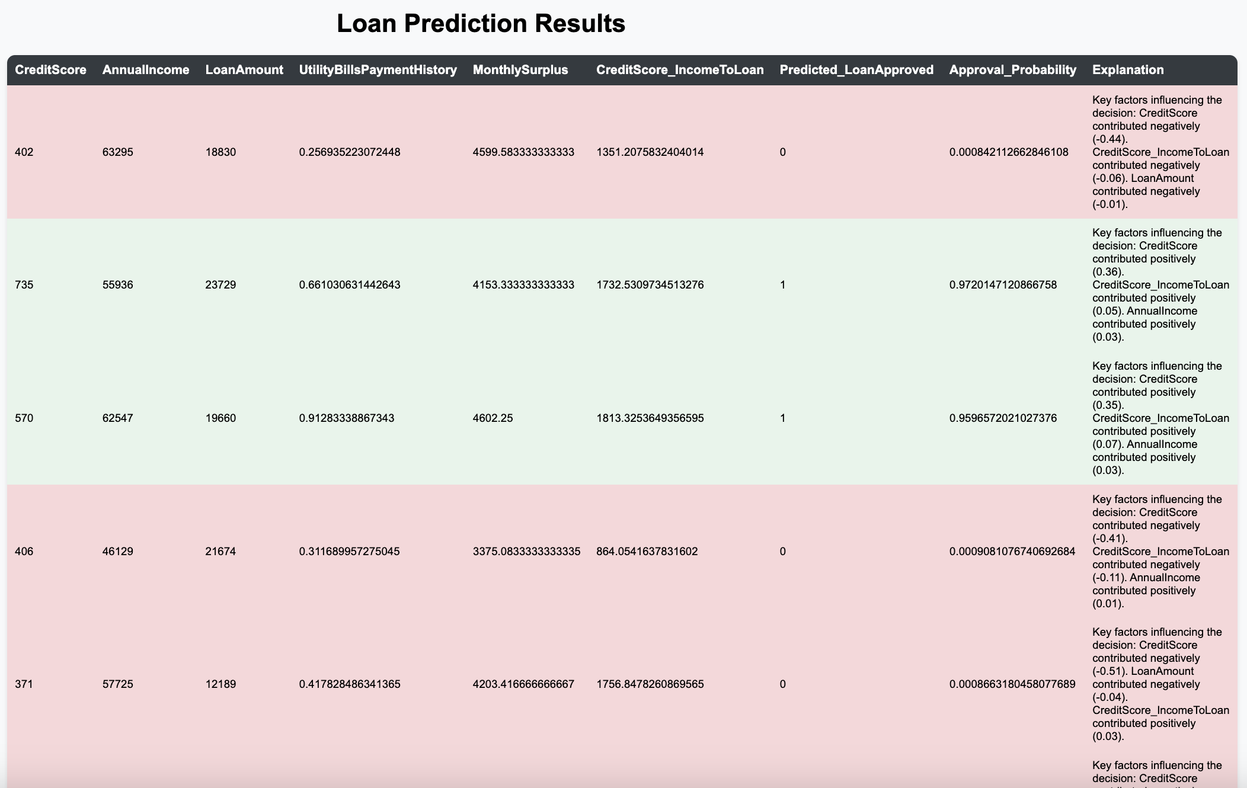
Web Application:
Key Features:
Banker uploads applicant datasets via an upload page.
Predicts loan approvals/rejections and highlights approval probabilities.
Displays key contributing factors for each decision.
Technical Stack:
Backend: Flask (Python).
Frontend: HTML, CSS, Bootstrap for professional styling.
SHAP: Explainable AI for decision transparency.

Slide 10
Future Scope:
Integration:
Connect with a database (e.g., Snowflake) for real-time data retrieval and updates.
Deployment:
Deploy the model and web application on cloud platforms like AWS or Azure for scalability.
Analytics Dashboard:
Create a dashboard for visualizing loan trends, approval rates, and applicant risk analysis.
Periodic Model Retraining:
Use new datasets to retrain the model periodically for improved accuracy.
End-to-End Workflow:
Implement API integrations for live data streams.
Scalability:
Optimize the application for larger datasets and real-time predictions.

Slide 11
Conclusion:
Project Outcomes:
Built a fully functional machine learning pipeline for loan underwriting.
Automated predictions with over 96% accuracy.
Developed a user-friendly web interface for practical usage.
Integrated SHAP for transparent and explainable decisions.
Impact:
Improved efficiency and objectivity in loan approvals.
Enhanced trust in loan decisions through explainability.
Scalable solution adaptable to real-world datasets.

Slide 12
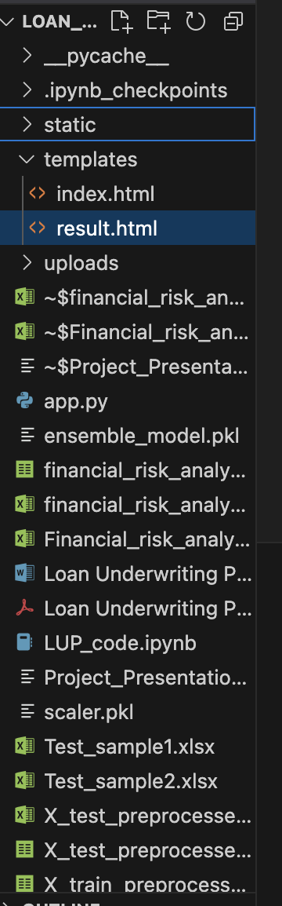
Project Code Structure:
Codebase Organization:
app.py: Core application logic.
style.css: Styling for the web interface.
index.html and result.html: Frontend pages for upload and results.
Logical Flow:
Data is uploaded via the web app.
Backend processes the data.
Model predicts loan approvals/rejections.
Results are displayed in a professional format.

Slide 13
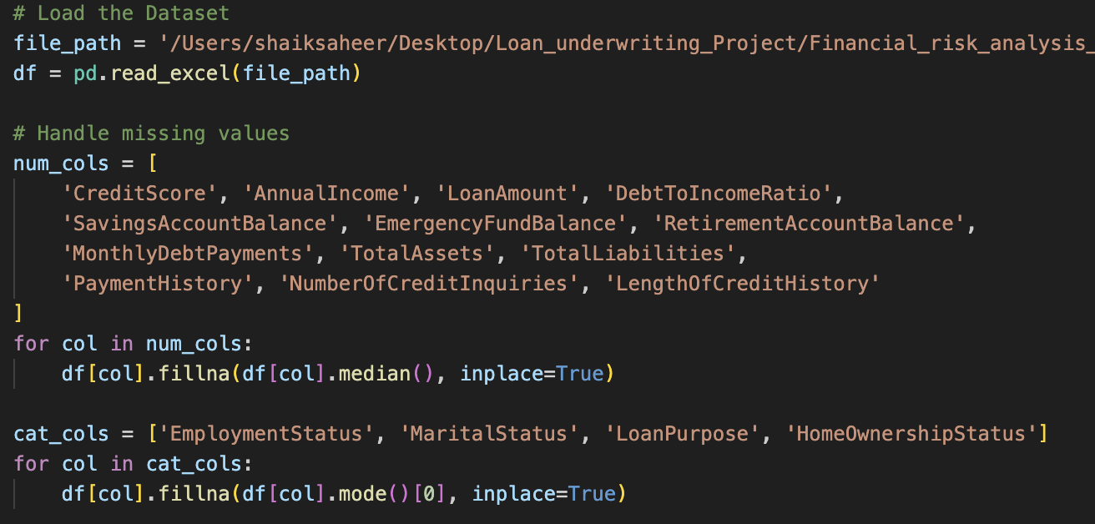
Loading and Preprocessing Data:
Loading Data: The pandas library loads the dataset into a
df = pd.read_excel(file_path)
Handling Missing Values:
Numeric columns: Missing values replaced by median.
Categorical columns: Missing values filled with the mode.
df[col].fillna(df[col].median(), inplace=True)

Slide 14
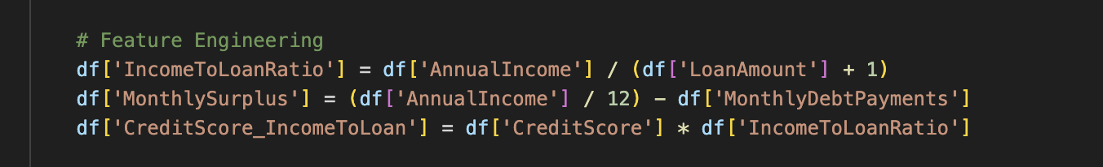
Feature Engineering:
Generated Features:
IncomeToLoanRatio: Relationship between income and loan.
MonthlySurplus: Monthly financial surplus after debt payments.
CreditScore_IncomeToLoan: Interaction term to improve prediction accuracy.

Slide 15
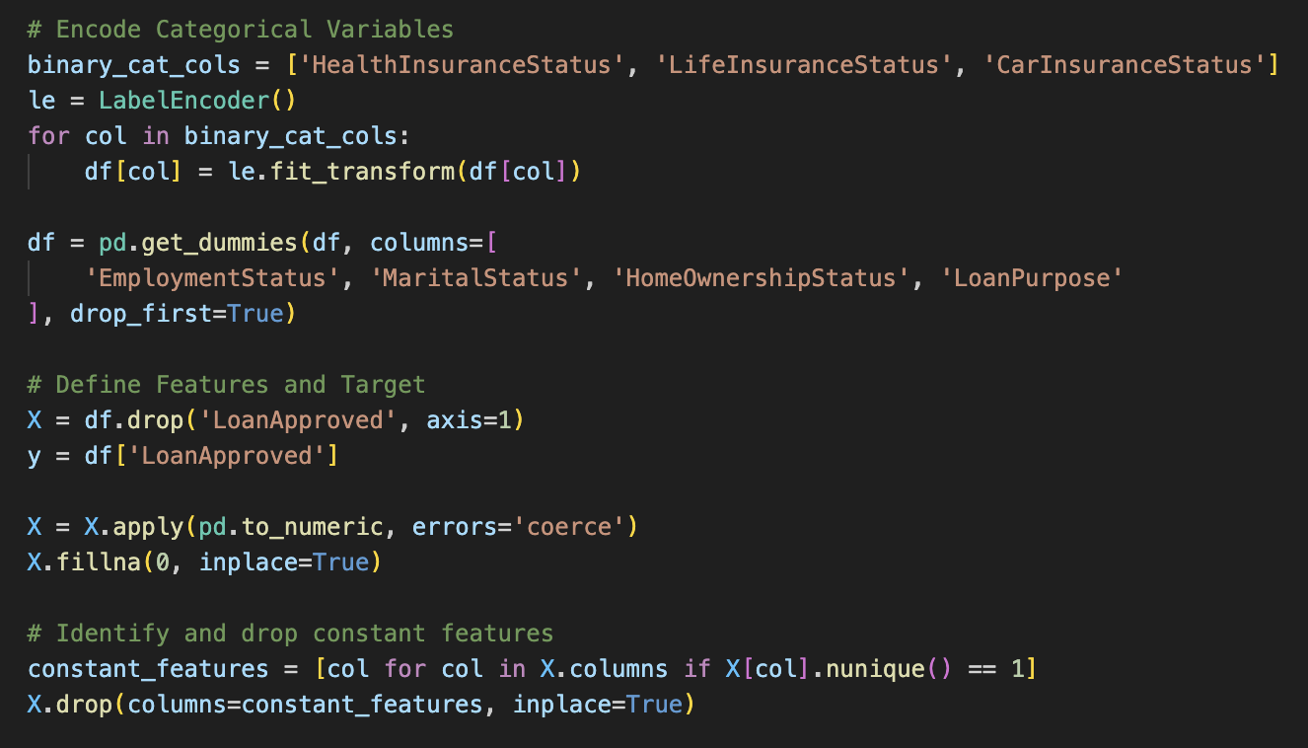
Encoding Categorical Variables:
Binary categories (e.g., Insurance Status):
Transformed into 0/1 using LabelEncoder.
Multiclass categories (e.g., EmploymentStatus): One-hot encoded using pd.get_dummies.

Slide 16
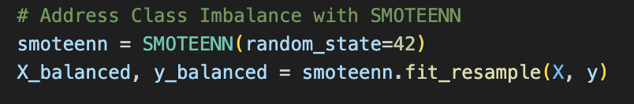
Handling Class Imbalance:
Problem: Loan approvals are imbalanced.
Solution:SMOTEENN combines oversampling and undersampling techniques to balance the dataset.

Slide 17
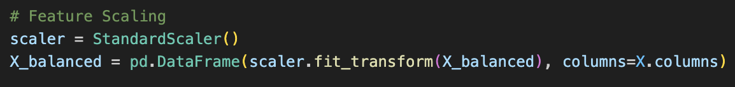
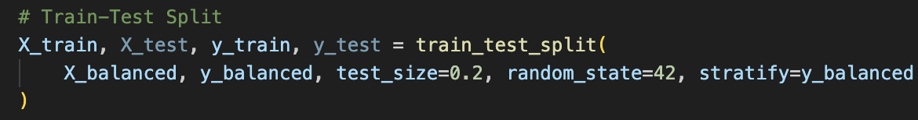
Feature Scaling and Train-Test Split:
Used StandardScaler to normalize features, ensuring equal weight for all:python
Copy code
scaler = StandardScaler() X_balanced = pd.DataFrame(scaler.fit_transform(X_balanced), columns=X.columns)
Methodology:
80% data for training.
20% data for testing.
Stratified sampling ensures class balance.

Slide 18
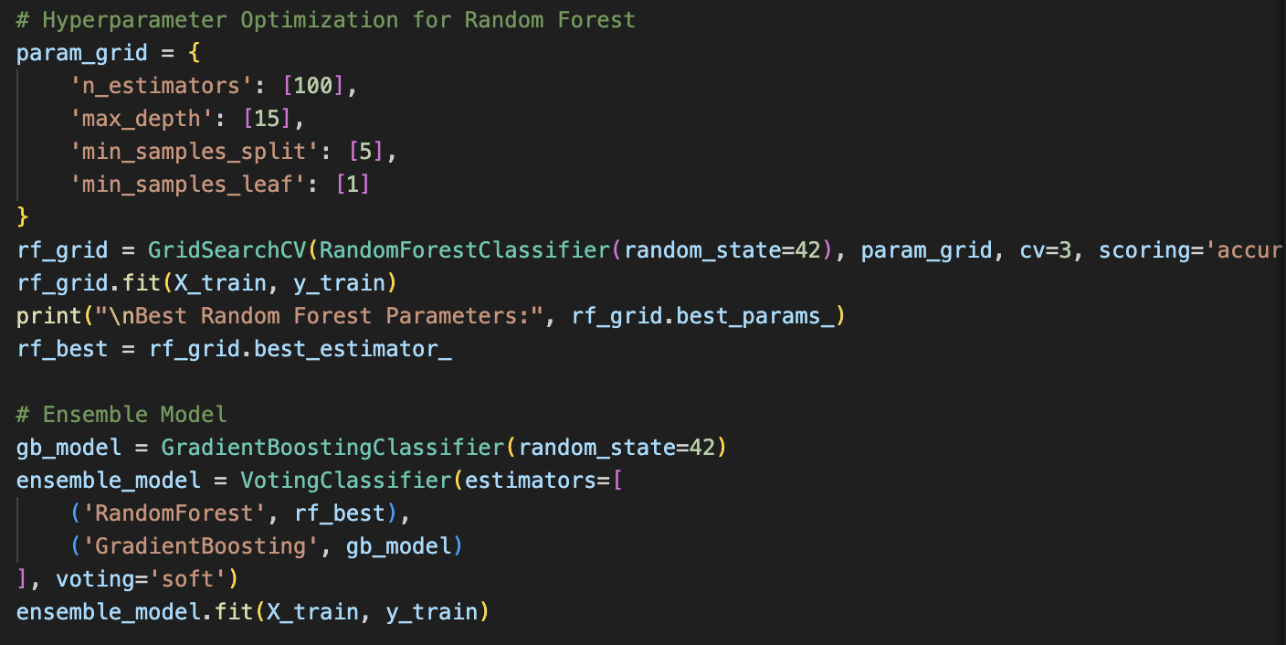
Model Training:
Random Forest Hyperparameter Tuning: Optimized using GridSearchCV.
Voting Classifier: Combines Random Forest and Gradient Boosting

Slide 19
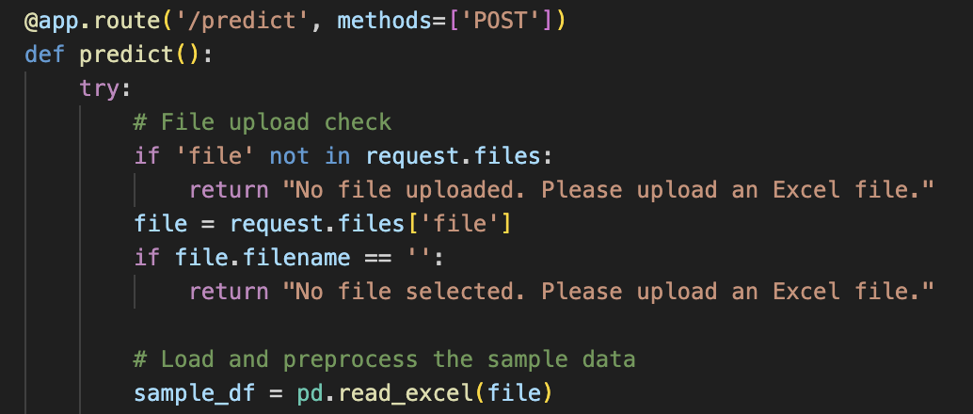
Flask Web Application:
Routes:
/: Displays the upload page (index.html).
/predict: Processes the uploaded file and predicts loan approvals.
/download: Allows users to download results.

Slide 20
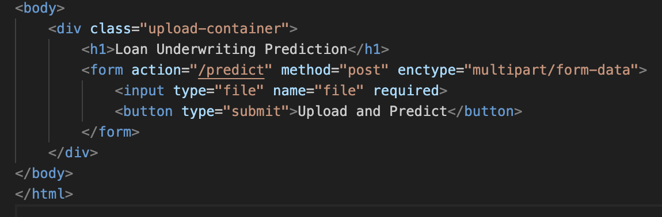
Frontend Code:
The web application's frontend was developed using HTML and CSS, ensuring a user-friendly and professional interface.
index.html: Handles file uploads by providing a clean and simple user interface.
Explanation:
A form element is used for uploading Excel files.
The <input> tag specifies the file upload functionality.
A button triggers the submission of the file to the backend.

Slide 21
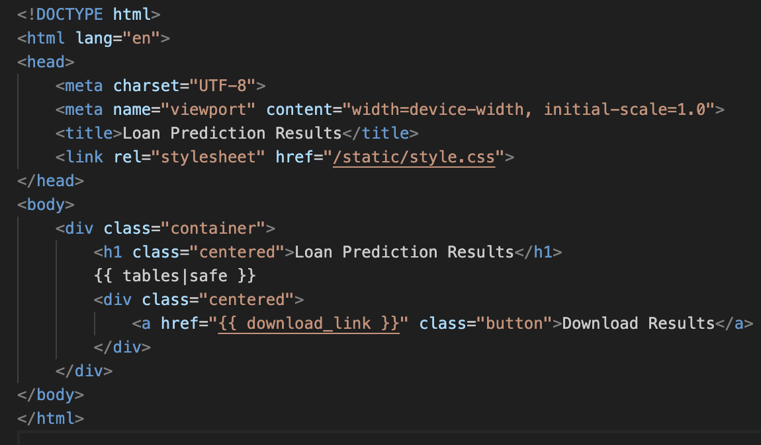
Result Page:
result.html:
Displays the loan prediction results in a table with color-coded rows for approved and rejected loans.
Explanation:
The {{ tables|safe }} placeholder dynamically displays the prediction results generated by the Flask backend.
A download link allows users to save the prediction results in an Excel file.

Slide 22
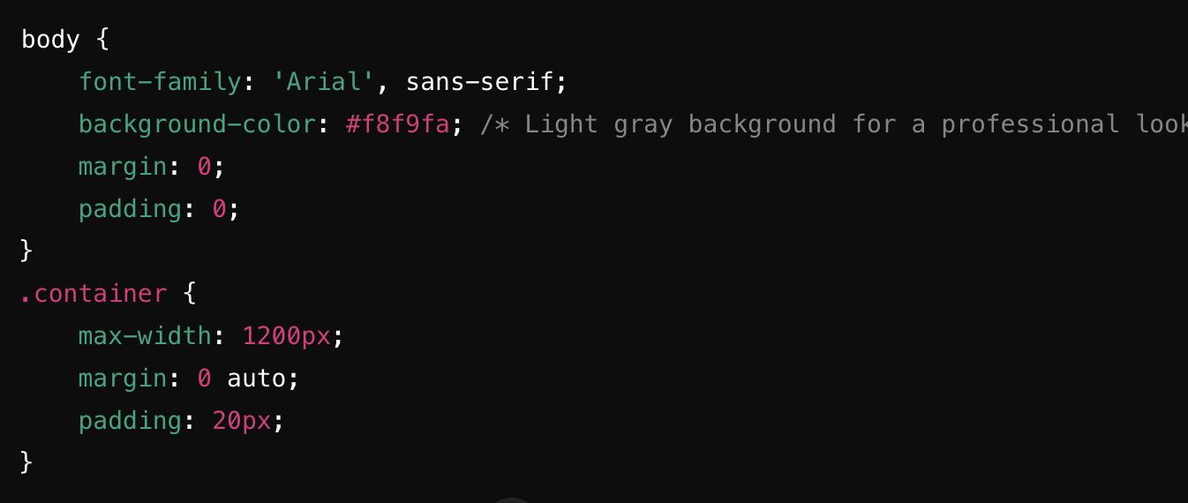
CSS Code for Styling:
The style.css file ensures the web application maintains a professional, modern, and user-friendly design. It includes styles for:
Page Layout: Consistent alignment and responsive design.
Upload Page: A simple and clean interface for uploading datasets.
Results Table: Highlighted rows with color-coded approvals and rejections.
General Styling: Sets the overall look of the application.
Ensures consistent fonts and light-colored backgrounds for a polished look.
The .container centers the content and defines its maximum width.

Slide 23
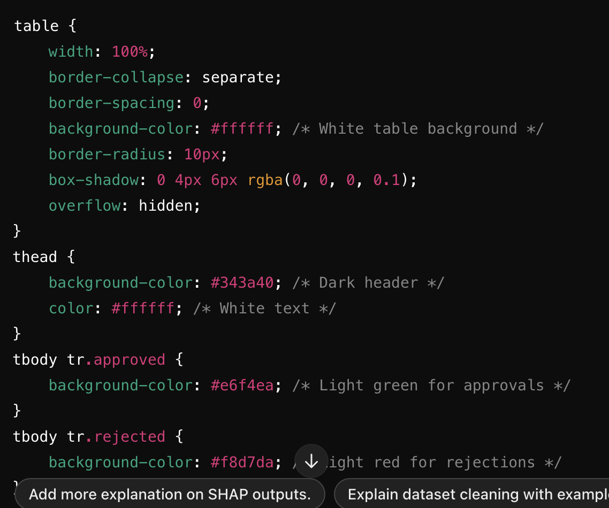
Table Styling:
Adds clarity and professionalism to the results.
thead Styling: Creates a dark, contrasting header for the table.
tbody Styling: Highlights approved rows in green and rejected rows in red.

Slide 24
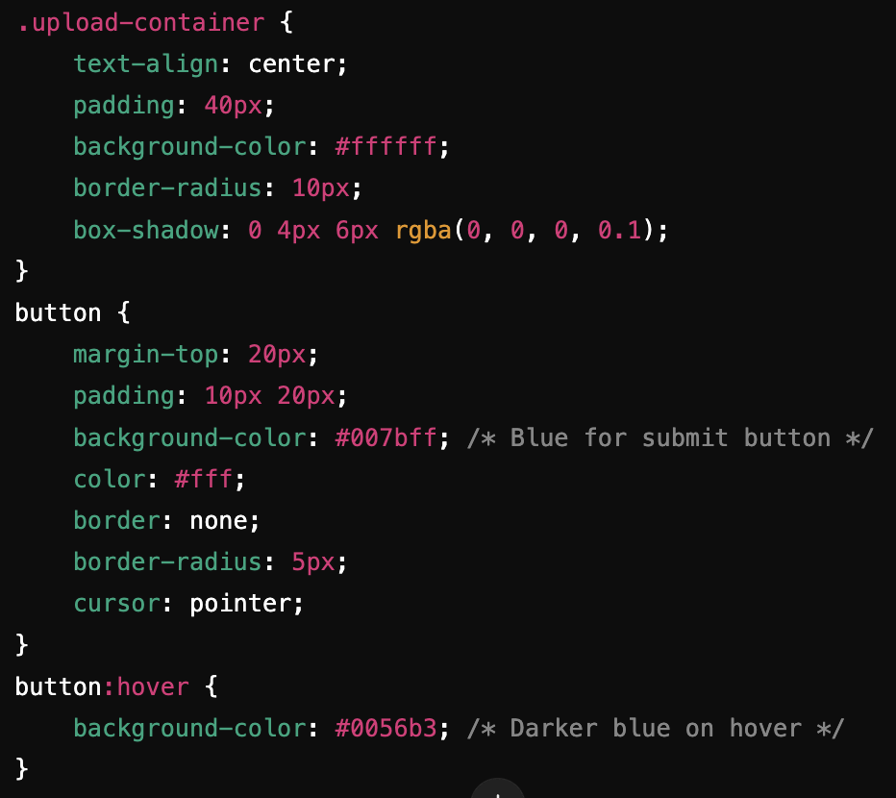
Upload Page Styling:
A visually pleasing design for file uploads.
Clean file upload interface with centered text and soft drop shadows.
Interactive buttons change colors on hover for a responsive experience.

Slide 25
This project successfully integrates machine learning and a Flask-based web application to streamline the loan underwriting process.
The system predicts loan approvals with high accuracy (96.78%) while providing detailed, interpretable insights using SHAP explanations.
The user-friendly interface ensures that even non-technical users, like bank employees, can upload datasets and review predictions effortlessly.
By automating decision-making and reducing biases, this project demonstrates how technology can enhance efficiency in financial workflows.

