Slide 1

Slide 1
Time Series analysis on vehicle traffic
Bhavya Vemavarapu
Kirti Tambe
Ramya Ramprakash
Ruhi Ghosh
Saheer
Vinisha
Praxis Business School

Slide 2
Agenda:
Exploratory Data Analysis
SMA
EMA
Automated Dickey-Fuller Test
ARIMA
Holt Winters
Naïve
Error Matrix
Recommendations and Outputs

Slide 3
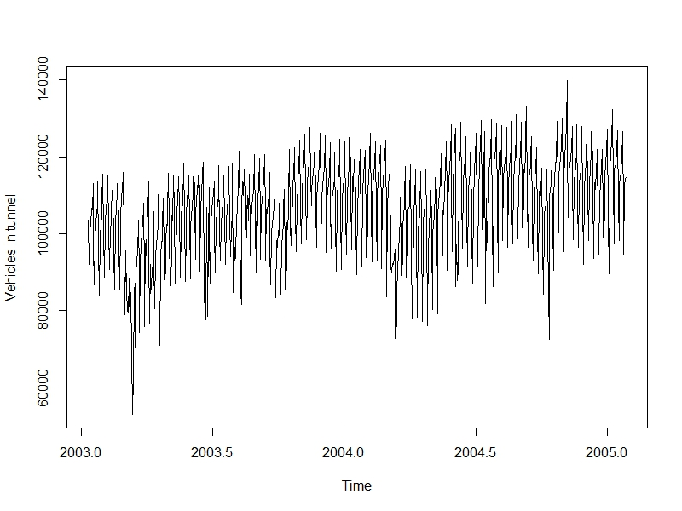
Slide 2
Exploratory Data Analysis
PLOT OF DATA
Scale X-Axis:
1 Unit= 1.2 months
2

Slide 4
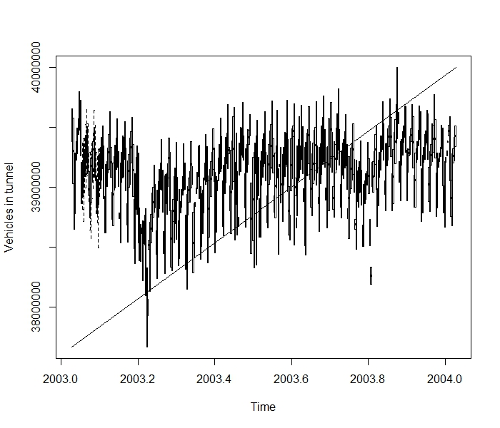
Slide 3
Trend
There is a increase in trend
3

Slide 5
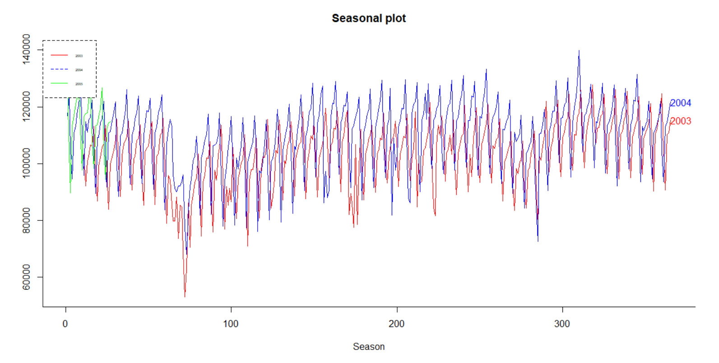
Slide 3
Seasonal Plot
Vehicles in tunnel
Scale X-Axis:
1 Unit= 1 day
Days
(Before Stationarity)
There is increase in traffic year after year
Low traffic on following dates
31-Dec-03 | 69097
01-Jan-04 | 53098
02-Jan-04 | 62895
04-Jan-04 | 70426
01-Jan-05 | 67960
4

Slide 6
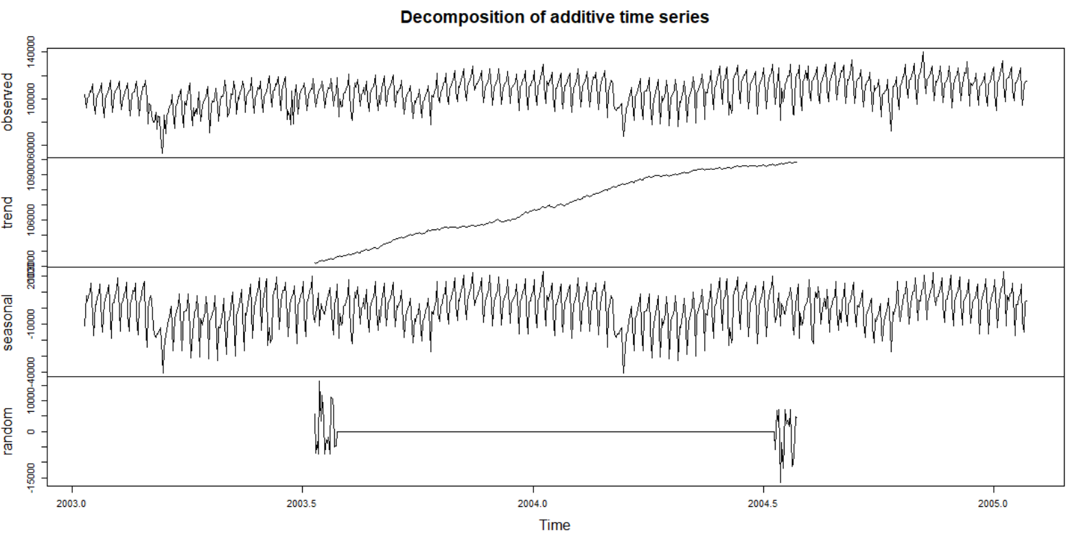
Slide 3
Decomposition of Data
Scale X-Axis:
1 Unit= 1.2 months
5
(Before Stationarity)

Slide 7
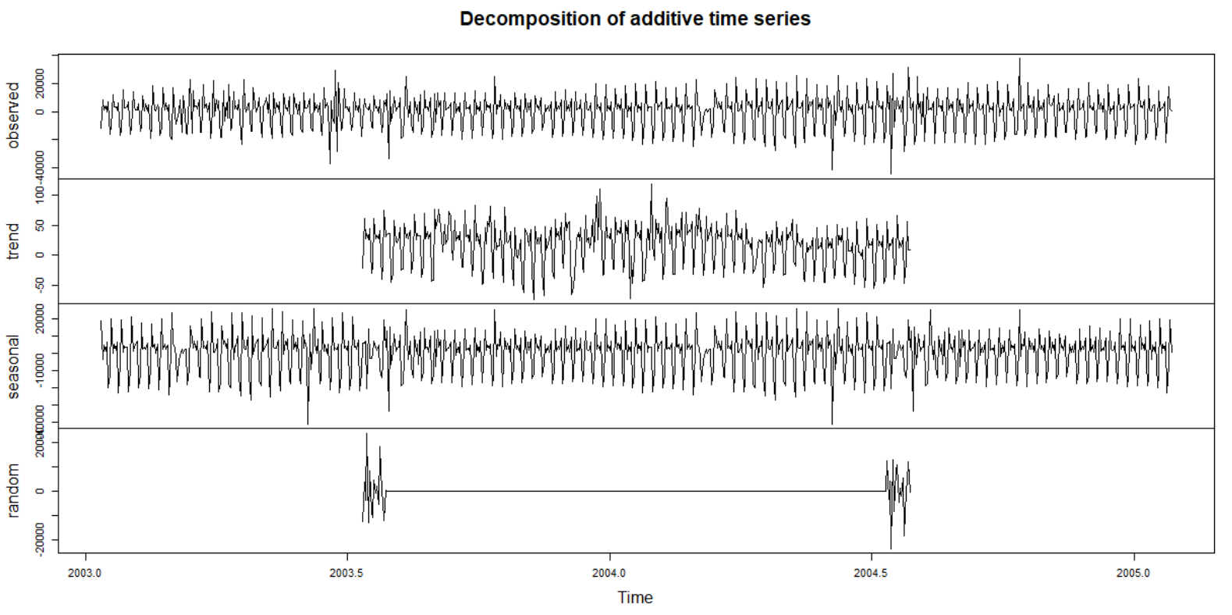
Slide 3
Scale X-Axis:
1 Unit= 1.2 months
6
(After Stationarity)

Slide 8
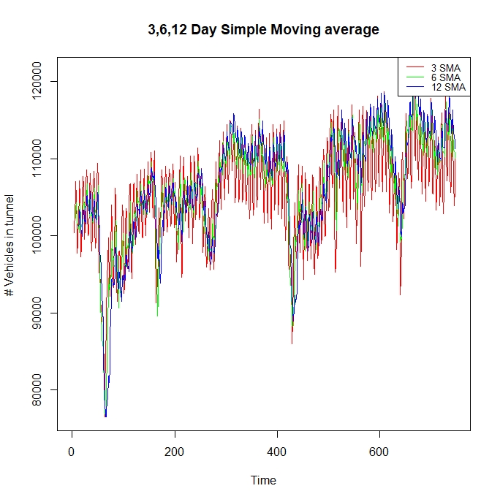
Simple Moving Average
Scale X-Axis:
1 Unit= 1 day
7

Slide 9
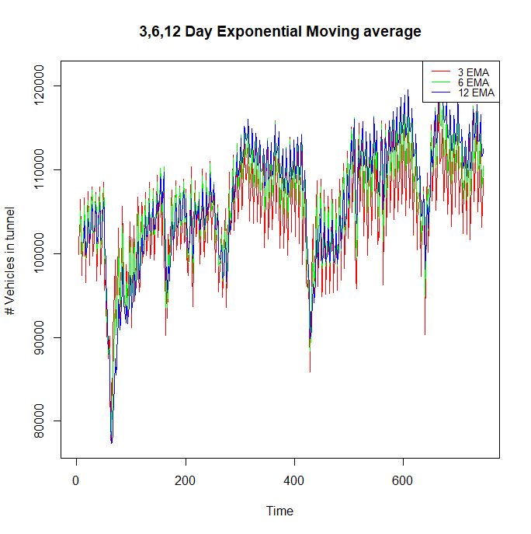
Exponential Moving Average
Scale X-Axis:
1 Unit= 1 day
8

Slide 10
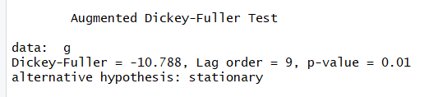
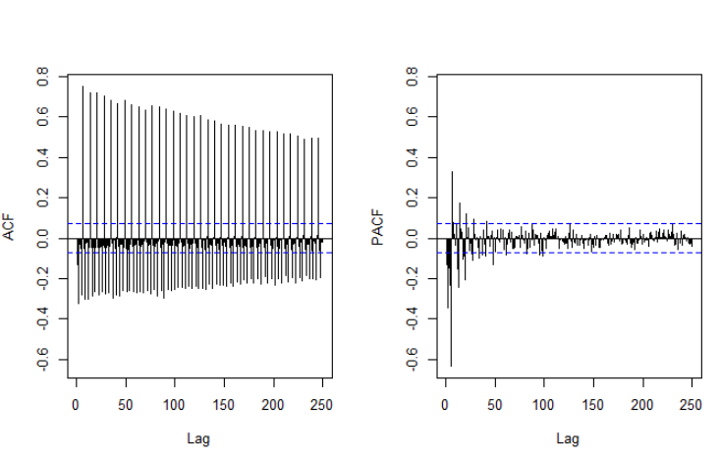
Augmented Dickey-Fuller Test
Since ‘p’ value is 0.01 this gives much evidence to reject NULL hypothesis, thus our data is stationary
PACF AND ACF OF ARIMA
9

Slide 11
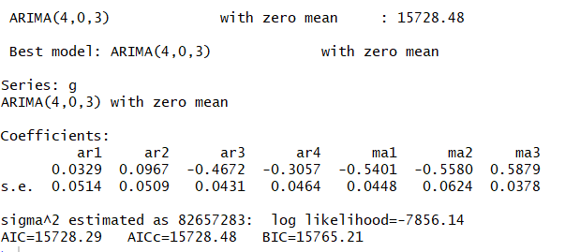
Summary of Arima
10

Slide 12
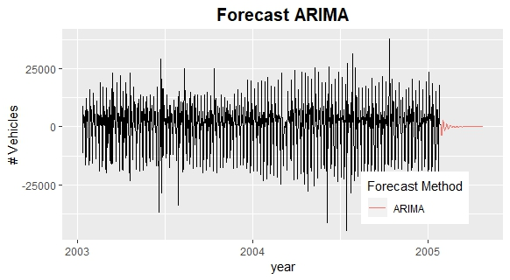
11

Slide 13
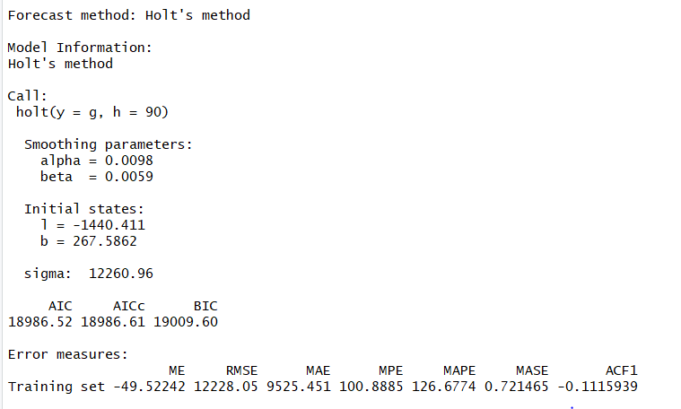
Holt’s Trend method Summary
12

Slide 14
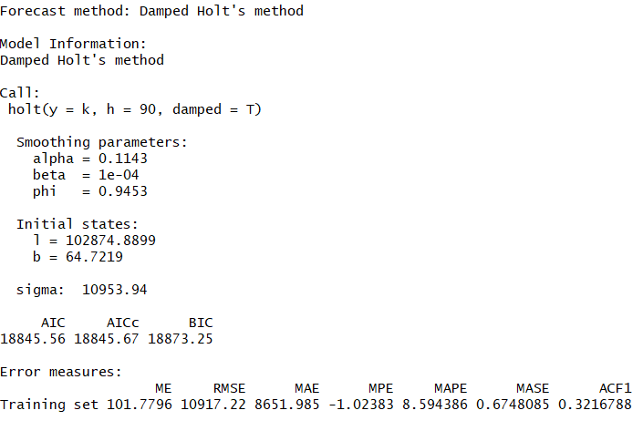
Damped Holt’s method Summary
13

Slide 15
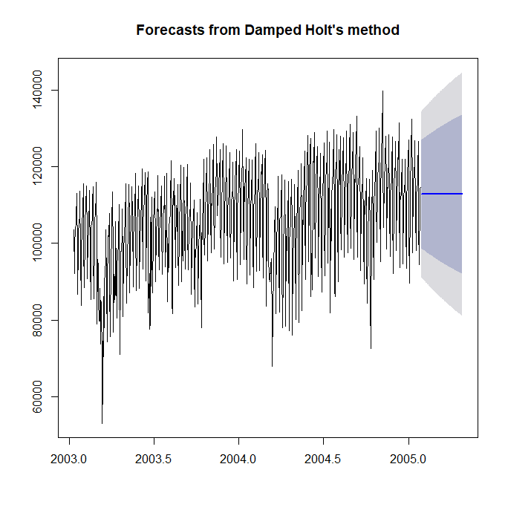
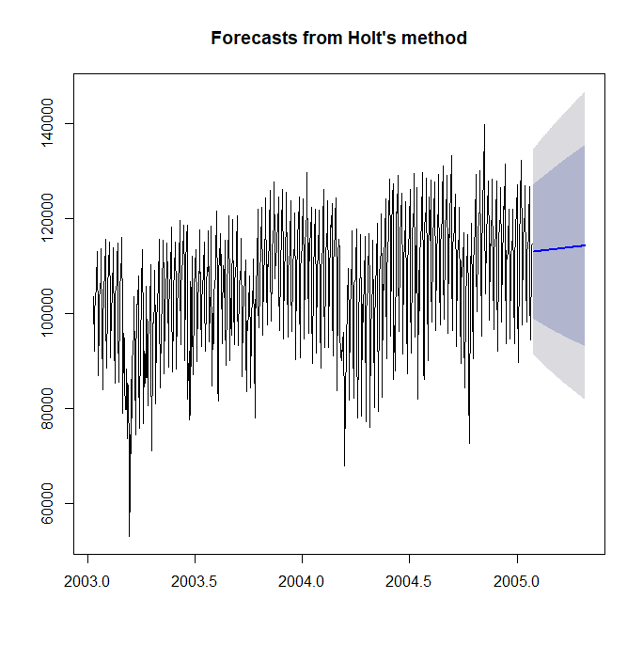
Holt’s Damped/Trend Forecast Plot
Scale X-Axis:
1 Unit= 1.2 months
14

Slide 16
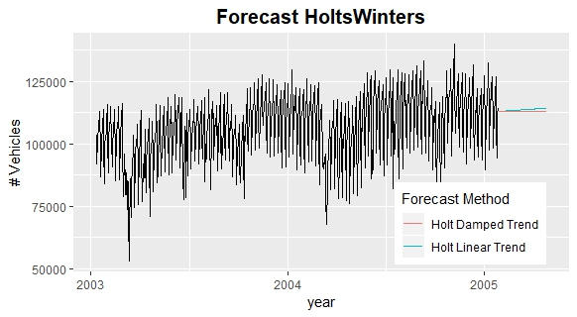
15

Slide 17
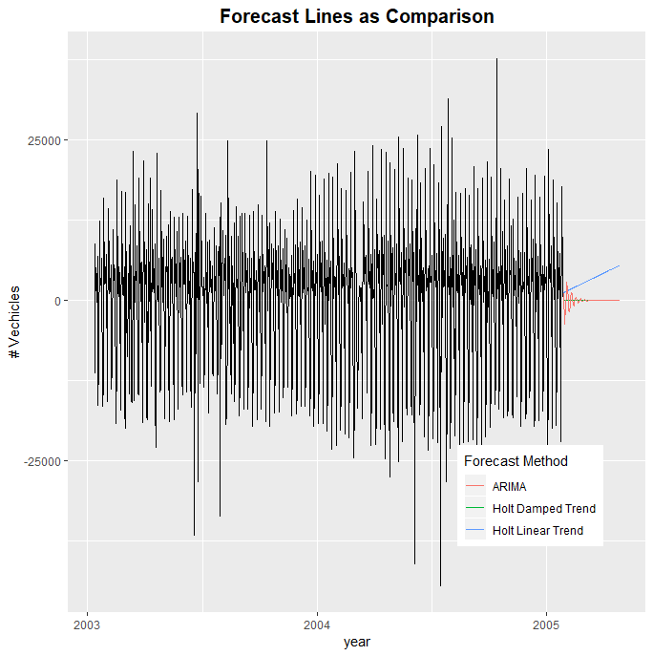
Forecast Line Comparison of Arima, Holt-Trend and
Holt-Damped
16

Slide 18
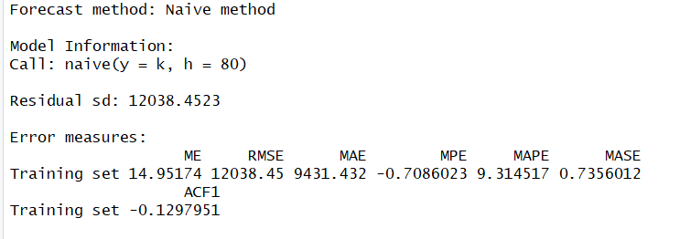
Naive method Summary
17

Slide 19
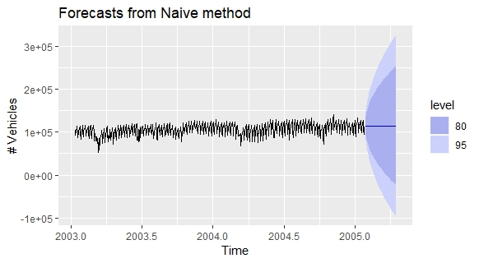
Naïve Forecast Plot
18

Slide 20
ERROR MATRIX
ARIMA ACCURACY
HOLTTREND ACCURACY
HOLTDAMPED ACCURACY
Error Matrix | Values
ME | 38.3439
RMSE | 9048.85
MAE | 6976.89
MPE | 73.7066
MAPE | 216.575
MASE | 0.52843
ACF | -0.0643
Error Matrix | Values
ME | -49.5224
RMSE | 12228.05
MAE | 9525.451
MPE | 100.8885
MAPE | 126.6774
MASE | 0.721465
ACF | -0.11159
Error Matrix | Values
ME | 7.559308
RMSE | 12039.75
MAE | 9430.191
MPE | 99.65236
MAPE | 99.95579
MASE | 0.71425
ACF | -0.12961
19

Slide 21
SMA
EMA
Error Matrix | RMSE Values
SMA 3 | 12700.4
SMA 6 | 11689.6
SMA 12 | 11490.1
Error Matrix | RMSE Values
EMA 3 | 0.05395897
EMA 6 | 0.02996435
EMA 12 | 1690.861
20

Slide 22
Recommendations and Output:
It is observed that EMA has lowest RMSE than other models
We can say that there is increase in usage of the tunnel
References:
https://github.com/Saheer7/time-series
21

Slide 23
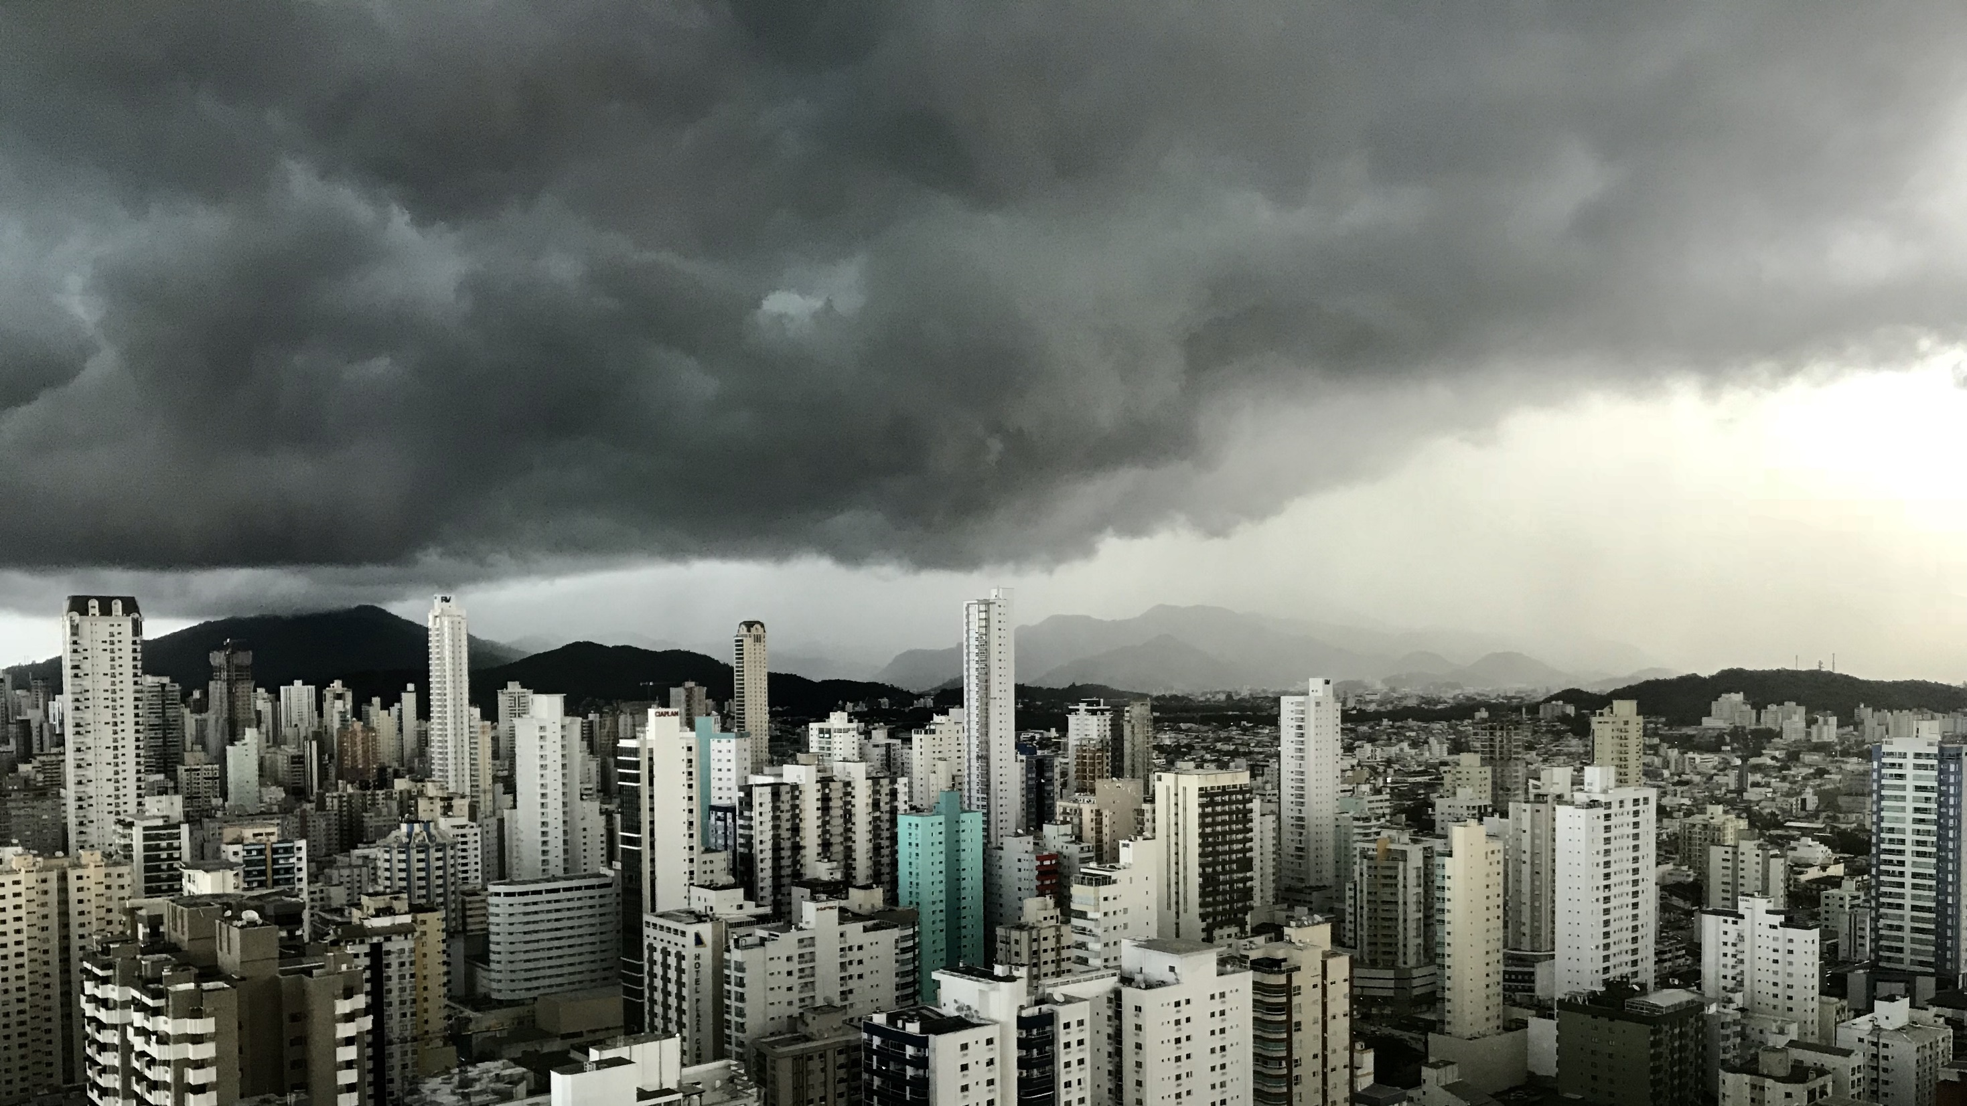
Slide 11
THANK YOU

