Slide 1


BANGLADESH UNIVERSITY OF BUSINESS & TECHNOLOGY
SUPERVISED BY
Dipu Akter Shila
Teaching Assistant, Department of CSE Bangladesh University of Business and Technology
GROUP: CodE_WaRRiors
Members
Md. Sahenul Islam Chowdhury (19202103022)
Nahida Zaman Bina (19202103025)
Md. Sakib Khan (19201103073)

Slide 2

Object
Help in Admission
Helping Hand
-Extends a helping hand to the students

Slide 3
Overview
Introduction
Motivation
Key features
Requirement Analysis
Admission Assistant Diagram
User Manual
Limitations
Future plan
Conclusion

Slide 4
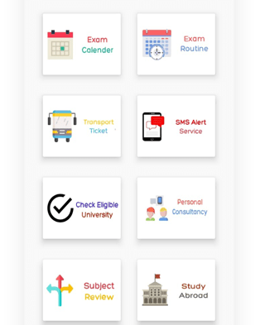
Introduction
Admission Assistant is the process of finding all details about universities.
Easiest way to registered in university.

Slide 5

Motivation
Desire to face the challenge in solving the unsolved problems.
Desire to get intellectual joy of doing some creative work.
Desire to serve the students.
Desire to get respectability.

Slide 6
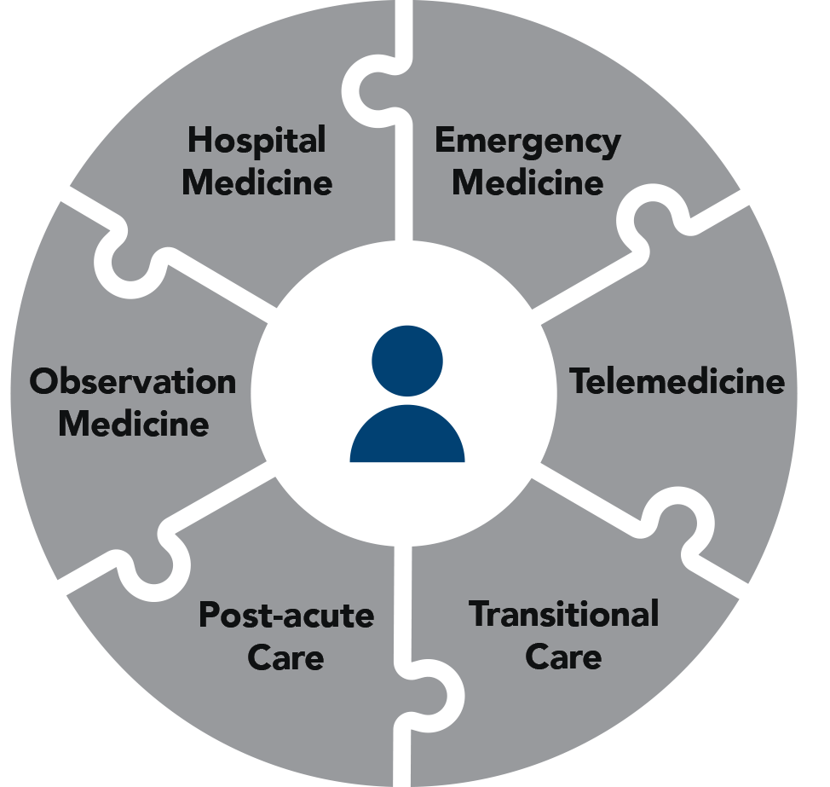
Key Features
It’s one kind of helping hand to get universities details.
Easily get rank list in a true way.
Easiest way to see registration formate .
Get admit card without any hassle.

Slide 7
Requirement Analysis
Tools
CodeBlocks
Programming Language and Database
C

Slide 8
Admission Assistant Diagram
Public
Public Universities name
University
Information
Private
Private Universities
name
Admission
Assistant
Registration
All university name
Form fill-up
Payment
successfully registered
Login
Registered university
Show Registered universities name
My information
Admit Card
Show universities name
Show select universities admit card
Circular & exam date
Show all universities
Show all universities circular & exam date
University
Rank List
Show all universities rank list
Logout
Exit

Slide 9

Limitations
This is not an online base system.
Admin panel is’nt added.
It shows details of some universities in Bangladesh.
The authority cannot add any university if it wants.

Slide 10
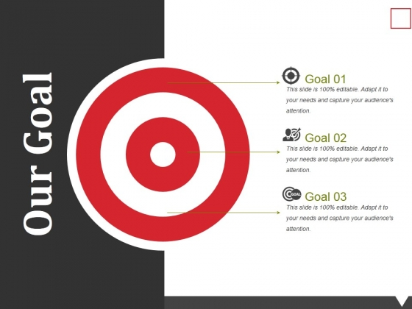
Will add the details of all the universities in Bangladesh and Abroad.
Will publish it as an app.
Will try to add pictures.

Slide 11

Conclusion
Everyone needs a guide line during admission. Our project is a guide line for all candidates. The good and the bad about the university will be found here in truth way. Our project will always try to solve everyone’s problem.

Slide 12


Slide 13


