Slide 1

Autonomous Systems milestone5

Slide 2
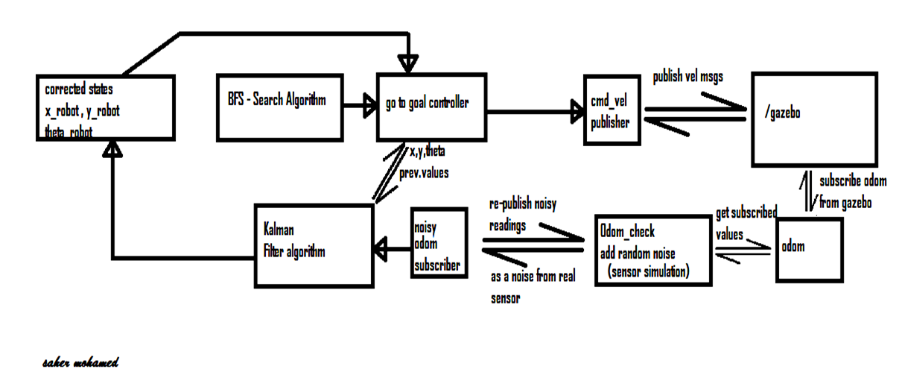

Autonomous Systems milestone 5

Slide 3
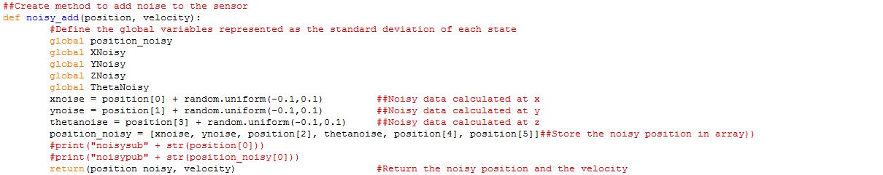

Autonomous Systems milestone 5

Slide 4
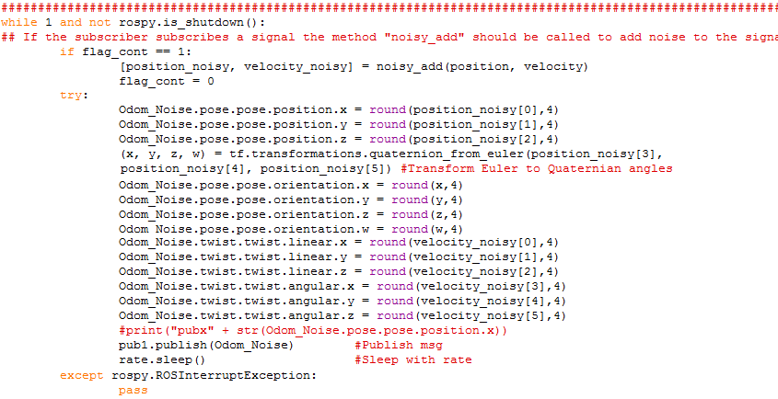
Autonomous Systems milestone 5

Slide 5
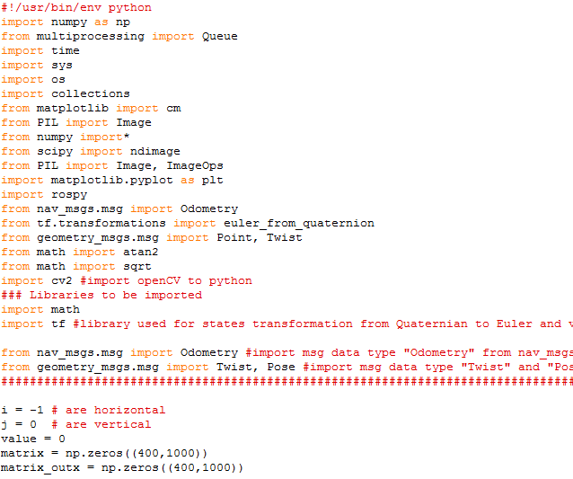
Autonomous Systems milestone 5

Slide 6
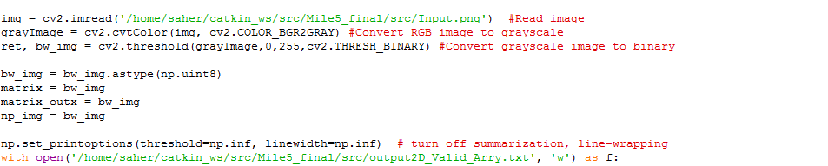
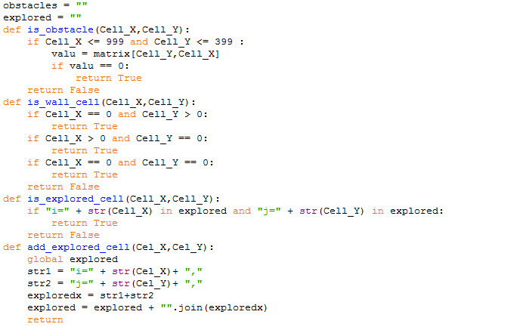
Autonomous Systems milestone 5

Slide 7
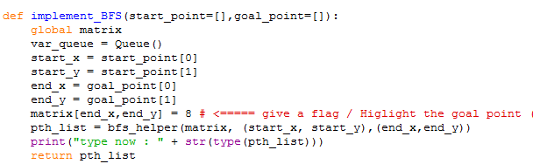
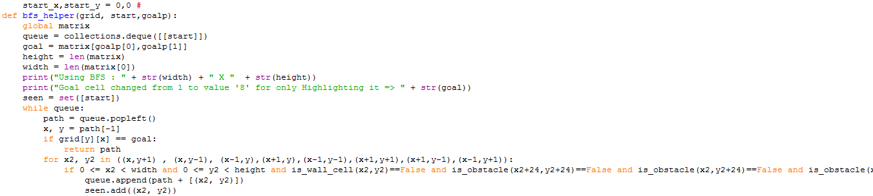
Autonomous Systems milestone 5

Slide 8
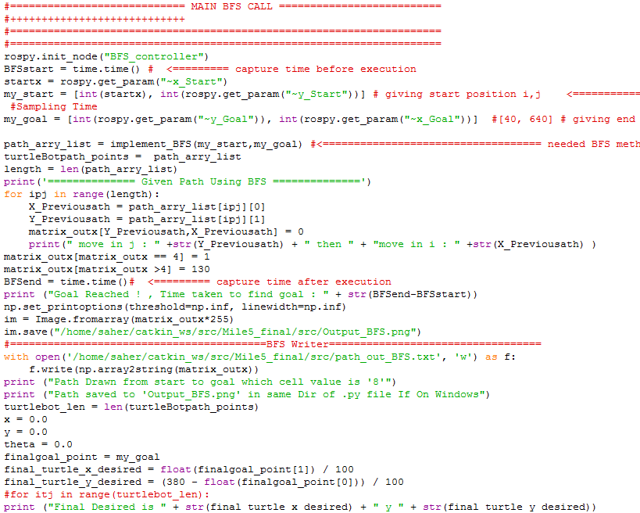
Autonomous Systems milestone 5

Slide 9
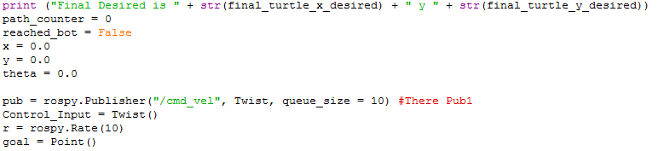
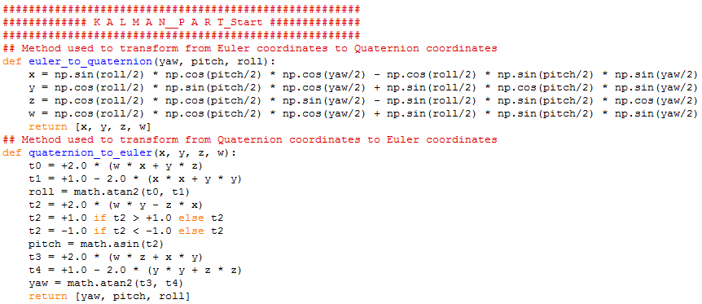
Autonomous Systems milestone 5

Slide 10
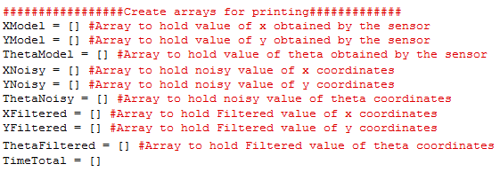
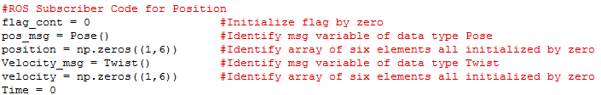
Autonomous Systems milestone 5

Slide 11
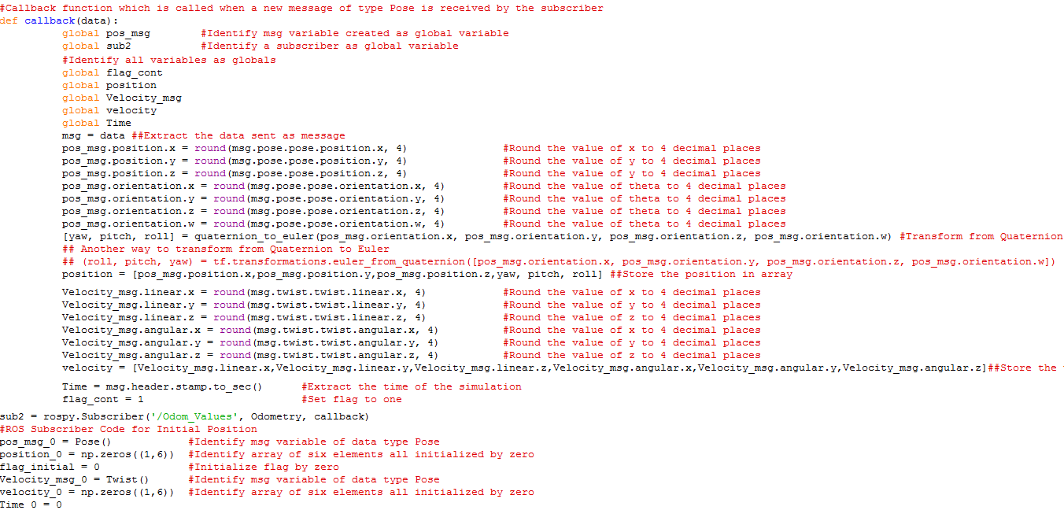
Autonomous Systems milestone 5

Slide 12
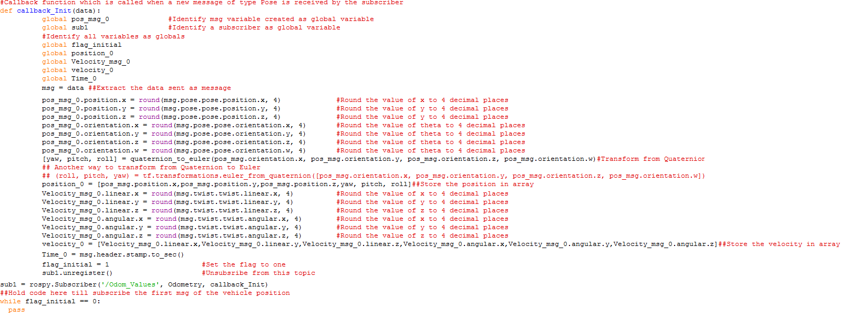
Autonomous Systems milestone 5

Slide 13

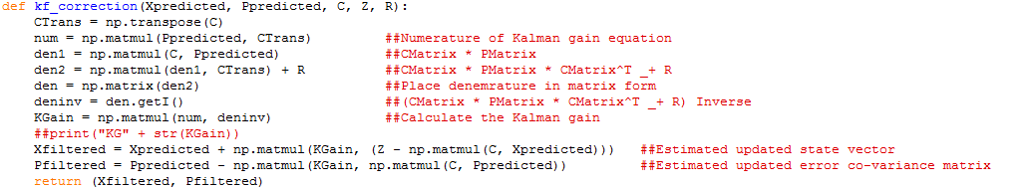
Autonomous Systems milestone 5

Slide 14
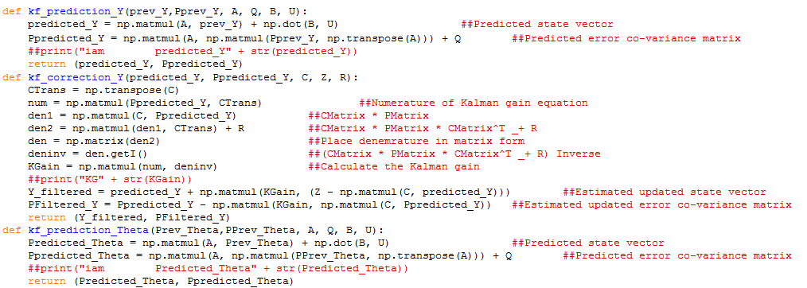
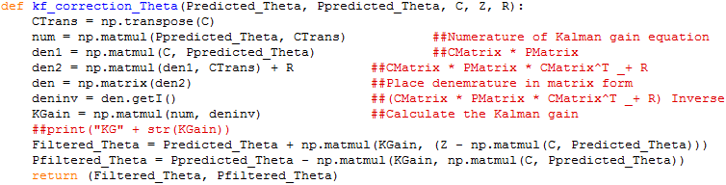
Autonomous Systems milestone 5

Slide 15
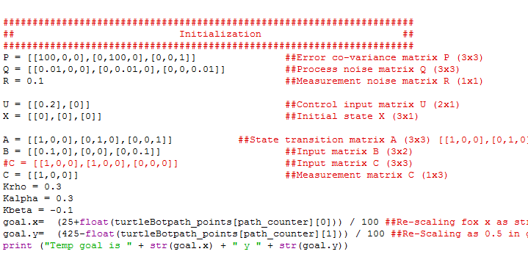
Autonomous Systems milestone 5

Slide 16
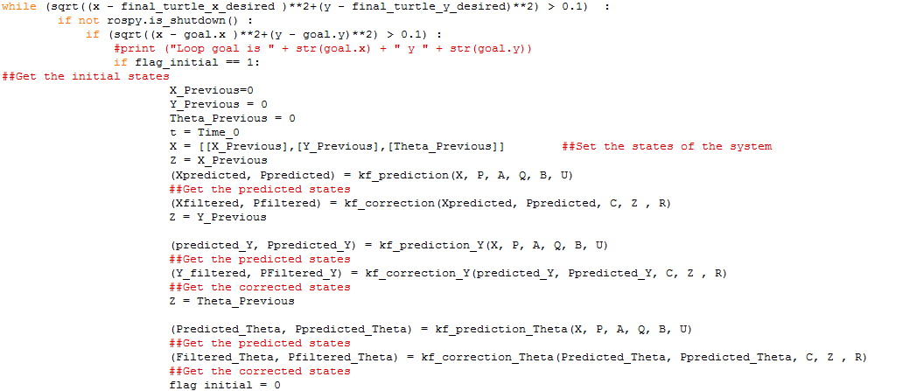
Autonomous Systems milestone 5

Slide 17
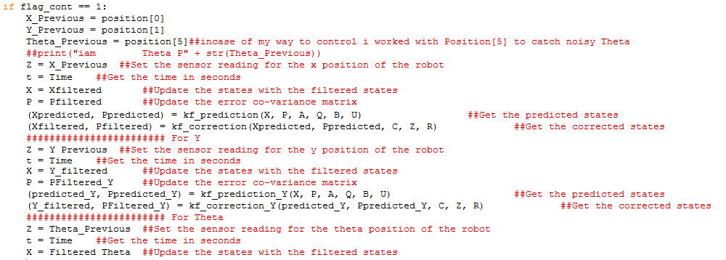
Autonomous Systems milestone 5

Slide 18
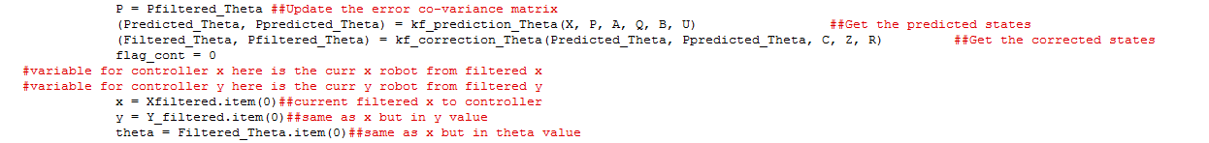
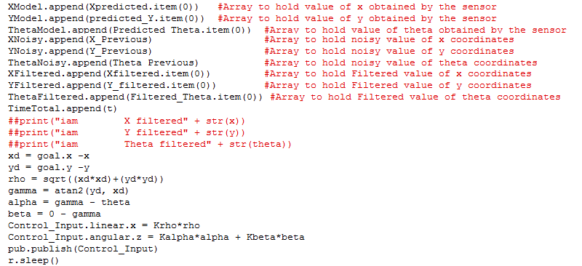
Autonomous Systems milestone 5

Slide 19
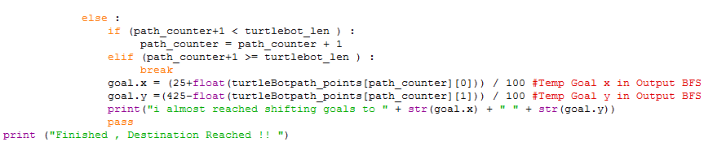
Autonomous Systems milestone 5

Slide 20
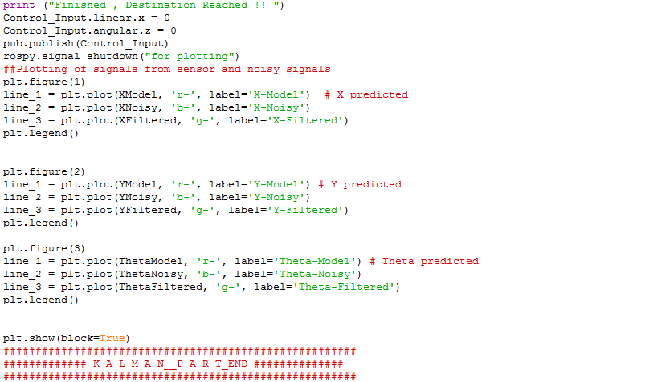
Autonomous Systems milestone 5

