Slide 1
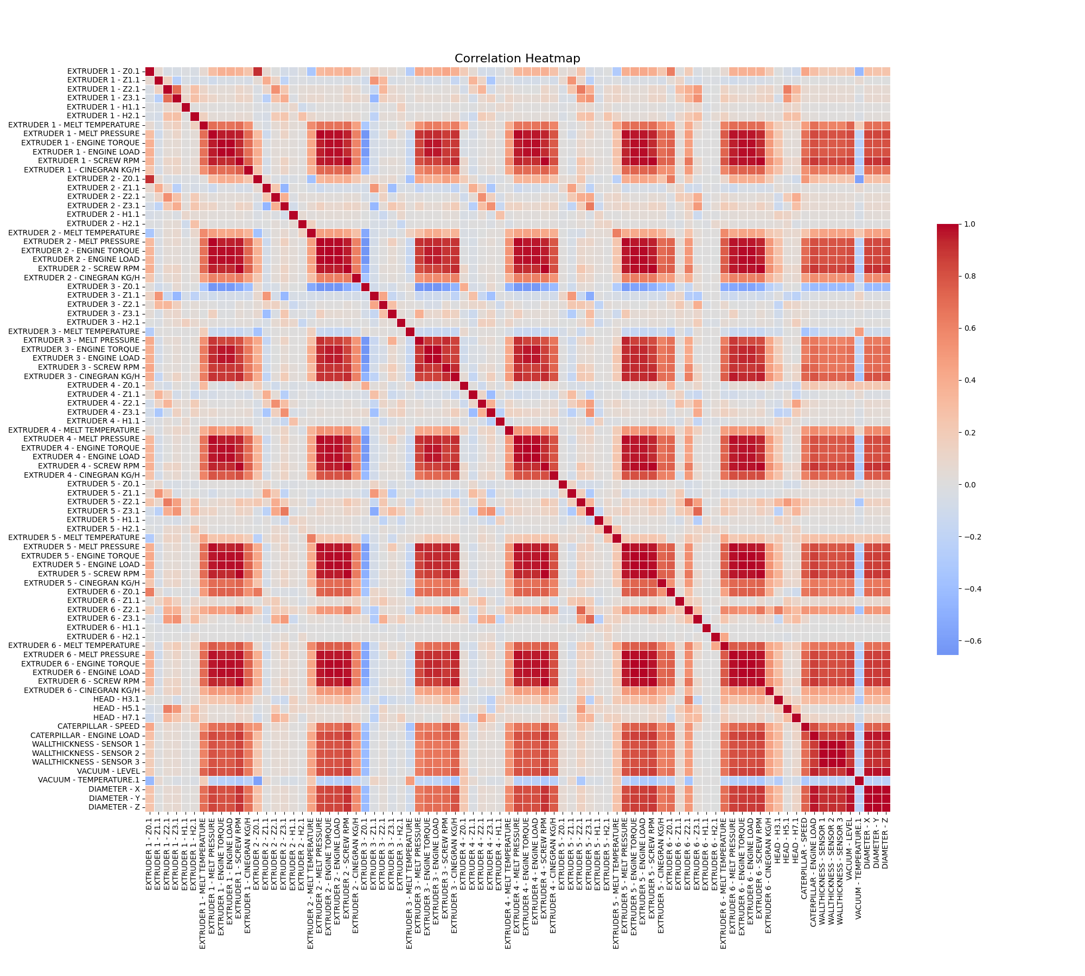
Input-Output Correlation Matrix for Process Optimization

Slide 2
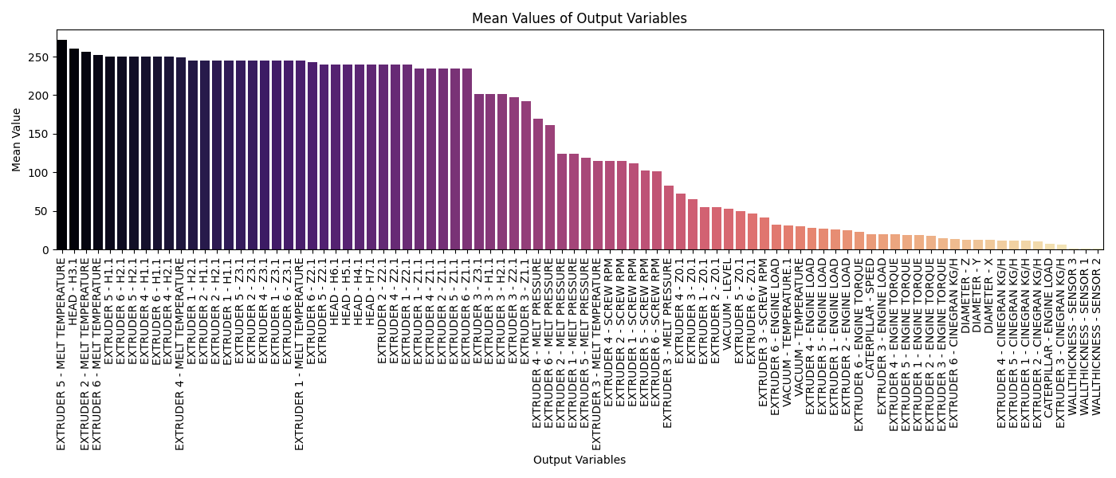
Output Performance Analysis for Process Optimization

Slide 3
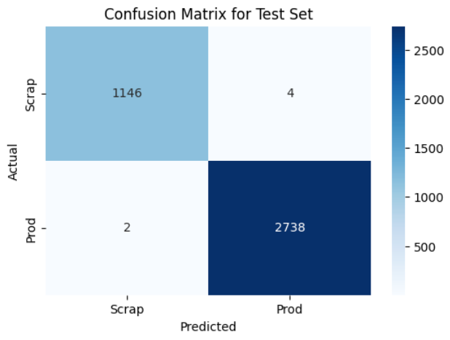
Model Prediction Based on Test Data

Slide 4
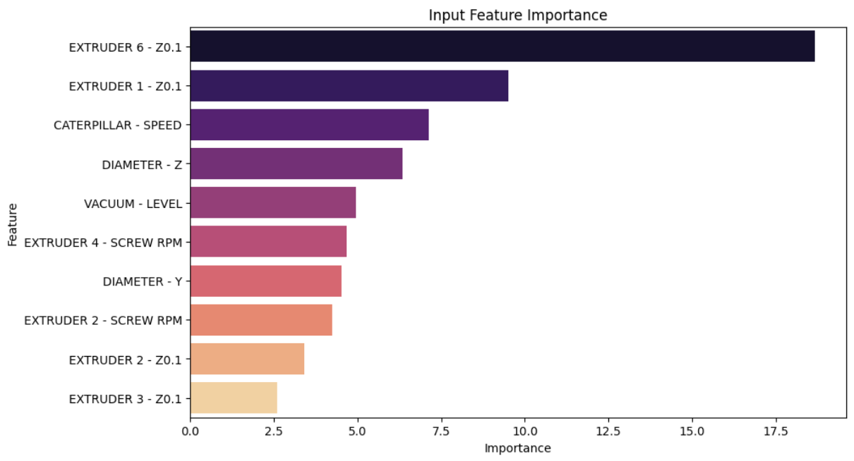
Feature Importance Analysis for Predictive Modeling in Industrial Processes

Slide 5
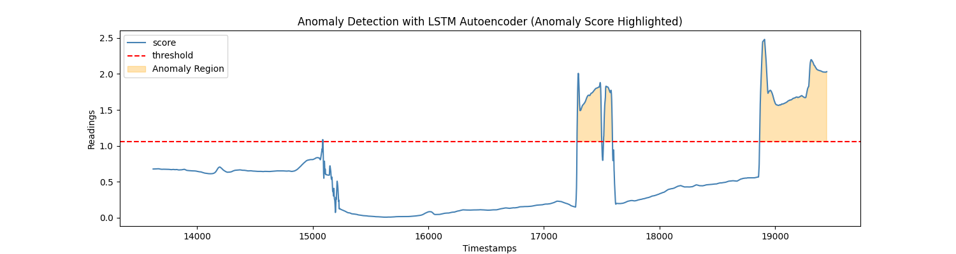
Anomaly Detection in Top 10 Output Features Using LSTM Predictions

Slide 6
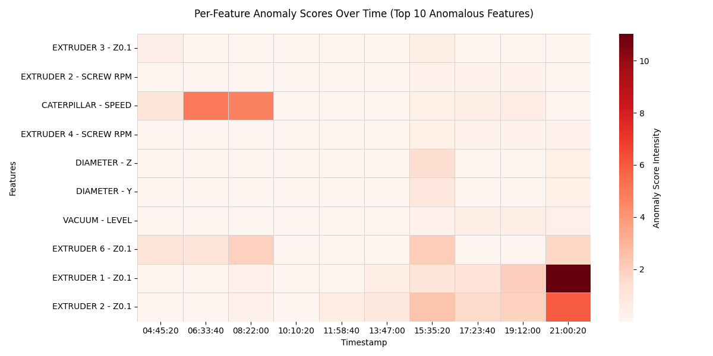
Anomaly Detection in Top 10 Output Features Using LSTM Predictions

