Slide 1
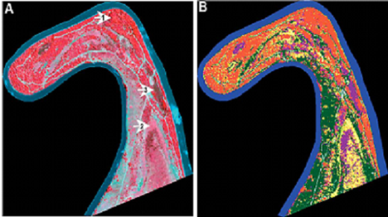
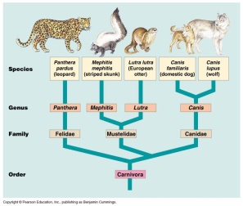
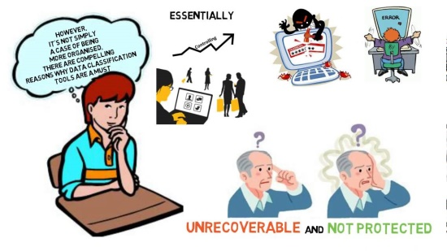
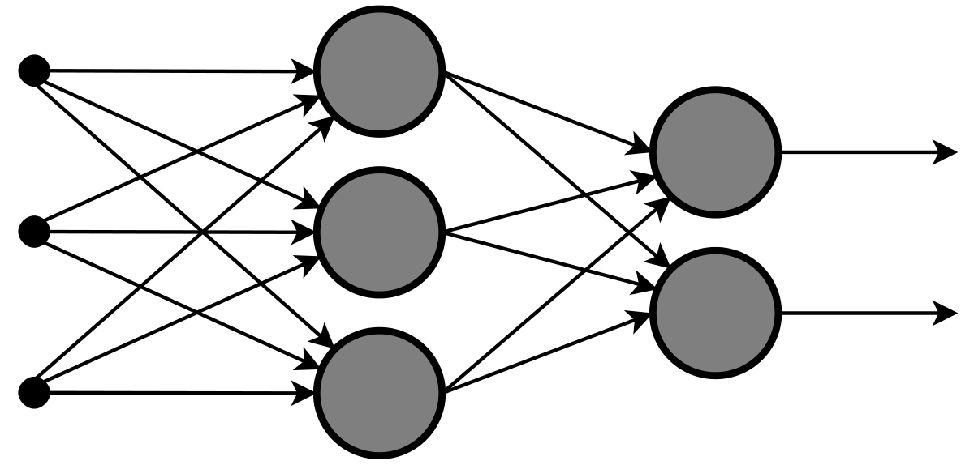
Image Classification
Presented By: Sahib Hussain
Internship 17

Slide 2
Problem Statement
Images are one of the major sources of data in the field of data science and AI. This field is making appropriate use of information that can be gathered through images by examining its features and details. We are trying to give you an exposure of how an end to end project is developed in this field.
The idea behind this project is to build a deep learning-based Image Classification model on images that will be scraped from e-commerce portal. This is done to make the model more and more robust.

Slide 3
About Data
The DataSet contains 200 images of Sarees, Trousers(Men), Jeans(Men ) each. These were then loaded to google drive and three separate folders were made each for Training, Validation and Testing purpose.
The data was collected from Amazon ecommerce website using selenium to build this model.
We collected 700 images approx of Sarees, Trousers(Men) and Jeans(Men) each.
It was saved to local system in jpg format which was later loaded to google drive for further processing and building the model.

Slide 4
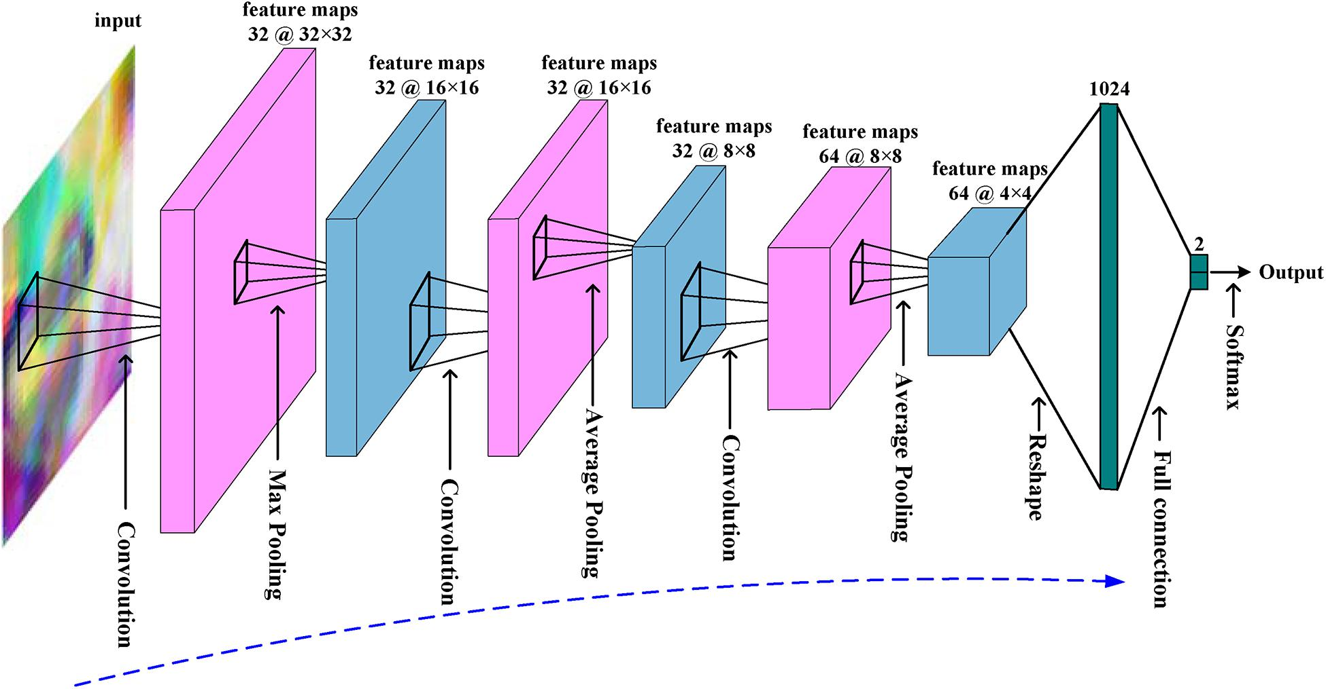
About Convolutional Neural Network
CNN is a specialized deep neural network model for handling image data.

Slide 5
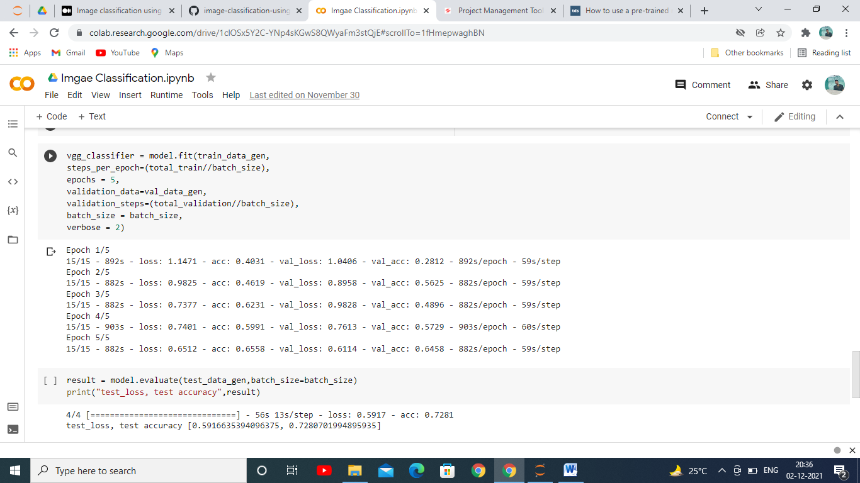
Model Selection
After Training Testing the model with 5 epochs we achieved accuracy score of 72.80%

Slide 6
Conclusion
CNN does not need the traditional image processing filters like the edge, histogram, texture, etc., rather on CNN, the filters are learnable. So, these need not be determined through trial and error.
This model helped us to know whether a image is of a Saree, Trouser or a Jeans based on what input it is taking. We know these days Image Classification is becoming popular and its application are increasing rapidly in every sector.

