Slide 1
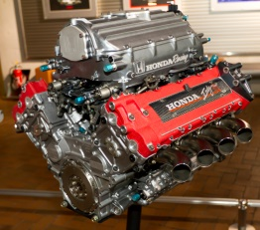
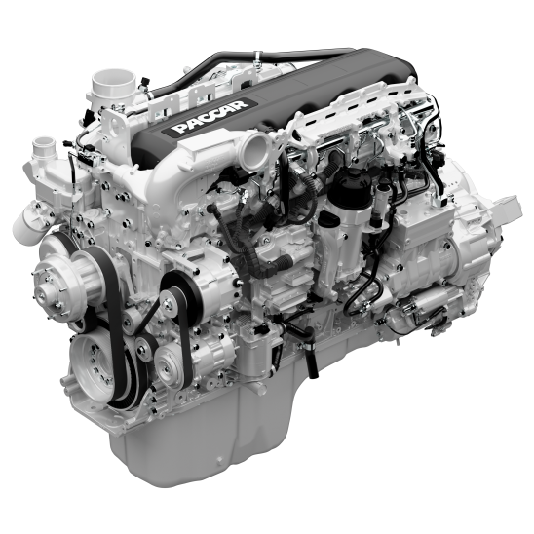

Used Cars Model
Presented By: Sahib Hussain
Internship 17

Slide 2
Problem Statement
With the covid 19 impact in the market, we have seen lot of changes in the car market. Now some cars are in demand hence making them costly and some are not in demand hence cheaper. One of our clients works with small traders, who sell used cars. With the change in market due to covid 19 impact, our client is facing problems with their previous car price valuation machine learning models. This model will be used by the management to understand how exactly various factors affect the price of an used car and how much accurate result they can predict if we give all those factors as input to our model.

Slide 3
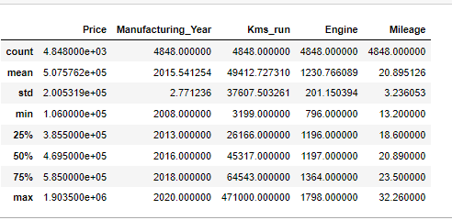
Statistics Of the Dataset
Originally it had 1 variable as integer datatype and rest of the variables were of object datatype but we changed it into 1 varaible as float, 3 as integers and rest of them as object to create a better model. We can see the mean, Standard Deviation , the Minimum, 25th,50th,75th quartiles and the Maximum.

Slide 4
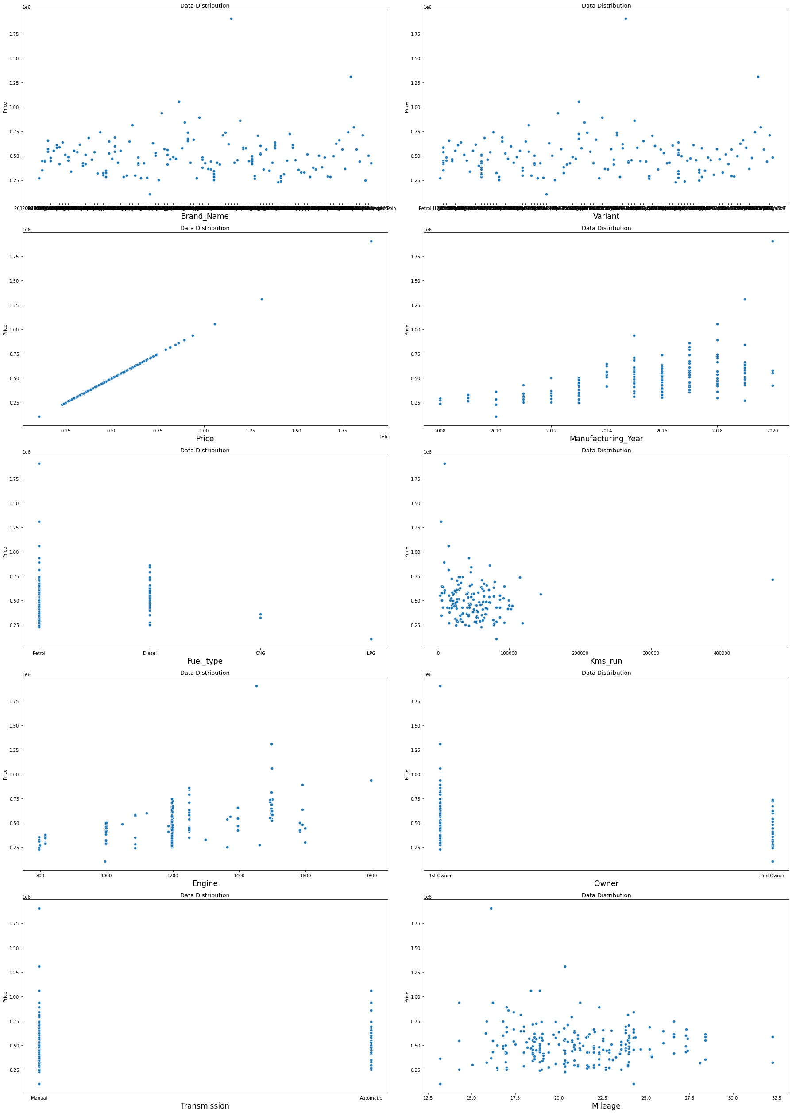
Checking Data Distribution of Our Dataset.

Slide 5
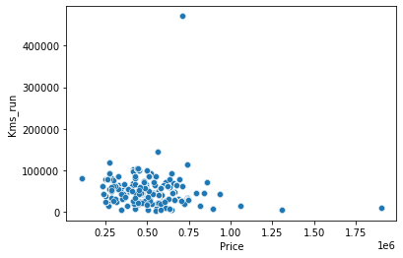
In the previous slide we saw data distribution for each independent variable with respect to our dependent variable Price. For example, Let’s take variable Kms_run.
In the figure x axis contains the values of independent variable and y the value of dependent variables which in our case is Kms_run,
From the figure we can clearly see that mostly the price was higher only in case when the Kms_run by the car is less, it helped us to know how the it affects in determining the price of the car.

Slide 6
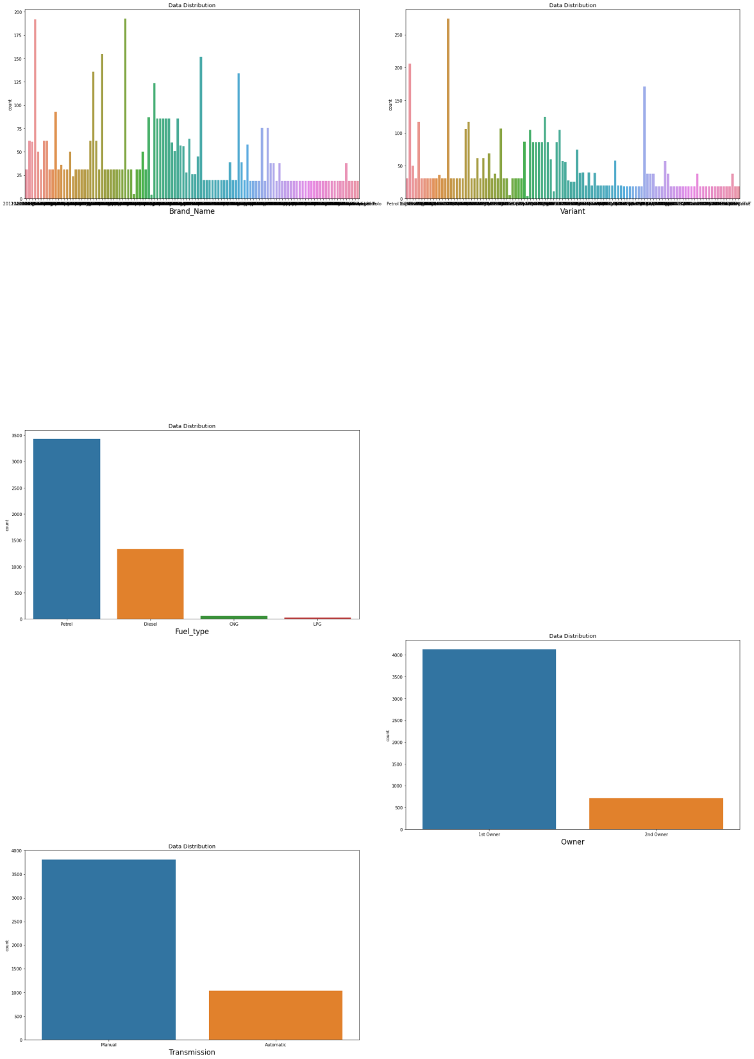
Checking All the Categorical Independent Variables
Those in blue bars for each category are higher in numbers when selling a car.

Slide 7
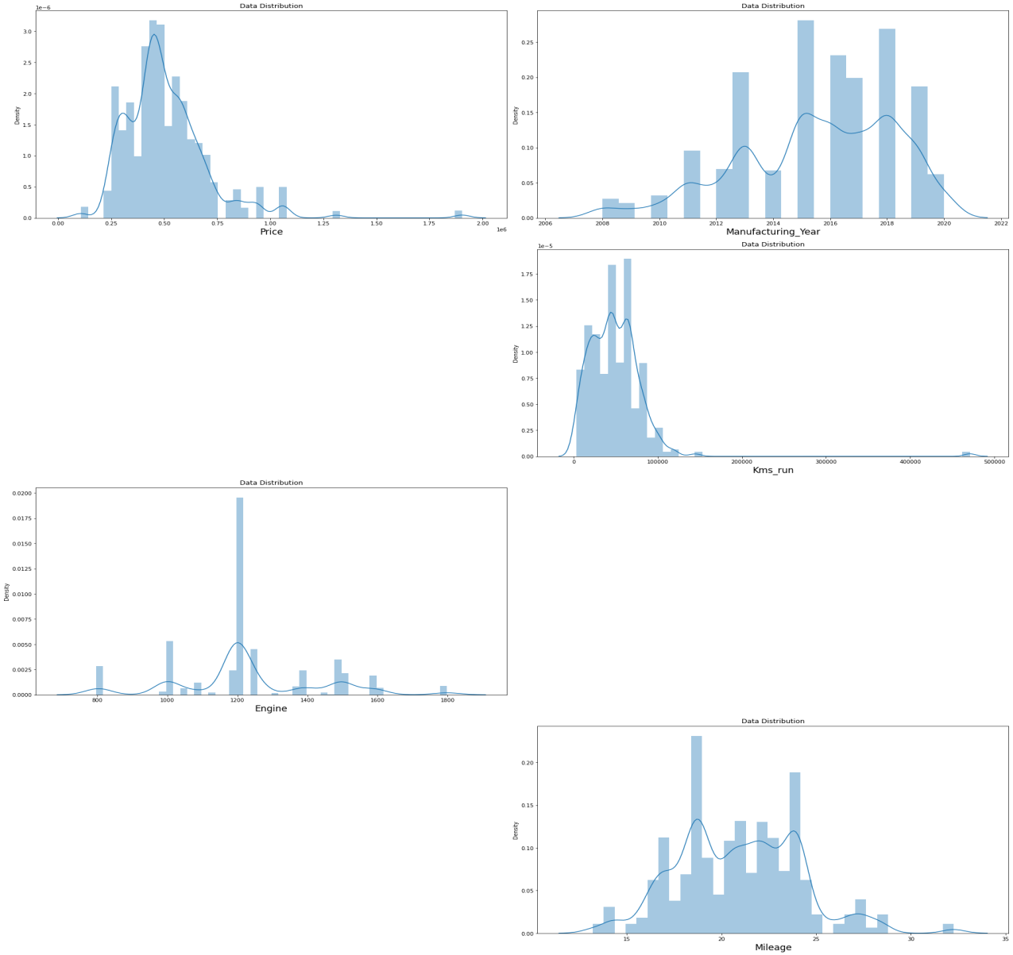
Checking for Skewness
This figure shows us the skewness for the continuous variables and we can see that Kms_run was skewed towards right, a perfect curve would be the one which forms bell like curve. This impacts the model and in its’ prediction so we needed to get rid of these with the help of quantile method.

Slide 8
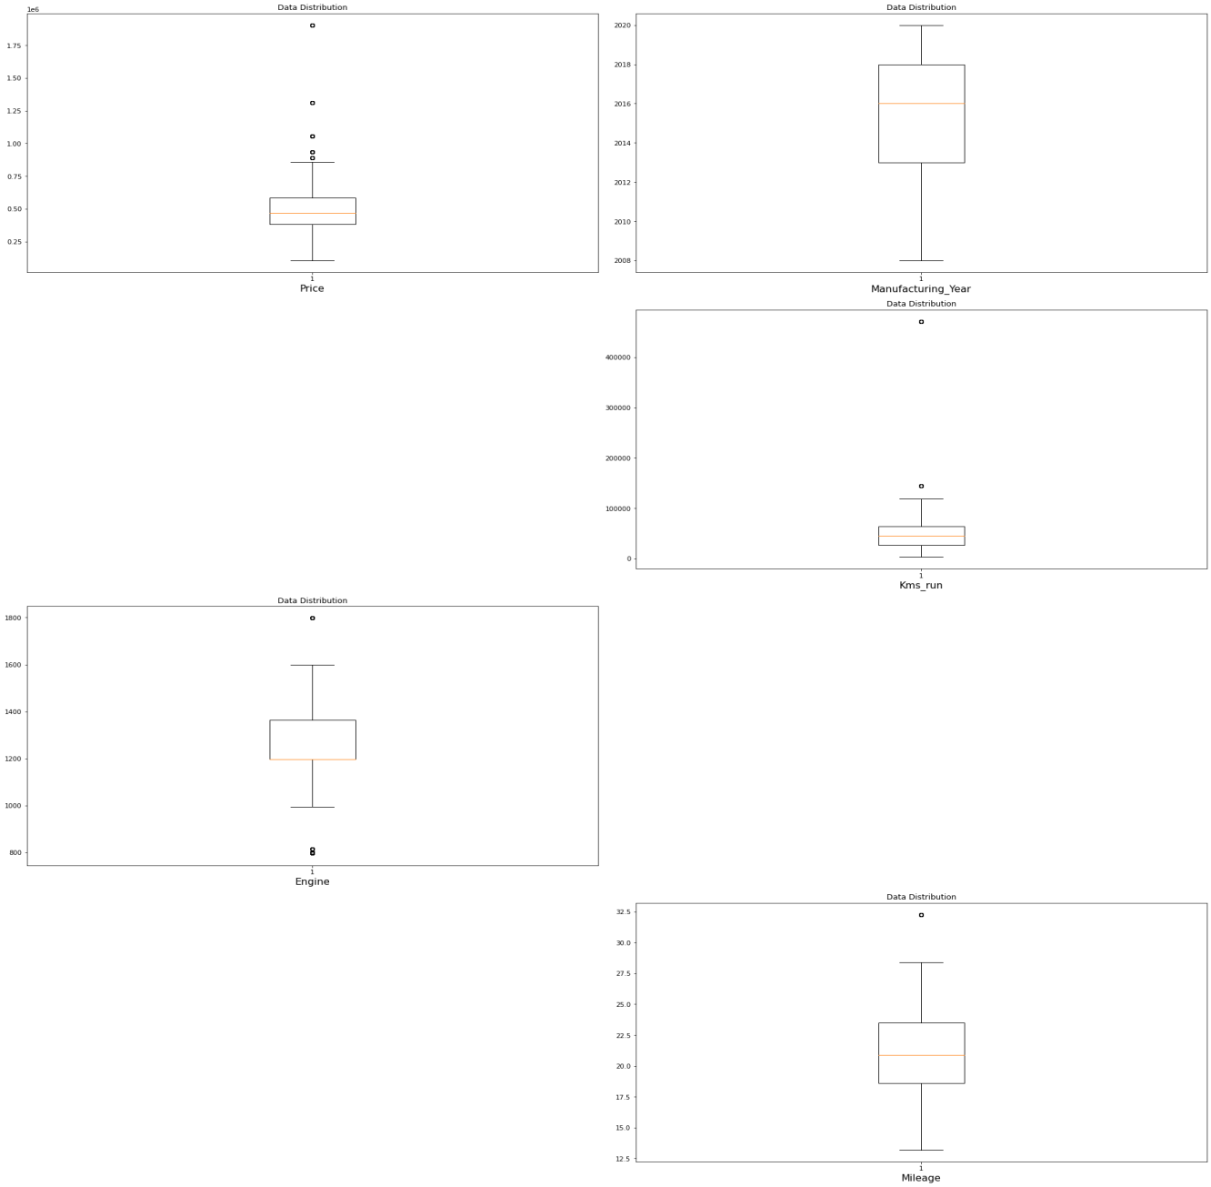
Checking for Outliers in the Dataset
In this figure we can see the outliers in each continuous variable which is not normal or not possible in real life and it occurs mostly because of incorrect entry so these had to be removed for creating a better model.

Slide 9
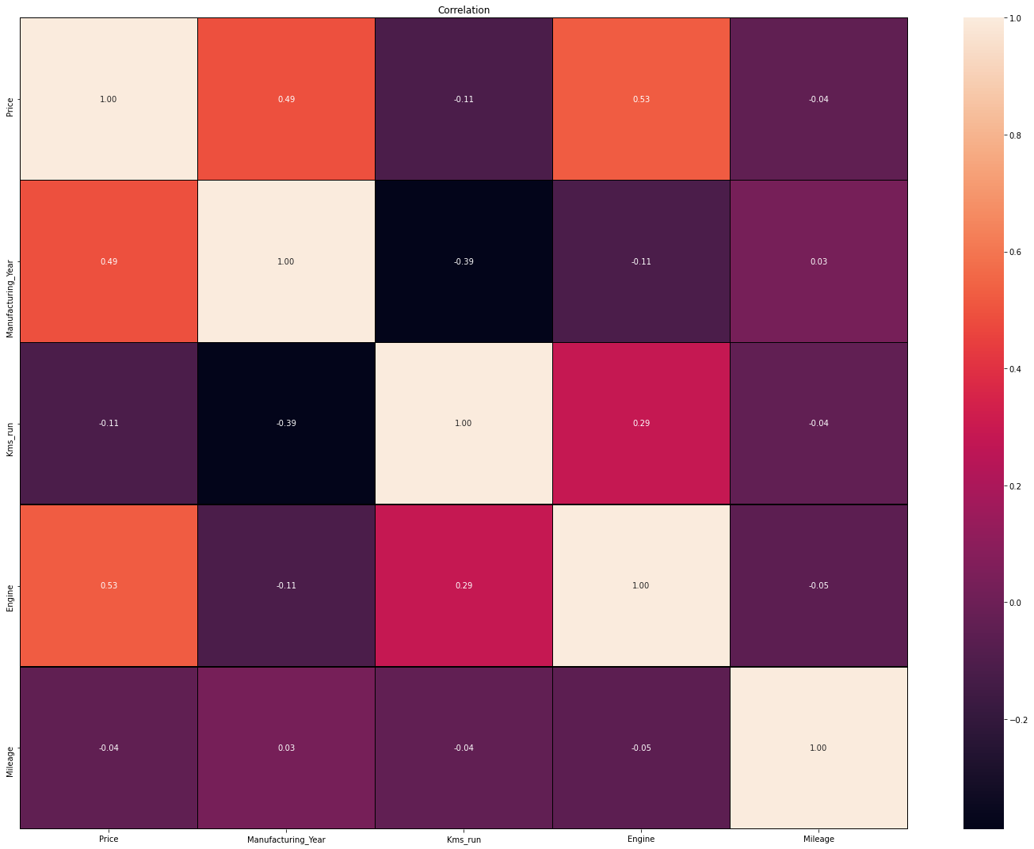
Let’s now see the co-linearity among the features
It is showing us the co-linearity among features how much they are co-related near to 1 has high co-linearity among them, from the above figure we can clearly see that there is hardly much co-linearity among the features.

Slide 10
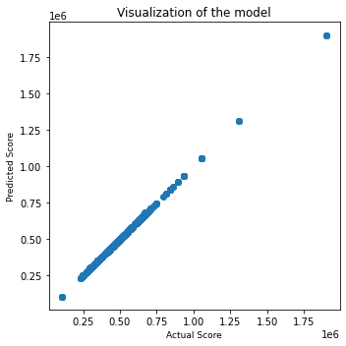
Model Prediction Scatter Plot
This image is showing us the relation between our predicted values and actual values as we can see that there is not much gap between predicted and actual datapoints for Xtreme Gradient Boost Regressor which shows that it is best fit for our dataset. Also we saw the scores for other 4 algorithms but XGB Regressor had delivered us the best scores among them

Slide 11
The Conclusion
In this project we found how various factors can hugely impact the sales price of a used cars. A little bit of change in the feature of car can drastically bring change to it’s price. How important the features are in determining the price of used cars. As we saw while doing Exploratory Data Analysis that some more features if could have been included it would have impacted on the model and helped in better prediction.

