Slide 1

Capstone Project
Play Store App Review Analysis(EDA)
By
Sahib Hingorani

Slide 2
INTRODUCTION
Google Play Store, also known as Android Market place, where the user can install different kinds of applications according to his/her needs It is the official distribution storefront for Android applications and other digital media, such a music, movies and books, from Google. User has ample amount of choices for the apps for a particular usage.
In this project, we are going to see what a user can check before installing the application for his/her android device.
For analysis the dataset we are going to analyze has around 10.5k scraped play store applications.

Slide 3
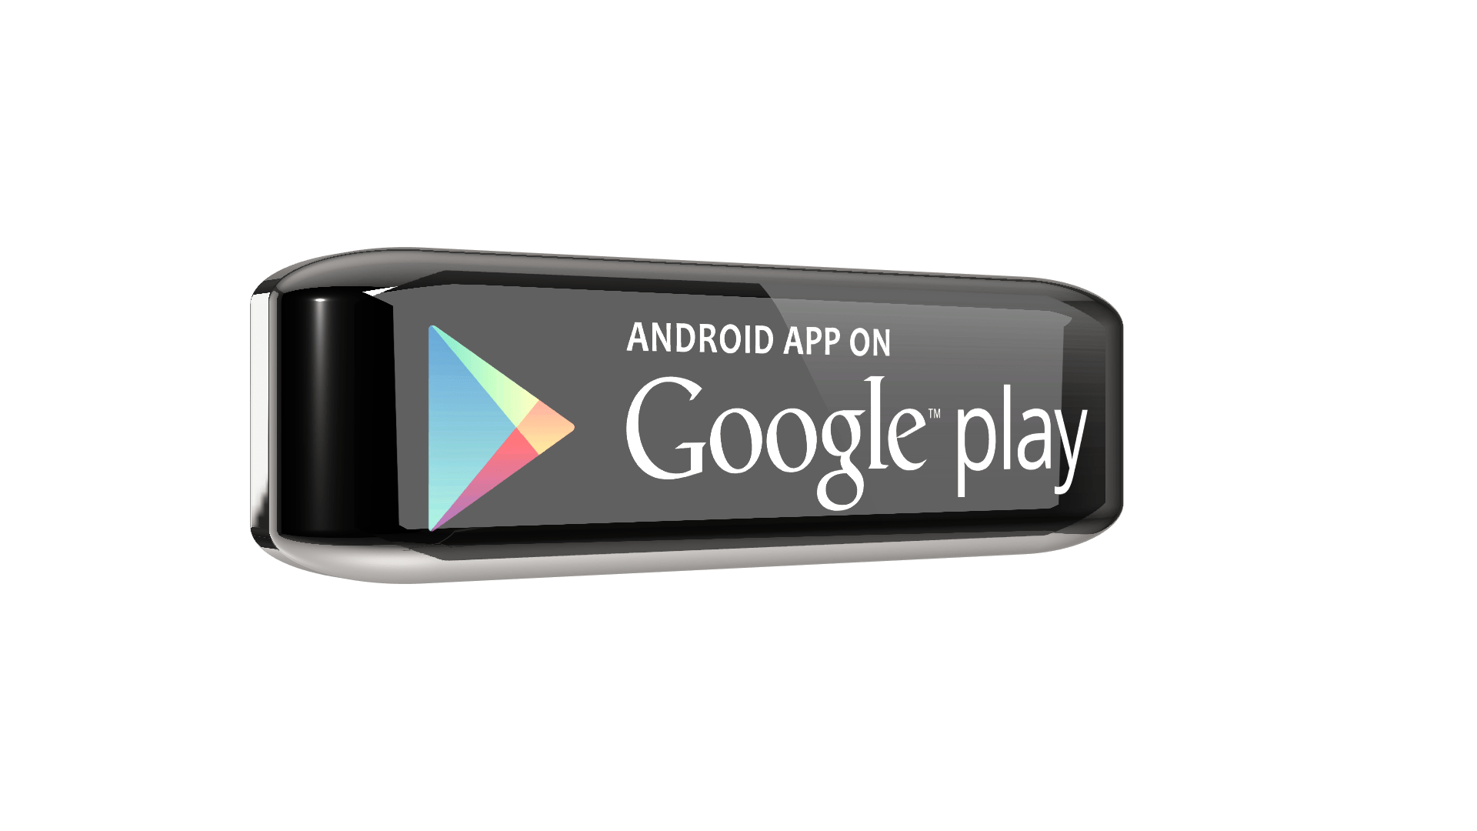
Analysis for Google Play Store
Analysis of play store apps data is necessary for both, users as well as developers.
Users->
Through analysis they can check which apps are trending and which applications has the highest rating. As there are ample number of applications present in the play store market.
App Developers->
Through analysis they can check the reviews and decide what is the current need of the hour and develop or upgrade the applications according to the needs of user

Slide 4
Given Dataset Summary:-
1) Play store app reviews
It means rating given by the user to the apps-
For ex- 4.1 , 3.5 etc.
Name of the application
It shows the information that is the application is paid or free
Play store
app
subsets
Apps
Ratings
Installs
Size
Reviews
Genres
Categories
Android version
Current version
Last updated
Type
Date of the latest update of the app
Total No. of installs of the application worldwide
Current version of the application
Size of the application (measured in mb)
Android version on which the app is supported
No. of reviews given by the users
Category to which app belongs to
It can be defined as further division of categories

Slide 5
Given Dataset Summary:-
USER REVIEWS
APP
TRANSLATED REVIEWS
SENTIMENT
SENTIMENT SUBJECTIVITY
SENTIMENT POLARITY
SENTIMENT POLARITY
2) User reviews
Sentiment polarity score
Range- [-1,1]
Name of the application
Sentiment Subjectivity score.
Range- [0,1]
Reviews given by the user
Positive Negative
Neutral

Slide 6


Overview of Analysis
Data Cleaning
Analysing the data and cleaning it according to the need
Data Exploration
Do some analysis from which user and app developers can get needed and important information
Conclusion
Helps the reader to see overview of whole analysis
i

Slide 7
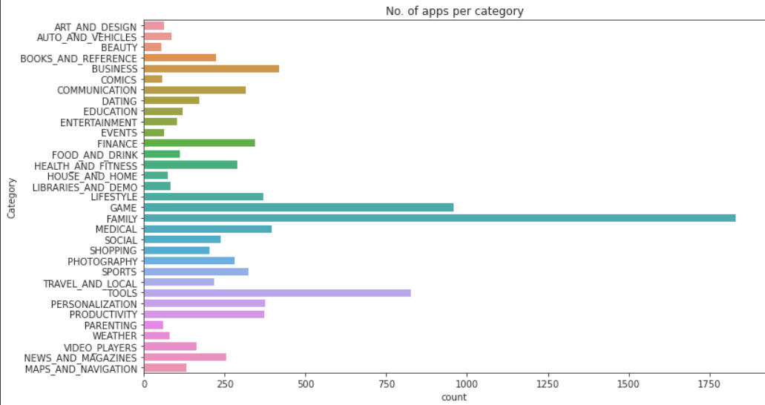
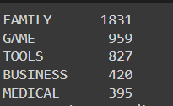
1.) Number of applications per category
Top 5 categories which has most number of applications
With the help of above analysis we can clearly check, that family category holds the most number of applications in play store market, and which is followed by Games and then tools

Slide 8
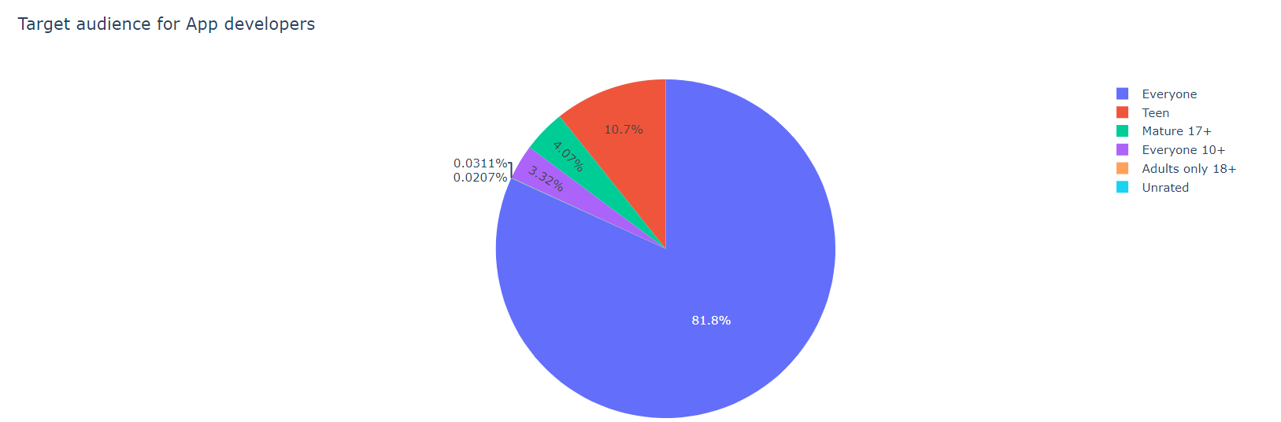
2.) Content rating given by PEGI(App Content Rating Statistics for Google Play)
With the help of above analysis we can see that audience that most of the app developers target is EVERYONE that is apps that are meant to be for all age group.
Which is followed by Teen and Mature 17+
To be continued…

Slide 9
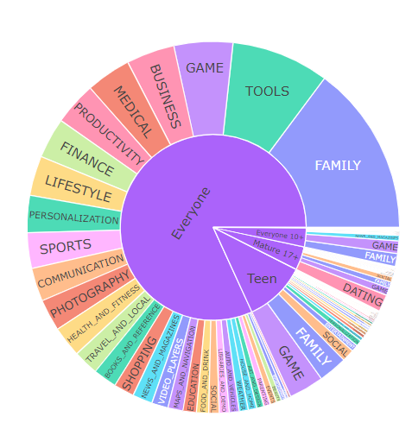
Continued…
Further we can check the distribution of categories across different kinds of content rating
On the same analysis we can check the apps distribution between content rating on a sunburst chart, and interestingly apps percentage were different for all.
EVERYONE - Family apps were leading followed by Tools and Games.
TEEN - Games and then Family.
MATURE 17+ - Dating apps are leading their way followed by Games
EVERYONE 10+ - Family and Games are leading to others.

Slide 10
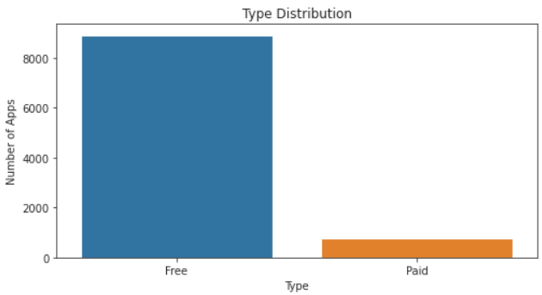
No.3) Types of apps in terms of their value
As observed there are 8000+ applications which are free of cost to users and less than 1000 are there which are paid to users
Through which we can say that around 90% of the applications are free for users.
To be continued…

Slide 11
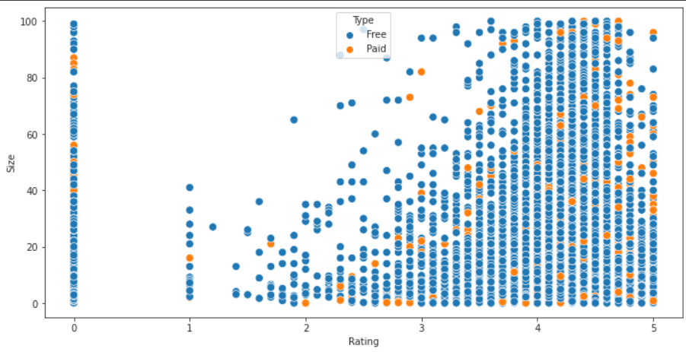
Continued…
Same analysis done using scatterplot.
As we all know play store is a market place for android applications from which all the applications can be installed
Suppose you are in a stadium stand where some of the crowd are wearing blue jersey in support of Team India, and other are wearing Yellow Jersey in support of Team Australia.
Through this scatterplot we can easily say that there are ample number of Indian fans and very few Australian fans.
Similarly there are ample number of free apps in market and very few are paid one.

Slide 12
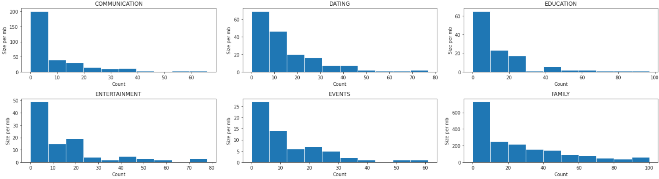
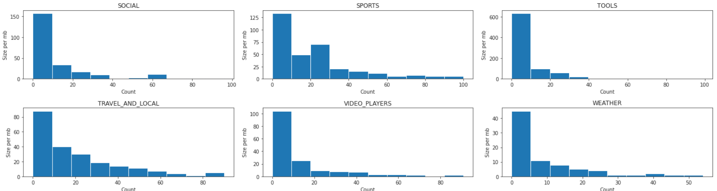
No.4) Size of the apps per categories
To be Continued…

Slide 13
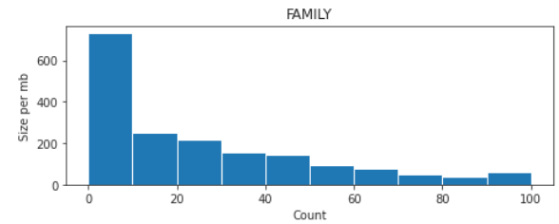
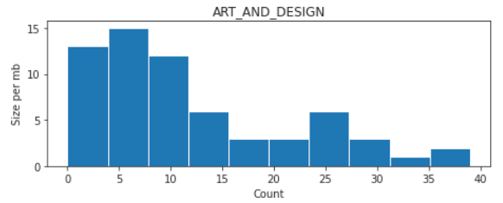
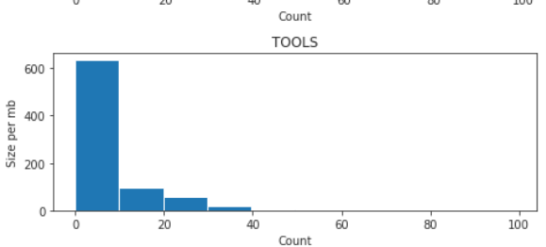
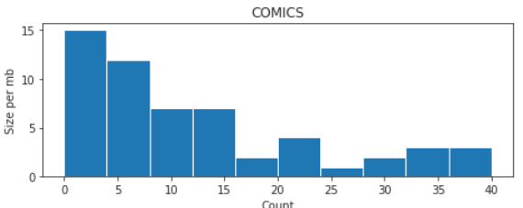
Continued…
Category with MAX size
Category with MIN size
Category Family and Tools has the highest amount of sizes as compared to the other categories.
Categories Art_and_Design & Comics has the lowest amount of app sizes as compared to the other categories

Slide 14
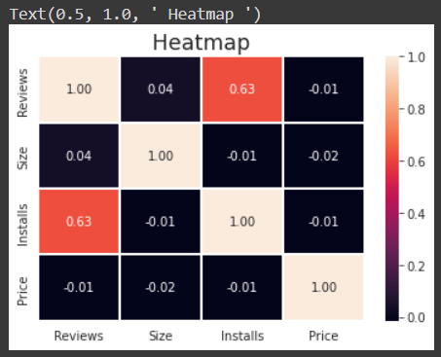
No.5) Correlation between Rating, Reviews, Installs and Price.
From the above Heatmap, we can see that the relationship between the factors mentioned above. From the above data it is clear that there is strong positive correlation between reviews and installs.
And rest of relationships are either slightly positive or slightly negative. Or we can say Rest of them are as good as neutral.

Slide 15
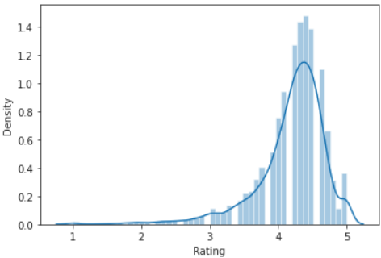

No.6) Some analysis on Rating
From the Histogram we can clearly check that most of the applications has rating in between 4 to 4.5 out of 5.

Slide 16
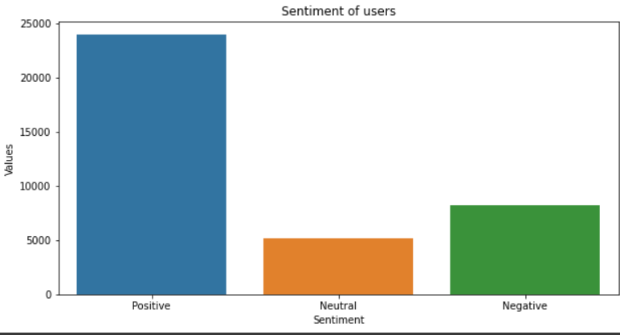

No.7) Analyze sentiment of the users while writing Reviews.
it is very clear that sentiment of the users are mostly positive while writing any review for the apps followed by Negative sentiments and in last there are very less number of neutral sentiments.
Positivity among users has been proved in one of the above fig no.6 that average ratings also lie in between 4-4.5 out of 5.

Slide 17
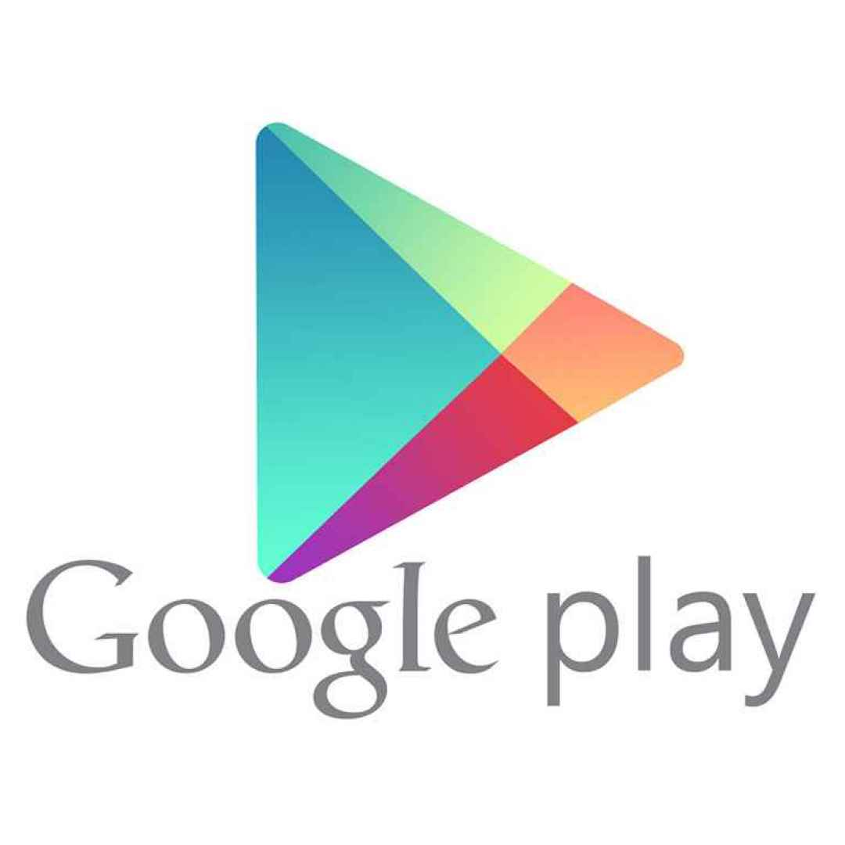
Challenges Faced
Reading the datasets and analyse the problem statement what exactly we have to do.
Handling errors created by uncleaned data, analyse it and clean the data on which work can be done easily.
Removing Nan values and duplicate rows.
Designing multiple visualizations to conclude the analyses done on the given datasets.

Slide 18
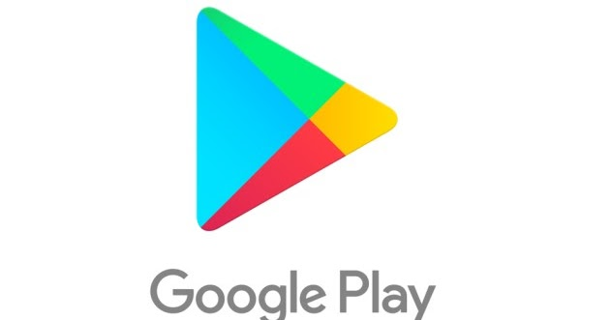
CONCLUSION
There are 1831 applications in Family category which is been followed by Game with 959 applications and Tools at 827 applications.
As per the analysis 81.8% applications are under EVERYONE content rating that means it belongs to every age group. Followed by TEEN with 10.7%. In “Everyone” section Family apps were leading followed by Tools and Games. Similarly in “Teen” it is Games and then family. In “Mature 17+” dating apps are most popular one.
There are around 90% apps which are free in play store market and rest of them are paid one.
Category Family and Tools has the highest amount of sizes as compared to the other categories.
Categories Art_and_Design & Comics has the lowest amount of app sizes as compared to the other categories

Slide 19
CONCLUSION
There is strong positive correlation between reviews and installs that also means it is directly proportional to each other.
And rest of relationships are either slightly positive or slightly negative. Or we can say Rest of them are as good as neutral that means it would not get affected by the other subsets.
Applications has rating in between 4 to 4.5 out of 5. To be precise it is 4.19 out of 5.
There are 23998 positive sentiments by the users followed by 8271 negative and 5158 neutral ones.

Slide 20


