Slide 1
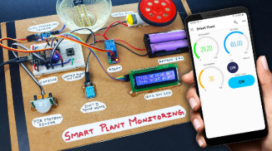
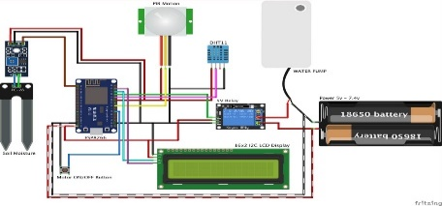
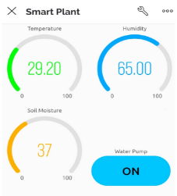
Program : Electronics and Telecommunication Engineering
Project Title
Domain
: Project Name
: Domain Name
: Er. Guide-Name
Name of Project Guide Name of Students
: Roll No. - Student Name_1
Roll No. - Student Name_2
Roll No. - Student Name_3
Brief idea of project:
Describe-the-project-briefly
Screenshots of the Project:
Application 1
Application 2
Applications:
1

