Slide 1
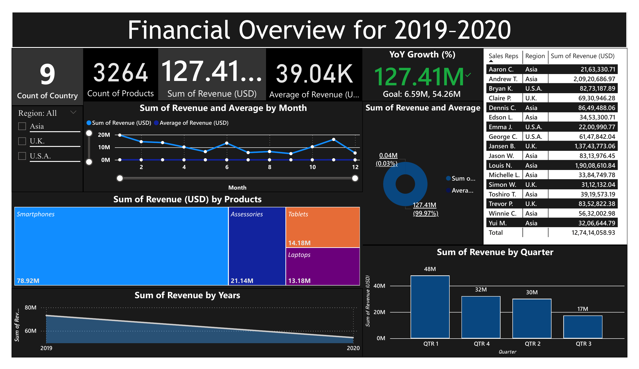
Sales & Financial Dashboard Overview (2019–2020)

Slide 2
Key Insights & Observations
• Total revenue generated: $127.41M USD
• Smartphones contributed the highest revenue: $78.92M
• Q1 showed the highest quarterly revenue: $48M
• Asia region led in total revenue across all sales reps
• YoY Revenue Growth visualized with trend line
• Consistent performance across product categories

Slide 3
Tools Used & Learnings
Tools:
• Power BI for data modeling & visualization
• Sales-Financial dataset from Kaggle
What I Learned:
• Creating interactive dashboards using KPIs, slicers, and visuals
• Building time-series analysis with Power BI
• Using card and KPI visuals effectively

